Slide 1
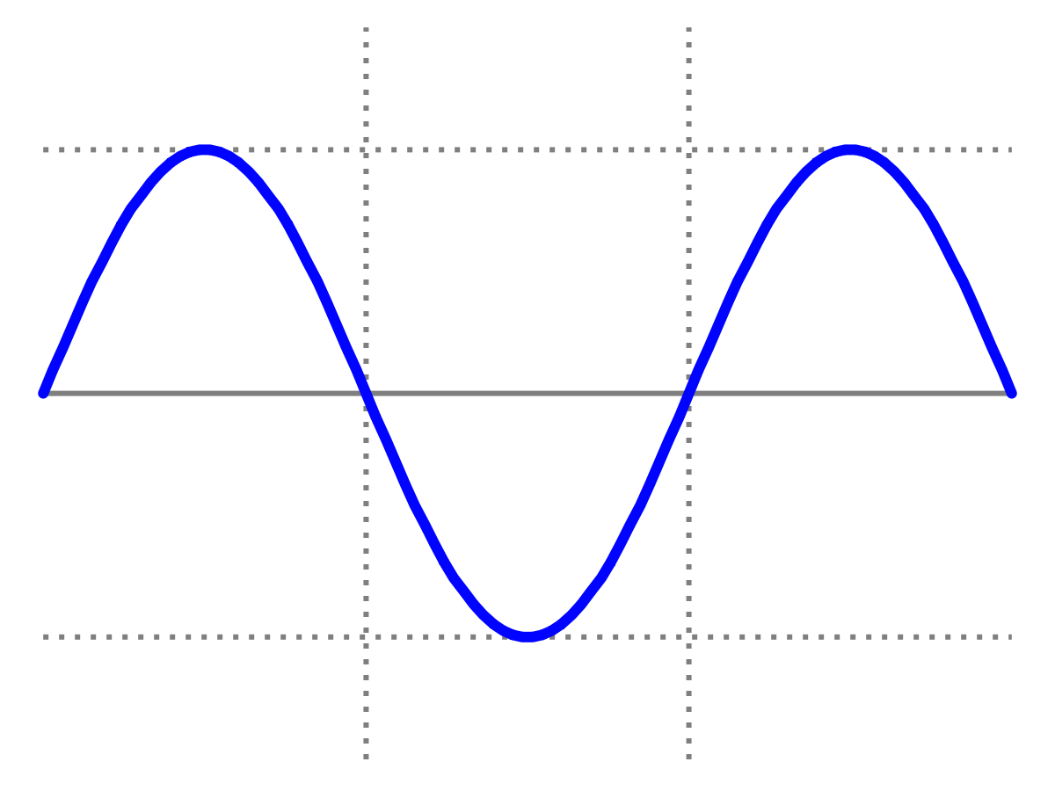
Introduction to Quantum Physics
(F3241)
Dr Lily Asquith
Week 3

Slide 2
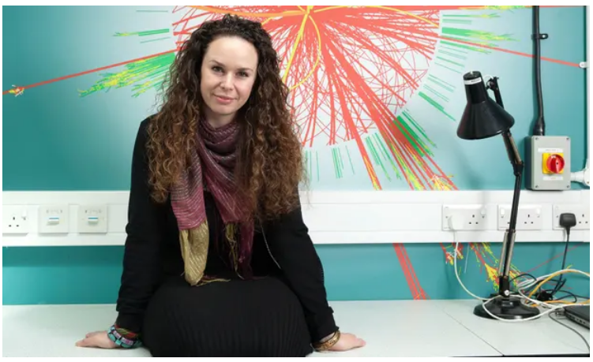
This week & Next week
Tomorrow 3pm we have our zoom
seminar with Dr Kate Shaw :
Promoting Particle Physics Worldwide
Tomorrow 4pm office hour with Lily
(optional).
Next Monday we will have my lecture on the photoelectric effect
Next Tuesday we will do some problems!

Slide 3
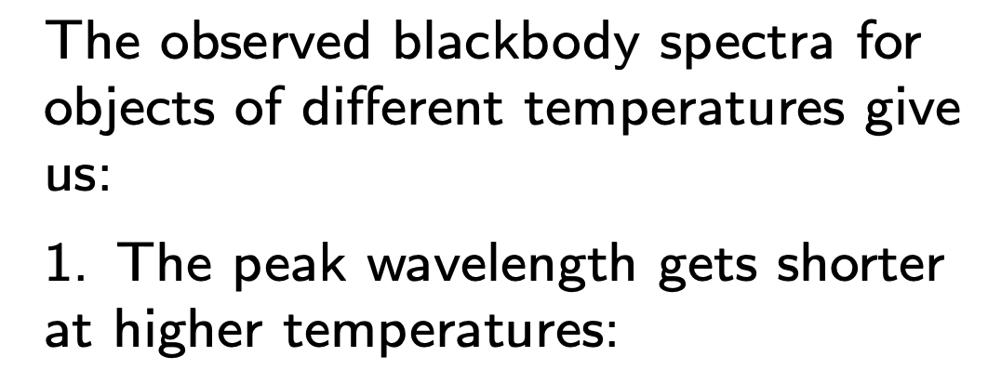
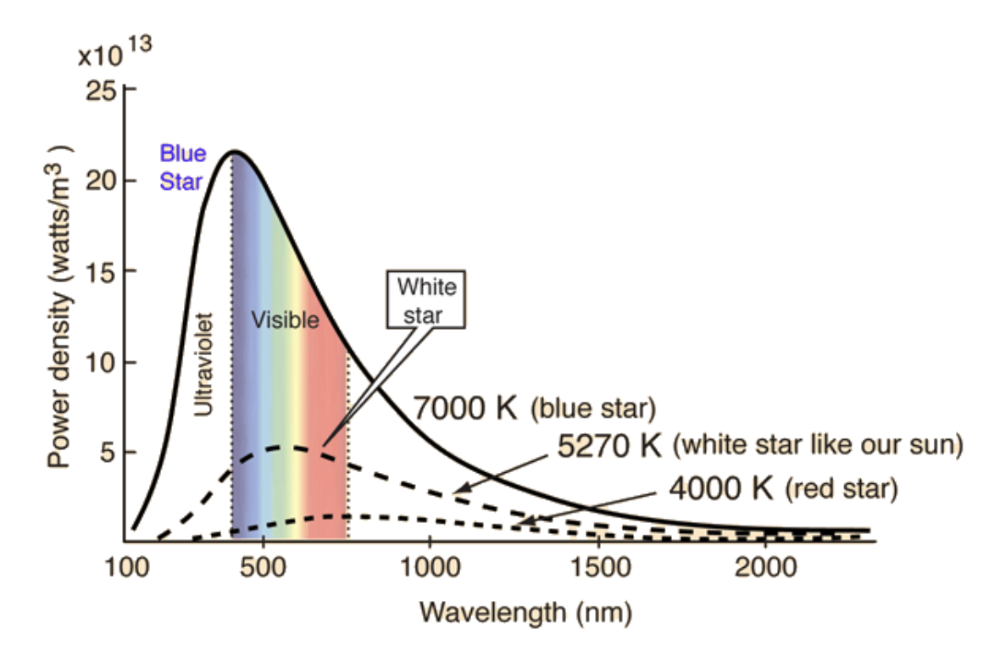
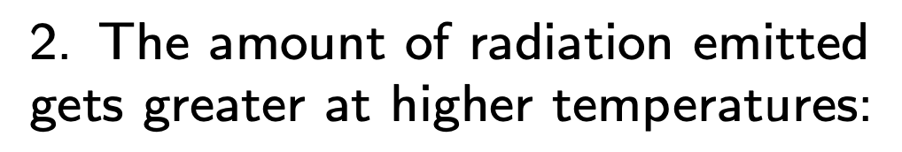
Recap: radiation

Slide 4
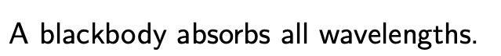
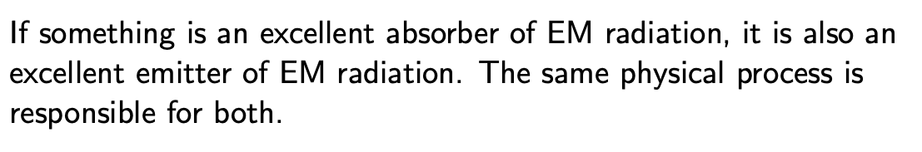
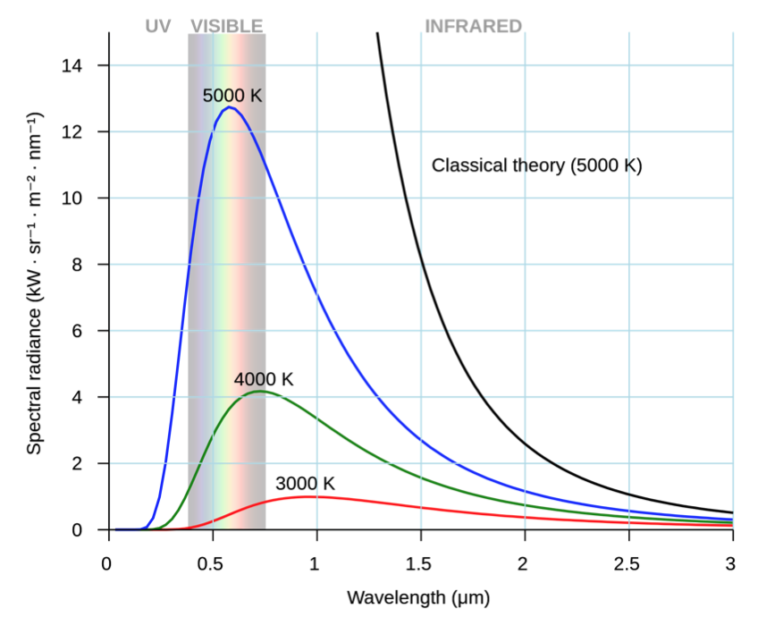
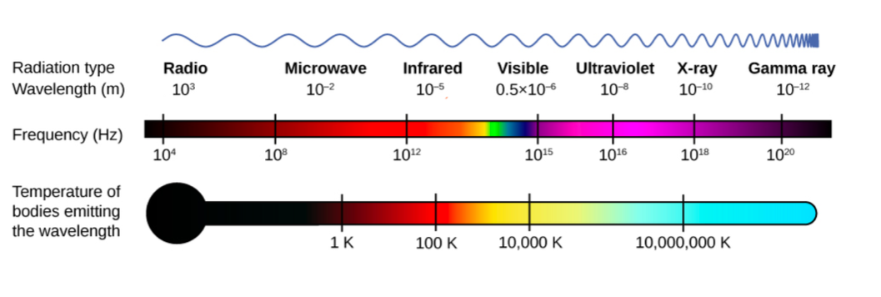
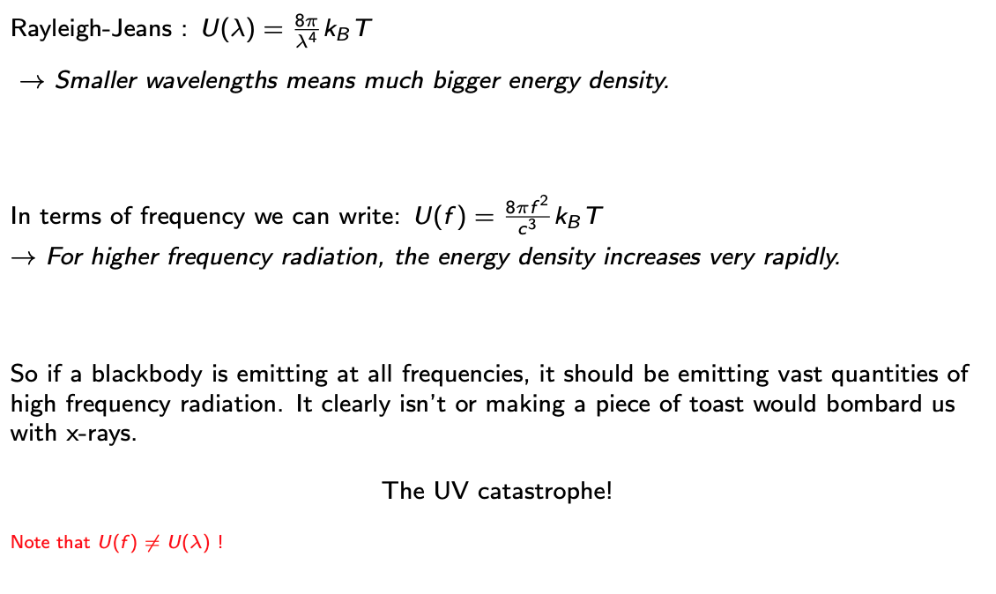
Recap: Energy density and the UV catastrophe

Slide 5
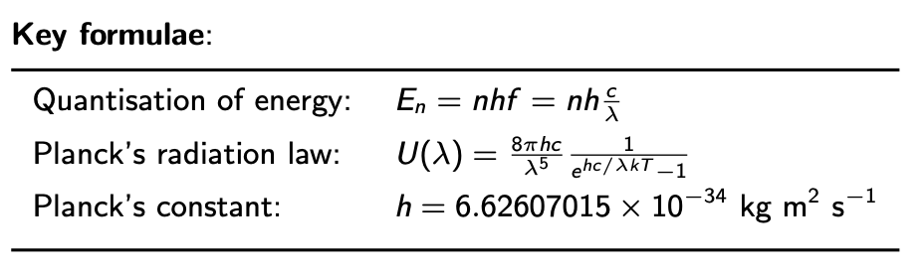
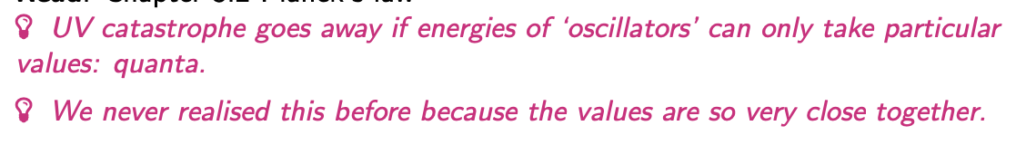
Lecture 3 Planck

Slide 6
Relationship: frequency, wavelength, speed

Slide 7
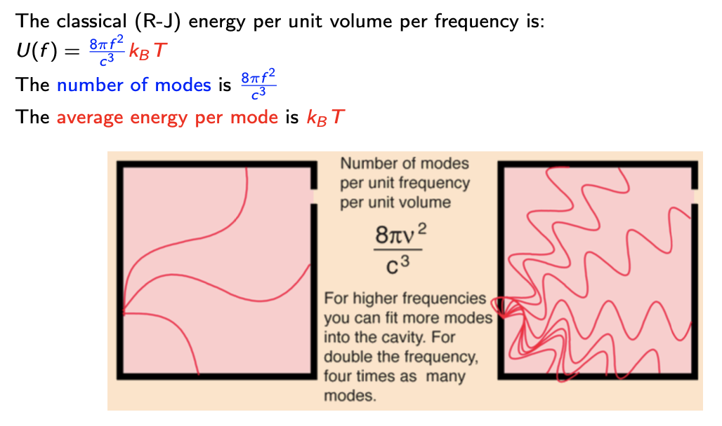
3.1 Investigating the UV catastrophe

Slide 8
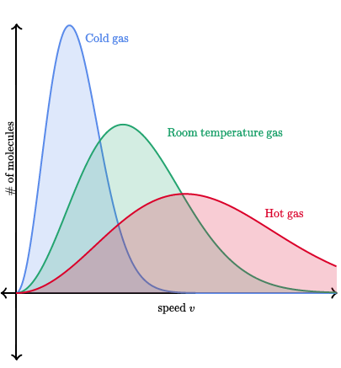
What is this average energy thing?
Maxwell and Boltzmann studied gases experimentally.
They found that the average KE of molecules in a gas was
directly proportional to T.

Slide 9
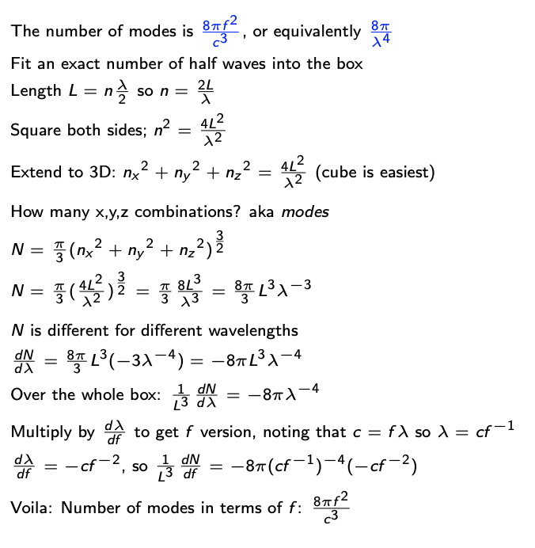
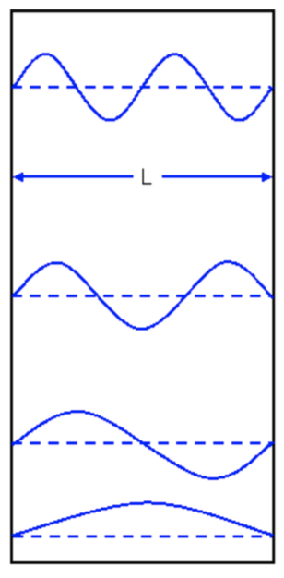
What is this number of modes thing?

Slide 10
What is this number of modes thing?

Slide 11
What is this number of modes thing?

Slide 12
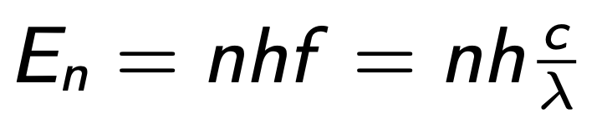
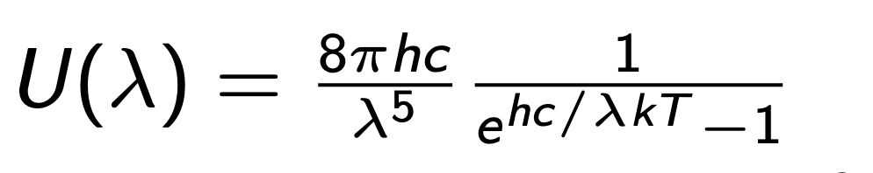
Planck’s “solution”
Need to modify this somehow, such that we obtain the
drop in probability of emission at small wavelength.
Planck found that if he insisted that the energy could only
take discrete values, this resulted in exactly such a
modification.

Slide 13
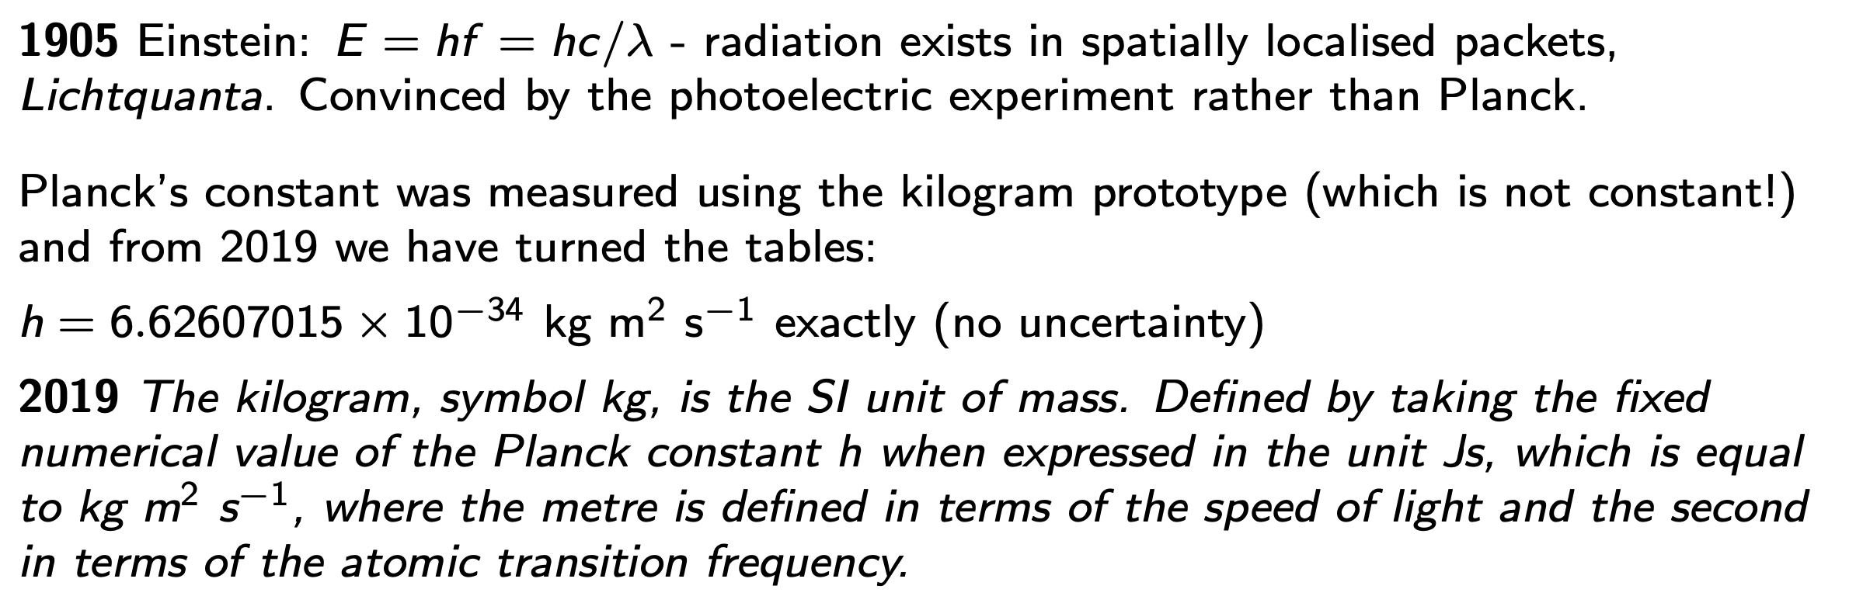
Significance of Planck’s constant

Slide 14
Where we are

