Slide 1
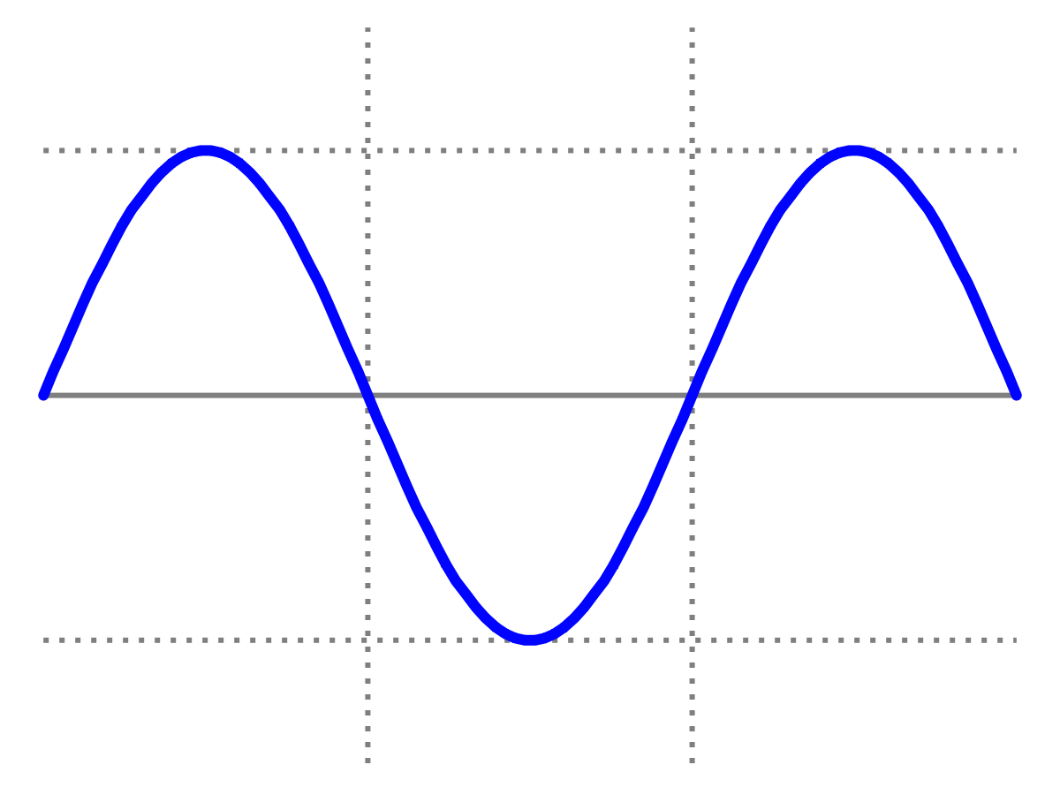
Introduction to Quantum Physics
(F3241)
Dr Lily Asquith
Week 4
Problem Class

Slide 2
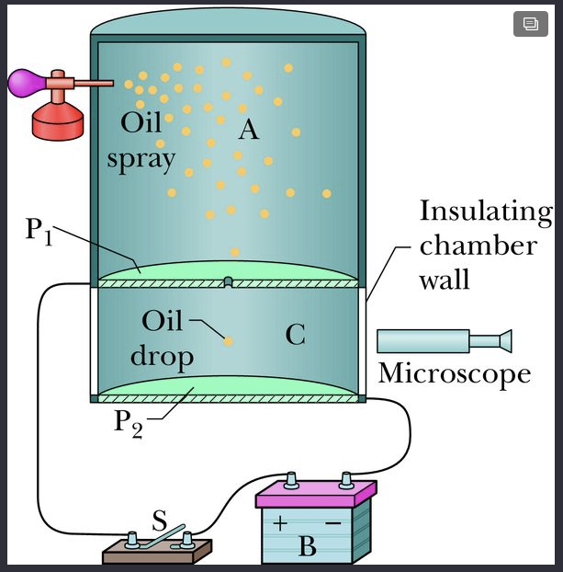
Problem 1
In Millikan’s experiment, an oil drop of radius 1.64 μm and density 0.851 g/cm³ is suspended in chamber C when a downward electric field of 1.92 × 10⁵ N/C is applied. Find the charge on the drop, in terms of e.

Slide 3
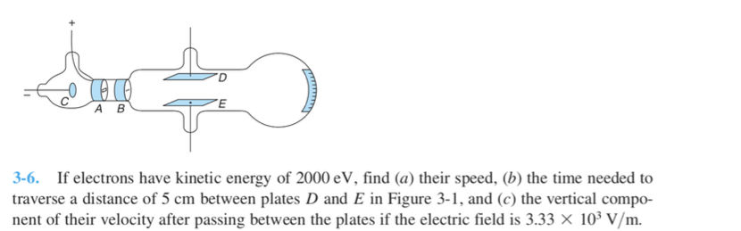
Problem 2

Slide 4

Problem 3
What is my peak wavelength?
How much radiation am I emitting?

Slide 5
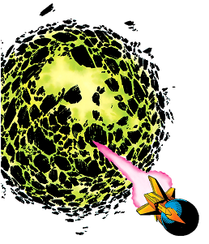
Problem 4
From 1960-1983, the metre was defined as 1650763.73 wavelengths of light emitted by a source containing krypton-86 atoms.
What is the photon energy of the light emitted from krypton-86?

Slide 6
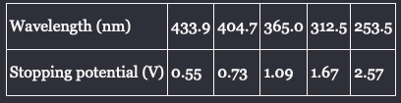
Problem 5
Here are some data taken for a photoelectric experiment using lithium as the photocell material:
Sketch a plot of the data, and use the plot to find
The Planck constant
The escape energy (work function) for lithium

Slide 7
Problem 6

Slide 8
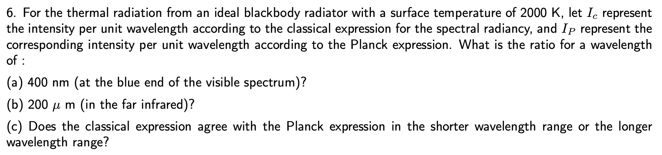
Problem 7 (extension!)

