Slide 1
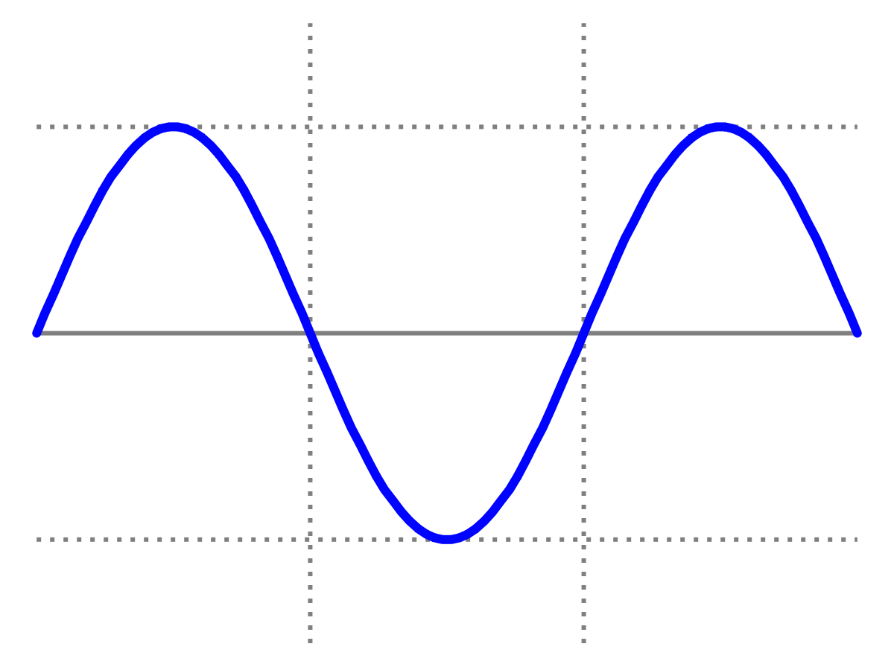
Introduction to Quantum Physics
(F3241)
Dr Lily Asquith
Week 2

Slide 2
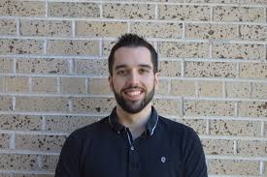
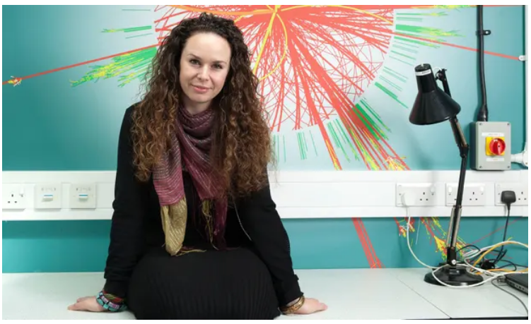
This week & Next week
Tomorrow 3pm we have our zoom seminar
with Dr Steven Calvez on neutrinos.
Tomorrow 4pm office hour with Lily (optional).
Next Monday we will have my lecture on Max Planck’s contributions to the birth of QM.
Next Tuesday we have a zoom seminar
with Dr Kate Shaw, an LHC physicist,
who works at Sussex on the ATLAS
experiment and is the founder of
Physics Without Frontiers.

Slide 3
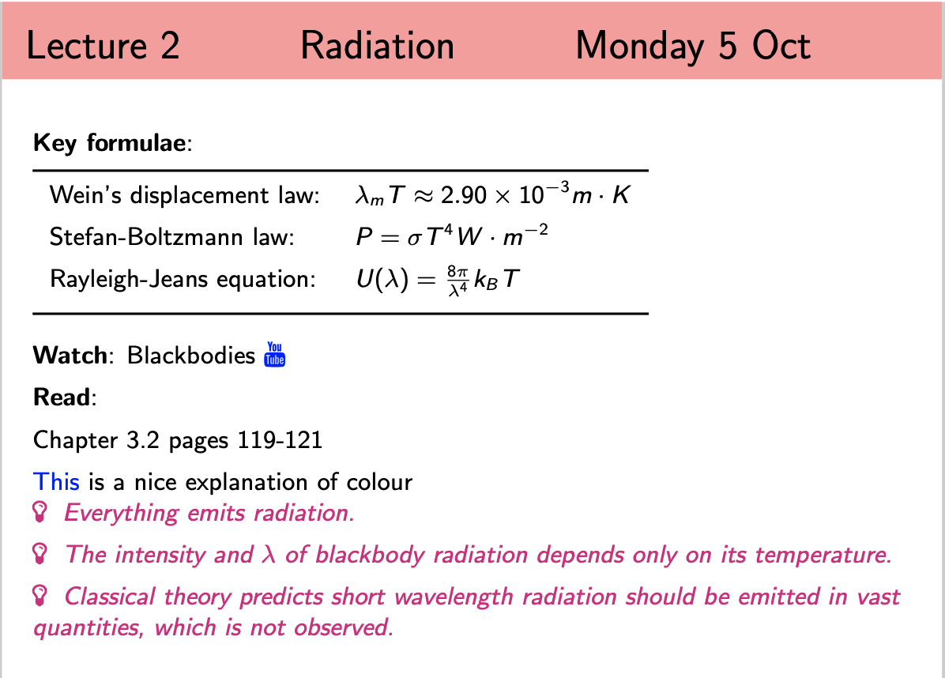
Lecture 2 Radiation

Slide 4
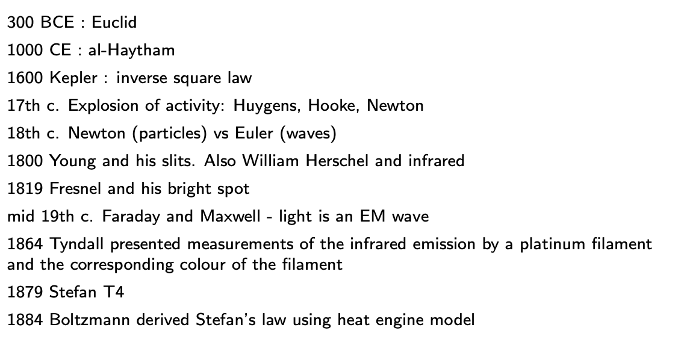
A brief history of humans and light

Slide 5
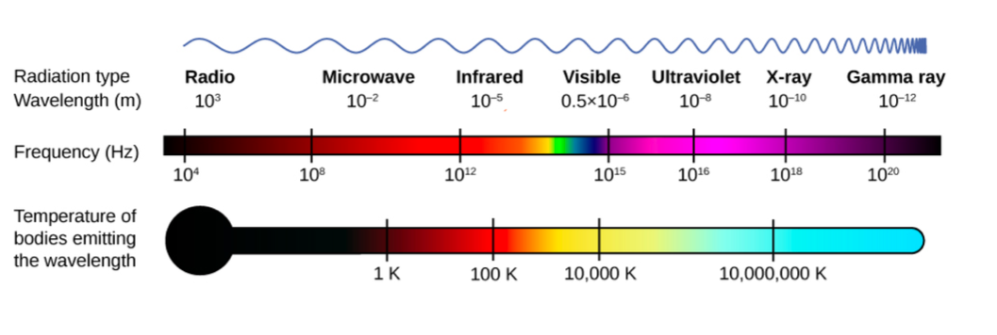
2.1 The electromagnetic spectrum

Slide 6
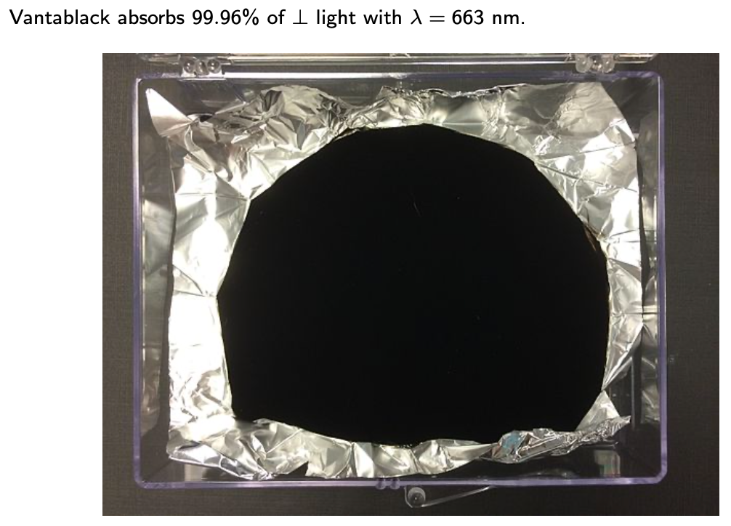
2.2 Blackness

Slide 7
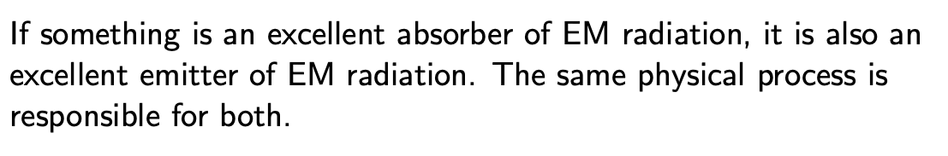
2.3 Good absorbers are good emitters

Slide 8
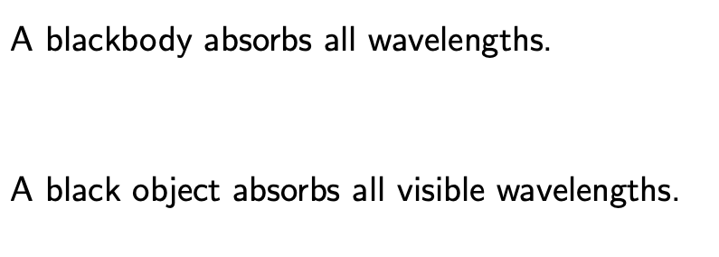
2.3 The blackbody

Slide 9
Recap Power

Slide 10
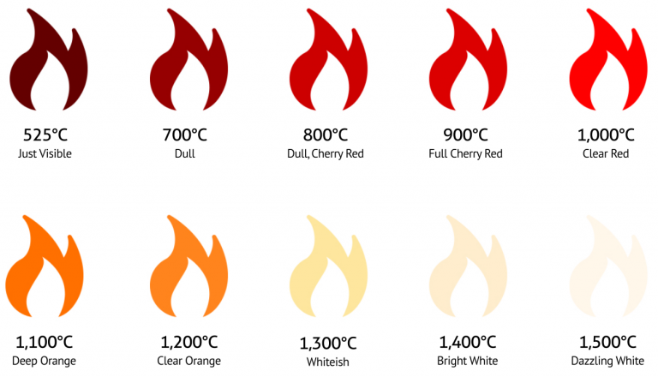
2.4 Tyndall : Colour and temperature
“On Luminous and obscure radiation”, Nov 1864 : no pictures ☹

Slide 11
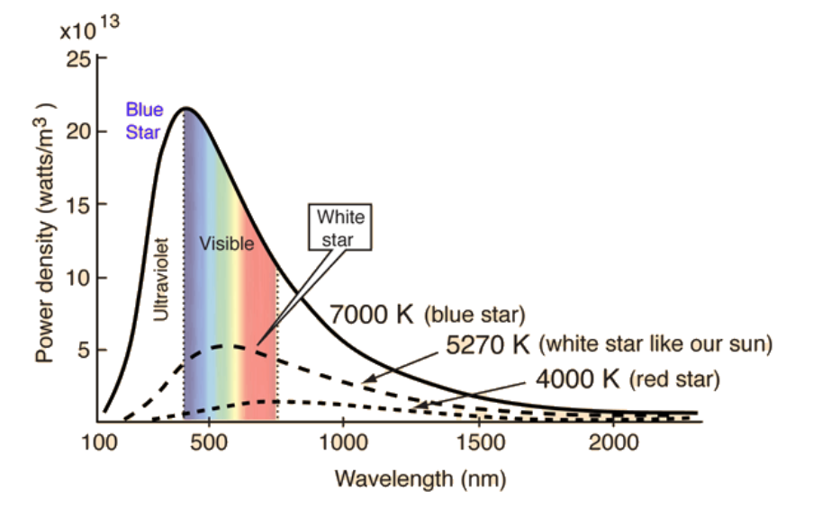
2.4 Temperature: observations

Slide 12
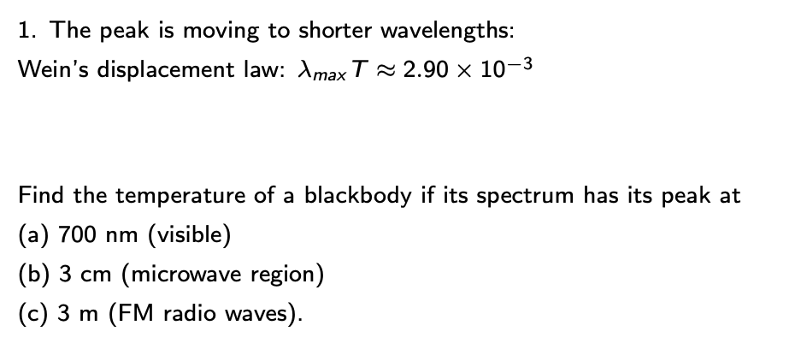
2.5 Temperature and wavelength : Wien’s law

Slide 13
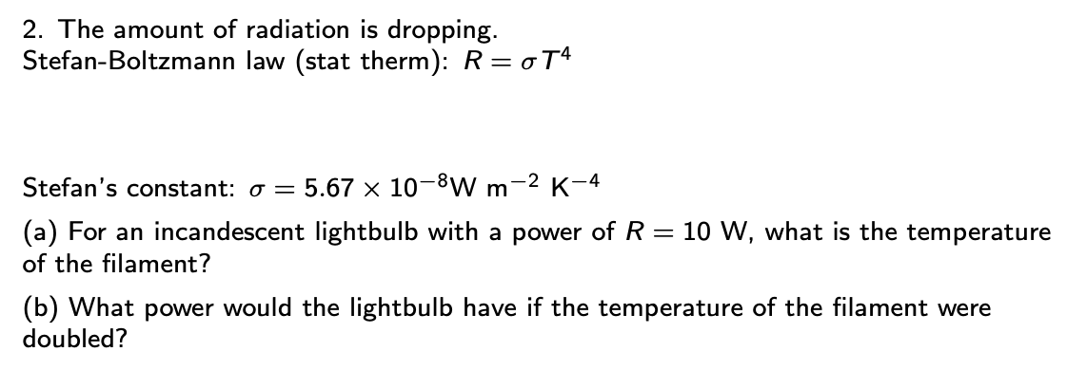
2.6 Temperature and power: Stefan-Boltzmann law

Slide 14
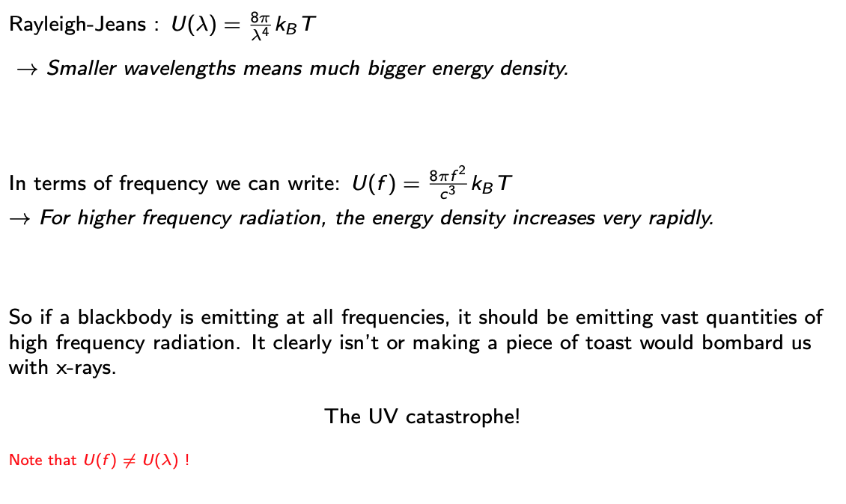
2.7 Energy density and the UV catastrophe

Slide 15
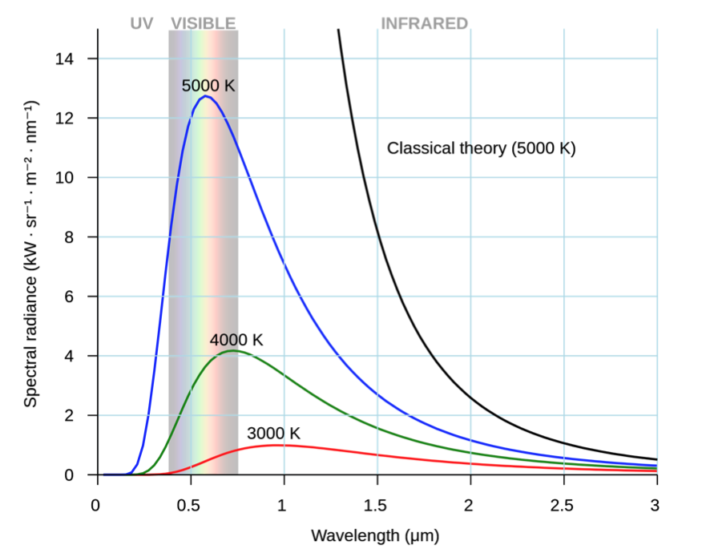
Argh!

Slide 16
2.7 Energy density and the UV catastrophe

Slide 17
Where we are
What is my peak wavelength? How much power am I emitting?
How might we get an estimate of our Sun’s temperature?
Sirius has a temperature of 9940K. What range of wavelengths might be visible to us if our planet
belonged in Sirius’s solar system?
Classical theory needs revisiting!

