Slide 1
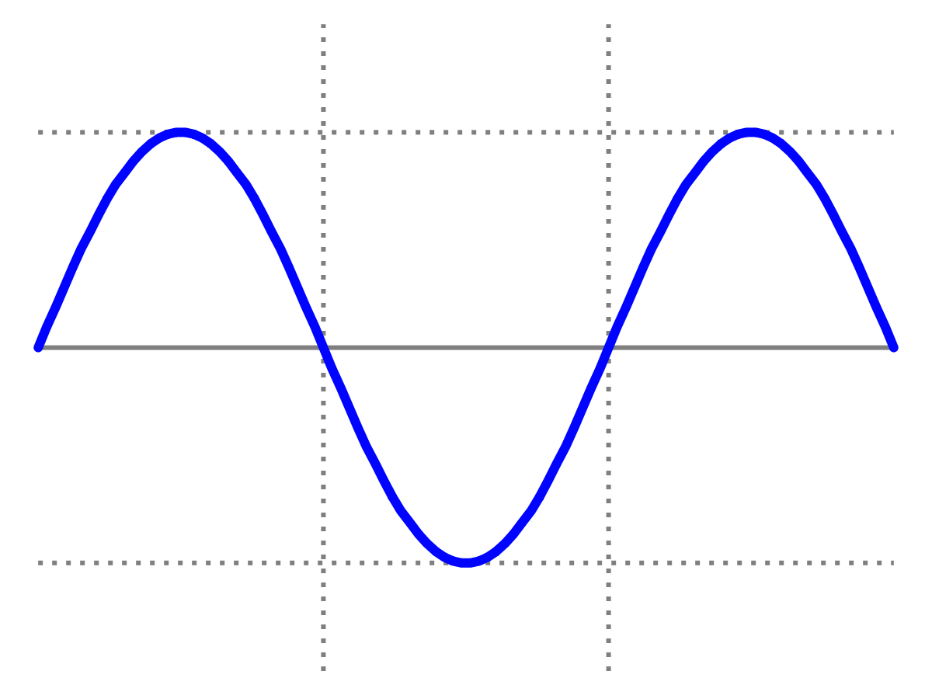
Introduction to Quantum Physics
(F3241)
Dr Lily Asquith
Week 7

Slide 2
This week & Next week
Tomorrow 3pm Exam-type practice questions
Tomorrow 4pm office hour with Lily (poll at end to see if anyone wants this).
Next Monday we will have my lecture on Bohr / de Broglie
Next Tuesday Matthias Keller: atoms and molecules
Your first assignment is on canvas. It is very gentle and shouldn’t take much time or effort. Due by 19 November.
The next one, due 10 Dec, will be harder (to assist revision).
Attendance: can you sign in with “the app”?

Slide 3
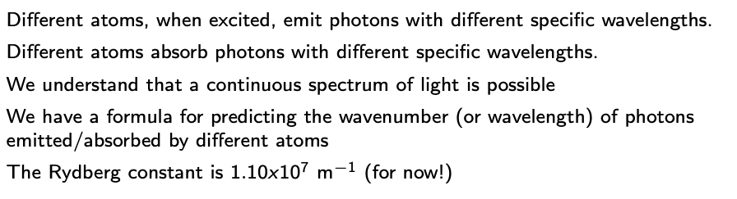
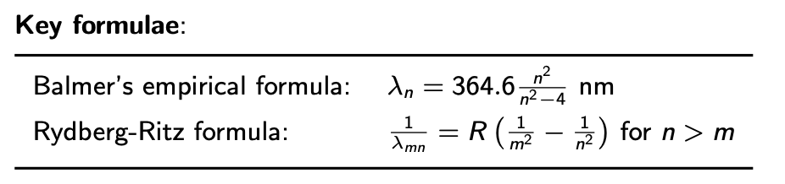
Recap Atomic Spectra

Slide 4

Rydberg formula
R is inversely proportional to wavelength.
Second term must be smaller than first term :
so second n must be larger than first n.

Slide 5

Collisions / scattering

Slide 6

Everything not forbidden is compulsory

Slide 7
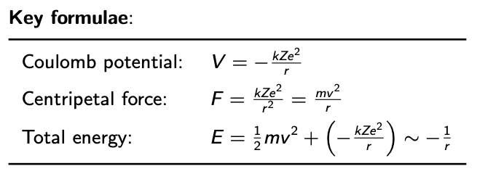
Rutherford Scattering

Slide 8

Whirlwind Intro to Electrodynamics
Opposites attract.
The force follows the inverse square law.
The force is different depending on the medium in which the charges are.
55.26 e² GeV⁻¹ fm⁻¹

Slide 9
Whirlwind Intro to Electrodynamics
What is the potential energy associated with this force?

Slide 10
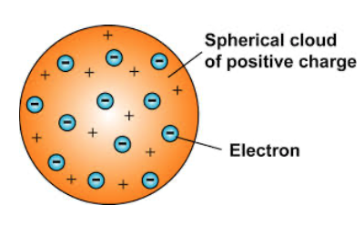
Thomson’s atom
Test this model by smashing charged particles into an atom!

Slide 11
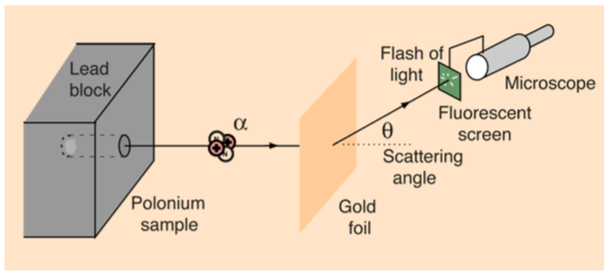
Rutherford’s experiment
Rutherford observed some alphas being back-scattered...

Slide 12
Conservation of KE and momentum

Slide 13
Conservation of total Energy

Slide 14
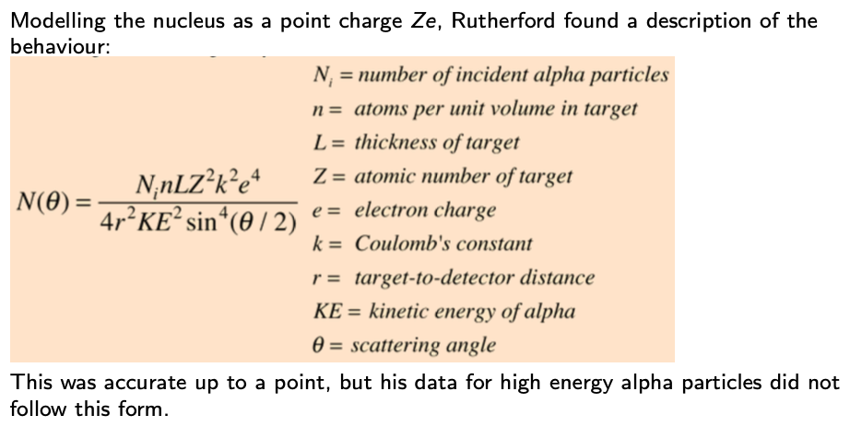
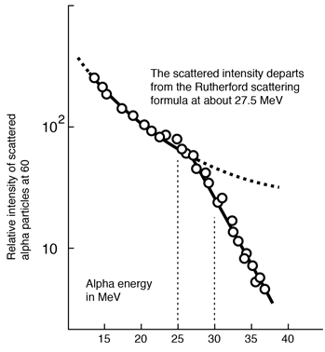
Rutherford’s formula

Slide 15
Higher energy reveals deeper structure
10 MeV
An atom contains a nucleus!
1 GeV
A nucleus contains nucleons!
10 GeV
A nucleon contains partons!

Slide 16
A conundrum

