Slide 1
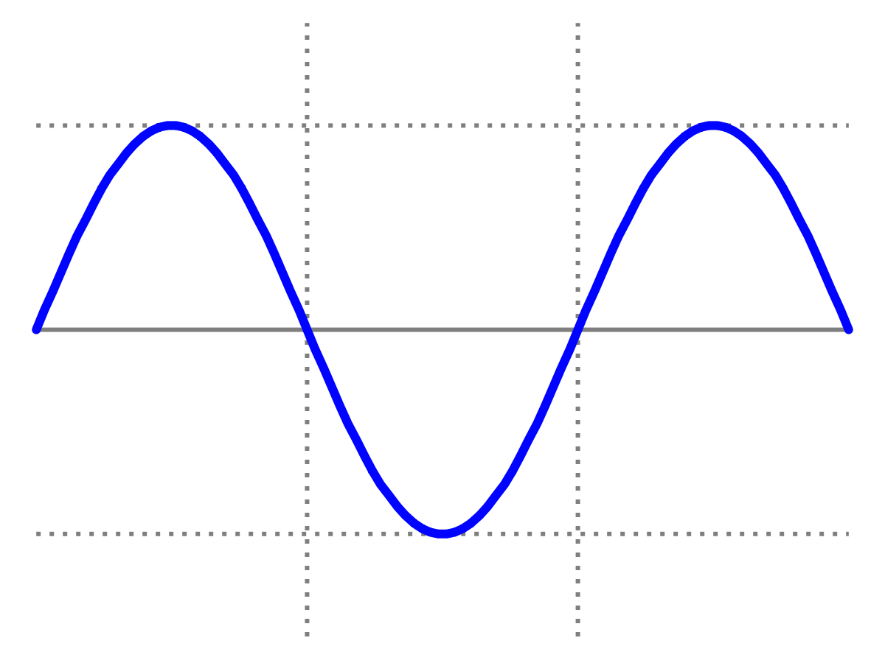
Introduction to Quantum Physics
(F3241)
Dr Lily Asquith
Week 2
2.1 The Electrical Force & Faraday’s electrolysis
2.2 Thomson’s experiment
2.3 Millikan’s experiment

Slide 2
2.1 The Electrical Force & Faraday’s electrolysis

Slide 3
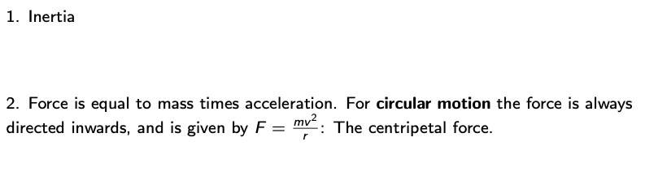
Newton’s Laws

Slide 4
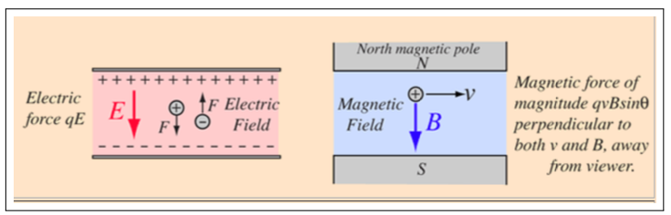
The Lorentz Force

Slide 5
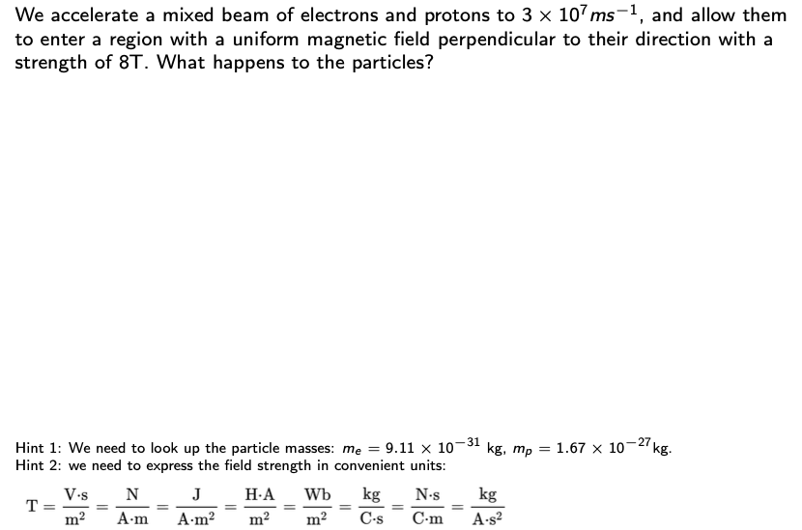
An example of equating forces

Slide 6
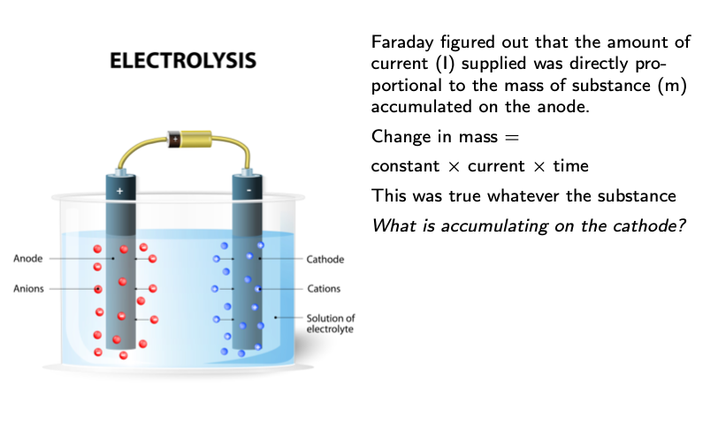
Faraday & Electrolysis (1834)

Slide 7
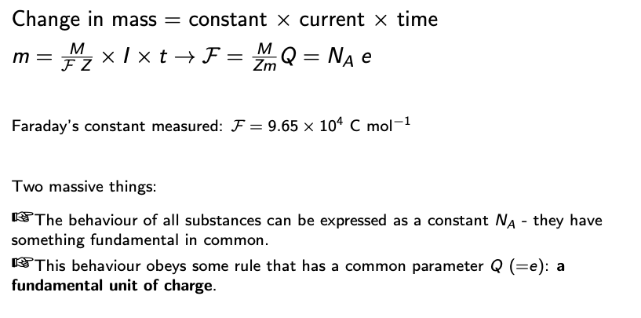
Faraday & Electrolysis - continued

Slide 8
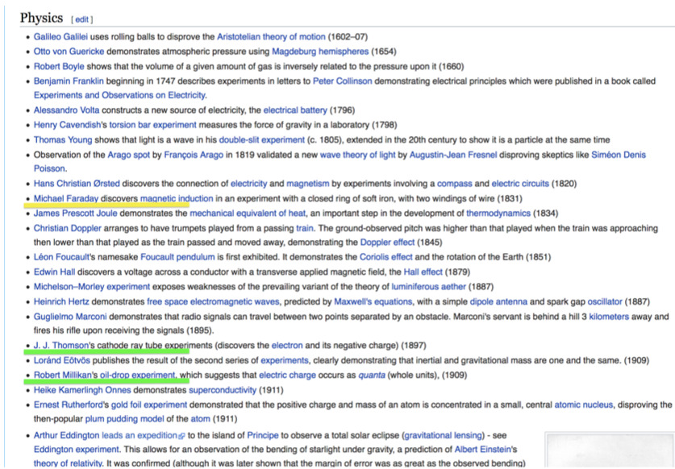
Experiments

Slide 9
2.2 Cathode Rays: JJ Thomson’s experiment

Slide 10
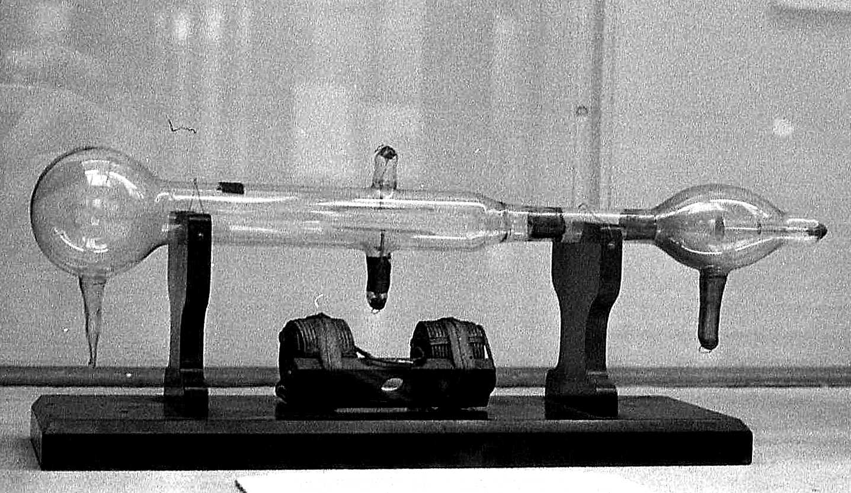
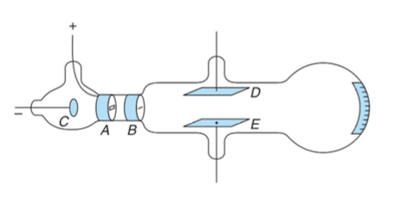
Cathode Rays

Slide 11
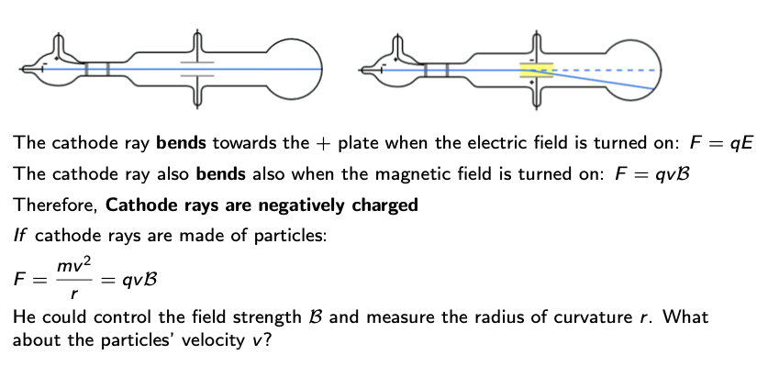
Thomson’s experiment: bendy rays

Slide 12
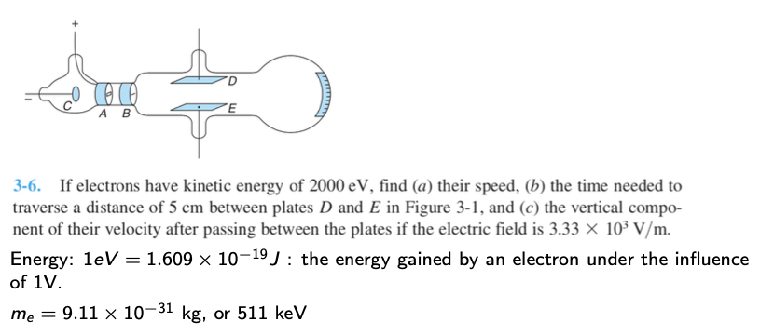
Example problem from Tipler

Slide 13
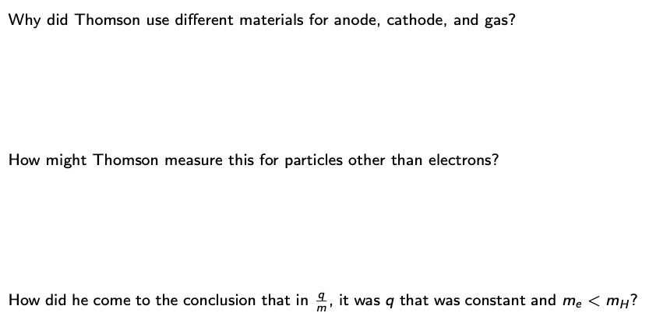
Think

Slide 14
2.3 Oil drops: Millikan’s experiment

Slide 15
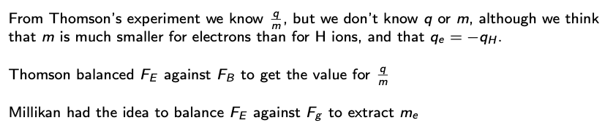
1.6 Millikan’s experiment: a balancing act

Slide 16
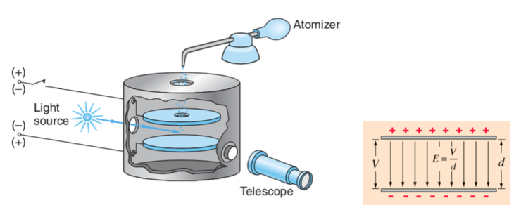
1.6 Millikan’s experiment: a balancing act

Slide 17
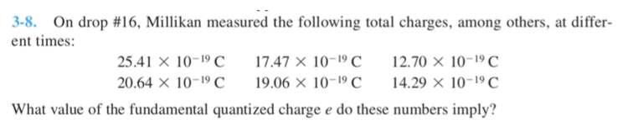
Example problem

Slide 18

Think

Slide 19
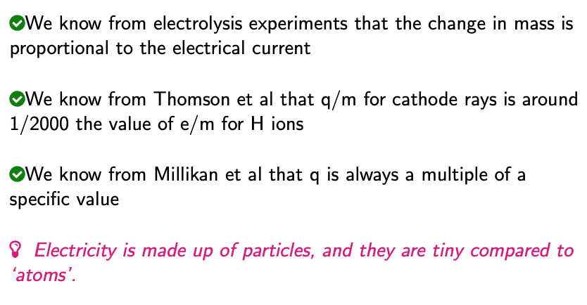
Where we are

