Slide 1
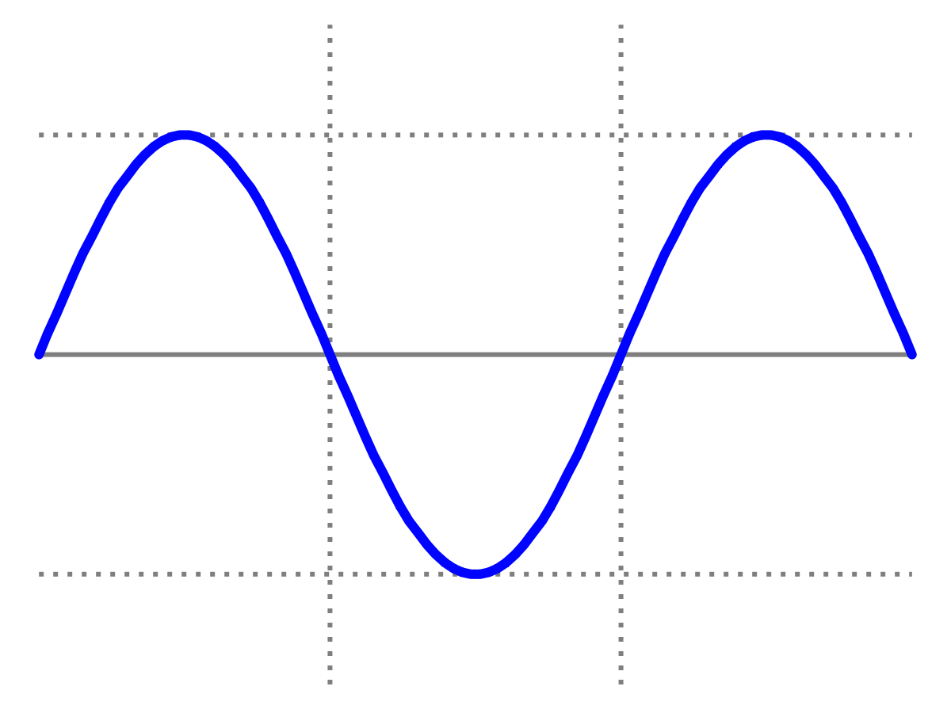
Introduction to Quantum Physics
(F3241)
Dr Lily Asquith
Week 9

Slide 2
This week & Next week
Today Matter waves
Tomorrow 3pm Problem class
Next Monday we will have my lecture on wavefunctions
Next Tuesday Seminar from Jacob Dunningham on entanglement
Attendance: can you sign in with “the app”?

Slide 3
Recap Bohr’s atom
Electrons don’t brem and fall into the nucleus if they are in certain stable orbits

Slide 4
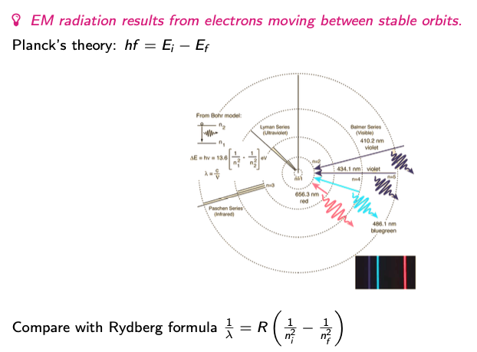
Recap Bohr’s atom
EM radiation results from electrons moving between stable orbits

Slide 5
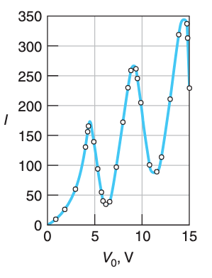
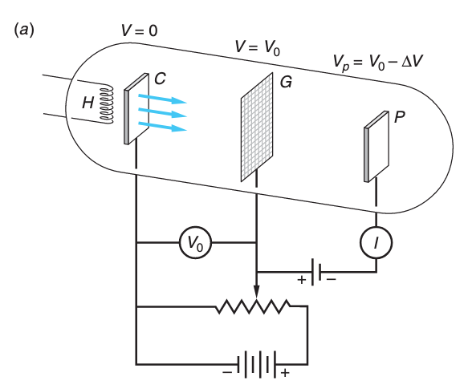
Recap Franck Hertz experiment

Slide 6
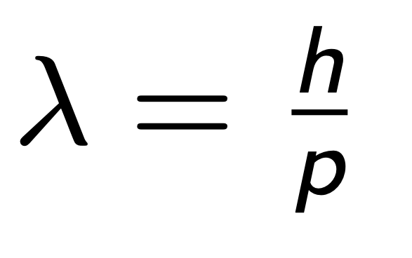
De Broglie 1924

Slide 7
Wavelength of an electron
What is the wavelength of an electron with KE = 120 eV ?

Slide 8
Wavelength of a physicist

Slide 9
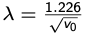
Useful experimental reformulation

Slide 10
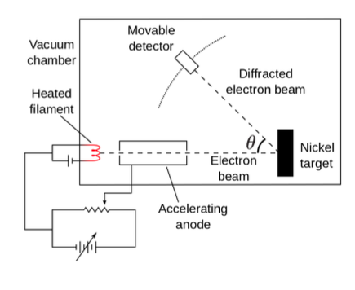
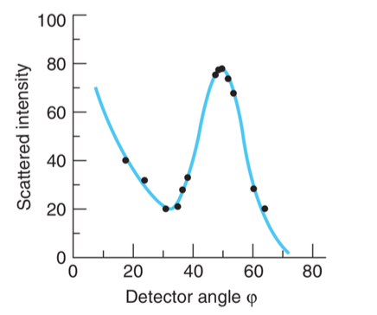
Experimental verification of matter waves 1926
Davisson & Germer

Slide 11
Experimental verification of matter waves

Slide 12
Back to de Broglie

