Slide 1
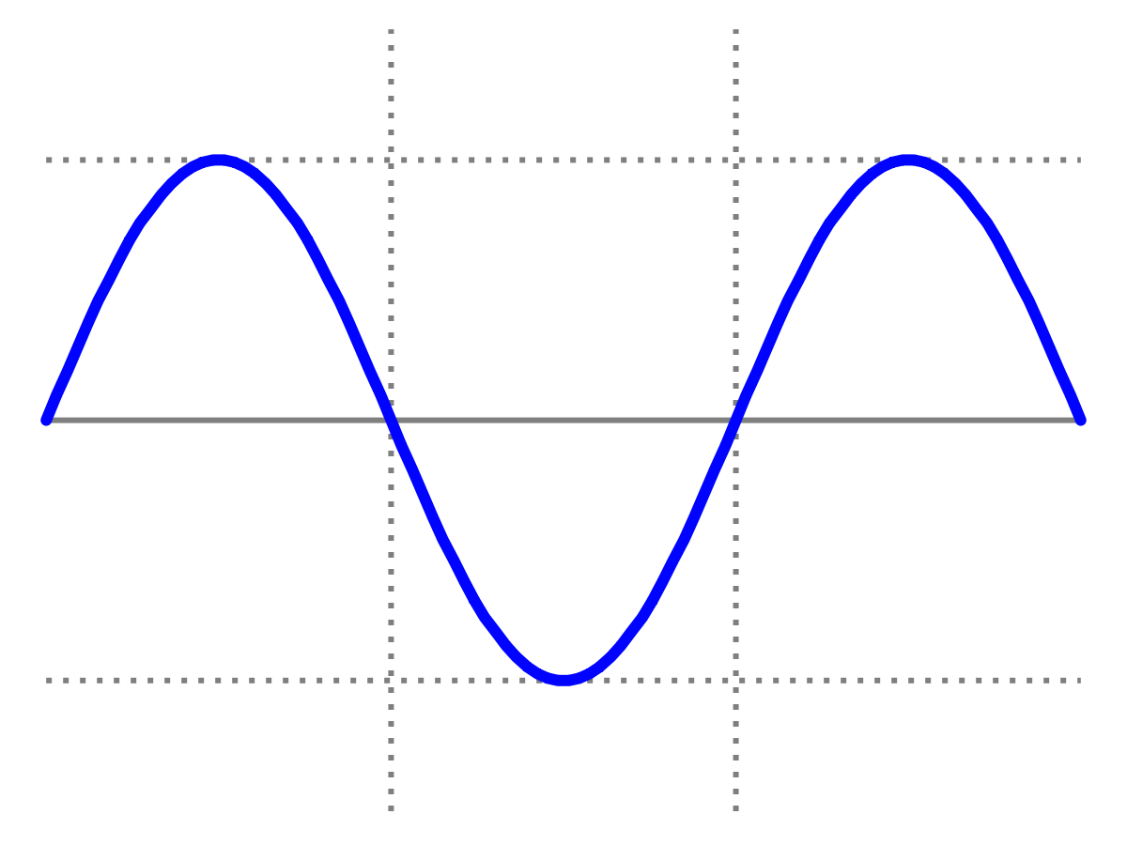
Week 9 - continued
Introduction to Quantum Physics
(F3241)
Dr Lily Asquith

Slide 2
Wavelength of a physicist

Slide 3
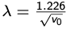
Useful experimental reformulation

Slide 4
Problems : De Broglie
In old-fashioned TVs electrons were accelerated through a potential difference of 25 kV and directed to a phosphorescent screen. What is the De Broglie wavelength of the accelerated electrons?

Slide 5
Problems : Bohr
Derive a formula for the allowed radii for atomic electrons

Slide 6
Problems : Rutherford
What is the minimum KE required for an alpha particle to just touch a gold nucleus?

