Slide 1
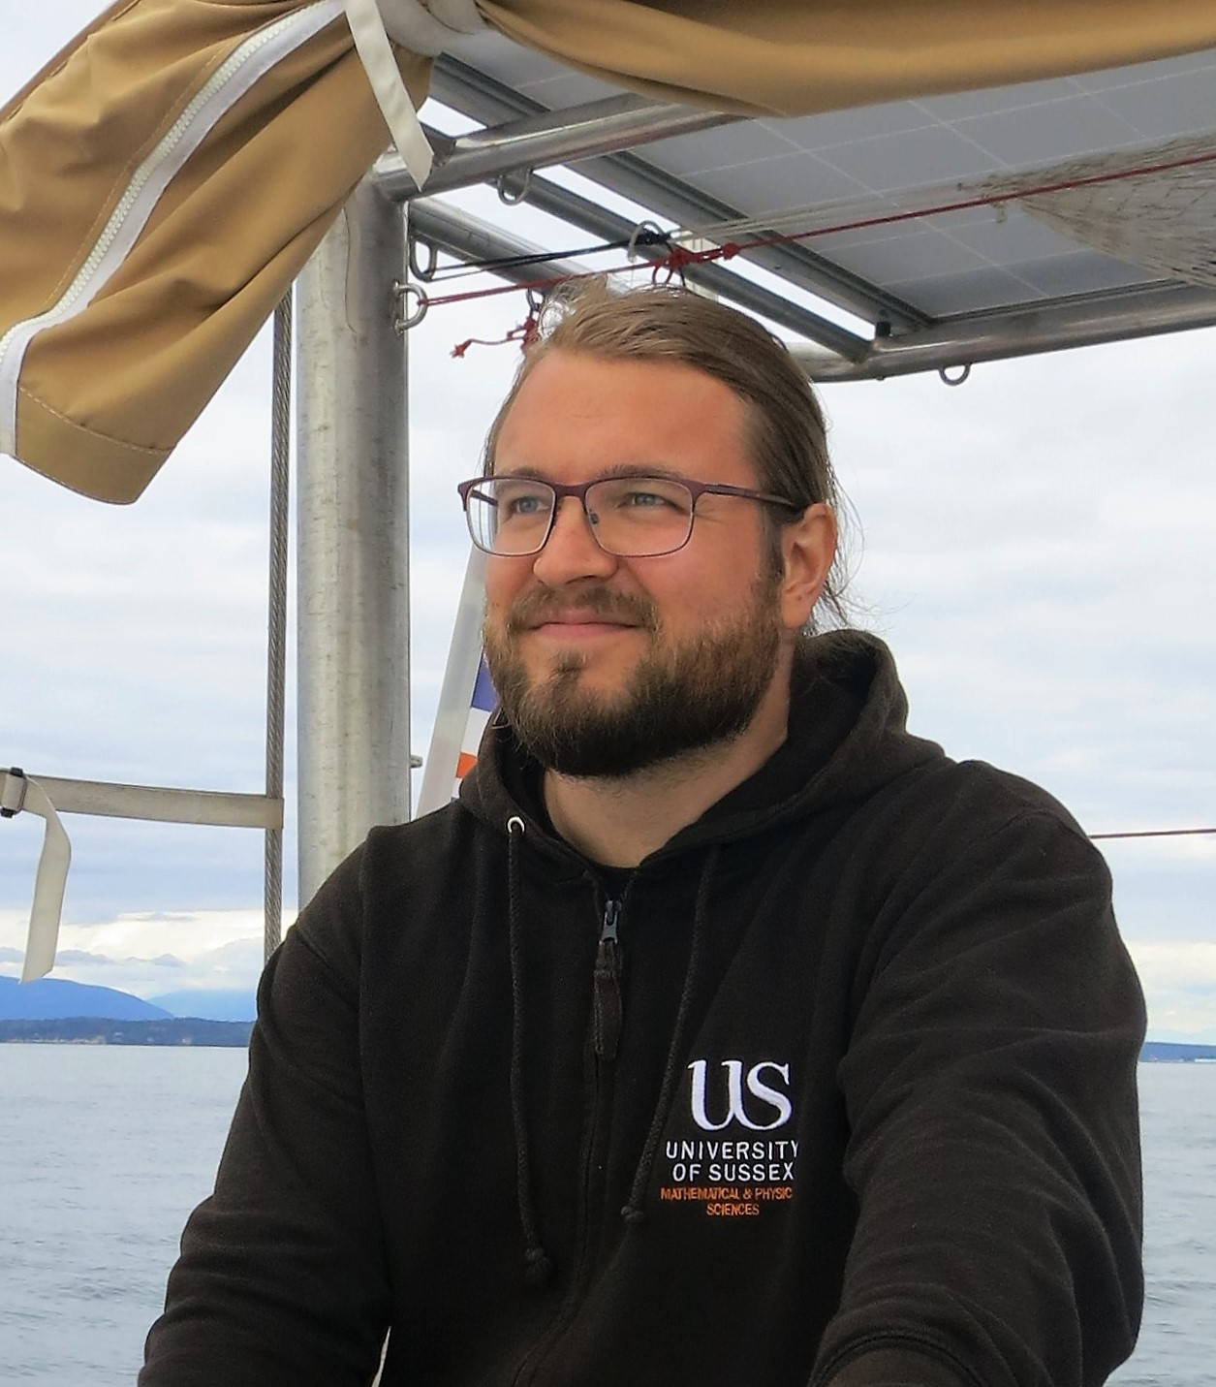
JUSSI KUUSISTO
“YOO-SEE”
He/Him
Astro

Slide 2


Slide 3
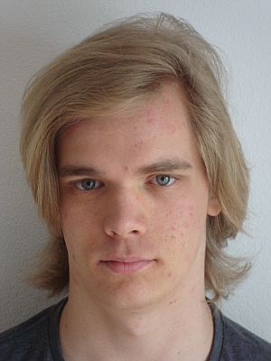
TIMO SCHWANDT
“TEE-MO”
He/Him
ATOMIC, MOLECULAR & OPTICAL PHYSICS

Slide 4

ROB CLEMENSON
“ROB”
He/Him
THEORY

Slide 5
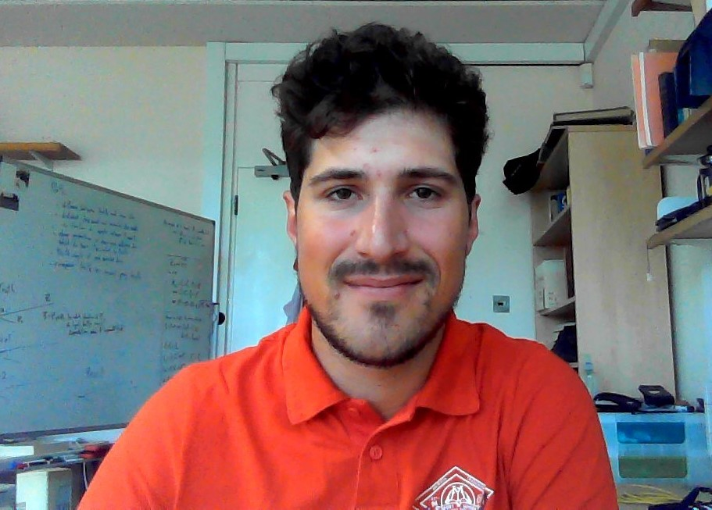
NICOLO TUCCORI
“NEE-CO-LO”
He/Him
EXP. PARTICLE

Slide 6

ZOE EARNSHAW
“ZOH-WEE”
She/Her
EXP. PARTICLE

Slide 7
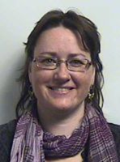
RACHEL KERR
“RAY-CHELL”
She/Her
TEACHING FELLOW

Slide 8
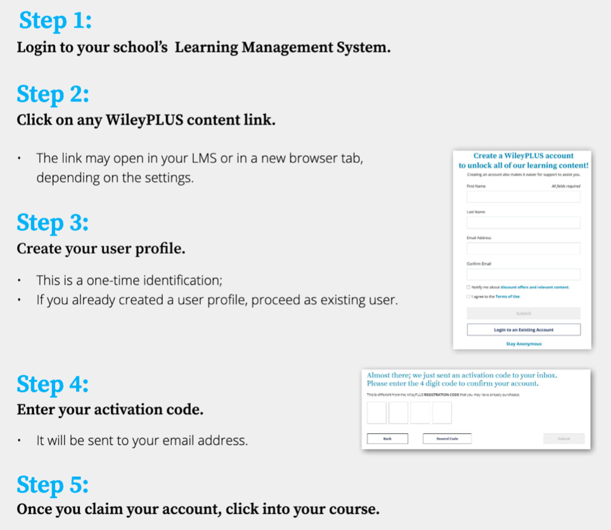

(Canvas)
(Wiley Course Resources)
Must use your Sussex email
Check your email
Now check your access by attempting the welcome week quiz on Measurement-
you can find this under Assignmeent

