Slide 1
Stream Monitoring Data Project
Anirudh Prakash, 3rd Year LWWIP Intern

Slide 2
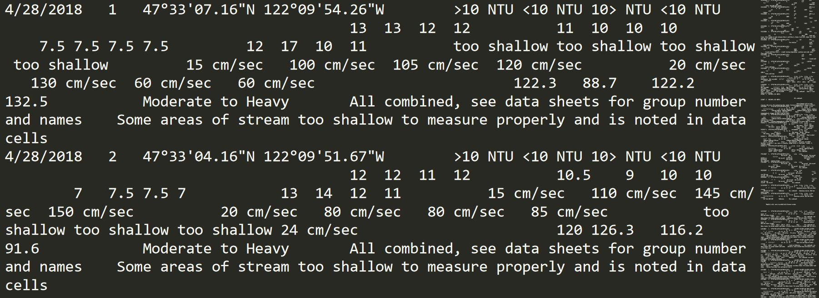
Motivations
Notes:
We collect data every month from Coal Creek and in Bothell, North Creek. Usually, we don’t have enough time to look at the data after stream monitoring, so at some point later Juntao or someone else enters the data into our spreadsheet, which we all should have access to, but don’t regularly access. If we do have time, we look at our data for the day and eyeball any outliers or abnormalities, but this does not give us a look over time. Here is a screenshot of our data for one day, and the right-side of the image shows how much data overall we have (about 300 lines).

Slide 3
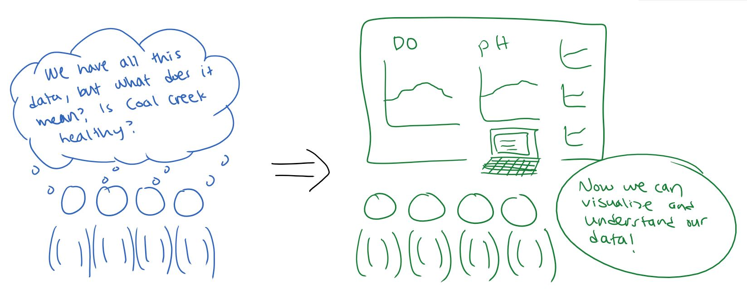
Motivations
Notes:
Last year we tried plotting our data by hand with colored pencils and paper and I remember, this took most of one full meeting. So because we don’t want to have to do this every time new data comes in, I wanted to create a way to automate analyzing and perhaps visualizing our data. Because I am currently studying Computer Science at UW, I thought it would be fitting to apply my skills from there for this project. Here is a drawing I had made as part of my project proposal in November, showing my vision for the project.

Slide 4
Process
Eli Arao’s project
Parsing data with opencsv
Cleaning/standardizing data
Data analysis: statistics
Data visualization: scatter plot/line graph and histogram
Notes:
My project was somewhat inspired by past intern Eli, who we have here actually, and he was kind enough to share the work he had done last year. However, I later decided that I would start from scratch, using tools and packages that I learned from classes at UW (like opencsv). A lot of time went into figuring out how to get the data out of the spreadsheet, and standardizing units for analysis. After that, I was able to calculate statistics like mean, median, mode, and others from the data given a date range and a few other options that you will see in a bit. I ended up deciding to continue by visualization the data by generating scatter plots and histograms.

Slide 5
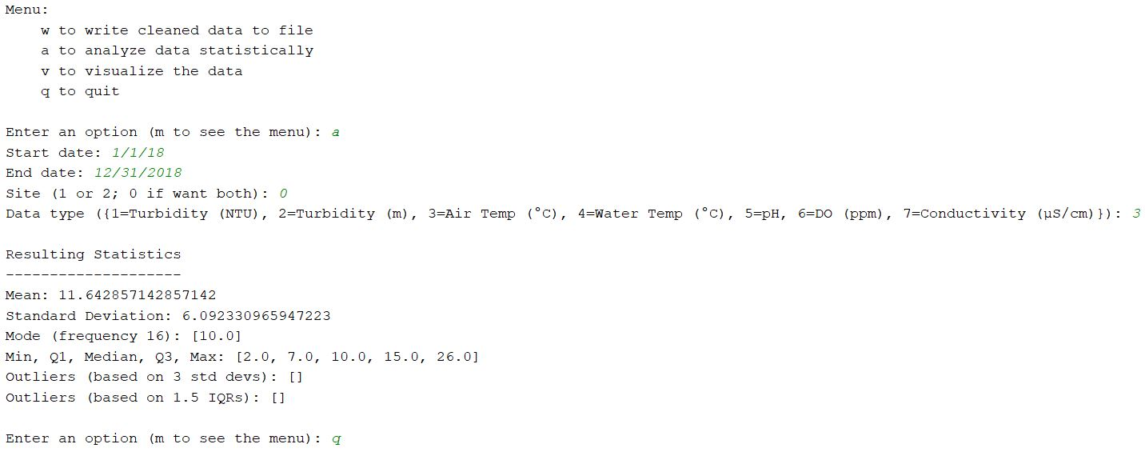
Functionality - Analysis
Notes:
Here is a sample run of the program. At the top we see that we can write, which is boring, analyze, shown here, visualize, and quit. Output is in black and user input is italicized in green. Here, I analyzed air temperature in 2018 at both sites, and the results are that we had an average temperature of 11.6 C (about 53 F), which is somewhat high given that we do a lot of winter monitoring. We can also see the standard deviation, the mode of 10, which appeared 16 times, the range from 2 to 26, with median 10, and no outliers, which are calculated in two different ways. So great, we can now analyze statistics of any date range, but that’s really only nice if you really love numbers, which many of us do not.

Slide 6
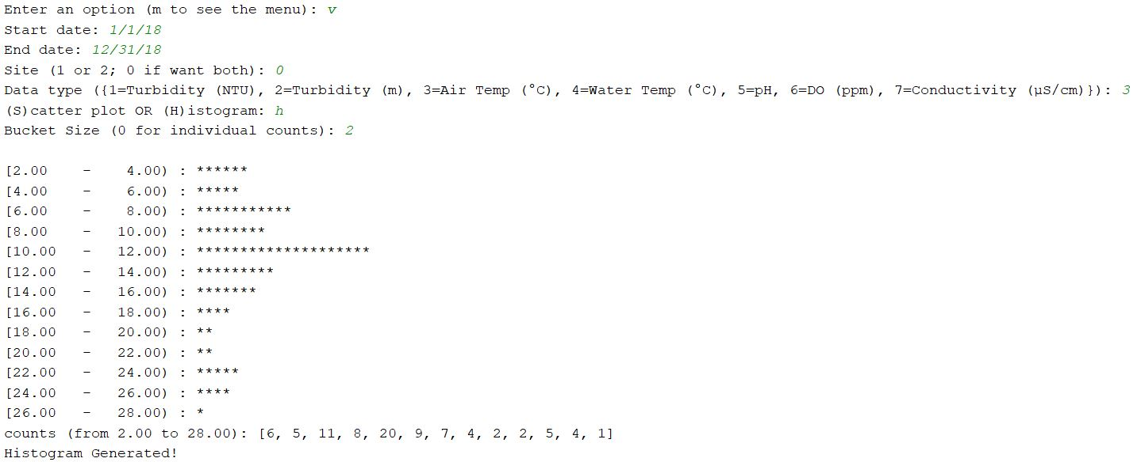
Functionality – Visualization (Histogram)
Notes:
So here we have visualization through a histogram of the same data. The user can specify the bucket size, which is the range of a bar in the histogram, and so counts are generated and printed here. So great, we have a histogram visualized using asterisks for counts, but we can agree that this isn’t the most beautiful. For one thing, it’s sideways!

Slide 7
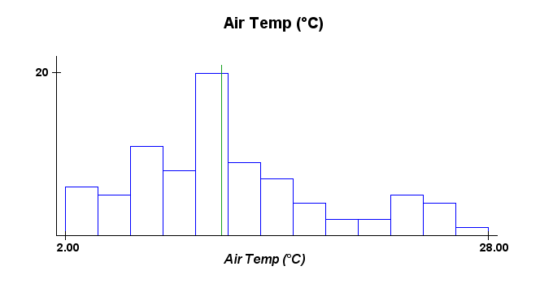
Functionality – Visualization (Histogram)
Notes:
That’s why it’s accompanied by a graphical histogram with pretty colors and everything. We see the bars and a green line for the average, which here is a little under 12, which is correct.

Slide 8
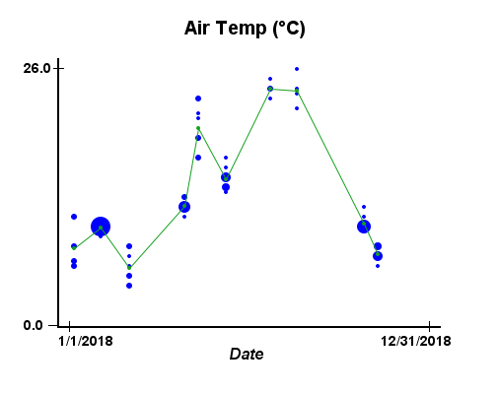
Functionality – visualization (Scatter Plot)
Notes:
And finally, if the user chose scatter plot instead of histogram, this is what they get. So it’s a bit more complicated than a scatter plot. The blue dots are the data points, and larger dots means more frequency. The green dots are the averages for each day, and the lines connect these green dots together. So basically here, we see that it’s cold in the winter (5 or 6 C, 40s F), and pretty hot in the summer (25 C, 70s F), and this varies, even between groups.

Slide 9
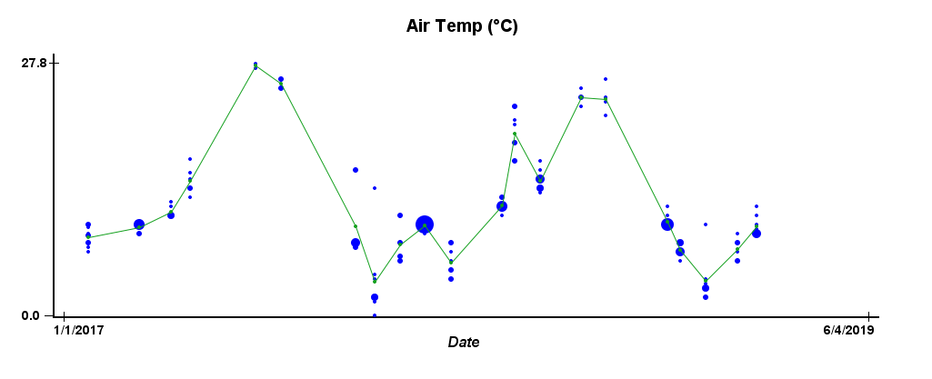
Charts – Air Temperature
Notes:
Now I’ll just show some more charts I generated, that show a few interesting things. Ironically, I actually didn’t get to spend much time actually looking at the data myself, because as I was testing during development, I was mostly using the same data, and became an expert in air temperature in 2018 ☺. Anyway, here is the air temperatures from 2017 to today, and we see a pretty consistent wave-like graph. I would show our all-time data, but the graph was too long. Now watch this transition to water temperature; any guesses as to how that will look?

Slide 10
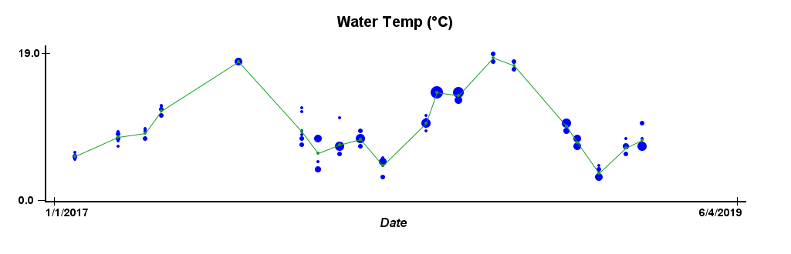
Charts – Water Temperature
Notes:
Yeah, so it looks like the air graph was squished: high temps are lower, and low temps are higher. This is kinda cool, and I’m sure all you AP Chem people can explain this better, but basically water heats and cools much slower than the air.

Slide 11
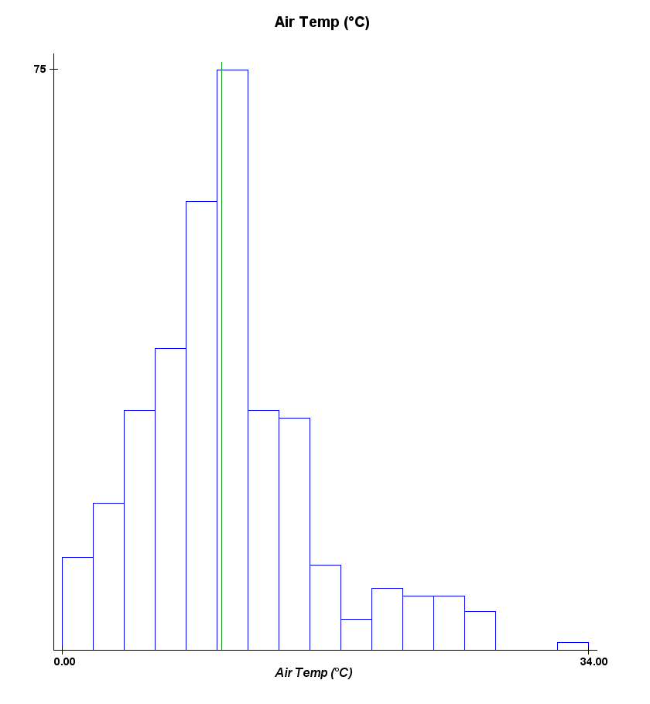
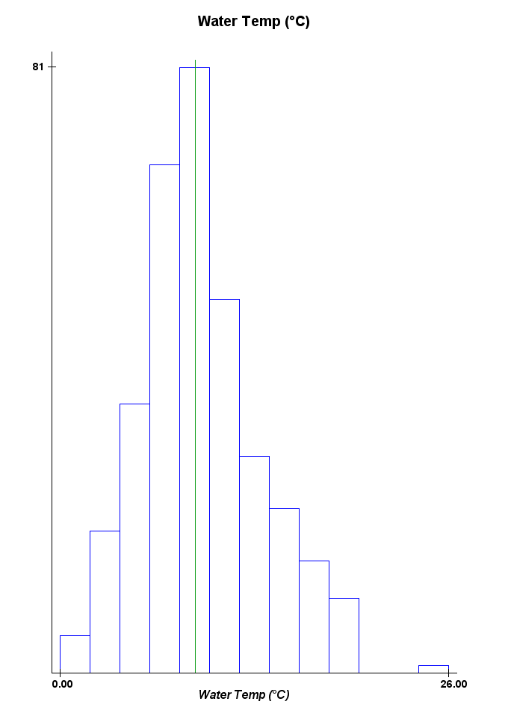
charts - Temperatures
Notes:
This is the all-time air temp and water temps compared, and we see a smaller range for water again. They both look very much like bell curves though. One interesting point, if we see this air temp histogram, the average all time is a little over 10 C, which is over 1 C less than the 2018 average. This may indicate climate change, or simply be because we did more stream monitoring in summer last year than we used to.

Slide 12
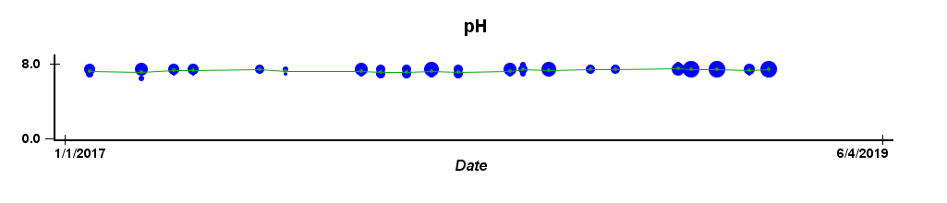
Charts – pH (acidity)
Notes:
Some data is really consistent, which is what we like to see. Here, pH is usually between 7 and 8, and the all-time histogram was super giant for 7.5, which is slightly basic, and what we consider normal.

Slide 13
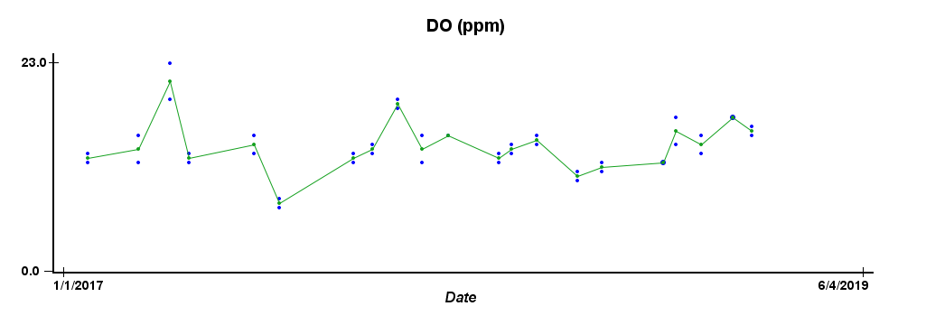
Charts – Dissolved Oxygen
Notes:
DO is also fairly consistent, and if we looked at all-time, we would see more consistency in the past. Nowadays, it has been fluctuating way more, perhaps because of melting ice caps. Increases in stream flow mean more air bubbles and more dissolved oxygen. DO is also affected by water temperature, which Juntao knows more about than I do.

Slide 14
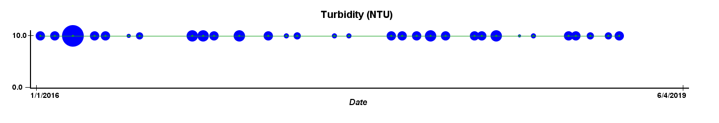
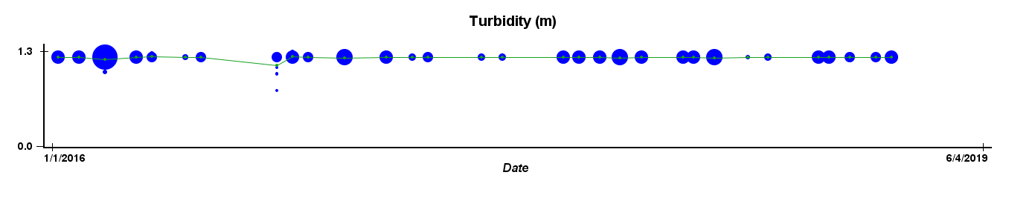
Charts - turbidity
Notes:
Turbidity is by far the most consistent data, at least since 2016, when we begin using the same turbidity tube we do now. We fill the tube with water and measure at what point we can’t see the Sechi disk at the bottom. The tube is 1.25 meters high and we almost always reach >1.2 meters. The tube also has NTU (Nephelometric Turbidity Units), which is almost always <10. This is great because nothing much has changed, and our water is very clear, so there are few polluting or sediment particles in the water.

Slide 15
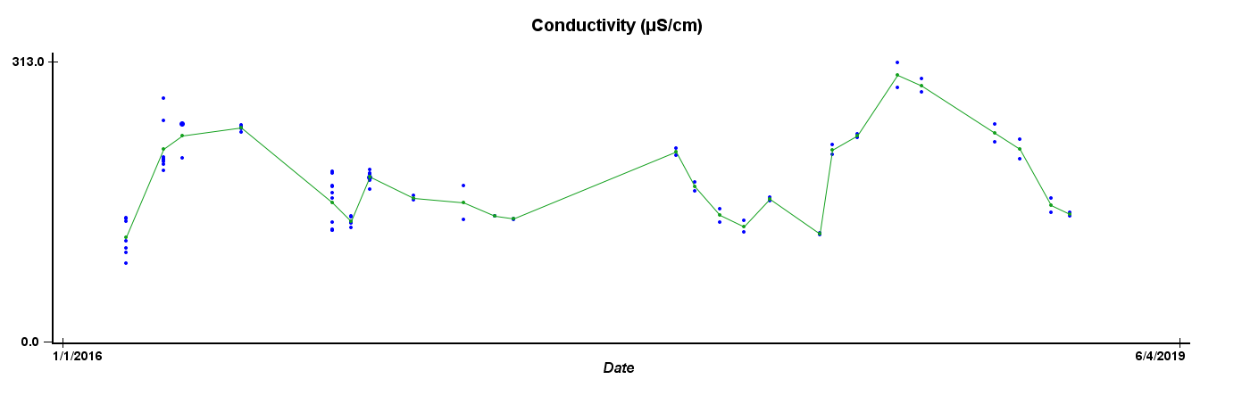
Charts - conductivity
Notes:
Conductivity has only been measured since 2016, and we have no real baseline for it. As you can see it varies quite a bit, and it’s hard to tell now if it’s seasonal or not.

Slide 16
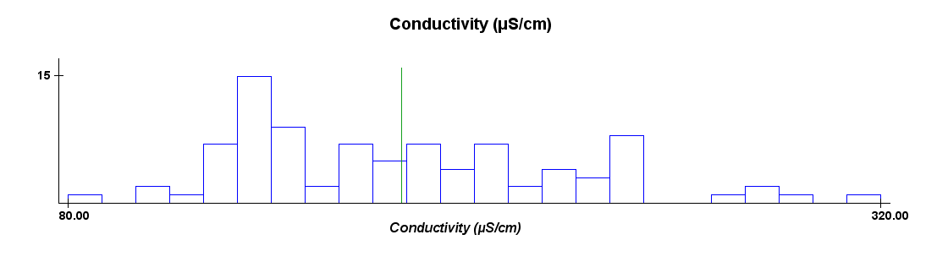
Charts - conductivity
Notes:
We can also see this with the histogram, as it is pretty evenly distributed in the middle as of now, and the average is not near the mode.

Slide 17
What I learned
General: No matter what, you always underestimate time
Programming: There are always bugs, and you should fix them early
Standardized data entry make life so much easier
Visualization is always good for data
Environment: Our Coal Creek is quite healthy in many ways ☺
Notes:
So what did I learn over this past year doing this project? First, you always underestimate. I went into this project thinking, “We have the whole year, there’s no way I’ll spend all of it on this project.” But of course, I did not take into account the fact that school is a thing and that it is very hard to have a life when you have school. So yeah, I’ll admit, I was still working on this project an hour ago ☺ I found that I often get so engrossed in programming that I lose track of time and spend way too long in front of a computer. As a programmer I learned that procrastination is a bad idea, as bugs catch up to you and mess everything up. Just earlier today, I was getting errors that I had never come across (probably because I did not test enough), and it could have ruined everything. As I said before, I spent way too much time writing code to clean and standardize our data. Our data has been collected over many years (since 2006), and it is understandable that entry differed over time and we added tests and all that. But from now on, it is always good to standardize the data when entered, rather than after, and perhaps even before, when we interns write our data sheets. I spent so much time on getting the statistical analysis done that I thought it would be fine to skip visualization. But adding the visualization helped so much, and I hope you all enjoyed the charts ☺ And finally, regarding the environment, I learned that Coal Creek is actually quite healthy, as we saw from many data types. So yeah, the data might be boring, but this is really good news, considering that there used to be a coal mine and a brick factory up there, the bricks of which we can still find at our sites.

Slide 18
Thank You!
Any questions?
Any data you would like me to Demo?
Notes:
Thank you! I probably went overtime, but if we have time, I can take questions and/or I can demo the program with you choosing what options I should pick!

