Slide 1
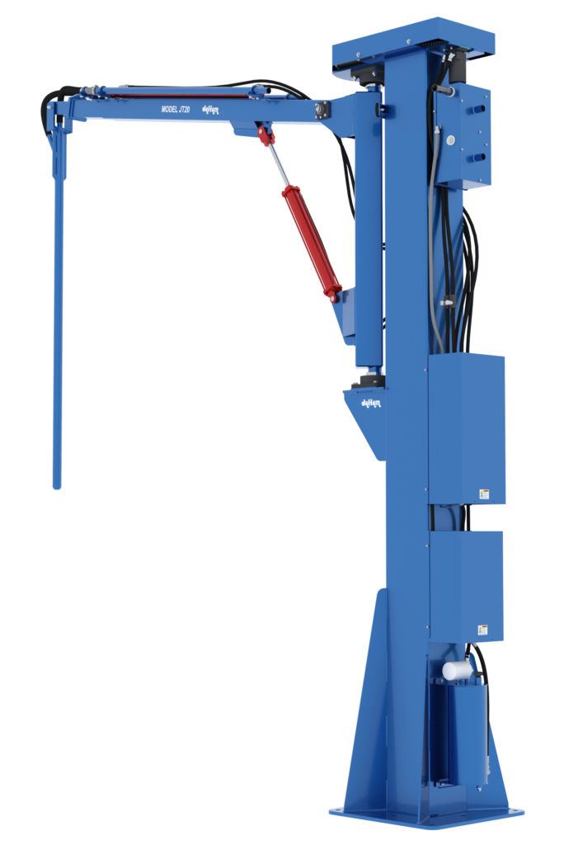

Automating Probe Sampling Process
https://dorna.ai
support@dorna.ai

Slide 2







Probe kinematic
$${mx}_{1}$$
Camera field of view
Turn up
Camera
$$p_{1}$$
$$0$$
$$0$$
Turn left
Turn right
Turn down
$$p_{0}$$
Grain
Grain
$${mx}_{0}$$
Top view
Side view

Slide 3
Grain sampling steps
Homing the probe
Wait for a truck
Process is completed
Find a feasible region for sampling
Approach the detected region
Move to the standby position

Slide 4
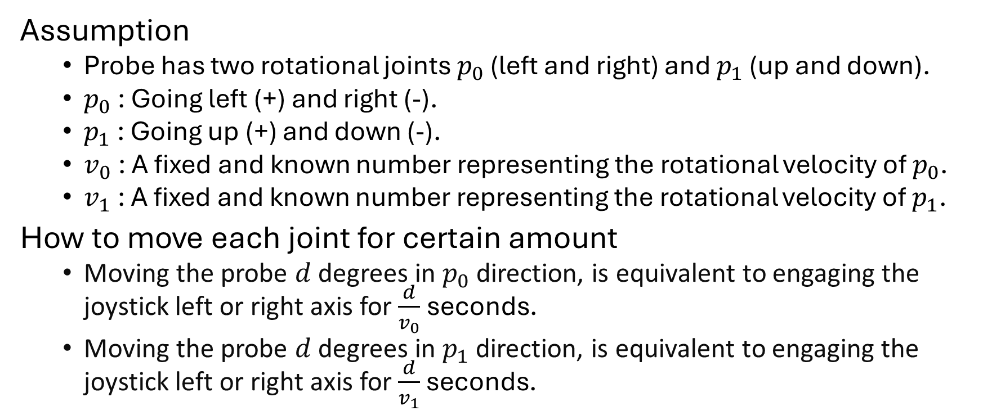
Moving probe
Assumption
Probe has two rotational joints $p_{0}$ (left and right) and $p_{1}$ (up and down).
$p_{0}$: Going left (+) and right (-).
$p_{1}$: Going up (+) and down (-).
$v_{0}$: A fixed and known number representing the rotational velocity of $p_{0}$.
$v_{1}$: A fixed and known number representing the rotational velocity of $p_{1}$.
How to move each joint for certain amount
Moving the probe $d$ degrees in $p_{0}$ direction, is equivalent to engaging the joystick left or right axis for $\frac{d}{v_{0}}$seconds.
Moving the probe $d$ degrees in $p_{1}$ direction, is equivalent to engaging the joystick left or right axis for $\frac{d}{v_{1}}$ seconds.

Slide 5




Homing probe
$${mx}_{1}$$
Home position side view
$$0$$
Task
The process of assigning the true $p_{0}$ and $p_{1}$ values to the probe joints.
Assumption
${mx}_{0}$: A fixed and known number representing the probe physical limit when traveling in the left direction ($p_{0}$ maximum value).
${mx}_{1}$: A fixed and known number representing the probe physical limit when traveling in the up direction ($p_{1}$ maximum value).
Process
Moving $p_{1}$ to its up limit, at this position the value of $p_{1}$ is ${mx}_{1}$.
Moving $p_{0}$ to its left limit, at this position the value of $p_{0}$ is ${mx}_{0}$.
$$0$$
Home position top view
$${mx}_{0}$$

Slide 6



Standby position
$${mx}_{1}$$
Standby position side view
$$0$$
Task
Moving the probe to $p_{0}=0$ and ${p_{1}=mx}_{1}$.
Process
When homing process is completed, ${p_{0}=mx}_{0}$and ${p_{1}=mx}_{1}$.
Move the probe to $p_{0}=0$ by activating the right joystick for $\frac{{mx}_{0}}{v_{0}}$ seconds.
The orientation of the probe at this position is $p_{0}=0$ and $p_{1}={mx}_{1}$.
$$0$$
Standby position top view
$${mx}_{0}$$

Slide 7
Wait for a truck
Process
At standby position activate the camera and run grain detection module every 10 seconds.
If for 12 consecutive images (2 minutes total) grain is detected, then there is a truck with grain.

Slide 8
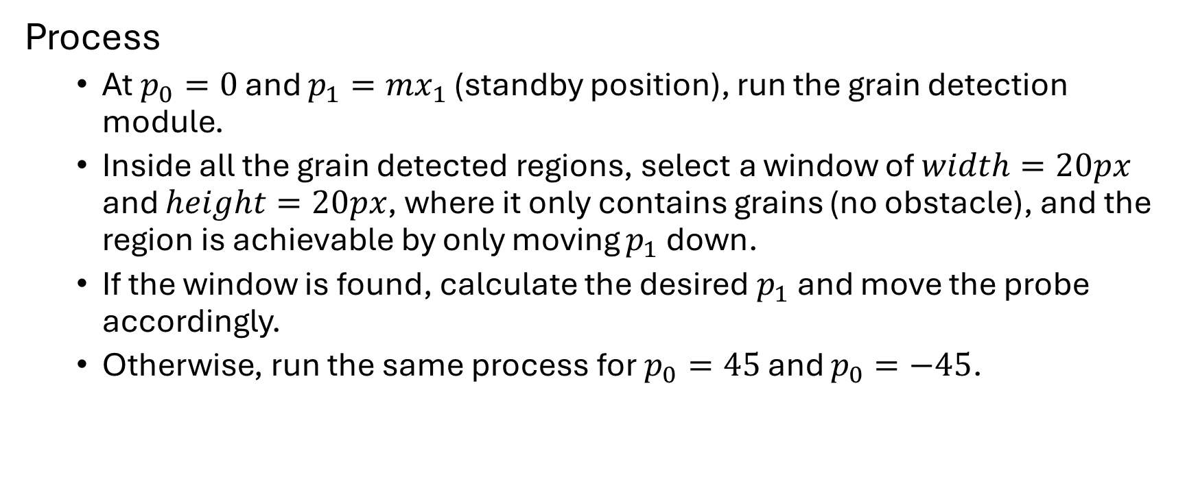
Find a region for sampling
Process
At $p_{0}=0$ and ${p_{1}=mx}_{1}$ (standby position), run the grain detection module.
Inside all the grain detected regions, select a window of $width=20px$ and $height=20px$, where it only contains grains (no obstacle), and the region is achievable by only moving $p_{1}$ down.
If the window is found, calculate the desired $p_{1}$ and move the probe accordingly.
Otherwise, run the same process for $p_{0}=45$ and $p_{0}=−45$.

Slide 9
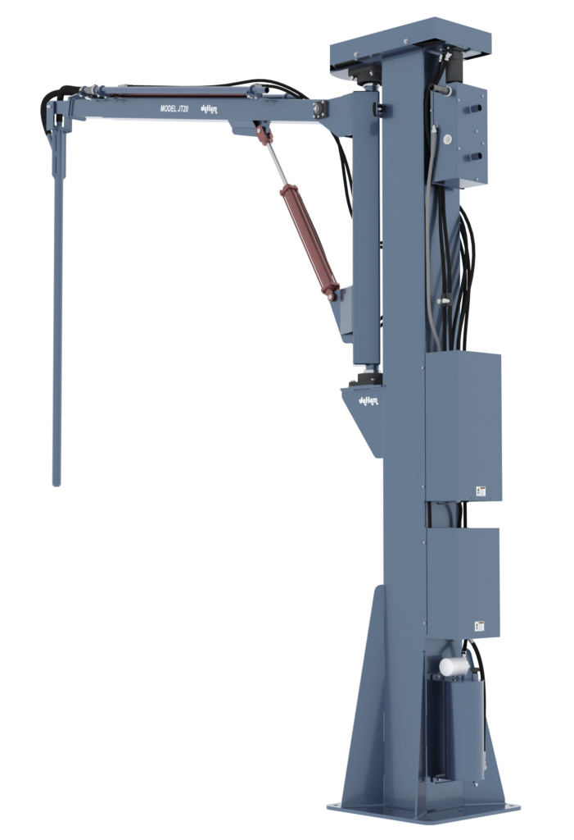


Camera attachment
$$l_{1}$$
Attach the camera on top of the probe.
Make sure to measure the distance between the camera and the tip of the probe.
Connect the camera USB cable to the designated computer.
Camera frame
$$l_{2}$$
Probe frame

