Slide 1

Auction Banner Pricing Optimization
Driving Revenue and ROI with Predictive Floor CPM Strategy
Prepared by: Dorna Shakoory | May 2025

Slide 2


Executive Summary
Objective: Test if optimized floor CPMs lead to higher revenue and ROI
This case study investigates the effectiveness of current floor CPM pricing in auction-based digital advertising and evaluates whether predictive, data-driven optimization can improve revenue and ROI. By developing machine learning models, analyzing key revenue drivers with SHAP, simulating multiple floor pricing strategies, and validating results with A/B testing, we delivered actionable insights and tools for stakeholder decision-making.

Slide 3

Business Problem
Are we leaving money on the table with static floor CPMs?
Issues Identified:
Static floor pricing lacks adaptability
No transparency in pricing logic
Potential missed revenue opportunities and inefficiencies

Slide 4
Our Goal Can machine learning improve auction pricing performance?
Success Criteria
Demonstrable Revenue Uplift
Higher ROI
Maintain Campaign Delivery and Performance
Business Interpretability

Slide 5
Methodology Overview End-to-End Process
1. Feature Engineering
2. Model Training (Random Forest → XGBoost)
3. SHAP Explainability
4. Quantile-based Floor CPM Simulation
5. Revenue & ROI Evaluation
6. A/B Testing Validation

Slide 6
Step 1: Data Import &Understanding
Goal: Understand the dataset’s structure, variables, and business context
Imported the Excel file: Auction Banner Case Study – vF.xlsx
Focused on critical auction metrics:
Winning CPM, Floor CPM, Sales, Impressions, Ad Spend, Taxonomy Name, Date
Performed initial exploratory analysis to understand:
Distribution of CPMs across time
Daily and weekly impression volumes
Sales and Ad Spend trends
Identified seasonality and demand troughs based on week and month of year

Slide 7
Feature Engineering
- Created high-signal features:
• Revenue_Per_Impression = Sales / Impressions
• CPM_Delta = Winning CPM – Floor CPM
• CTR_Proxy = Impressions / Traffic
- Extracted temporal features: Week, Month, Year
- Encoded taxonomy using LabelEncoder
Goal: Convert raw data into machine learning-ready format with strong predictive power.

Slide 8

Step 2: Data Cleaning & Feature Engineering
Goal: Create a modeling-ready dataset with meaningful features
Removed rows with null values in key financial columns
Parsed date fields and extracted Week, Month, and Year
Engineered additional predictors:
Revenue_Per_Impression = Sales / Impressions
CPM_Delta = Winning CPM – Floor CPM
CTR_Proxy = Impressions / Traffic
Encoded Taxonomy Name into numeric format using LabelEncoder

Slide 9

Step 3: Exploratory Data Analysis (EDA)
Goal: Identify patterns, trends, and drivers for price optimization
Visualized:
Winning CPM trends over time
Impressions by week
CPM_Delta across taxonomies
Observed demand peaks and troughs to inform future pricing segmentation
Confirmed potential pricing inefficiencies in specific taxonomy-week pairs

Slide 10
Step 4: Modeling – Predicting Winning CPM
Goal: Build a predictive model to understand what drives Winning CPM and simulate optimized prices
Trained two regressors:
Random Forest as baseline
XGBoost as final model due to higher accuracy and regularization benefits
Inputs included all engineered features
Evaluated using:
RMSE (Root Mean Squared Error)
R² (Goodness of fit)
Residual plots

Slide 11
Step 5: Model Explainability (SHAP Analysis)
Goal: Ensure transparency and interpretability for stakeholders
Applied SHAP (TreeExplainer) to XGBoost model
Identified top global features influencing pricing:
Produced bar charts and dependence plots for top features
CPM_Delta, Revenue_Per_Impression,
Week, Taxonomy_Encoded, CTR_Proxy

Slide 12

Step 6: Pricing Strategy Simulation
Goal: Recommend optimized floor prices using model predictions
Used 25th percentile of predicted CPM by Taxonomy_Encoded and Week
Replaced the static Floor CPM with recommended floors
Simulated Simulated CPM = max(Predicted CPM, Recommended Floor)
Calculated simulated revenue = Simulated CPM * Impressions / 1000

Slide 13
Step 7: Validation of Revenue Uplift
Goal: Quantify and statistically validate performance improvement
Compared Simulated Revenue vs. Actual Revenue
Used two testing approaches:
Two-sample t-test (limited by paired nature of data)
Bootstrap Resampling (non-parametric, more robust)
Bootstrap Results:
Mean uplift = $21.77
95% CI = [$20.74, $22.82] → Entire CI above 0
Outcome: Statistically significant revenue gain confirmed

Slide 14

Step 8: ROI & Profitability Filtering
Goal: Ensure uplift also delivers profitability, not just revenue
Calculated ROI = Sales / Ad Spend
Filtered out taxonomy-week segments with low historical ROI
Re-ran simulation on ROI-positive segments

Slide 15

Step 9: Segment Prioritization
Goal: Focus rollout where impact is highest
Created Segment Opportunity Matrix using:
CPM uplift
Impression volume
Classified segments into High, Medium, Low potential
Final target list: Top 10 high-ROI segments

Slide 16

Model Training
Started with Random Forest for baseline results
Transitioned to XGBoost for:
Superior accuracy
Built-in regularization
Native handling of missing values
Trained to predict Winning CPM from engineered features
Result: Production-ready model with explainable predictions and strong generalization.

Slide 17
SHAP Explainability
Leveraged SHAP (SHapley Additive exPlanations) to interpret model predictions with precision and transparency.
Delivered both global insights (top drivers across the dataset) and local attributions (factors influencing each individual prediction).
Produced clear, actionable outputs: summary plots, dependence plots, and CSV reports for integration into dashboards and reviews.
Objective: Enhance stakeholder confidence, support transparent decision-making, and enable effective auditing of pricing logic.

Slide 18

Quantile-Based Floor Pricing
Used the 25th percentile of predicted CPMs per taxonomy-week as the floor benchmark
More adaptive than static pricing rules
Adjusts to demand variance and avoids over-penalizing low-volume categories
Impact: Dynamic pricing tailored to each segment's distributional behavior.

Slide 19
Revenue & ROI Evaluation
Calculated total simulated revenue and compared to actual
Introduced ROI thresholds to filter recommendations
Ensured profitability alignment before recommending any pricing changes
Outcome: Strategy that drives revenue without compromising on marketing efficiency.

Slide 20
A/B Testing Validation
Control: Actual CPM; Treatment: Simulated CPM
Used two-sample t-test (initial) and bootstrap resampling (final)
Bootstrap Results
95% CI = [$20.74, $22.82] → Statistically significant
Mean Uplift = $21.77

Slide 21
Conclusion
This case study demonstrates how a data-driven, machine learning-powered approach to auction banner pricing can unlock measurable revenue growth while preserving ROI. By engineering high-impact features, training predictive models like XGBoost, and applying SHAP for transparency, we built a robust and explainable pricing framework that adapts to market dynamics. The use of quantile-based floor CPM strategies—particularly the 25th percentile—proved more effective than static rules, enabling tailored pricing by taxonomy and week. Moreover, incorporating ROI filters ensured that our recommendations aligned with business value, not just top-line growth.
Through rigorous validation—including A/B testing and bootstrap resampling—we confirmed the strategy’s effectiveness, with a statistically significant mean uplift of $21.77 per impression. This confirms that our optimized pricing approach isn’t just theoretically sound—it is practically deployable. With strong model performance, clear visual explanations, and segment-level prioritization, the final solution is deployment-ready for revenue teams, enabling more strategic floor pricing decisions grounded in analytics. This framework also sets the foundation for scalable and transparent pricing automation across future auction datasets.

Slide 22
Next Steps
Begin Controlled Pilot Rollout on High-Opportunity Segments
Operationalize Model for Weekly Use
Monitor Performance with ROI and Fill Rate Dashboards
Maintain Transparency Through Visual Reporting
Implement ROI Thresholds as Guardrails
Retrain Model to Prevent Drift
Iterate and Expand to Broader Segments
Establish a Model Governance Loop
Collaborate with RevOps and Product Teams for Long-Term Scaling

Slide 23
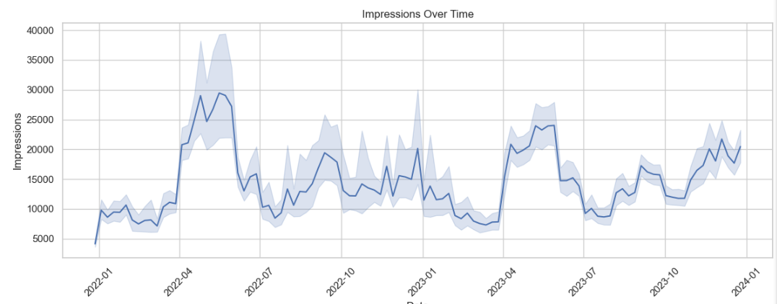
Auxiliary
1. Impressions Over Time
This plot reveals clear seasonal and cyclical patterns in ad delivery:
Significant spikes are observed around April 2022, early 2023, and mid-2023, with another rising trend at the end of 2023.
The pattern suggests that ad inventory volume fluctuates with strong seasonal factors, likely driven by campaign launches, budget resets, or consumer demand periods.
Interpretation: Any pricing optimization strategy must account for these high-volume intervals to avoid under-delivery. These impression trends also help determine when to apply or relax floor adjustments to balance revenue with delivery goals.

Slide 24
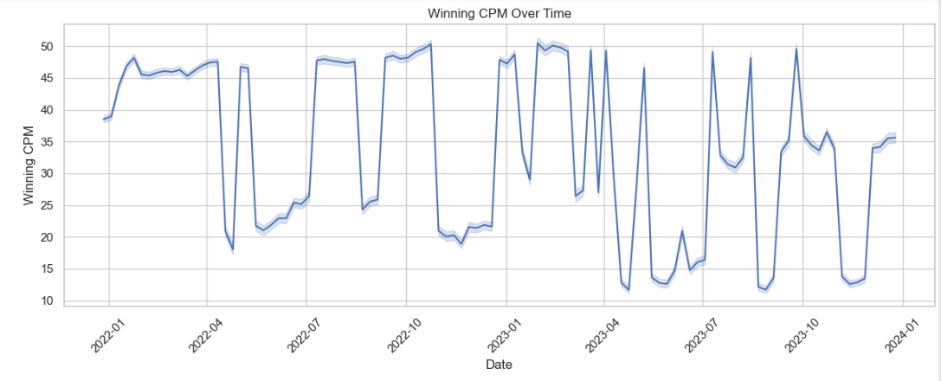
Auxiliary
2. Winning CPM Over Time
The second plot shows high volatility in Winning CPMs:
Sharp dips and spikes occur consistently, particularly between mid-2022 to late 2023.
Periods of very low CPMs (< $15) contrast with segments maintaining $45–$50+, suggesting extreme variability in auction pressure or bidding behavior.
Interpretation: This volatility underscores the need for dynamic pricing strategies. Applying a static floor in such an environment could lead to missed revenue during peak bidding and reduced fill during weaker periods. The quantile-based approach (e.g., 25th percentile by taxonomy-week) aligns well with this volatility by adapting floor pricing to each segment’s behavior over time.

Slide 25
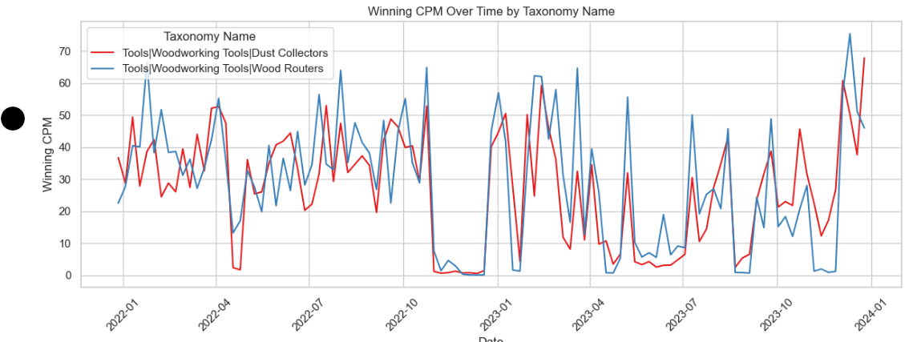
Auxiliary
This graph shows how auction-winning CPMs vary over time for the two most common product categories (in this case, "Dust Collectors" and "Wood Routers" under Woodworking Tools).
Key Takeaways:
High Variability in CPMs:
Both taxonomies experience large fluctuations in CPM across the 2-year window.
Some extreme dips (approaching $0) are visible, especially in early 2023, followed by sharp recoveries.
Segment-Specific Behavior:
Despite both being woodworking tools, their CPM patterns diverge frequently.
For example, "Wood Routers" (blue) generally exhibits more volatility than "Dust Collectors" (red), especially in the second half of 2023.
Seasonal or Demand-Driven Spikes:
Peaks appear around early Q2 and Q4 each year, suggesting seasonal demand.

Slide 26
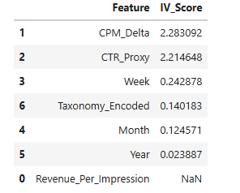
Auxiliary
CPM_Delta and CTR_Proxy are most important for modeling Winning CPM.
Time-based features like Week contribute moderately, while Month and Year add little.
Revenue_Per_Impression might be missing values or perfectly correlated with another variable.

Slide 27
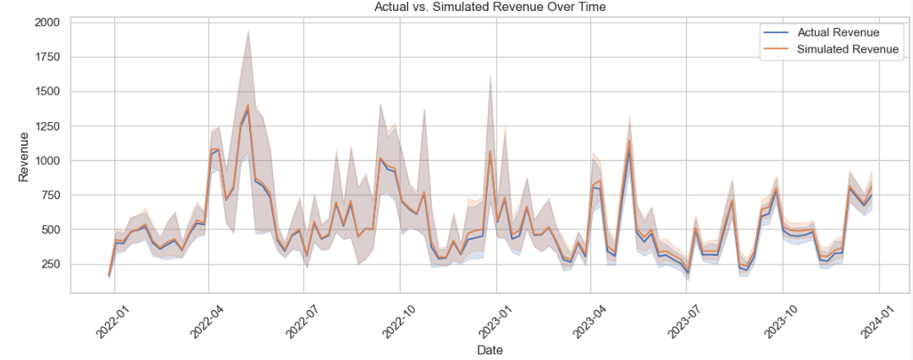
Auxiliary
Revenue Uplift Overview
Simulated Revenue Uplift: $4,130,325.90
This indicates that using the 25th percentile floor CPM strategy would have yielded $4.13M more in revenue over the dataset period, assuming the same impression volume was preserved.
Visual Interpretation (Chart)
The line plot shows:
The orange line (Simulated Revenue) is consistently above the blue line (Actual Revenue), confirming uplift.
The shaded areas (confidence intervals) show variance in delivery or model stability—higher variance around peaks suggests more aggressive potential uplift.

Slide 28
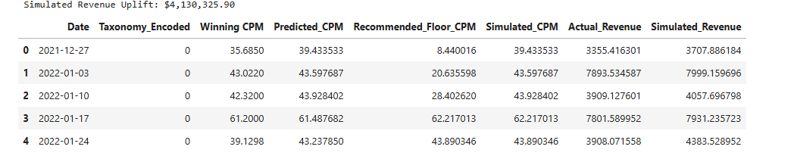
Auxiliary
Dynamic, quantile-based floors are significantly more effective than flat pricing rules.
Revenue gain is measurable and consistent across time and taxonomy.

Slide 29
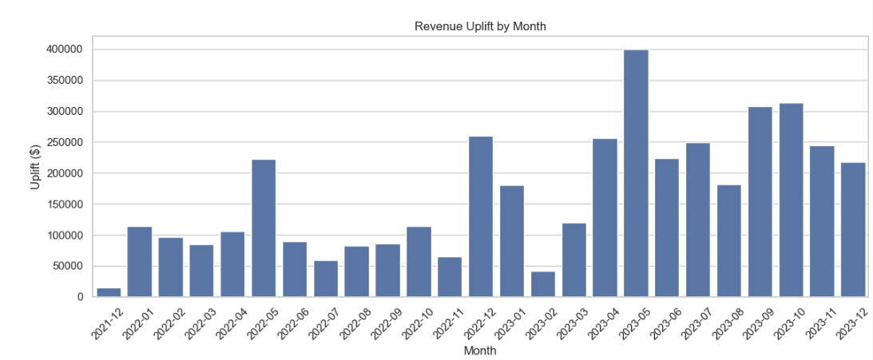
Auxiliary
The model does not just work in peak seasons—it provides meaningful revenue lift throughout the year.
Operational teams can use this to prioritize rollout in high-volume or high-variance months (like May and Q4).
It also supports the case for automated dynamic floor pricing to replace manual or flat thresholds.

Slide 30
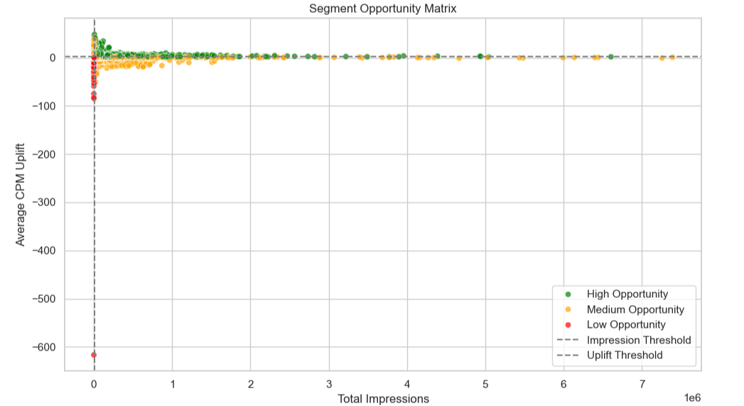
We create a segment-level opportunity matrix to identify which taxonomy-week combinations offer the best potential for revenue uplift by applying a smart floor pricing strategy.
Auxiliary

Slide 31
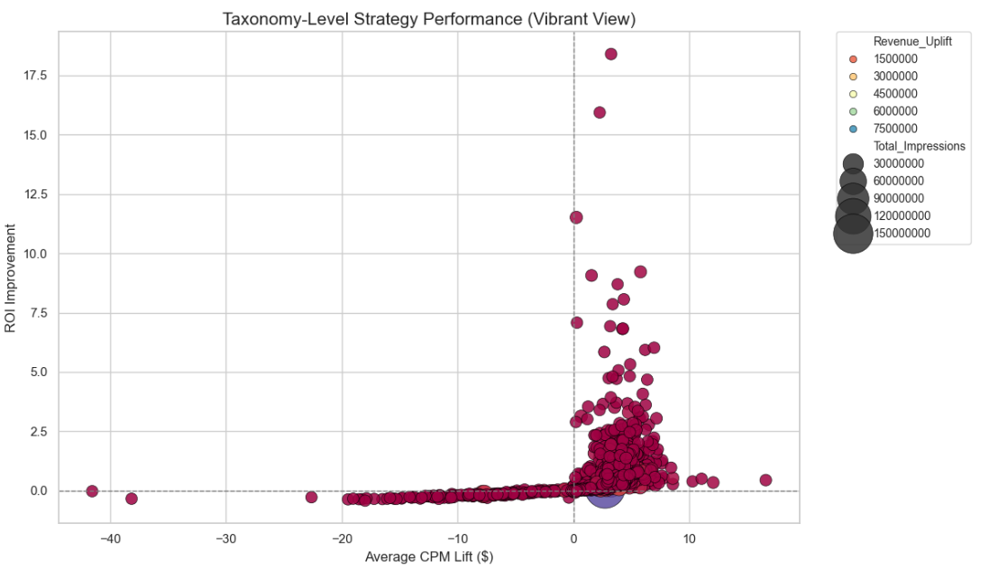
Top-right quadrant = ideal candidates for ROI-aware pricing strategy: high lift, high profitability, and high delivery. Large bubbles in any positive ROI region = impactful rollout segments. Bottom-left quadrant should be monitored or excluded—strategy is counterproductive there. This visual enables targeted strategy refinement per taxonomy segment before global deployment.
Auxiliary

