Slide 1


Predicting Hotel Cancellations
Analysis By: Dylan Orndorf-Ronk
dorndorfronk@deloitte.com

Slide 2
Business Problem
Hotel reservations are user-friendly but potentially revenue-reducing.
“[Hotel] cancellations negatively affect forecasting and controls, the two fundamental elements of revenue management”. –Boston University*
How can we address this problem?
*Source
Notes:
While hotel reservations are user-friendly, they also allow customers to “book and search”.
Cancelling bookings for free forces the hotel to quickly find a replacement customer for that room.
Hotel room pricing greatly varies depending on conditions like weekday, time of year, etc.

Slide 3
Solution – Predict Customer Behavior
Data sourced from Kaggle.com
Includes over 36k entries
Prediction provides business advantage
Assess relevant rates based on prediction
Manage staff more easily
Number of people, weekend nights vs weeknights, lead time, time of arrival, etc.
Notes:
Increase or decrease pricing based on how likely someone cancels

Slide 4
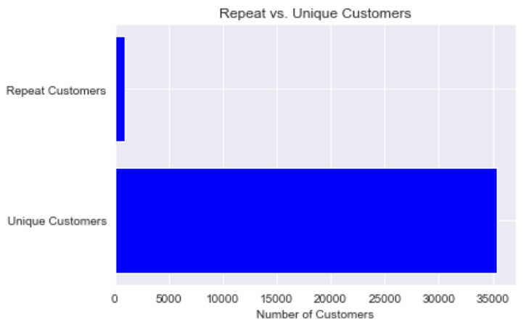
Vast Majority of Customers Unique
2.6% repeat
Useful for modeling real-world conditions
Notes:
2.6% repeat
Unique – more important to consider as many variables as we can

Slide 5
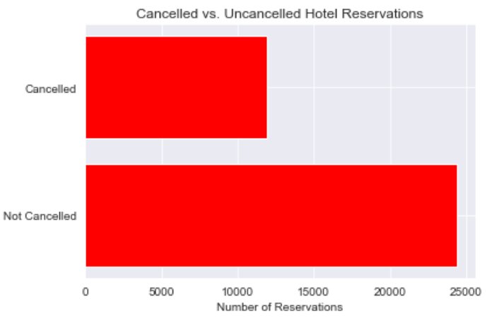
Nearly Half Have Cancelled
Lost potential revenue
Lack of price control
Notes:
Reduce cancellation rate = more revenue
Last minute sales force lower pricing

Slide 6
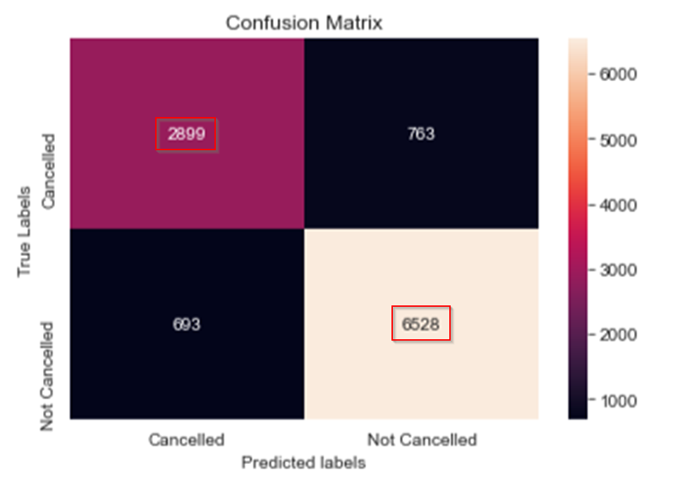
Predictive Model Performance
Best accuracy at 88%
2899 correctly predicted cancelled bookings
6528 correctly predicted uncancelled bookings

Slide 7
Next Steps
Tighten cancellation policies
Consider a fee to create a booking
Risk: less user-friendly
Gather larger dataset
More data points to train from could provide more robust modeling
Refine model performance
Improve accuracy in future model iterations

Slide 8

Questions?

