Slide 1

SOLANGE
Planning a transdisciplinary quantum-oncology research platform under technological uncertainty
Doron Cohen | Manuel Blanco | Amit Mekel
TNDY 315: Principles of Project Management in a Complex World | Dr. Matthew Muga | Claremont Graduate University | September 2026
Presenter: Doron Cohen
1
Notes:
SPEAKER: DORON COHEN (about 30 seconds)
Hello. We are Doron Cohen, Manuel Blanco, and Amit Mekel. Our project is called SOLANGE. It is a research platform that asks one simple question: when do we really need a quantum computer to study a cancer mutation?
I will open with the problem and the technology. Manuel will explain what earlier projects teach us, our management approach, and the team. Amit will walk you through the plan, step by step. I will close.

Slide 2

The problem: cancer mutations with no drug
Lung cancer is the most diagnosed and most lethal cancer worldwide
2.5M
1.8M
~60%
new lung cancer cases in 2022
lung cancer deaths in 2022
of NSCLC patients carry mutations with no approved targeted drug
Bray et al., 2024
Bray et al., 2024
Cohen, 2026a (estimate)
Why: designing a drug needs an accurate model of the electrons at the mutated site. Classical computers lose accuracy when many electrons interact strongly.
Presenter: Doron Cohen
2
Notes:
SPEAKER: DORON COHEN (about 1.5 minutes)
Lung cancer is the most common cancer in the world, and it kills more people than any other cancer. In 2022 there were almost 2.5 million new cases and about 1.8 million deaths.
Most patients have non-small cell lung cancer. Many of them carry mutations that no approved targeted drug can treat. My dissertation estimates that this applies to about 60 percent of these patients.
One reason is computational. To design a drug for a mutated protein, we need an accurate model of the electrons at the mutated site. When many electrons interact strongly, classical computers lose accuracy. This is where quantum computing enters the story.

Slide 3

Why quantum computing, and why not yet
The technology we need matures after our milestones are due
2023
2026
2027
2029
IBM "utility" claim, later matched classically
Today: noisy hardware, pipeline tests on 3 IBM devices
Our defense (Dec 2027)
IBM Starling: first large-scale fault-tolerant system
A wicked problem
We cannot fully define what the platform must compute until we try to compute it (Rittel & Webber, 1972). Each discipline also defines success differently.
Presenter: Doron Cohen
3
Notes:
SPEAKER: DORON COHEN (about 1.5 minutes)
Quantum computers are expected to handle this kind of chemistry better. But today's machines are noisy. IBM plans its first large-scale, fault-tolerant machine, called Starling, for 2029. Our defense is planned for December 2027. So the technology we need matures after our milestones are due.
On top of that, this is what Rittel and Webber call a wicked problem. We cannot fully define what the platform must compute until we try to compute it. And every discipline on the team, chemistry, physics, biology, medicine, finance, and diplomacy, defines success in a different way.

Slide 4




What SOLANGE does
It decides, per mutation, whether a quantum computer is needed at all
Mutation
Two classical methods
Verdict
LEON seals the record
from real patient sequencing data
DMRG and SHCI run independently
Class B: classically tractable
Class A: quantum-necessary
P1 to P9 provenance, re-verified (FDA Part 11 logic)
Finding so far: every real biological target we measured was classically tractable. The platform reports this openly.
Presenter: Doron Cohen
4
Notes:
SPEAKER: DORON COHEN (about 1.5 minutes)
So SOLANGE does not assume that a quantum computer is needed. It checks.
For each mutation, taken from real patient sequencing data, the platform runs two independent classical methods, called DMRG and SHCI. If both methods agree that the problem can be solved classically, the verdict is Class B. If both agree that it cannot, the verdict is Class A, which means quantum-necessary.
A verification layer called LEON seals every result in nine provenance fields, P1 to P9, and checks it again before anyone may rely on it. This follows the audit-trail logic of the FDA rule for electronic records, known as Part 11.
So far, every real biological target we measured was classically tractable. We report that openly, because it is a real result.
This is not only a plan on paper.

Slide 5
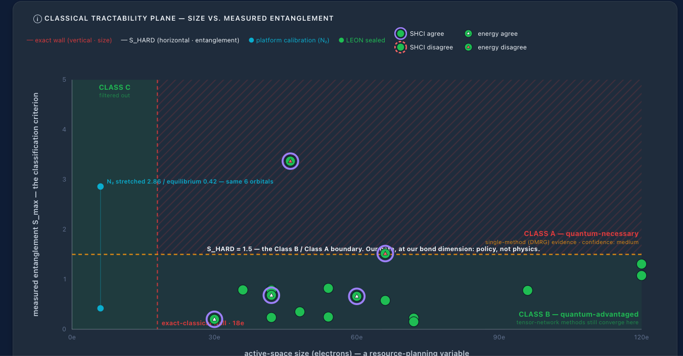
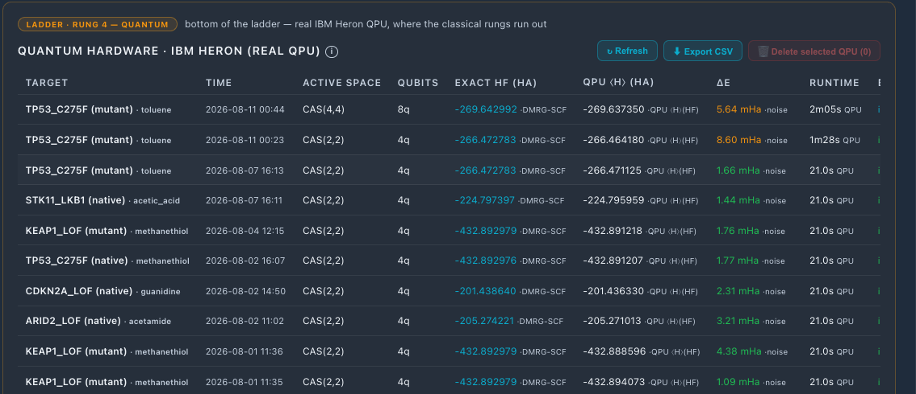
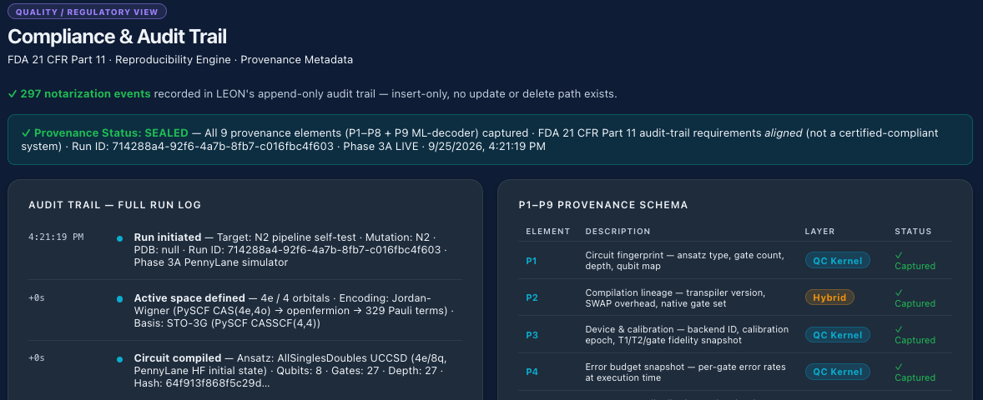
SOLANGE today: a working platform
Screens from the live system, September 2026
Test jobs on real IBM Heron hardware
Classifier map: every real target so far lands in Class B (classically tractable)
LEON audit trail, P1 to P9 provenance
Presenter: Doron Cohen
5
Notes:
SPEAKER: DORON COHEN (about 1 minute)
Here is the platform as it runs today. On the left is the classifier map. Each point is a real target. The horizontal line is the boundary between Class B and Class A. So far, every real biological target sits below the line, in Class B.
On the upper right are small test jobs that ran on real IBM Heron quantum computers in July and August. They proved that the pipeline works on real hardware.
On the lower right is the audit trail. Every run is sealed and can be verified again.
Now Manuel will explain what earlier projects teach us.

Slide 6


What earlier projects teach us
Progress came when evidence set the pace, not marketing
What went wrong
What went well
IBM Watson for Oncology
KRAS G12C
MD Anderson spent $62M, then canceled. Little evidence of patient benefit (Strickland, 2019).
Pocket found in 2013, drug approved in 2021: eight years of patient work (Ostrem et al., 2013; FDA, 2021).
Quantum advantage claims
Long partnerships
IBM's 2023 result was later matched on classical computers, partly on a phone (Schirber, 2024).
Cleveland Clinic and IBM: a 10-year program that also trains people (Cleveland Clinic, 2023).
Presenter: Manuel Blanco
6
Notes:
SPEAKER: MANUEL BLANCO (about 2 minutes)
Thank you, Doron. I look at this field the way a banker and an investor would, so I start with money and trust.
The best-known failure is IBM Watson for Oncology. MD Anderson Cancer Center spent 62 million dollars on a project built on Watson, and then canceled it. There was very little published evidence that Watson helped patients. The promises came before the proof, and the computer scientists and the doctors never fully understood each other.
Quantum computing carries a similar risk. In 2023, IBM announced a result that classical computers supposedly could not match. Within months, other researchers matched it on classical computers, and some of the calculations even ran on a mobile phone.
On the positive side, real progress came slowly and steadily. A lung cancer target called KRAS was considered almost impossible to drug. The key discovery came in 2013, and the drug was approved in 2021. That is eight years of patient work. And Cleveland Clinic and IBM built a ten-year partnership that also trains people.
For an investor, the lesson is simple: let evidence set the pace, not marketing.

Slide 7
Our main model: Cynefin
PMBOK Guide, Section 4.2.5.1: match each part of the problem to its context
Complicated
Complex
Known unknowns. Analyze, then apply good practice.
Unknown unknowns. Probe, sense, respond in short cycles.
SOLANGE: Classification stage: predictive plan, fixed milestones
SOLANGE: Quantum stage: short cycles, quarterly re-plan
Clear
Chaotic
Obvious cause and effect. Use best practice.
Act first to stabilize, then sense.
SOLANGE: Routine operations
SOLANGE: Not expected in this project
Presenter: Manuel Blanco
7
Notes:
SPEAKER: MANUEL BLANCO (about 1.5 minutes)
So how do we manage a project like this? We use a model from the PMBOK Guide called Cynefin.
Cynefin sorts problems by how well we understand cause and effect. In a complicated situation, the questions are known, so experts can analyze and plan ahead. In a complex situation, nobody knows the answer in advance, so the team tries something, measures the result, and adjusts, in short cycles.
SOLANGE has both kinds of work. The classification stage uses proven classical methods, so we plan it with fixed milestones. The quantum stage is complex, so we work in short cycles and update the plan every quarter.
Using different approaches for different parts of one project is what our course calls tailoring.

Slide 8





Adding a communication model for people
Cynefin does not cover stakeholders (PMBOK Table 4-1)
Chemist
Oncologist
Investor
Health ministry
Success = Converged energy
Success = Clinical relevance
Success = Credible progress
Success = Trust and access
Cross-cultural communication (PMBOK 4.2.2.1)
Every result states its context: established or experimental.
Uncertain results are explained in a live briefing, not only in a report.
The same result must mean the same thing to every reader.
Presenter: Manuel Blanco
8
Notes:
SPEAKER: MANUEL BLANCO (about 1.5 minutes)
Cynefin tells us how to handle uncertainty, but it does not tell us how to talk to people. The PMBOK table does not link it to stakeholders. So we add a second model: cross-cultural communication.
This model says that the background of the sender shapes the message, and the background of the listener shapes how it is understood. A chemist, a doctor, an investor, and a health minister will read the same result in four different ways. Each of them defines success differently.
So we set three rules. Every result states clearly whether it is established or still experimental. Uncertain results are explained in a live meeting, not only in a written report. And the same result must mean the same thing to every reader.
From my side, this is how we protect the trust of funders.

Slide 9


Team roles and responsibilities
Each member leads the area of his own professional expertise
Doron Cohen
Manuel Blanco
Amit Mekel
Project lead and technical lead
Funding and investor relations
International partnerships
Platform architecture and science
Research phases 1 to 7
Evidence discipline (LEON)
Grants and binational funding
IBM Research Israel collaboration
Budget and funder reporting
Health diplomacy
Partner hospitals and ministries
Expert-panel sourcing
Presenter: Manuel Blanco
9
Notes:
SPEAKER: MANUEL BLANCO (about 1 minute)
Here is how we divided the work. Each of us leads the area of his own professional expertise.
Doron leads the project and all the technical and scientific work.
I lead funding and investor relations. U.S. federal funding is not open to this project, so we focus on binational science grants and an academic collaboration with IBM Research Israel. I also own the budget and the reporting to funders.
Amit leads international partnerships and health diplomacy. He builds relationships with partner hospitals and health ministries, and he helps us find experts for the evaluation panel.

Slide 10
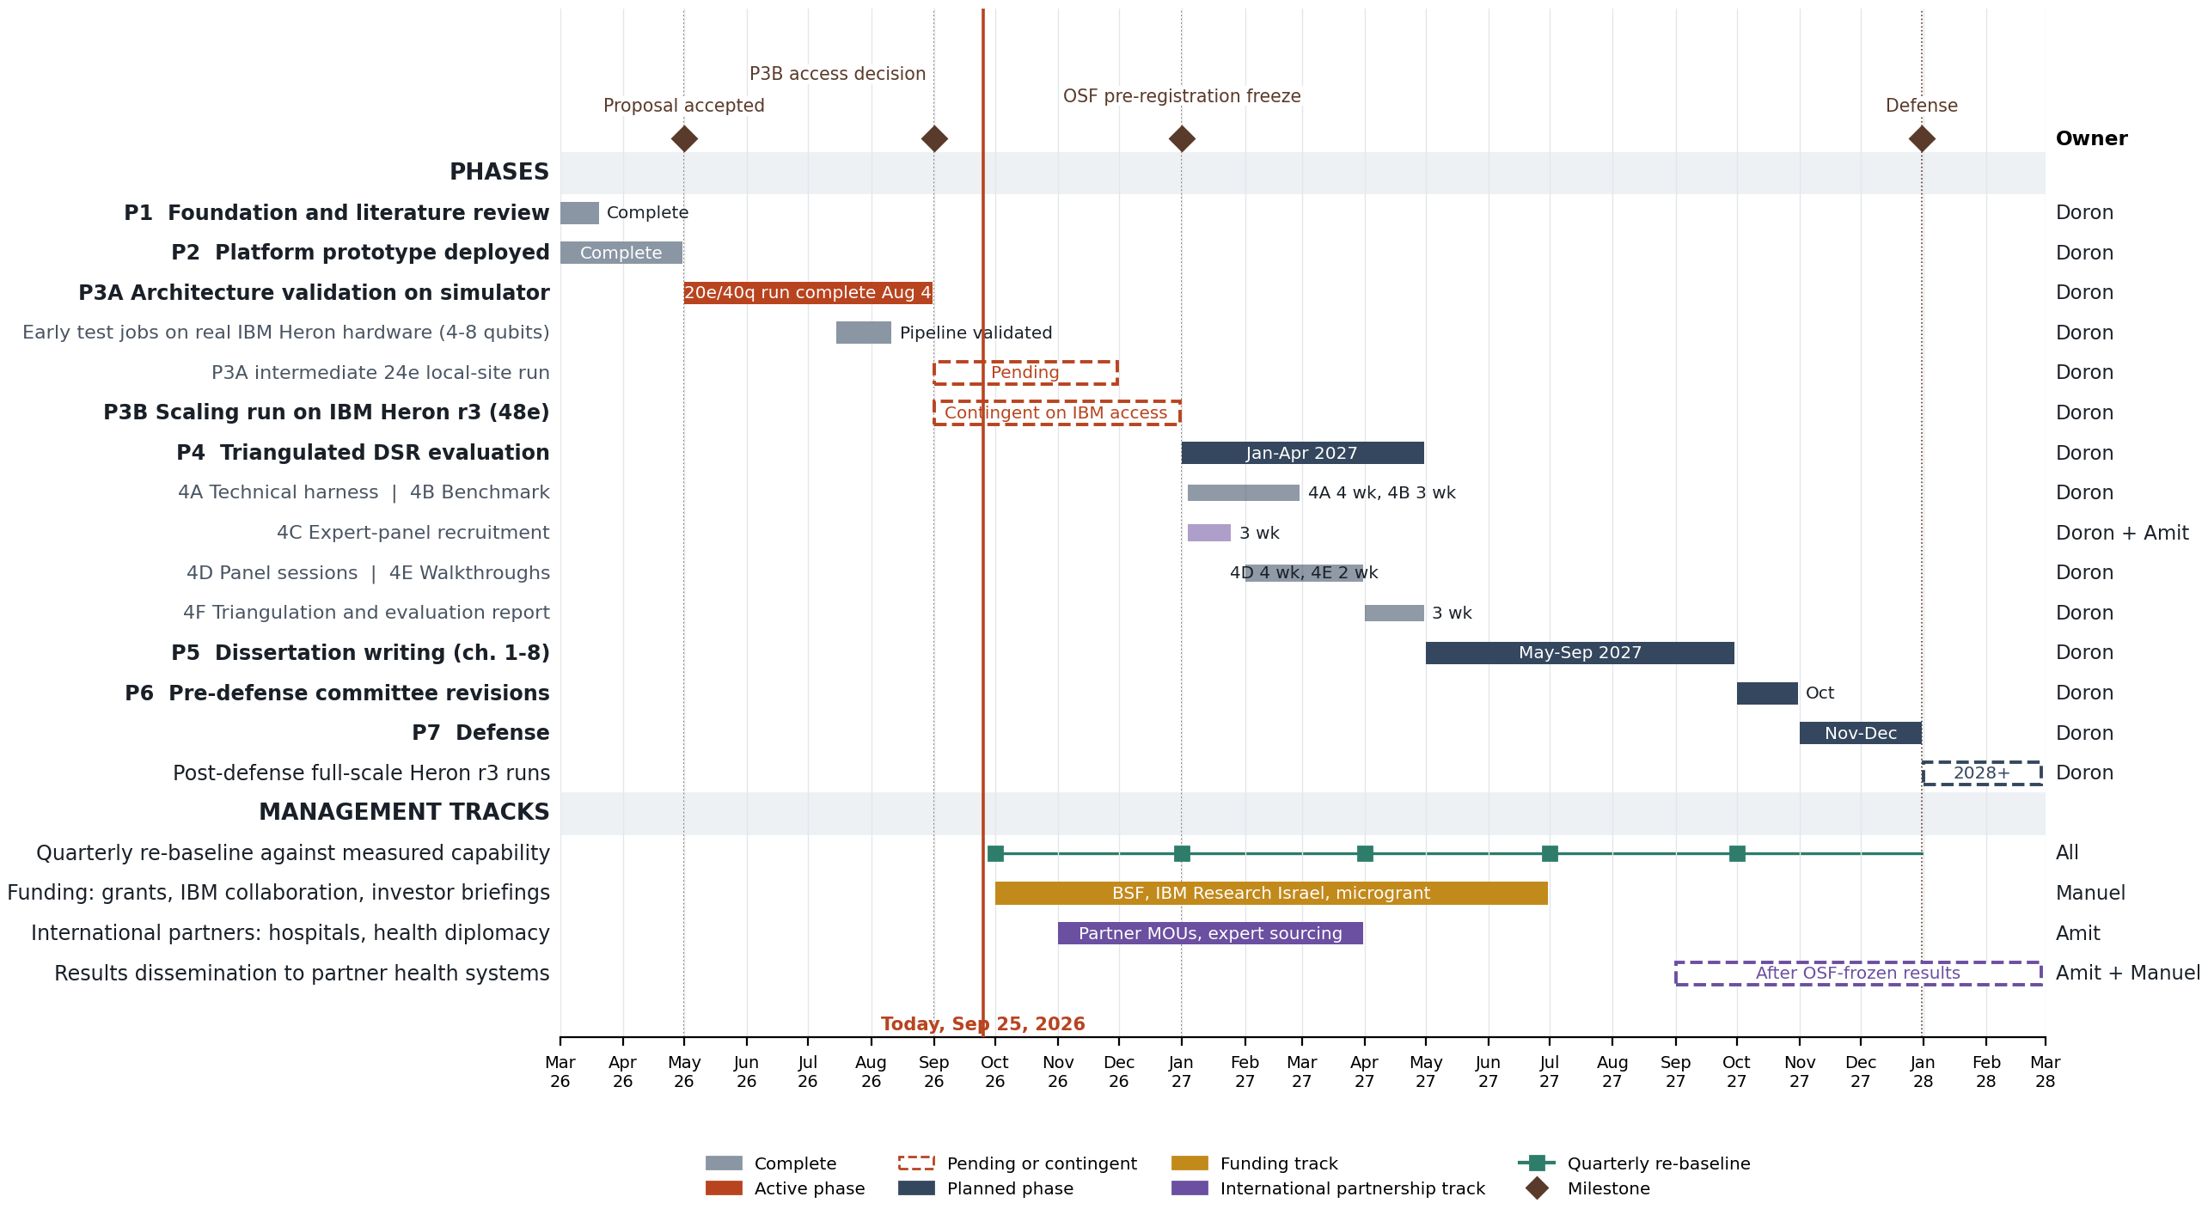
Project timeline: March 2026 to February 2028
Presenter: Manuel Blanco
10
Notes:
SPEAKER: MANUEL BLANCO (about 1 minute)
This is our full timeline, from March 2026 to February 2028.
The upper part shows the research phases. The lower part shows the management tracks: the quarterly review of the plan, my funding track, and Amit's international partnership track.
There are four milestones, shown as diamonds: the proposal, the decision on access to IBM hardware, the freeze of our evaluation criteria, and the defense in December 2027. The red line shows where we are today.
Amit will now walk you through the plan, step by step.

Slide 11

Plan walkthrough: where we are today
Phases 1 to 3A
Phase 1
Foundation and literature review
Complete
Phase 2
Working prototype deployed
Complete
Phase 3A
Test the design on a simulator (May to Aug 2026)
Main run done Aug 4; larger run pending
Jul-Aug 2026
Small test jobs on 3 real IBM computers: Kingston, Marrakesh, Fez
Pipeline proven; not yet medical-grade chemistry
Presenter: Amit Mekel
11
Notes:
SPEAKER: AMIT MEKEL (about 1.5 minutes)
Thank you, Manuel. I will walk through the plan in simple terms.
Phases one and two are complete: the research foundation and a working prototype of the platform.
Phase 3A tests the design on a simulator. A simulator is a normal computer that imitates a quantum computer. The main test run finished on August 4, 2026. A larger run is still pending.
In July and August, the team also ran small test jobs on three real IBM quantum computers, called Kingston, Marrakesh, and Fez. These jobs proved that the whole pipeline works from end to end. They did not yet produce medical-grade chemistry results, and the team says that clearly. Being honest about what a result proves is part of the plan.

Slide 12

The hardest phase: 3B on IBM Heron r3
September to December 2026, contingent on access
Why it is hard
How the plan responds
Access depends on IBM: 3 to 6 months
Immature hardware can fail on its own
Each discipline defines success differently
Officially contingent: no access by December means future work, not failure
A target goes to hardware only if it fits what we already ran
Success criteria are written before each run
Presenter: Amit Mekel
12
Notes:
SPEAKER: AMIT MEKEL (about 1.5 minutes)
Phase 3B is the hardest part of the plan. Here the project moves to IBM's newer machine, called Heron r3.
There are three problems. First, access depends on IBM, and it can take three to six months. Second, the hardware is still immature, so a run can fail for reasons the team does not control. Third, each discipline defines success differently, and here the differences are largest.
The plan answers each problem. Phase 3B is officially contingent. If access does not come by December, it becomes future work, and the project continues without delay. A target goes to the hardware only if it fits what the team has already proven it can run. And every discipline writes down its success criteria before the run, not after it.
In diplomacy we know this pattern well: when a result depends on another party, you prepare the alternative before the meeting, not after it.

Slide 13

Phase 4: independent evaluation
January to April 2027, criteria frozen in advance on the Open Science Framework
4A
4B
4C
4D
4E
4F
Technical test harness
Comparative benchmarks
Recruit 4 to 6 experts
Two rounds of panel sessions
Real case walkthroughs
Triangulation and report
4 wk
3 wk
3 wk
4 wk
2 wk
3 wk
The hardest step here is 4C: finding experts from several fields in three weeks. Our international partner network supports this recruitment.
Presenter: Amit Mekel
13
Notes:
SPEAKER: AMIT MEKEL (about 1.5 minutes)
Phase 4, from January to April 2027, is the independent evaluation. It has six steps: a technical test system, comparative benchmarks, recruiting a panel of four to six experts, two rounds of panel sessions, walkthroughs of real cases, and a final report.
The two rounds matter. In the first round, the experts review the idea. In the second round, they use the platform themselves.
The evaluation criteria are frozen in advance on the Open Science Framework. This means nobody can change the rules after seeing the results.
The hardest step here is recruiting the experts. We need people from several fields, and we have only three weeks. This is where my international network helps, through partner hospitals and research institutions.

Slide 14

Management tracks next to the research
People, money, and partnerships run in parallel with the science
Quarterly re-plan
Every quarter, the plan is updated from what we actually achieved, never from vendor promises.
Whole team
Funding track
Grants, binational funding, IBM Research Israel collaboration. October 2026 to June 2027.
Manuel
Health diplomacy
Partner hospitals and health ministries. Cancer does not stop at borders; shared science brings countries together.
Amit
Presenter: Amit Mekel
14
Notes:
SPEAKER: AMIT MEKEL (about 1.5 minutes)
Three management tracks run next to the research.
First, every quarter the whole team updates the plan based on what was actually achieved, never on vendor promises. This rule came from our earlier A3 analysis.
Second, Manuel's funding track runs from October 2026 to June 2027.
Third, my track builds partnerships with hospitals and health ministries. For me, this is health diplomacy. Cancer does not stop at borders. A shared and trusted scientific platform can bring countries together, even when politics divides them. After the results are final, we plan to share them with our partner health systems.

Slide 15




Key project artifacts
Categories from PMBOK Guide Section 4.6
Project charter
Roadmap
Assumption log
Risk register
Authority, milestones, 3B contingency
Re-planned each quarter
Every modeling choice behind a result
Access, hardware, funding, recruitment
Stakeholder register
Change log
Communications plan
Budget
What success means to each group
Formal changes and retractions
Who hears what, and how
Compared with actuals each quarter
Presenter: Amit Mekel
15
Notes:
SPEAKER: AMIT MEKEL (about 1.5 minutes)
Finally, the artifacts the project would use. These are the documents and tools that keep everyone aligned.
The project charter and the roadmap set the direction. The assumption log records every modeling choice behind a result. The risk register tracks the main risks: access, hardware, funding, and recruitment. The stakeholder register lists what success means for each group.
The change log records every formal change. For example, on September 23 the team retracted a result after a check found an error in the input structure. The change log shows that openly.
The communications plan and the budget complete the set.
Doron will now close.

Slide 16


What this course changed in our plan
Tailoring
Models for coverage
Evidence first
One project, different approaches for different parts.
Cynefin for uncertainty, communication for people.
"No quantum computer needed" is a result, not a failure.
Uncertain hardware becomes a managed condition: every phase delivers value on its own.
Presenter: Doron Cohen
16
Notes:
SPEAKER: DORON COHEN (about 1.5 minutes)
Thank you, Amit. Three lessons from this course shaped our plan.
First, tailoring. One project can use different approaches for different parts. Our classification stage follows a fixed plan, and our quantum stage works in short cycles.
Second, choose models for coverage. Cynefin handles the uncertainty of the technology, and the communication model handles the people. Each model covers what the other leaves open.
Third, evidence first. Our platform is allowed to say that a quantum computer is not needed. That is a result, not a failure.
With this structure, the uncertain future of quantum hardware becomes a managed condition. Every phase delivers value on its own, the hardware phase is contingent, and every result reaches its readers with its evidence and its context.

Slide 17
Thank you
Questions and discussion
Doron Cohen | Manuel Blanco | Amit Mekel
Presenter: Doron Cohen
17
Notes:
SPEAKER: DORON COHEN (about 20 seconds)
Thank you for listening. On behalf of Manuel, Amit, and myself, we are happy to take your questions.

Slide 18
References
The ASCO Post. (2026, March 13). p53 reactivator rezatapopt in TP53 Y220C-mutated solid tumors. https://ascopost.com/news/march-2026/p53-reactivator-rezatapopt-in-tp53-y220c-mutated-solid-tumors/
Bray, F., Laversanne, M., Sung, H., Ferlay, J., Siegel, R. L., Soerjomataram, I., & Jemal, A. (2024). Global cancer statistics 2022: GLOBOCAN estimates of incidence and mortality worldwide for 36 cancers in 185 countries. CA: A Cancer Journal for Clinicians, 74(3), 229-263. https://doi.org/10.3322/caac.21834
Cleveland Clinic. (2023, March 20). Cleveland Clinic and IBM unveil first quantum computer dedicated to healthcare research [Press release]. https://newsroom.clevelandclinic.org/2023/03/20/cleveland-clinic-and-ibm-unveil-first-quantum-computer-dedicated-to-healthcare-research
Cohen, D. (2026a). Deciding when quantum computation is warranted: A governed instrument for classical-tractability adjudication in non-druggable oncology [Doctoral dissertation proposal, Claremont Graduate University]. https://nsclc-quantum-viewer.netlify.app/dissertation_revised
Cohen, D. (2026b). A governed QC-AI-HPC architecture for deciding when quantum computation is warranted in non-druggable oncology [Unpublished manuscript prepared for arXiv submission]. Claremont Graduate University. https://github.com/doron66-collab/lili2014/tree/main/arxiv
IBM. (2025a, June 10). How IBM will build the world's first large-scale, fault-tolerant quantum computer. IBM Quantum Computing Blog. https://www.ibm.com/quantum/blog/large-scale-ftqc
IBM. (2025b, November 12). Scaling for quantum advantage and beyond. IBM Quantum Computing Blog. https://www.ibm.com/quantum/blog/qdc-2025
Kim, Y., Eddins, A., Anand, S., Wei, K. X., van den Berg, E., Rosenblatt, S., Nayfeh, H., Wu, Y., Zaletel, M., Temme, K., & Kandala, A. (2023). Evidence for the utility of quantum computing before fault tolerance. Nature, 618, 500-505. https://doi.org/10.1038/s41586-023-06096-3
Lee, S., Lee, J., Zhai, H., Tong, Y., Dalzell, A. M., Kumar, A., Helms, P., Gray, J., Cui, Z.-H., Liu, W., Kastoryano, M., Babbush, R., Preskill, J., Reichman, D. R., Campbell, E. T., Valeev, E. F., Lin, L., & Chan, G. K.-L. (2023). Evaluating the evidence for exponential quantum advantage in ground-state quantum chemistry. Nature Communications, 14, Article 1952. https://doi.org/10.1038/s41467-023-37587-6
Ostrem, J. M., Peters, U., Sos, M. L., Wells, J. A., & Shokat, K. M. (2013). K-Ras(G12C) inhibitors allosterically control GTP affinity and effector interactions. Nature, 503, 548-551. https://doi.org/10.1038/nature12796
Project Management Institute. (2021). A guide to the project management body of knowledge (PMBOK guide) (7th ed.). Project Management Institute.
Rittel, H. W. J., & Webber, M. M. (1972). Dilemmas in a general theory of planning (Working Paper No. 194). Institute of Urban and Regional Development, University of California, Berkeley. https://escholarship.org/uc/item/01v4t1c9
Schirber, M. (2024). A moving target for quantum advantage. Physics, 17, 13. https://physics.aps.org/articles/v17/13
Strickland, E. (2019, April 2). How IBM Watson overpromised and underdelivered on AI health care. IEEE Spectrum. https://spectrum.ieee.org/how-ibm-watson-overpromised-and-underdelivered-on-ai-health-care
U.S. Food and Drug Administration. (2003). Part 11, electronic records; electronic signatures: Scope and application [Guidance for industry]. https://www.fda.gov/regulatory-information/search-fda-guidance-documents/part-11-electronic-records-electronic-signatures-scope-and-application
U.S. Food and Drug Administration. (2021, May 28). FDA grants accelerated approval to sotorasib for KRAS G12C mutated NSCLC. https://www.fda.gov/drugs/resources-information-approved-drugs/fda-grants-accelerated-approval-sotorasib-kras-g12c-mutated-nsclc
Presenter: Not presented
18
Notes:
Reference slide. Not presented aloud.

