Slide 1
IST 362 · EMERGING TECHNOLOGIES
SOLANGE Copilot
A privacy-preserving, local-LLM assistant for auditable quantum-oncology results
Doron Cohen · Claremont Graduate University · 2026
Runs entirely on your machine - no data leaves it.

Slide 2
The problem
Powerful results, hard to trust
◆
∿
★
Complex
Stochastic
Sensitive
Nine-part provenance records, quantum energies in Hartree, and cryptographic seals - hard to read and review.
Quantum sampling and variational noise make results non-reproducible by default.
Genomic and clinical context cannot be sent to a third-party cloud API.

Slide 3
The idea
Capable AI - running privately, on a laptop
Small local models are now good enough to extract, summarize, and answer over scientific records - no cloud.
Served locally via Ollama. nothing ever leaves the machine. (a benefit a cloud API cannot offer)
Every answer is grounded in retrieved sources and cites them - it refuses rather than guessing.
THE THESIS
Determinism where reducible,
notarization where irreducible.
Remove randomness at the LLM layer (temperature 0). notarize it where it is physical - quantum sampling - with cryptographic seals. Grounding handles correctness.

Slide 4
Model choice
Four local models, three size tiers
522 MB
1.1 GB
2.0 GB
5.2 GB
qwen3:0.6b
deepseek-r1:1.5b
llama3.2 (3B)
deepseek-r1:8b
tiny / fast baseline
small reasoning
general - our pick
largest reasoning
SWEET SPOT
Model choice is itself a finding - see the evaluation.

Slide 5
How it works
Retrieval-grounded, two modes, one local engine
→
→
→
→
1
2
3
4
5
Query
Retrieve
Ground
Generate
Answer
a mutation or a
provenance record
BM25 over 19 real
PubMed-sourced refs
strict contract:
use only the context
local model
via Ollama
narrative + cited
sources + provenance
Zero-dependency Python server (stdlib only), auto-detects Ollama, and falls back to a deterministic mock so it runs anywhere.

Slide 6
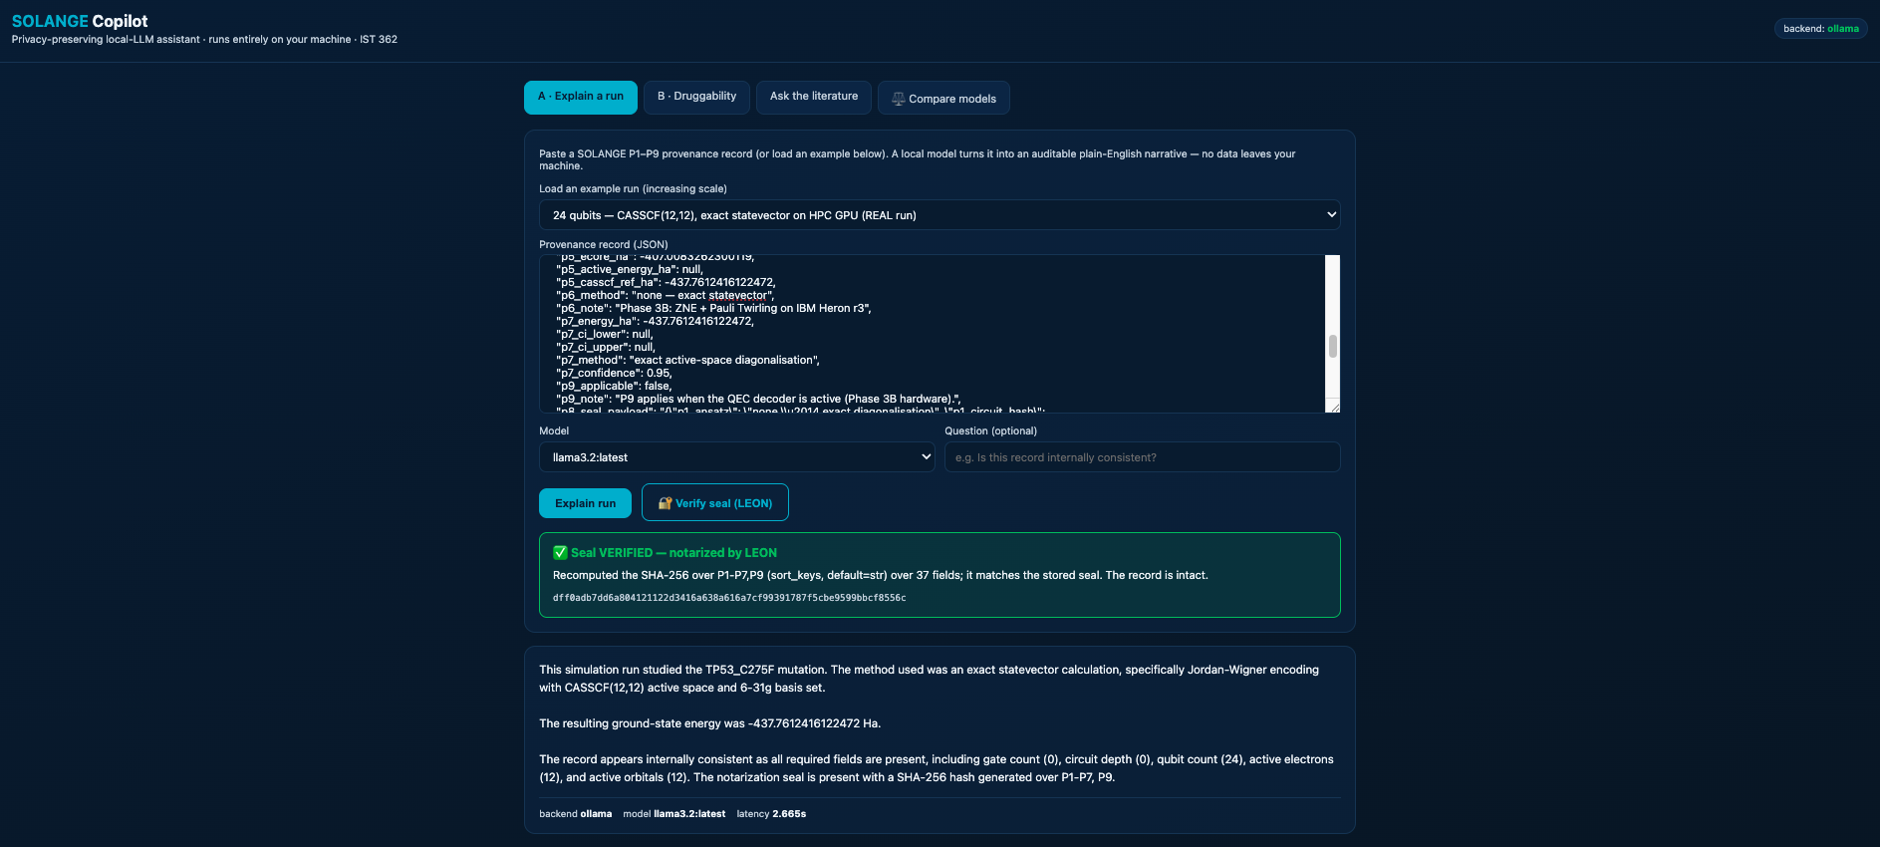
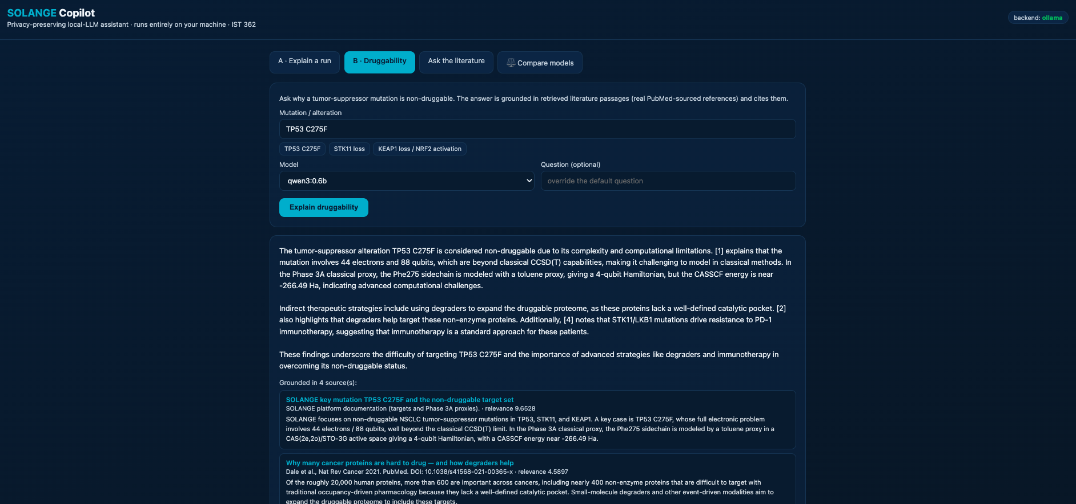
Capabilities
What it does
A
A · Explain a run
B
B · Druggability
Turns a P1-P9 provenance record into an auditable narrative and checks internal consistency.
Explains why a tumor-suppressor mutation is non-druggable - grounded in literature, with citations.
✓
LEON seal verification
⬢
Multi-scale, real runs
Recomputes the P8 SHA-256 seal locally and detects tampering - offline.
Explains real records at 4, 24, and 88 qubits - scale-agnostic.

Slide 7
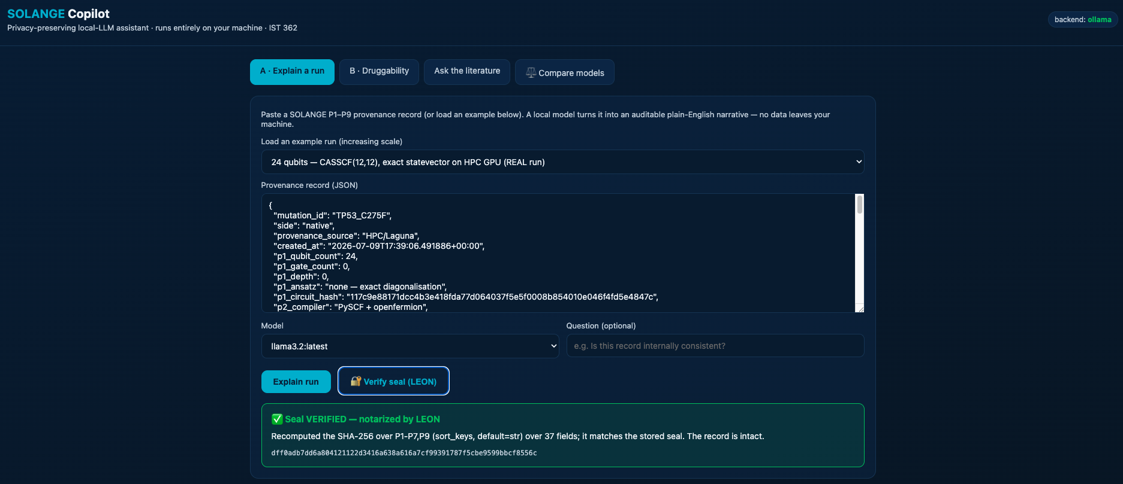
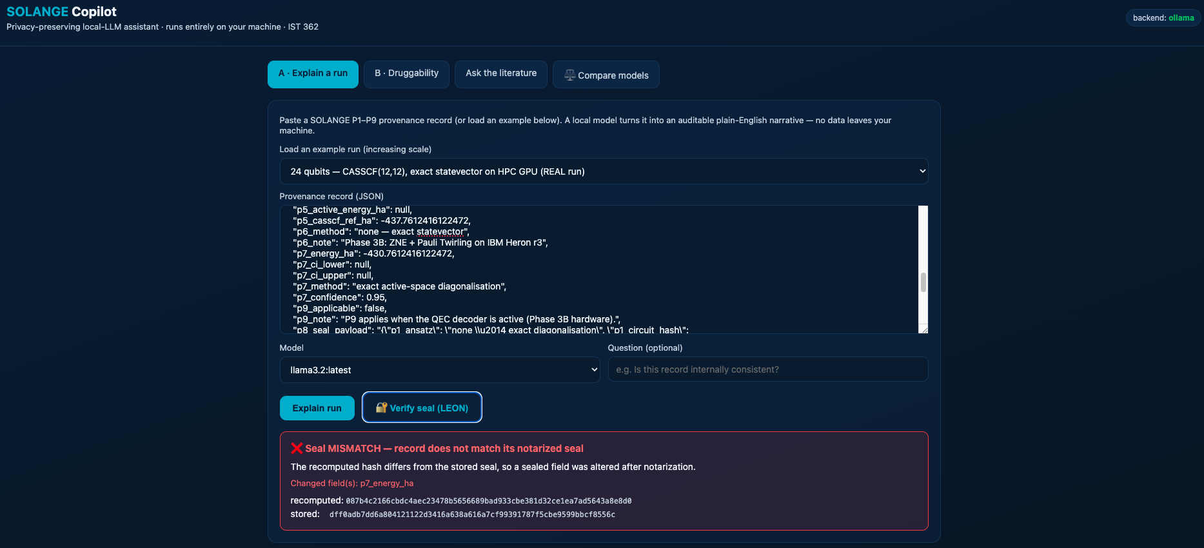
Verify, don't trust
Live seal verification – “LEON”, locally
✓
Seal VERIFIED
✗
Seal MISMATCH
Recomputed the SHA-256 seal over 37 fields. it matches the stored hash. The record is intact.
Changed one character/digit of the results - it catches the exact field. p7_energy_ha. Tamper detection, offline.
A faithful reproduction of the platform's notary - the practical embodiment of “verify, don't trust.”

Slide 8
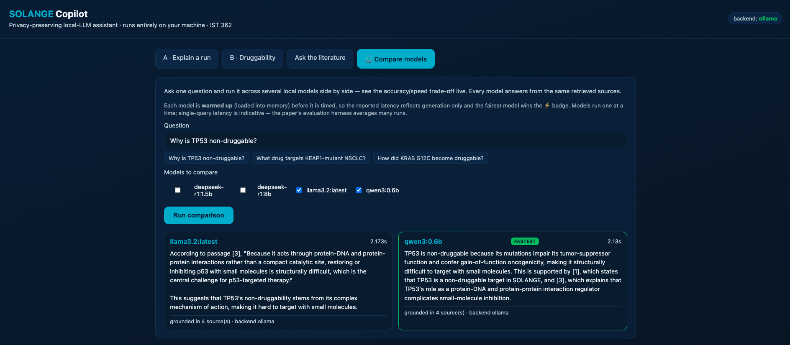
Evaluation
llama3.2 (3B) wins
Bigger isn't better
Perfect on every quality metric and the fastest - ties the 8B model at ~12× lower latency.
Retrieval > size
Enriching the corpus lifted the 0.6B model to 100% grounding.
No hallucination
Every model refused 100% of out-of-context questions.

Slide 9
Randomness · Topic 1
Temperature 0 = reproducible, at no cost
0.00
100%
+ variance
std-dev at temperature 0 - fully deterministic, bit-for-bit reproducible
refusal of out-of-context questions at every temperature tested
higher temperature adds variability with no gain in accuracy
The language-model half of the thesis: reduce randomness where it is reducible.

Slide 10
Limitations · Future
Honest limits, clear next steps
LIMITATIONS
FUTURE WORK
Small local models are weaker than frontier cloud models
Determinism buys reproducibility, not correctness
Small evaluation set - single-item flips are noise
The 88-qubit Phase 3B record is a plan, not yet run
Chain-of-custody verification across record versions
Semantic retrieval (embeddings) vs. lexical BM25
Live PubMed lookup per mutation
Larger, repeated evaluation with tighter intervals

Slide 11
Private. Reproducible. Auditable.
A capable AI assistant for quantum-oncology - running entirely on your machine.
GitHub (code + run instructions):
github.com/doron66-collab/ist362-solange-copilot
Doron Cohen · IST 362 Emerging Technologies · CGU 2026

