Slide 1



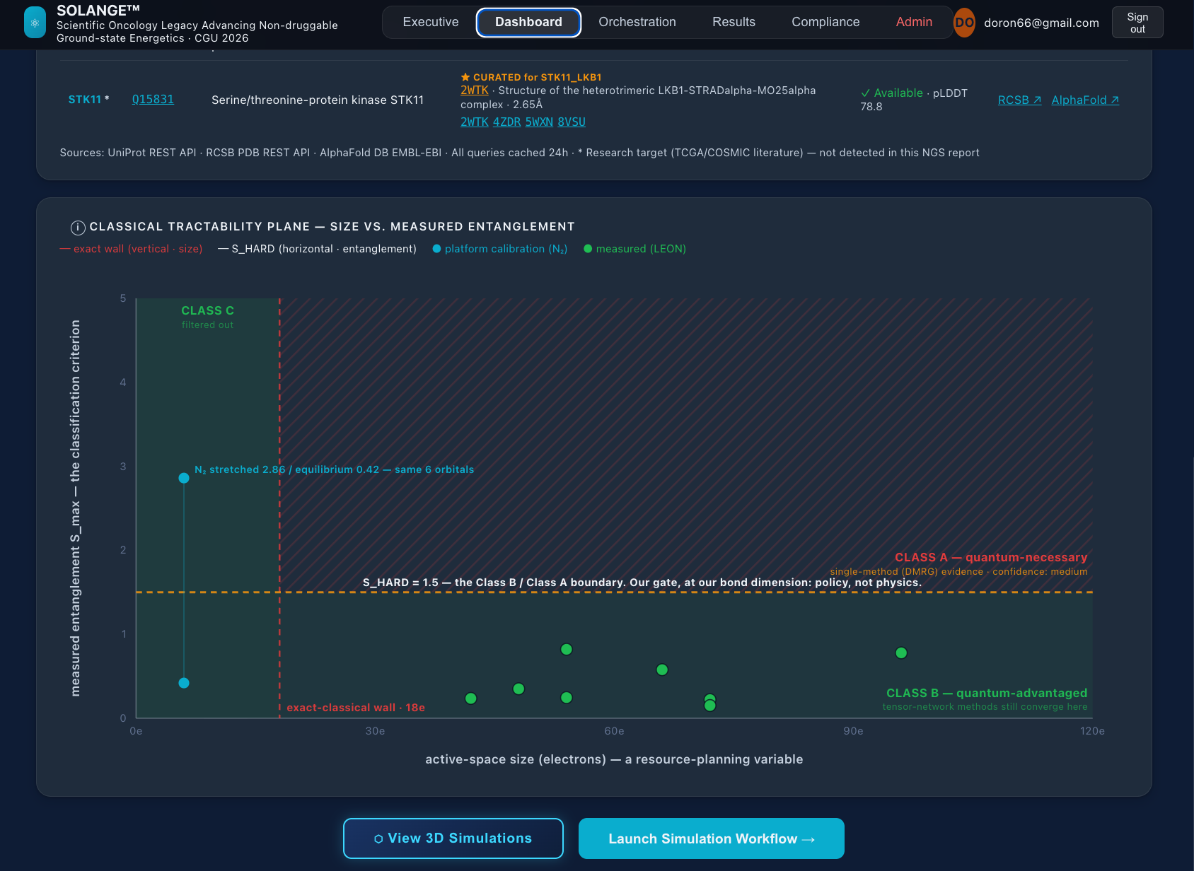
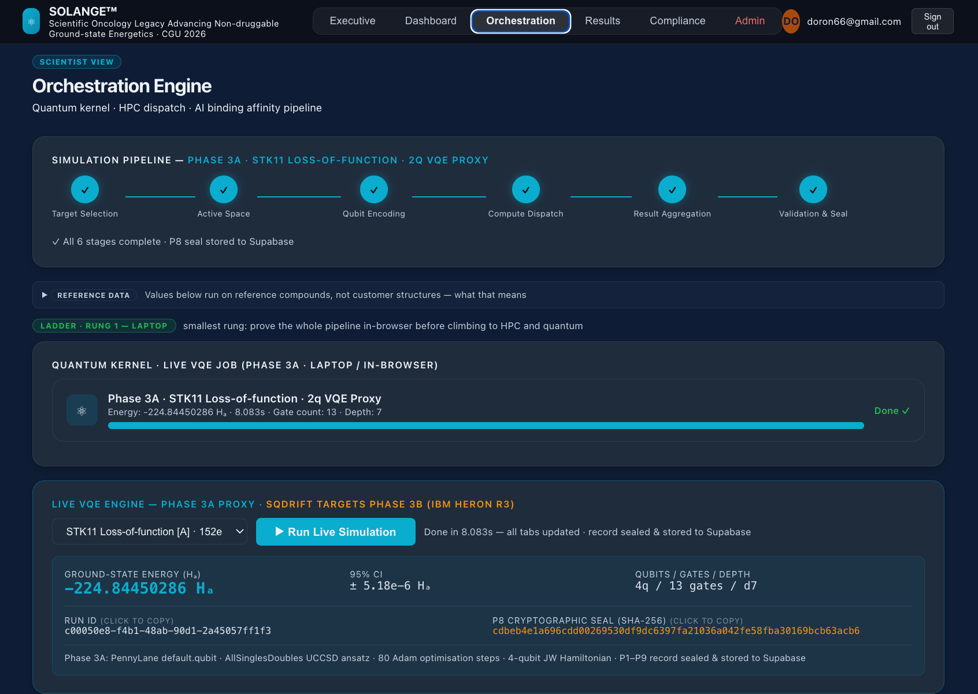
Deciding When Quantum Computation Is Warranted: A Governed Instrument for Classical-Tractability Adjudication in Non-Druggable Oncology
LIVE DISSERTATION
solange-platform.bio
A Design Science approach to translating quantum-computed molecular evidence into governed, reproducible, clinically-accessible knowledge.
Doron Cohen, Doctoral Candidate Supervised by Prof. Itamar Shabtai
THE PROBLEM
THE SOLUTION · THREE-LAYER ARCHITECTURE
THE PROTOTYPE
Non-druggable TP53 mutations exceed classical
computational chemistry.
NGS PATIENT INPUT Patient case MI25-0349 · TP53 C275F · non-druggable tumor-suppressor mutation
Live, deployed, navigable
~60% of NSCLC patients have no FDA-approved targeted therapy. TP53 structural mutants like p.Cys275Phe (C275F) disrupt the DNA-binding interface at the loop-sheet-helix region - no exploitable cavity for conventional drug design.
LAYER 3 · CONTRIBUTION (this dissertation)
BQP-relevance classification framework - non-druggable tumor-suppressor mutations
Translational orchestration - oncology-specific · Part-11-governed · bifurcation-aware
FDA 21 CFR Part 11 framework with ML-decoder provenance, P1 - P9
Live QC·AI·HPC platform on Netlify - anchored in real NGS data (MI25-0349). 3D molecular viewer · 8 DMRG-classified targets · six-screen workflow.
DFT (B3LYP): 2-4 kcal/mol error → ΔG shifts x5-6 → candidate misclassification
CCSD(T): gold standard, but O(N⁷) infeasible at 48 active electrons
FCI: O(2ⁿ) ~ 10¹³ ops at N=48 - intractable
LAYER 2 · HYBRID INTEGRATION SUBSTRATE (commodity)
8 DMRG-classified targets - TP53 C275F, R175H, G245S, R249S, R282W, KEAP1 G333C, STK11 D194N, SETD2 R1625C; all measured Class B.
Mutation-aware Hamiltonian per mutation class
P1-P9 audit-trace emission (ML-decoder lineage conditional)
Cross-disciplinary views - oncology, pharma, hospital IT
Bifurcation-aware backend (Qiskit live today · CUDA-Q-compatible for Heron r3)
HPC orchestration - pull-based agent, USC CARC 'Laguna' · no stored credentials
Active-space selection - AVAS (PySCF), RDKit-built fragments from real PDB coords
Classical-tractability classifier - block2 DMRG, ΔE<1.6 mHa convergence
Quantum execution - PennyLane VQE (3A) · IBM Heron r3 (3B)
BQP-relevance: the fermionic Hamiltonian eigenvalue problem at C275F admits a known BQP-class quantum algorithm. Real DMRG measurements on today's generic, not-yet-chemist-defined active space, classify Class B (quantum-advantaged) across every target tested. A chemist-defined setup could plausibly shift a target to Class A (quantum-necessary). The architecture is built for either outcome.
LAYER 1 · QUANTUM KERNEL (scientific anchor)
IBM Heron r3 · 156 qubits · heavy-hex lattice · improved gate/readout fidelity (IBM Quantum 2026, r3 ibm_pittsburgh)
SqDRIFT - sample-based quantum diagonalization (Trotterized, stochastic drift)
Empirical anchor: 32-electron / 100-qubit C₁₃Cl₂ benchmark (IBM Research 2026, arXiv:2603.08696)
IBM roadmap · Starling 2029: 200 logical qubits · C275F (24–56q) within trajectory
→ solange-platform.bio
LIVE DEMO · TP53 C275F QUANTUM SIMULATION
RESULTS & BENCHMARKING · QC vs DFT vs CCSD(T)
The active site - visualized,
navigable, BQP-classified.
Method comparison at
the C275F active-space boundary.
React 3D viewer:
Illustrative platform outputs:
TP53 C275F + candidate ligand (Eprenetapopt / APR-246) shown at the loop-sheet-helix DNA-contact region (illustrative)
Encircling rings: wavefunction visualization
Orange field: active-space region (illustrative)
24–56-qubit BQP target within IBM Heron r3 capacity
*DFT B3LYP: −8.4 kcal/mol (2.8 error - outside chemical accuracy)
*sqDRIFT (Phase 3B target): ≤1 kcal/mol error
*CCSD(T) reference: −11.2 kcal/mol
Benchmarking framework is itself an original IT contribution.
METHODOLOGY
THE IMPACT
Five DSR phases. Twenty months. Triangulated evaluation.
To our knowledge, first FDA 21 CFR Part 11-governed quantum-chemistry orchestration for oncology.
Phase 1 · Foundation - NGS · BQP-relevance · active-space scoping ✓ complete
Phase 2 · Architecture - Workflow spec · React/Three.js prototype ✓ complete
Phase 3A · Live Circuit - PennyLane 4-qubit live VQE + 20e/40q HPC run, both complete (LEON-sealed, Aug 2026) · PySCF JW Hamiltonian ✓ complete
Phase 3B · Heron r3 - C275F: 24–56q active site, DMRG Class B · well within Heron r3's 156q capacity · KEAP1/STK11: current-era, 32–74q, DMRG Class B · PDB-verified
Phase 4 · DSR Evaluation - 4 layers · OSF pre-registered · n=4-6 panel · Jan-Apr 2027
Phase 5 · Synthesis & Defense - May-Dec 2027
Proposed BQP-relevance classification for non-druggable oncology targets - reusable across mutation classes
Unlike quantum-enhanced approaches targeting classically-tractable proteins (e.g. KRAS — Vakili et al., Nature Biotechnology 2025), quantum necessity here is established empirically, not assumed - a DMRG classifier tests every target before any quantum claim is made, now cross-checked against an independent solver (SHCI, 0.198 mHa agreement)
Novel Part-11 compliance framework for probabilistic quantum binding data (incl. P9 ML-decoder provenance)
Bifurcation-aware orchestration - CPU and GPU (NVIDIA L40S) backends both provisioned on Laguna; GPU path proven at benchmark scale, not yet production-scale
Selective computational escalation - formal routing of subproblems to AI / HPC / QC
Architecture is the contribution. Simulation is the application. Patients are the motivation.
8
100%
56
Copyrights: ©️ Doron Cohen, May 2026, All rights reserved
C275F's largest AVAS-tested active space · within Heron r3 capacity
DMRG-classified targets, all Class B
of measured targets converged to Class B (8/8, DMRG)

