Slide 1

MEIKA
Explainable AI-Based Personal Financial Copilot for
Predictive Budgeting, Goal Forecasting, and Financial Risk Analysis
FINAL YEAR PROJECT · PHASE-I REVIEW 1
Doron Linton Prince (23CU0330010) · Kannapiran R (23CU0330020) · Baskar Adithiya S (23CU0330006)
Guide: Dr. John Aravindhar · Department of Computer Science & Engineering (AI & ML), 7th Semester
Hindustan Institute of Technology and Science · Academic Year 2026–2027 · 14 August 2026

Slide 2




INTRODUCTION
Why personal finance needs an explainable copilot
Domain
Background
FinTech + Explainable AI (XAI) — intelligent personal financial-management software for everyday users.
Managing money is a daily task for almost everyone — students, employees, freelancers, and families — yet most tools only record what already happened.
Motivation
Overview
AI-driven predictions are becoming common, but users distrust advice they can't verify. Explainability is the gap between “tracking money” and “understanding money.”
Meika pairs predictive budgeting and goal forecasting with an XAI copilot — every prediction ships with the computed factors behind it.
02

Slide 3



PROBLEM STATEMENT
Budgeting apps track the past.
They don't explain the future.
Limited prediction
No transparent reasoning
Weak goal forecasting
Limited risk analysis
Most apps log transactions and produce simple reports — they don't forecast where a user's finances are headed.
Where predictions do exist, users see an output with no explanation of how it was produced — eroding trust in AI-driven advice.
Long-term savings and goal-achievement forecasting is largely absent from mainstream expense trackers.
Overspending and cash-flow risk are rarely surfaced proactively, before they become a problem.
Why it needs solving: existing systems couple prediction with a black box, or skip prediction entirely. Meika treats explainability as a design constraint, not an add-on.
03

Slide 4


OBJECTIVES
Three to five measurable objectives
1
Predictive budgeting engine
Forecast month-end spend from live transaction history and current-month velocity, with alerts before overspending occurs.
2
Explainable Clarity Score
Compute a financial risk score from ≥ 3 auditable factors (pace, projection, concentration) — every number traceable to source data.
3
Goal forecasting
Project whether a savings or spending goal is on track, updated in real time as new expenses are logged.
4
Explainable conversational copilot
Ground every chat reply in computed XAI factors — zero fabricated figures or explanations.
5
≥ 20% functional implementation
Ship 3 live, tested REST modules (health, expense, dashboard) by the Phase-I Review 1 milestone.
04

Slide 5
EXISTING SYSTEM
What today's budgeting apps do — and don't
Current / existing method
Limitations / problems
• Manual or semi-automated expense logging, synced from linked accounts.
• Retrospective reports and charts of past spending.
• Technologies: rule-based categorization, basic ML classifiers, cloud sync, occasional robo-advisors for investment.
• Where AI predictions exist, they are shown as a bare output.
• Retrospective only — issues surface after they've already happened.
• Black-box AI recommendations reduce user trust (confirmed by Saini et al., 2025).
• No unified, real-time, cross-platform view — tools handle isolated tasks (Unde et al., 2026).
• Goal-based forecasting and proactive risk analysis are largely absent.
05

Slide 6
LITERATURE SURVEY
Ten recent papers, one consistent gap · Part 1 of 2
No.
Author & Year
Paper Title
Method / Technology
Key Finding
Limitation / Gap
1
Pathak, B. (2010)
A Survey of Comparison Shopping Agent-Based Decision Support Systems
DSS framework — data / model / interface / user-customization components
Formalizes a 4-component decision-support model reused to justify Meika's architecture
Pre-dates AI/LLM era; no treatment of explainability
2
Kakulapati et al. (2026)
AI-Powered Personal Expense Tracker
ML-based predictive expense tracking (Grenze)
Automates categorization and forecasts near-term spend
No explainability layer; predictions given without reasoning
3
Nie et al. (2024)
A Survey of Large Language Models for Financial Applications
Survey of LLM techniques, arXiv:2406.11903
Maps LLM capabilities across financial NLP tasks
Broad survey; not a deployed personal-budgeting/advisory system
4
Deepthi C G et al. (2026)
AI-Powered Finance Management Platform
ML-driven finance management platform (IEEE ICSFT)
Delivers automated insights across income/expense tracking
No transparent-reasoning layer behind the insights shown
5
Ganta et al. (2025)
An Intelligent Multi-Module Financial Assistant
Multi-module ML assistant — budgeting + risk + advisory (IEEE CSITSS)
Closest in scope: combines budgeting, risk, and advisory in one system
Outputs remain opaque — no factor-level explanation
06

Slide 7
LITERATURE SURVEY
Ten recent papers, one consistent gap · Part 2 of 2
No.
Author & Year
Paper Title
Method / Technology
Key Finding
Limitation / Gap
6
Khan, Li & Cao (2025)
Bridging Finance and AI
Conceptual review, Digital Finance (Springer)
Frames how AI methods map onto financial decision-making
Conceptual only — no forecasting or XAI implementation
7
Badiger et al. (2026)
Next.js-Powered AI Platform for Smart Expense Tracking, Budgeting & Insights
Modern web stack (Next.js) + AI insights (SSRN 6615358)
Ships a production-style tracking + insights web app
Minimal predictive risk analysis; no explainability layer
8
Unde S.P. et al. (2026)
AI-Based Real-Time Personal Finance Dashboard
CNN/OCR receipts + BERT/LSTM categorization + anomaly detection + LLM advisory (IJARP)
Unified real-time dashboard integrating 4 AI subsystems; own gap analysis confirms most tools are isolated
Complex multi-model pipeline; no explainability treatment of its own recommendations
9
Saini et al. (2025)
AI-Powered Personal Finance Management Applications
Review of ML / NLP / predictive analytics / robo-advisor techniques (IEEE WorldS4AS)
Confirms user trust rises as AI shifts “from black-boxed to transparent and explanative”
Review paper only — no prototype; directly validates the trust gap Meika targets
10
Patil et al. (2026)
Nexus Finance: AI-Powered Financial Goal Planner for Personalized Budgeting & Investment
K-Means clustering + Random Forest (91%/88% acc.) + nudge theory (IJRISS)
Strong accuracy for financial health scoring and user segmentation
No explainability treatment; forecasting (ARIMA) and bank integration left as future work
07

Slide 8
RESEARCH GAP
What's missing — and how Meika closes it
Gap in the literature
Where it shows up
How Meika addresses it
Predictions given without reasoning
Kakulapati, Deepthi C G, Ganta et al.
Clarity Score built from named, auditable factors surfaced directly in the UI
Black-box AI reduces user trust
Saini et al. (2025) survey finding
Deterministic, rule-based scoring — not a trained black-box model
Isolated, single-purpose tools
Unde S.P. et al. (2026)
One decoupled backend unifying expense, budgeting, and (planned) advisory in a single schema
Conceptual work, no forecasting shipped
Nie et al., Khan/Li/Cao
Working spending-velocity + month-end projection computed from live Postgres data today
No explainable goal-forecasting
Patil et al. (2026)
Goal-forecasting on the roadmap, held to the same explainability standard from day one
08

Slide 9

OBJECTIVES · REFINED
Objectives, re-stated against the research gap
1
Eliminate black-box outputs
100% of Clarity Score components traceable to named XAIFactor objects (closes Gaps 1–2).
2
Unify fragmented tools
One schema and service layer spanning expense tracking, budgeting, and planned price-comparison + advisory (closes Gap 3).
3
Ship working forecasting, not concept
Live spending-velocity and month-end projection computed from real Postgres data (closes Gap 4).
4
Extend to explainable goal-forecasting
Apply the same explainability standard when goal-tracking ships (closes Gap 5).
5
Demonstrate ≥ 20% functional completion
3 live, automatically-tested REST endpoints running today — shown in this review.
09

Slide 10


DATASET / INPUT
What the system runs on
Live operational data · IN USE
Seoul retail catalog · PLANNED
Source: the app's own Expense API — not a static training dataset.
Records: 7 seeded transactions across 6 categories (seed_dev_user.py), growing with real usage.
Features: title, category, amount, store, transit cost/mode, date, user_id.
Preprocessing: Pydantic schema validation, category-enum normalization, UTC timestamps, tenant isolation by user_id.
Source: Store / Product / ProductListing / PriceQuote schema, modeled and migrated.
Purpose: powers the Price-Finder / true-economic-cost comparison module.
Status: not yet seeded with real or synthetic price data — the open item for Phase 3.
10

Slide 11
PROPOSED SYSTEM
Meika, next to what it replaces
Aspect
Existing systems
Meika (proposed)
Prediction
Retrospective reports only, or opaque ML where present
Deterministic velocity + month-end projection, fully explainable
Trust / transparency
Black-box outputs
Named XAIFactor objects surfaced with every score
Goal tracking
Absent or basic
Goal-forecasting against live spend trend (roadmap)
Risk analysis
Minimal, reactive
Proactive Clarity Score with overspending alerts
Architecture
Siloed, single-purpose tools
Unified FastAPI + PostgreSQL backend, one tenant-isolated schema
11

Slide 12
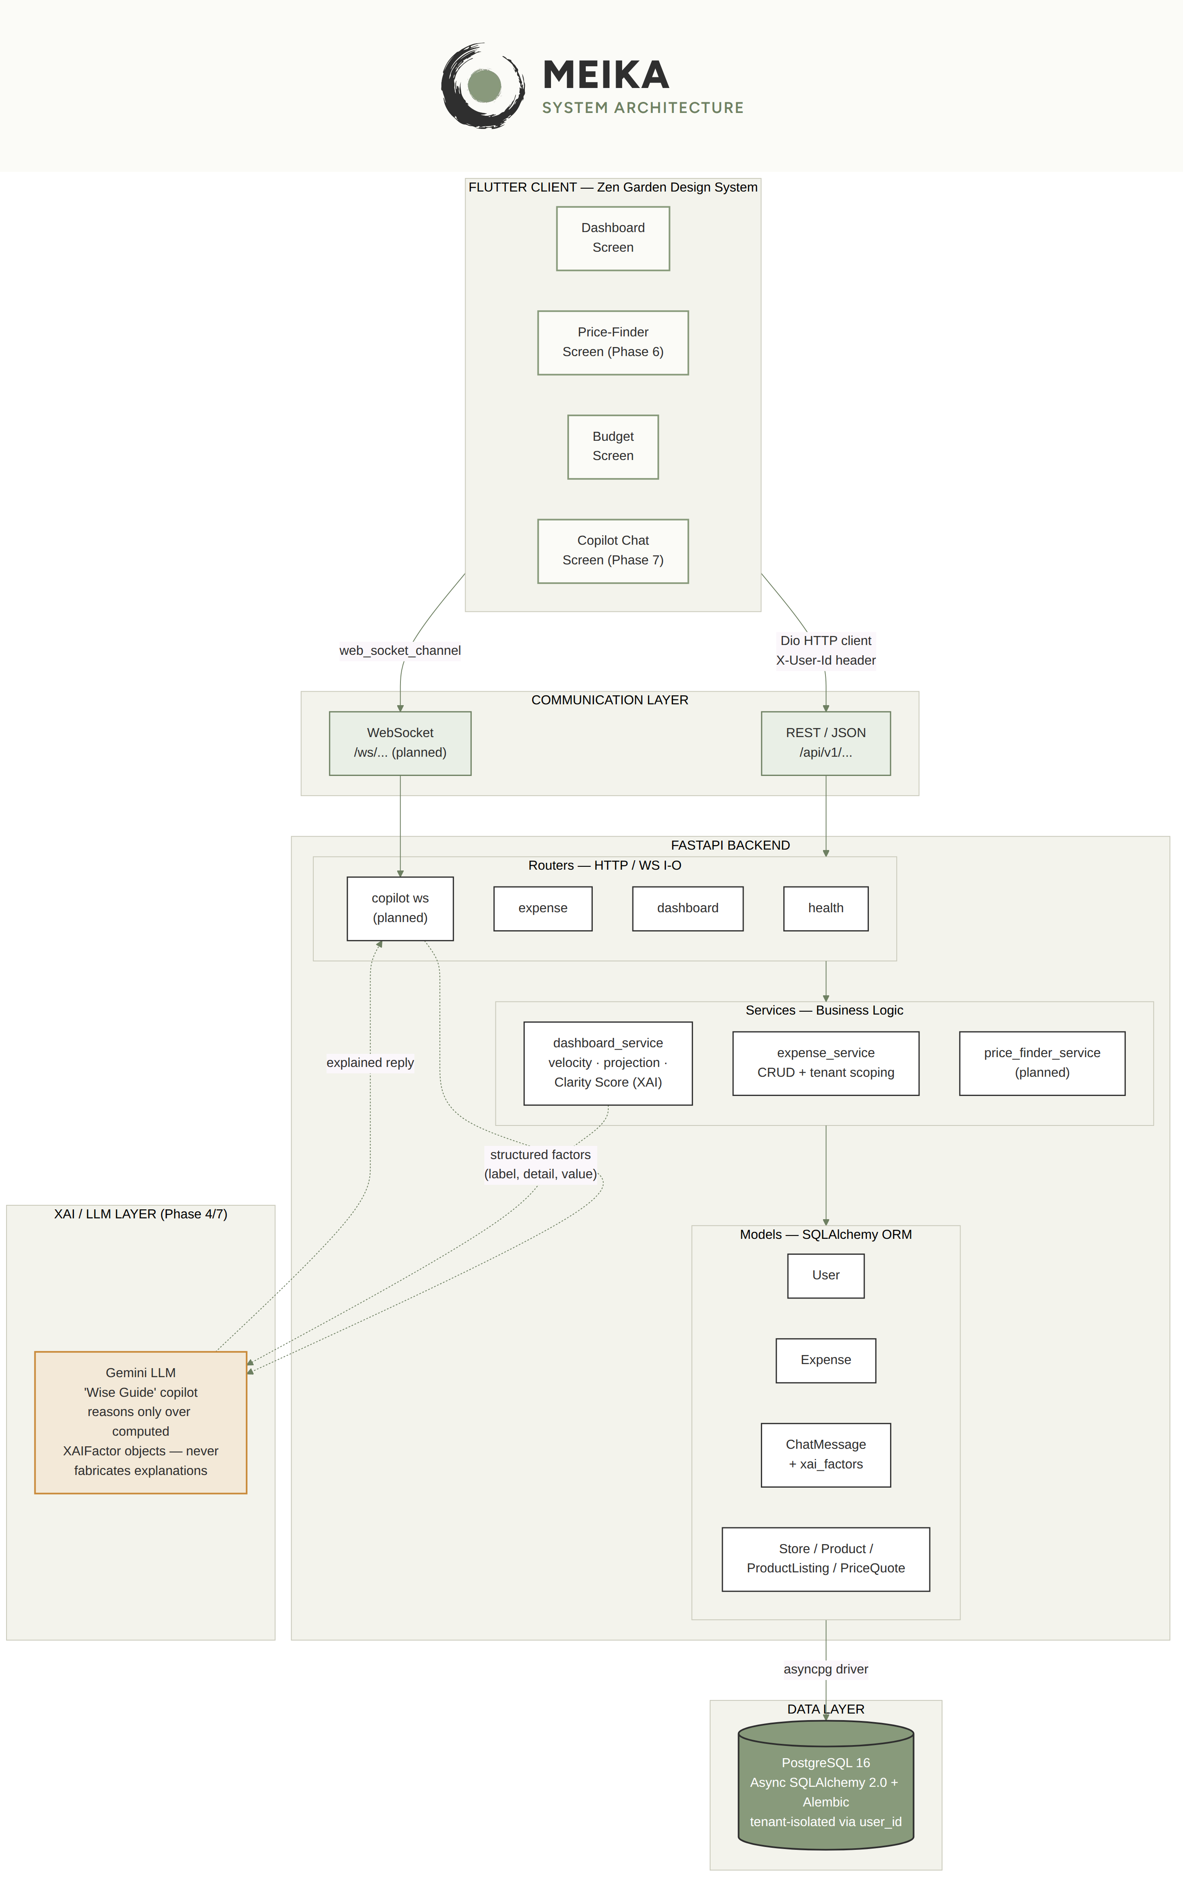
SYSTEM ARCHITECTURE
Finalized architecture
Decoupled monorepo — Flutter client, layered FastAPI backend, PostgreSQL, and a bounded Gemini reasoning layer.
12

Slide 13
METHODOLOGY
Step-by-step workflow
1
Capture
User logs an expense in the Flutter app — Dio sends it to the REST API.
2
Persist
FastAPI validates via Pydantic and writes to PostgreSQL through async SQLAlchemy, scoped to user_id.
3
Compute
dashboard_service derives spending velocity, month-end projection, and category concentration from live rows.
4
Explain
Factors are assembled into named XAIFactor objects (label, detail, value) that make up the Clarity Score.
5
Present
The Flutter UI renders the score together with its factors — never a bare number.
6
Converse (planned)
The Gemini copilot reasons only over these computed factors when answering a question — it never fabricates figures.
13

Slide 14
TECHNOLOGIES USED
Languages, frameworks, and tools
Languages
Python 3.12, Dart
Backend framework
FastAPI, Pydantic, Uvicorn (ASGI)
Frontend framework
Flutter — Riverpod state management, Dio HTTP client, custom Zen Garden design system
Database & ORM
PostgreSQL 16, SQLAlchemy 2.0 (async), Alembic migrations
AI / XAI layer
Deterministic factor-based scoring engine; Gemini LLM (planned, bounded to explanation generation only)
Testing & tooling
pytest, asyncpg, Git, Playwright (QA tooling)
Hardware / environment
Standard developer laptop + cloud-hosted PostgreSQL instance — no GPU required, no model training
14

Slide 15
PROJECT DEMONSTRATION
First module — 20% of project work
3
2
9 / 11
3
Live REST endpoints
Alembic migrations
Automated tests passing
Live XAI factors
health · expenses · dashboard
applied to a real Postgres schema
pytest, run this session
pace, projection, concentration
PHASE 1
Project scaffold
DONE
PHASE 2
DB schema, models, migrations
DONE
PHASE 3
Core backend logic (velocity, Clarity Score / Price-Finder)
PARTIAL
PHASE 4
XAI Copilot WebSocket integration
TO DO
PHASE 5
Frontend design system
DONE
PHASE 6
Dashboard & budgeting UI / Price-Finder screen
PARTIAL
PHASE 7
Copilot chat UI
TO DO
PHASE 8
Security, JWT auth, rate limiting
TO DO
Next up: seed the Price-Finder catalog, wire the Gemini copilot to the WebSocket, and replace the interim auth header with JWT.
15

Slide 16
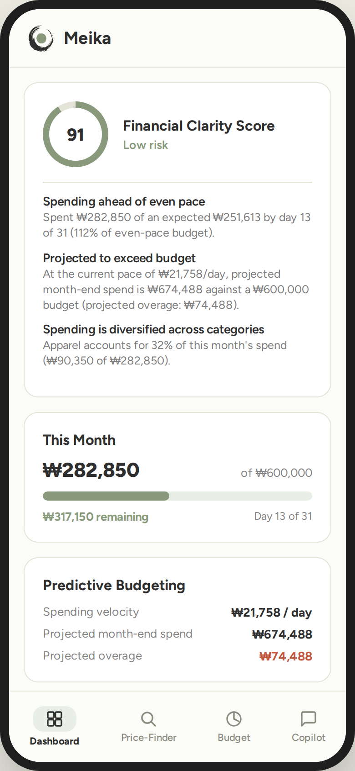
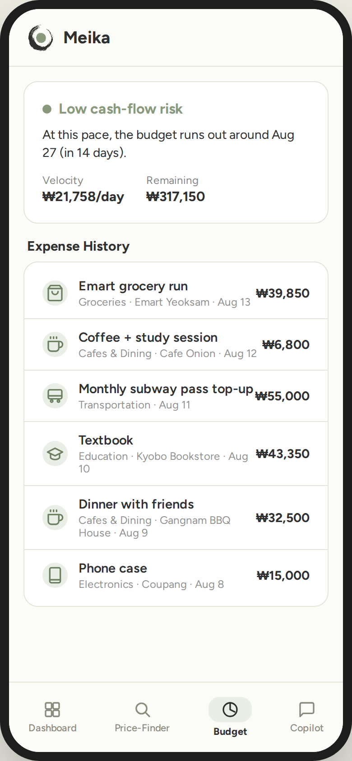
LIVE APPLICATION — REAL COMPUTED DATA
Dashboard & Budget screens
Financial Clarity Score: 91 / 100 (Low risk)
Cash-flow outlook: budget lasts to Aug 27 at current pace
16

Slide 17
JOURNAL PAPER
Soft copy for review — Introduction & Literature Survey
Meika: An Explainable AI-Based Personal Financial Copilot for Predictive
Budgeting, Goal Forecasting, and Financial Risk Analysis
Doron Linton Prince · Kannapiran R · Baskar Adithiya S — Dept. of CSE (AI & ML), Hindustan Institute of Technology and Science
IEEEtran format
Abstract
Introduction
Literature Survey
Drafted — problem, approach, and contribution in ~200 words.
Drafted — domain, motivation, and overview, matching this presentation.
Drafted — 7 references reviewed in prose form.
For the panel: the compiled soft copy (PDF) of the Introduction and Literature Survey sections will be shown on a laptop/tablet during this review.
17

Slide 18
Thank you
Questions & Discussion
Meika — Spend Savvy. Live Fully.

