Slide 1
gem5 and RISC-V
Architetture dei Sistemi di Elaborazione 2024-25
P. Bernardi, E. Sanchez
F. Angione, G. Insinga, A. Ruospo
Politecnico di Torino
Dipartimento di Automatica e Informatica

Slide 2
Outline
RISC-V
gem5 introduction
Hands-on experience
Useful links

Slide 3
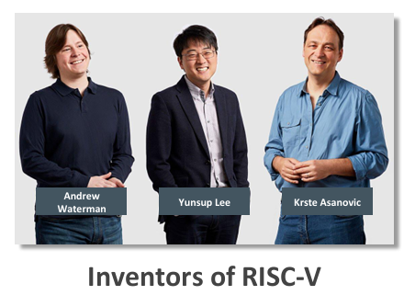

RISC-V
RISC-V is an open standard Instruction Set Architecture (ISA)
History:
RISC-V instruction set in May 2010 as part of the Parallel Computing Laboratory (Par Lab) at UC Berkeley, of which Prof. David Patterson was Director.
The first RISC-V Workshop held in January 2015, and the RISC-V Foundation launch later that year with 36 Founding Members

Slide 4
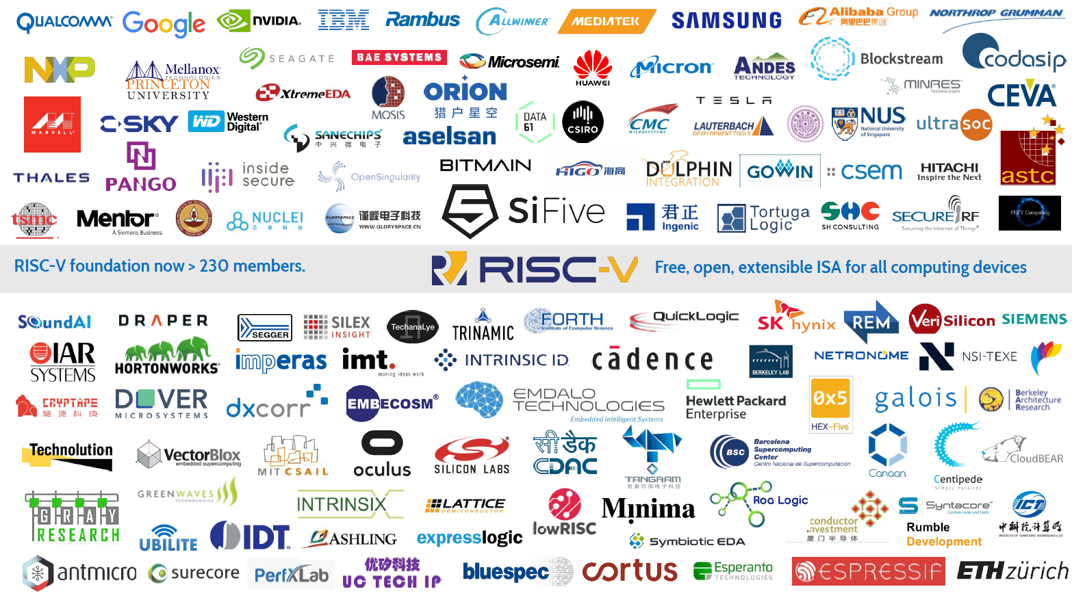
Worldwide interest

Slide 5
RISC-V
What is RISC-V?
A high-quality, license-free, royalty-free RISC ISA
Standard maintained by the non-profit RISC-V Foundation
Suitable for all types of computing systems
From Microcontrollers to Supercomputers
RISC-V is available freely under a permissive license
RISC-V is not…
A Company
A CPU implementation

Slide 6
RISC-V
The worldwide interest in RISC-V is not because it is a great new chip technology, the interest is because it is a common free and open standard to which software can be ported, and which allows anyone to freely develop their own hardware to run the software.
In 2010, when RISC-V was founded, commercial ISAs were too complex and presented IP legal issues.

Slide 7
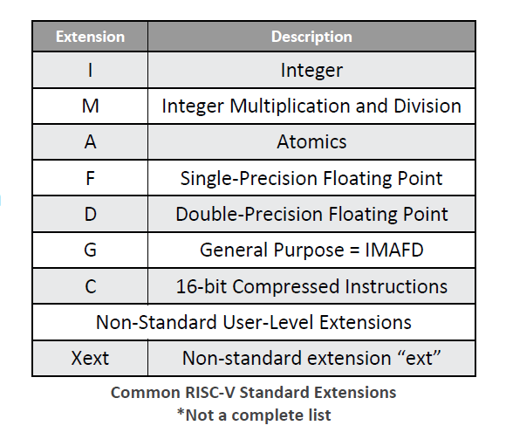
The standard extensions
RV32I – The most basic RISC-V implementation
RV32IMAC – Integer + Multiply + Atomic + Compressed
RV64GC – 64bit IMAFDC
RV64GCXext – IMAFDC + a non-standard extension

Slide 8
Outline
RISC-V
gem5 introduction
Hands-on experience
Useful links

Slide 9
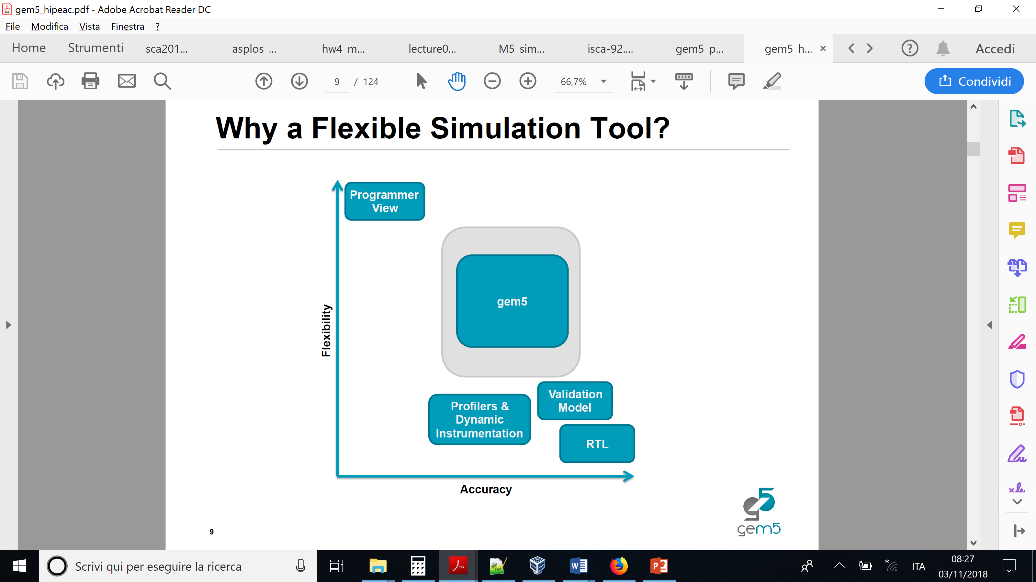
gem5
The gem5 simulator is a modular platform for computer-system architecture research, encompassing system-level architecture as well as processor microarchitecture.
gem5 is a joint project made by the union of 2 simulation tools:
Michigan m5 + Wisconsin GEMS = gem5

Slide 10
Importance of System Simulation
Complex iteration between the CPU and the memory system should be considered.
HW/SW performance verification
Need accurate performance measures
Early Architectural Exploration
Need an environment where it is fast and easy to model and connect the key architectural components
Useful for computing:
Benchmark run time, CPU performance, Interconnect latencies, DRAM controller scheduling.

Slide 11
gem5 is a flexible simulator

Slide 12
gem5 modes of operation
Full system (FS)
For booting operating systems
Models bare hardware, including devices
Interrupts, exceptions, privileged instructions, fault handlers
Syscall emulation (SE)
For running individual applications, or set of applications on MP/SMT
Models user-visible ISA plus common system calls
System calls emulated, typ. by calling host OS
Simplified address translation model, no scheduling.

Slide 13
gem5 timing
Gem5 is an event-driven discrete simulator.
The time is not continuous but discrete.
In this case the smallest unit is the tick.
Therefore, the Tick is a way for discretizing the time (again, normally continuous) on a computer and let gem5 know that the time is running.
Given this, the clock cycle is made of some ticks and this allows for event-driven programming (i.e. things to happen within the clock cycle).
Notes:
REVISAR y MEJORAR

Slide 14
gem5 timing
In our case, 1 tick expires every 1ps
1 tick = 1ps, since we have in the configuration (gem5 output): global frequency set at 1,000,000,000,000 ticks per second
https://www.gem5.org/documentation/learning_gem5/part1/gem5_stats/
Notes:
1000 ticks -> 1 clk period -> 1000 ps -> 1 ns -> 1 GHz
1 ns -> 1000 ticks -> 1 s -> 1000 * 10 ^ 9 ticks

Slide 15
gem5 capabilities
Execution modes: System-call Emulation (SE) & Full-System (FS)
ISAs: ALPHA, ARM, MIPS, Power, SPARC, x86, RISCV
CPU models: AtomicSimple, TimingSimple, InOrder, and O3
Cache coherence protocols: broadcast-based, directories, etc.
Interconnection networks: Simple & Garnet
Devices: NICs, IDE controller, etc.
Multiple systems: communicate over TCP/IP.

Slide 16
CPU models
Simple CPUs
Models Single-Thread 1 CPI Machine
Two Types: AtomicSimpleCPU and TimingSimpleCPU
Common Uses:
Fast, Functional Simulation: 2.9 million and 1.2 million instructions per second
Studies that do not require detailed CPU modeling

Slide 17
CPU models - 2
Detailed CPUs
Parameterizable Pipeline Models w/SMT support
Two Types: InOrderCPU and O3CPU
Slower than SimpleCPUs: 200K instructions per second
Models the timing for each pipeline stage
Forces both timing and execution of simulation to be accurate
Important for Coherence, I/O, Multiprocessor Studies, etc.

Slide 18
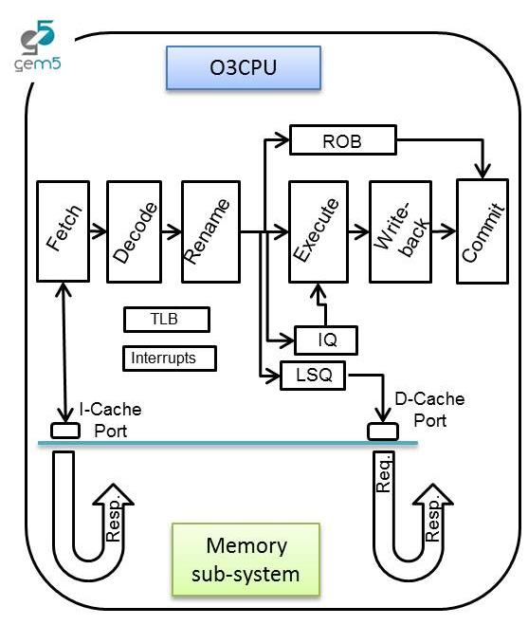
O3 CPU
Detailed Out-Of-Order CPU
Default 7-stage pipeline
Fetch, Decode, Rename, IEW, Commit
IEW <=>Issue, Execute, and Writeback
Functional units with varying latencies
Branch prediction
Memory dependence prediction.
AKA: DerivO3CPU.

Slide 19
Outline
RISC-V
gem5 introduction
Hands-on experience
Useful links

Slide 20
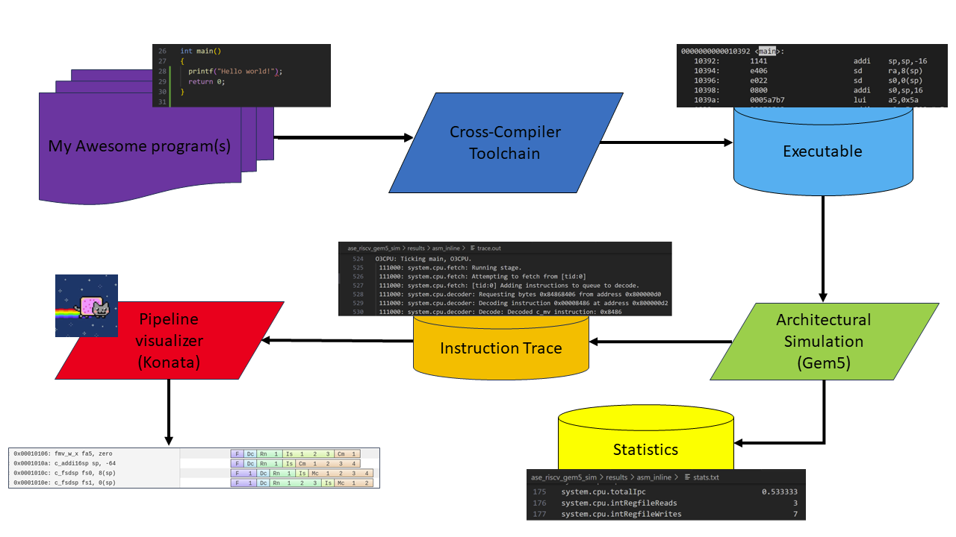

Hands-on experience

Slide 21
Useful Links
Open Source
Gem5:
https://www.gem5.org/
https://www.gem5.org/documentation/
RISC-V
https://riscv.org/
https://riscv.org/wp-content/uploads/2017/05/riscv-spec-v2.2.pdf
KONATA
https://github.com/shioyadan/Konata

