Slide 1

ML in Applications
Dipartimento di Automatica e Informatica
Politecnico di Torino, Torino, ITALY

Slide 2
Generative Adversarial Networks

Slide 3
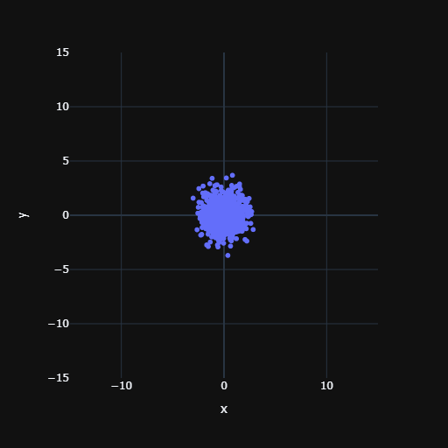
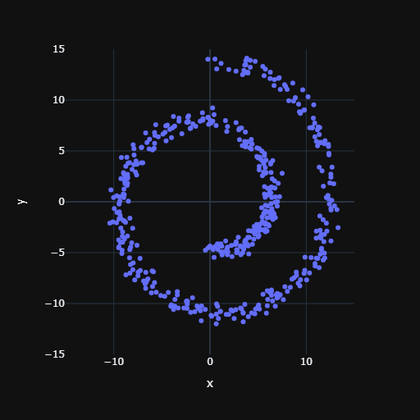
Naive
Decoder
MSE
Slide credit: L. Lazebnik

Slide 4
VAE
Decoder
MSE
Encoder
Slide credit: L. Lazebnik

Slide 5
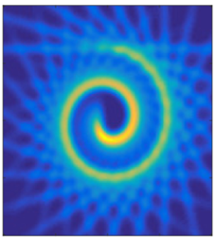
Ideal Loss Function
Decoder
Slide credit: L. Lazebnik

Slide 6
Ideal Loss Function
Easy
Decoder
MSE
Hard
Decoder
Slide credit: L. Lazebnik

Slide 7
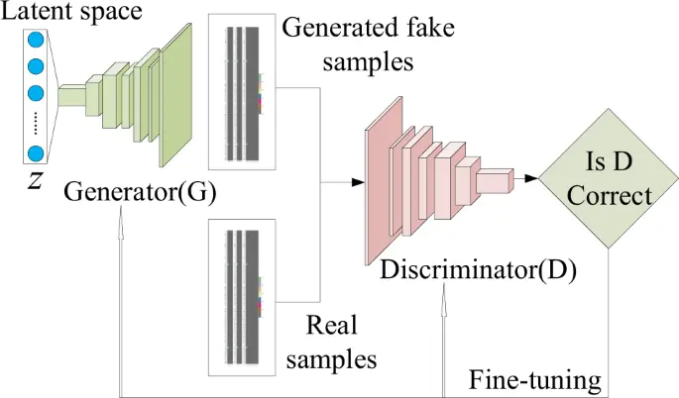
GANs
Slide credit: L. Lazebnik

Slide 8
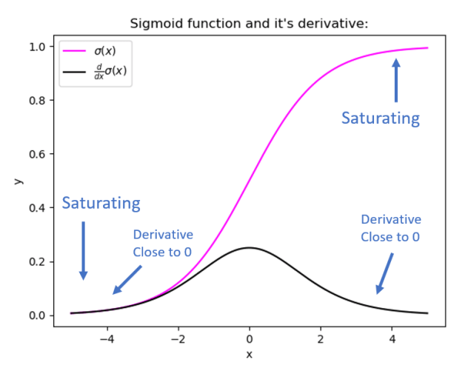
The problem with softmax
DCGAN
Slide credit: L. Lazebnik

Slide 9
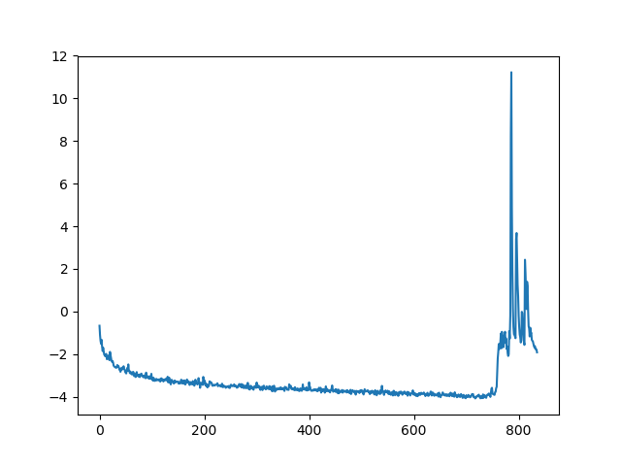
The problem with linear
WGAN
WGAN-GP
Slide credit: L. Lazebnik

Slide 10
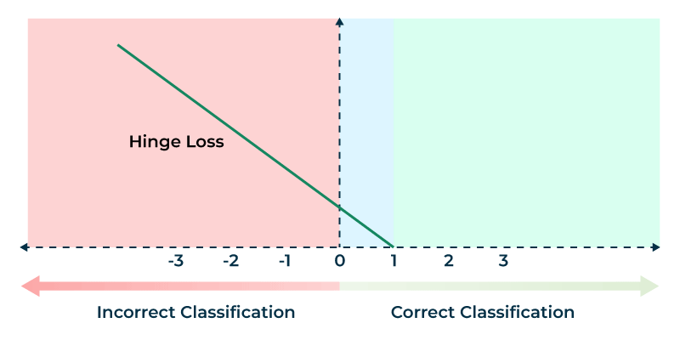
Hinge Loss
RELU(1-x)
Target value is 1
RELU(1+x)
Target value is -1
Slide credit: L. Lazebnik

Slide 11
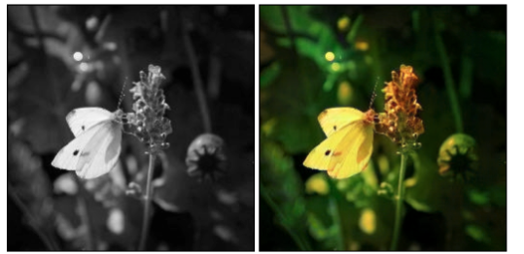
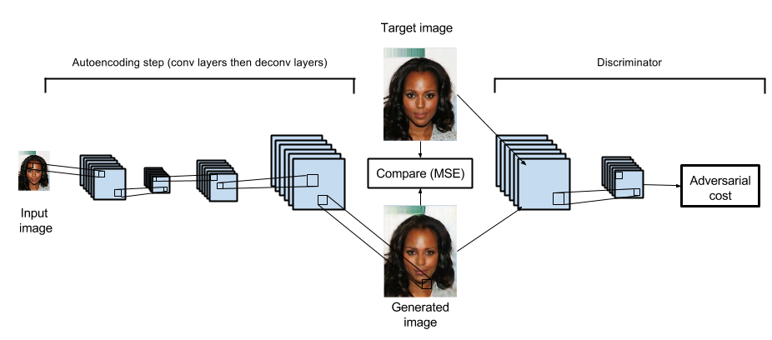
Adversarial training
From the point of view of the Generator, the Discriminator is simply a loss function
This means that the GAN loss can be used together with a traditional loss function
Examples: Paired translation (Pix2Pix)
Adversarial Autoencoder

Slide 12
Keep in mind
With x being the discriminator output, the generator uses RELU(1-x) as loss function because its aim is to have its output classified as 100% real (+1)
The discriminator uses RELU(1-x_{real})+ RELU(1+x_{generator}) as loss function, to classify real images as 100% real (+1) and generated images as 100% false (-1)
Ensure the loss function of the generator does not update the parameters of the discriminator and viceversa
One step for the generator, one step for the discriminator

Slide 13
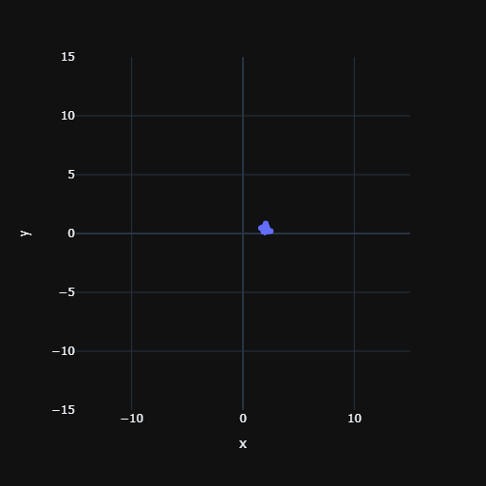
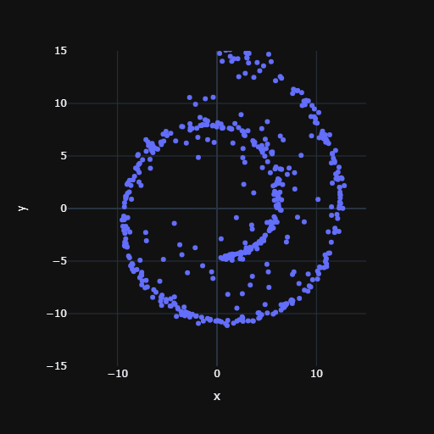
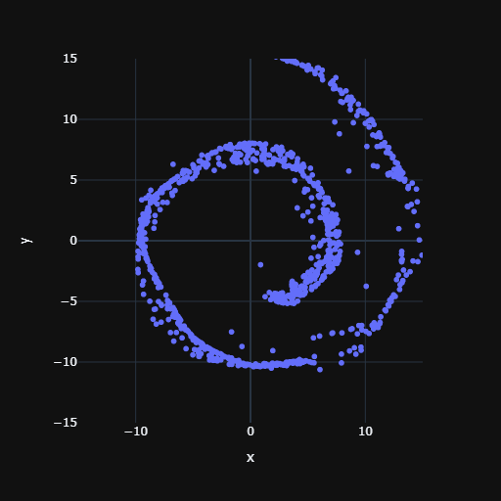
Result
Naive
VAE
GAN
Slide credit: L. Lazebnik

