Slide 1

ML in Applications
Dipartimento di Automatica e Informatica
Politecnico di Torino, Torino, ITALY

Slide 2
Introduction to Generative Models

Slide 3
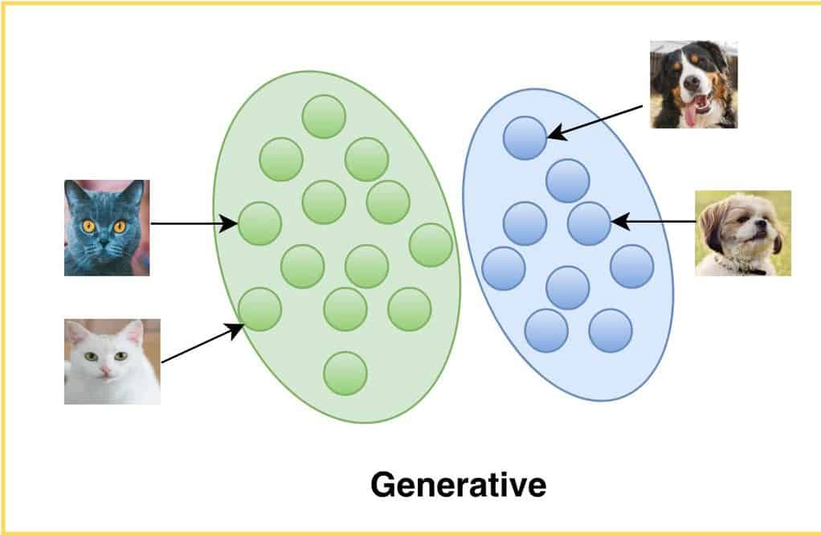
Deterministic Outputs
Generative models are models which learn to output samples which belong to a target distribution.
The target distribution can be anything, from points on a graph to images to human speech or videos
Slide credit: L. Lazebnik

Slide 4
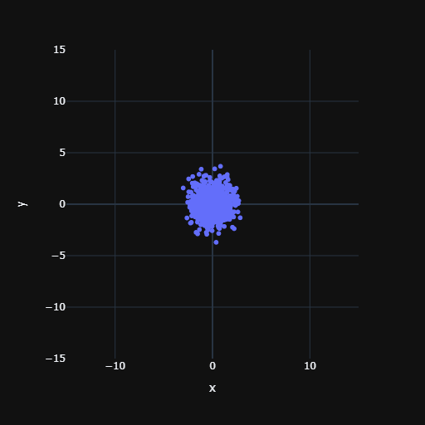
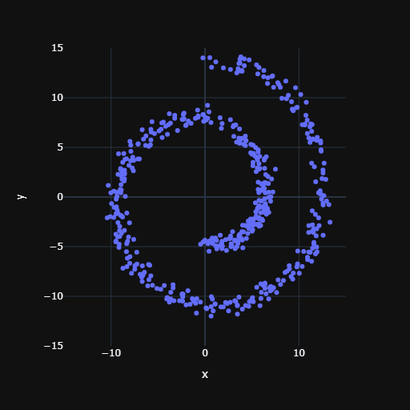
Deterministic Outputs
We don’t want the same output each time we call a model, but computers are fundamentally deterministic systems, which poses a challenge in generating diversified outputs from the same input.
We can fix this by sampling a point from a source distribution, typically a standard gaussian distribution
Slide credit: L. Lazebnik

Slide 5
Well-Posed vs. Ill-Posed Problem
In mathematics, well-posed problems are defined as problems that have a unique, correct solution for a given set of inputs. On the other hand, ill-posed problems do not satisfy these criteria, often having multiple valid solutions or no solution at all.
Traditional loss functions like cross entropy and mean square error (MSE) assume that problems are well-posed, which means they expect one correct answer. However, in generative modeling, the goal is to model a distribution, not a single outcome.
Slide credit: L. Lazebnik

Slide 6
Naive Approach
What happens if we ignore this?
We start our training by sampling a point from the target distribution. Then we sample one from the source distribution (standard gaussian) and feed it to our model.
The MSE loss function will only reward the model if it outputs the point which was sampled from the target distribution, but the model has no information about which one was sampled.
The result is that the model predicts the mean of the distribution to minimize the distance.
Slide credit: L. Lazebnik

Slide 7
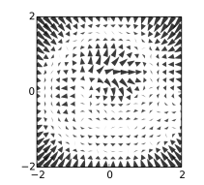
Well-Posed vs. Ill-Posed Problem
To solve this we need a loss function that can reward any sample which belongs to the target distribution. This mean being able to measure the likelihood of a generated sample being from the target distribution.
Unfortunately there is usually no mathematical function for this purpose.
Slide credit: L. Lazebnik

Slide 8
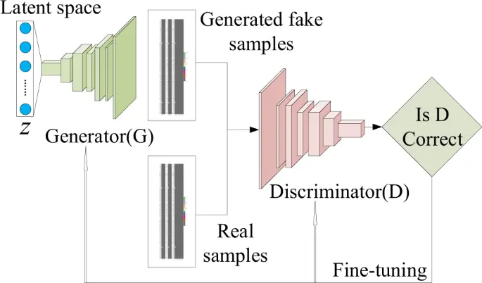
Solutions
The first solution involves creating this loss function using a second neural network which tells us how likely sample is to belong to the target distribution. This forms the basis of Generative Adversarial Networks (GANs).
Slide credit: L. Lazebnik

Slide 9
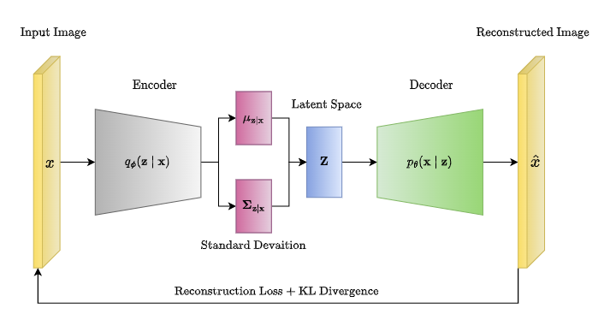
Solutions
The second approach is to reparameterize the problem so that it becomes well-posed and thus has only one correct solution, allowing the use of traditional loss functions like MSE. This is the base of Variational Autoencoders and Diffusion Models.
Slide credit: L. Lazebnik

Slide 10
Model Size
The complexity of a neural network is often indicated by its number of parameters. A higher number of parameters typically signifies greater expressive power, enabling the model to capture more intricate patterns.
The number of layers is know as depth, while the size of the activations is know as width.
In practice, models tend to perform best with about 4-30 layer, since Fully Connected layers have input x output parameters we adjust the width so we achieve our target parameter count with a depth in this range
Slide credit: L. Lazebnik

Slide 11
Model Size
Ballpark estimates
Small Models: Up to 100k parameters for fast training and iterations, work with small datasets.
Medium Models: 1M to 100M parameters to learn more complex functions
Big Models: >1B parameters, exemplify state-of-the-art commercial capabilities, require GPU clusters and 1B+ data points (Stable Diffusion, ChatGPT, etc…)
Slide credit: L. Lazebnik

Slide 12
Naive
Architecture
Block
Training Loop
2
Dense
Sample from source
64
BatchNorm
Sample from target
64
ReLU
Run model with source input
64
Compare prediction with target with loss
64
Update parameters
2
Slide credit: L. Lazebnik

Slide 13
Variational Autoencoder
Slide credit: L. Lazebnik

Slide 14
Variational Autoencoder
We force the encoder to output a normal distribution
The decoder input now contains information about the sampled point, because the encoder put it there
Problem is now well posed
We throw away the encoder and have a decoder which takes samples from a normal distribution as input and returns samples from the target distribution
Slide credit: L. Lazebnik

Slide 15
Variational Autoencoder
How do we force the encoder to output a normal distribution?
We predict mean and variance rather than a point, sample from that distribution and feed it to the decoder.
To ensure mean and variance are closer to a standard gaussian, we apply an additional term named KL Divergence
mean = latent[:,:2]
logVar = latent[:,2:]
std = exp(0.5 * logVar)
latentSample = mean + std * gaussian_noise
kl = mean**2 + EXP(logVar) - logVar
The encoder output size is 2x the input size of the decoder
Slide credit: L. Lazebnik

Slide 16
Variational Autoencoder
What’s the catch?
If the latent were perfectly gaussian, we would go back to the naive scenario
The encoder output is not a perfect gaussian distribution, as it contains information about the sample
By removing the encoder after training, we run the decoder with a distribution that’s slighly different than the one it was trained with
Result: lower generation quality compared to other methods, but easy and fast training and well behaved latent space
Slide credit: L. Lazebnik

Slide 17
The dataset
def swissRoll(samples=1024, noise=0.5):
t = 1.5 * 3.14 * (1 + 2 * tf.random.uniform((samples, 1)))
x = t * tf.math.cos(t)
y = t * tf.math.sin(t)
X = tf.concat([x, y], axis=1)
if noise > 0:
X += noise * tf.random.normal(shape=(samples, 2))
return X
Slide credit: L. Lazebnik

Slide 18
Suggested Hyperparameters
1024 batch size
1000 steps
Adam optimizer with 10^-3 learning rate
Less than 20k parameters
Slide credit: L. Lazebnik

