Slide 1

ML in Applications
Dipartimento di Automatica e Informatica
Politecnico di Torino, Torino, ITALY

Slide 2
Anomaly Detection

Slide 3
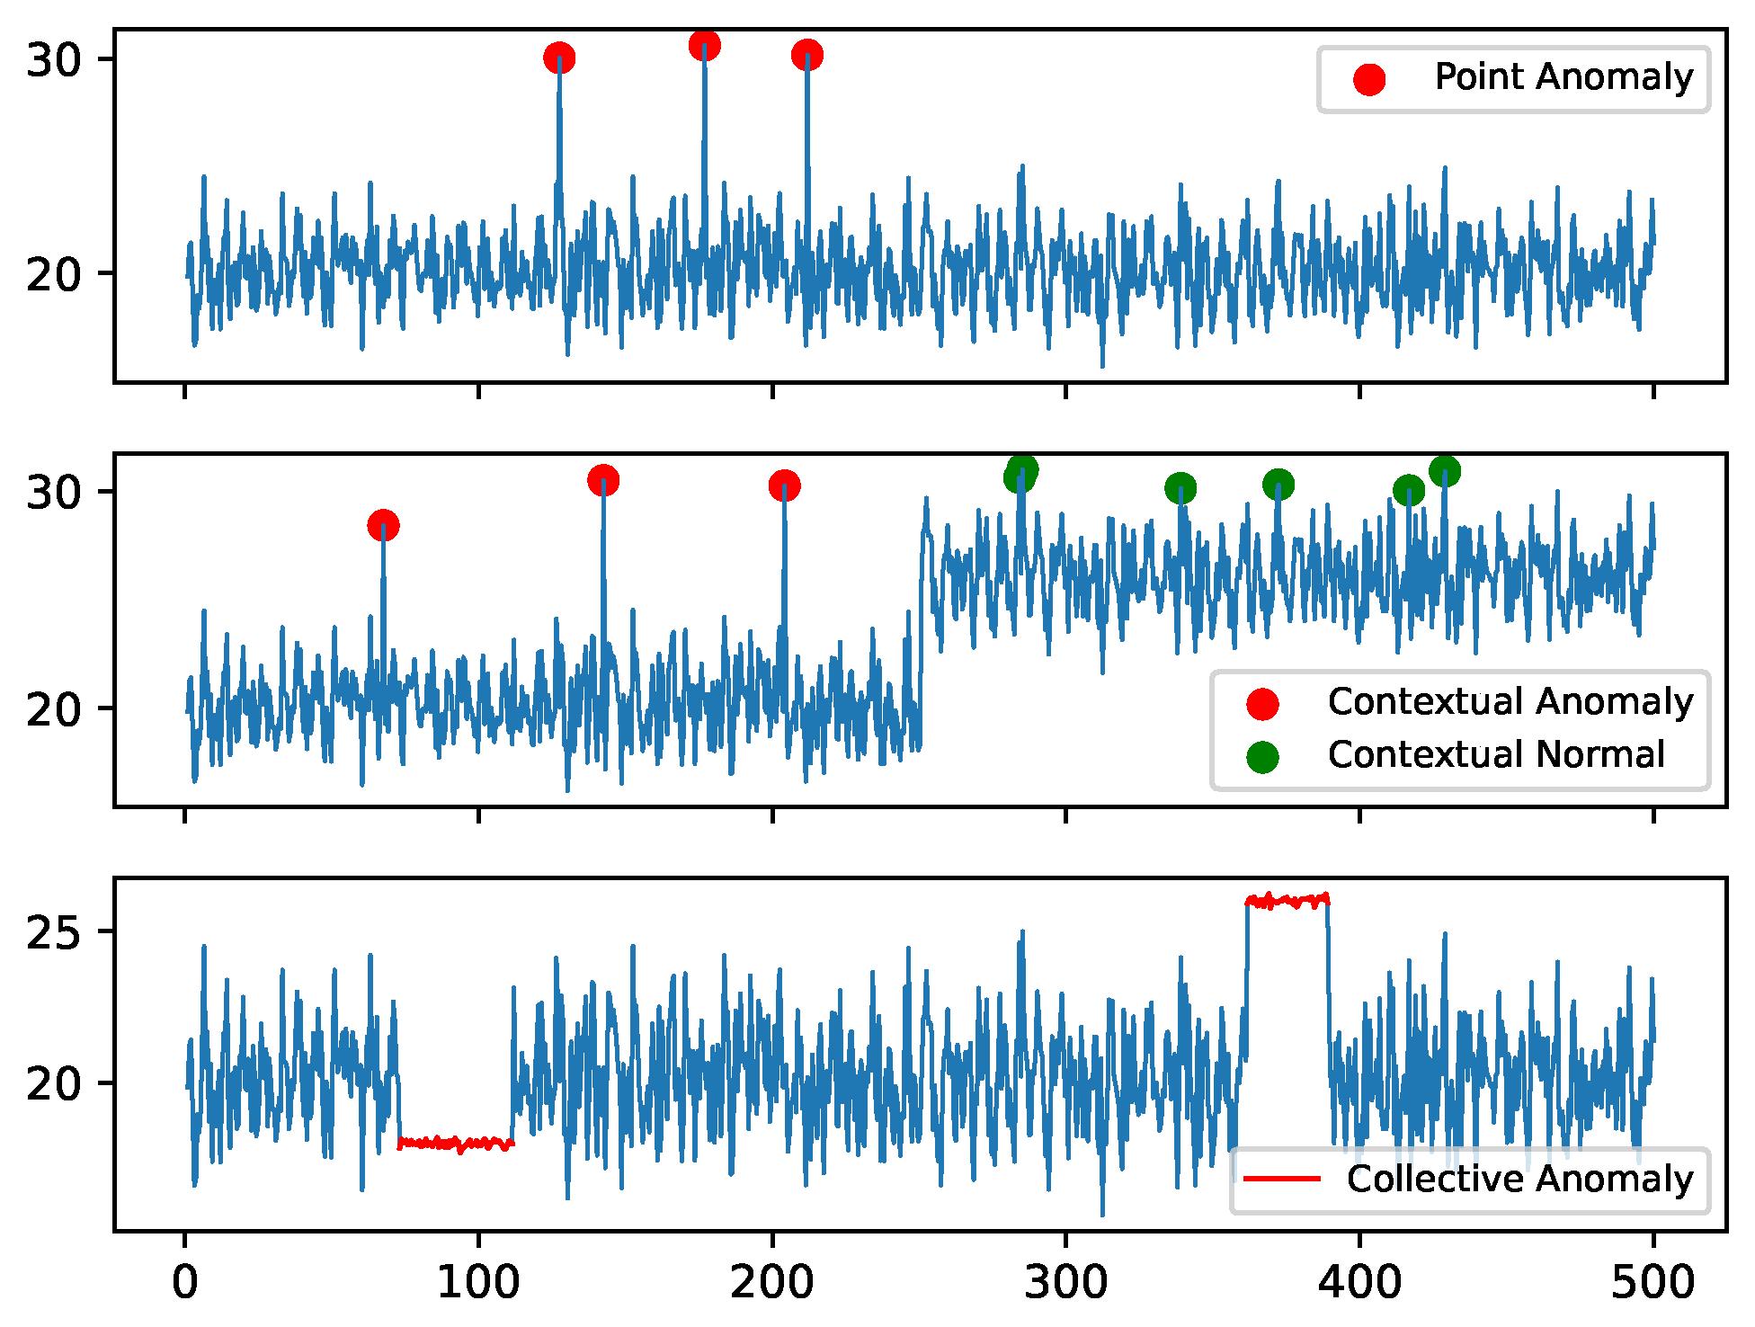
Anomaly Detection
When building a classifier, you are creating a network that Is able to discern whether the data belongs to a certain distribution. Sometimes though, for example when monitoring a production line, you may want to create a system that learns the normal pattern of operation and detects any deviation.

Slide 4
Anomaly Detection
This problem is surprisingly more complex than what it may initially appear. If we only have normal data, then we have to effectively train a classifier with only data from one class.
There are many approaches, and this is currently an unsolved problem

Slide 5
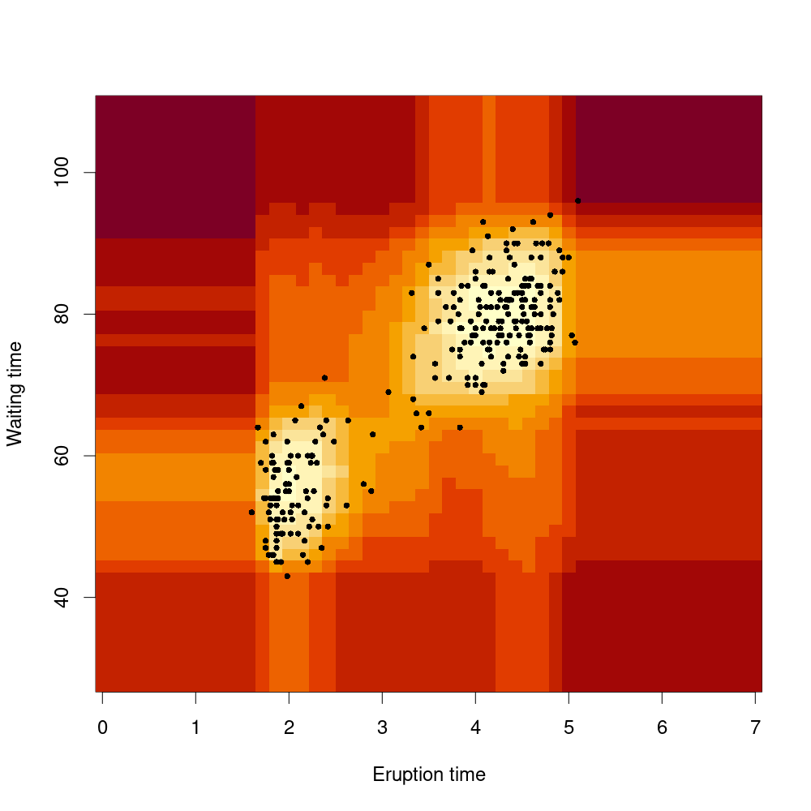
Non Deep Learning
Sometimes it’s worth trying machine learning techniques such as local outlier factor and isolation forests for simpler tasks like tabular data, since they only take a few minutes to setup and train and often excel at this type of task.

Slide 6

Reconstruction Based
The most common deep learning base approach is reconstruction based. This approach leverages the phenomenon where neural networks tend to perform better in inference when given data with a distribution similar to the training data distribution.
You may have experienced this when generating data using a VAE

Slide 7
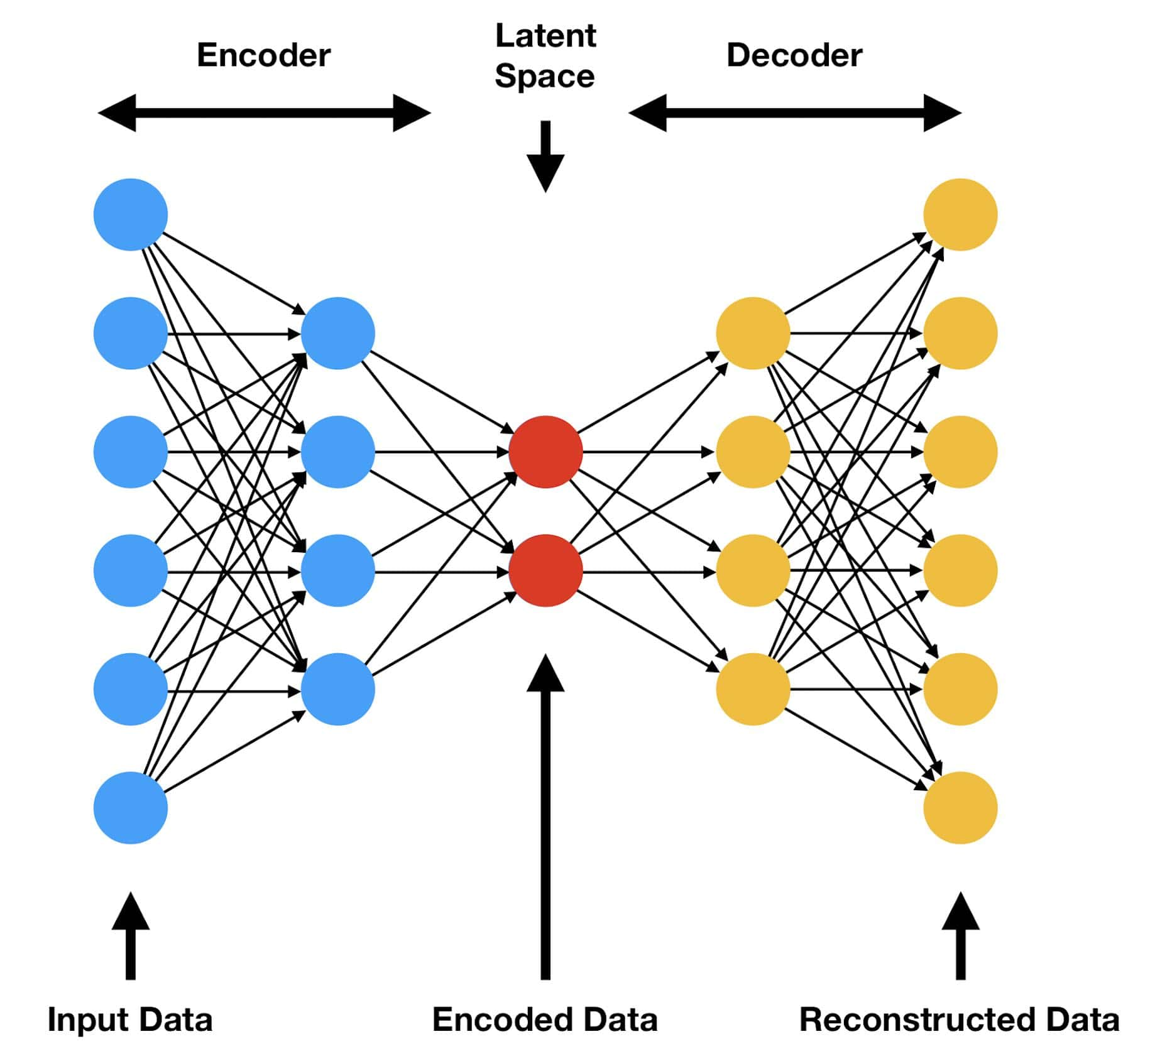
Reconstruction Based
Autoencoders are the perfect candidate for this, as they require no labels to train.
We can train the autoencoder on the normal data, and measure the reconstruction error during inference.
Due to this phenomenon, it will perform worse as the inference distribution strays further away from the training distribution

Slide 8
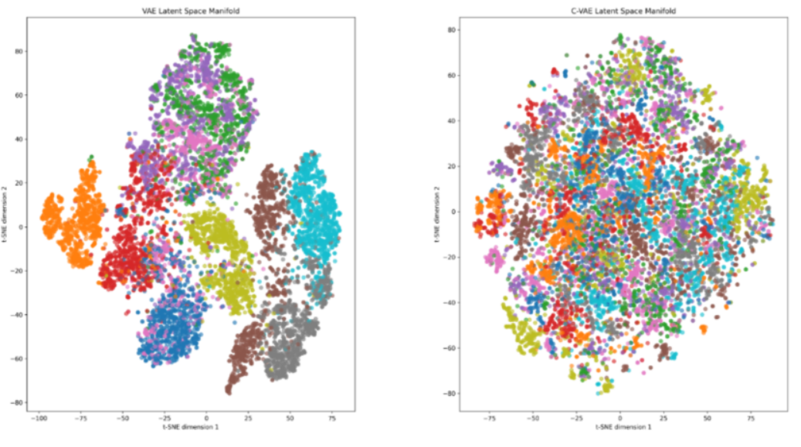
Reconstruction Based

Slide 9
Anomaly Detection Lab
You have been hired by a company to develop a tool that can identify anomalies in their robot through the sensor measurements
Problem: There are only 4 recorded anomalies, no annotations
Build a reconstruction based anomaly detection model
Train it on normal data and see if you are able to find something in the anomalous run of the robot

