Slide 1

ML in Applications
Dipartimento di Automatica e Informatica
Politecnico di Torino, Torino, ITALY

Slide 2
Diffusion Models

Slide 3

Diffusion Models
Like the VAE, it’s a way to reparametrize the generation problem as only having one solution, allowing the use of MSE as loss function

Slide 4
Diffusion Models
It does this by dividing the inference process into many tiny steps

Slide 5
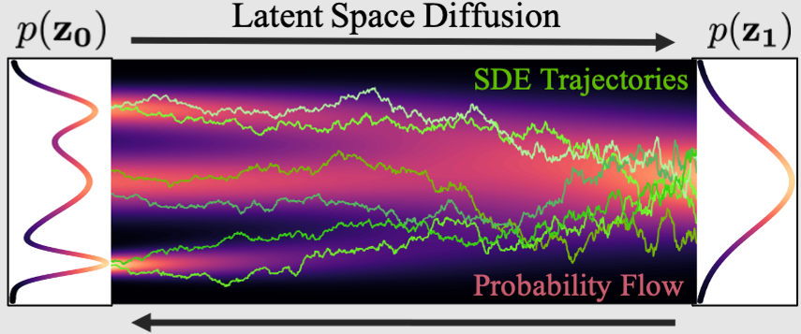
Diffusion Models
It does this by dividing the inference process into many tiny steps

Slide 6
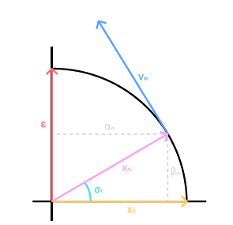
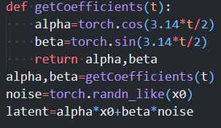
V Diffusion - Forward
We’re going to use v-diffusion
In v-diffusion the noising process is done on a circle, to ensure constant power through the whole process

Slide 7
V Diffusion - Backward
Forward (random t)
Sample+Noise
Real Sample
Model Prediction
MSE
Predicted Sample
We sample a random t, and perform the forward step
A point is sampled from the target distribution
The model tries to predict the sampled point from the target distribution
The loss function is once again MSE

Slide 8
V Diffusion - Inference
Prediction
0,8
0,6
0,4
0,2
Noise
Generating new samples works differently from training
We pick a number of steps, then we slowly transform the source distribution into the target

Slide 9
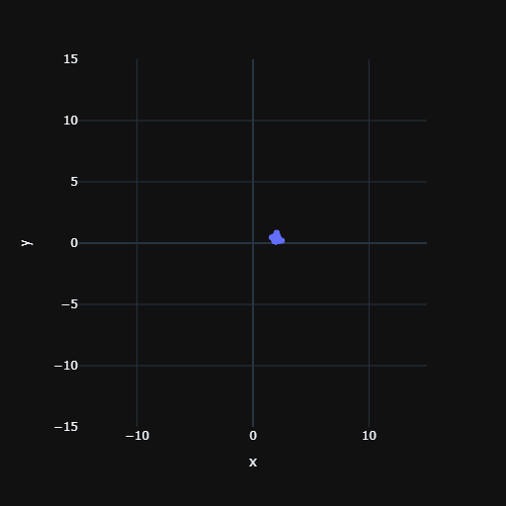
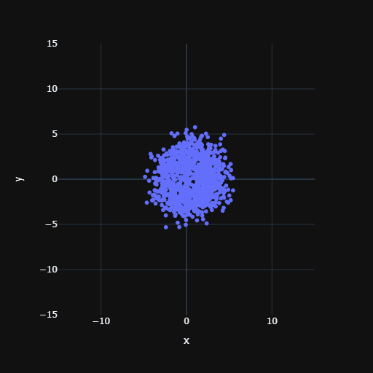
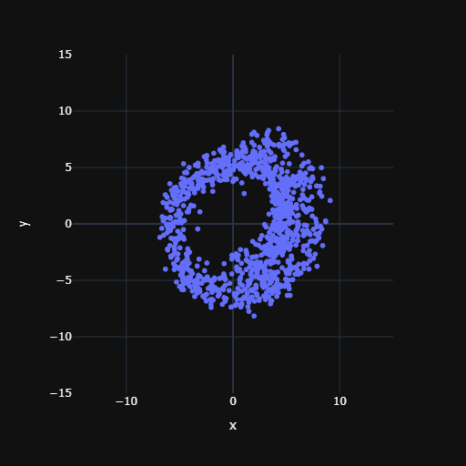
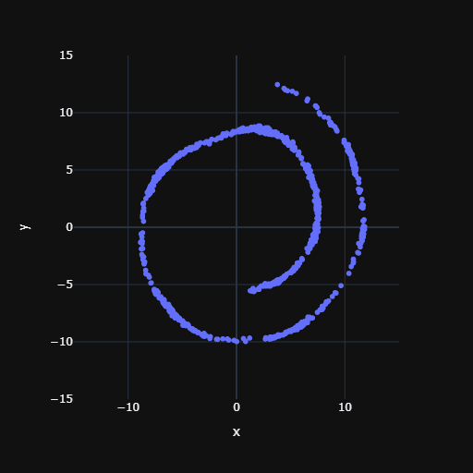
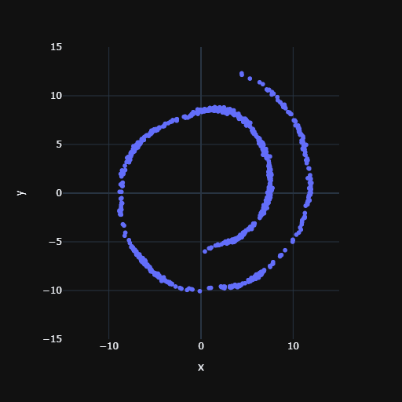
Result
1 step
5 steps
10 steps
20 steps
100 steps
Slide credit: L. Lazebnik

