Slide 1
Working Memory Analysis
Ashley Chang, Simo Chen, Huiwen Duan, Sidong Wang, Shangshang Wang
Stats 141SL
Spring 2019

Slide 2
Overview of Questions
Predict the relationship between cognitive ability with demographics (5), fMRI (7) and MRI (17) data (220 observations).
Build a model using only controls (subjects with no mental diseases) to predict cognitive ability on patients with mental diseases.
Explore other relationships within the data set.

Slide 3
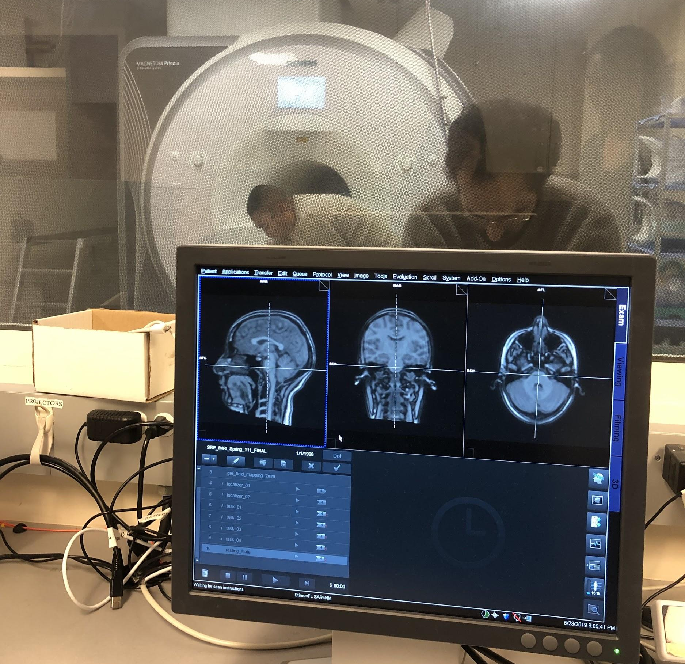
Background
Working Memory
Cognitive system with a limited capacity that is responsible for temporarily holding information available for processing.
Important for reasoning and the guidance of decision-making and behavior.
fMRI vs MRI
MRI image anatomical structure. Brain MRI renders a clear picture of brain; it shows a clear picture of brain construction.
fMRI image metabolic functions. Its results are useful in analyzing connectivities and functions of different brain areas.

Slide 4
Exploratory Data Analysis
1. Sample Structure
2. Predictor Variables
3. Response Variables

Slide 5
Exploratory Data Analysis - Sample Structure
In the CNP dataset, we have individuals in four different categories:
Controls
ADHD
Schizophrenia (SZ)
Bipolar Disorder
First we want to see the distribution of sample across the four categories and with respect to different demographic variables.

Slide 6
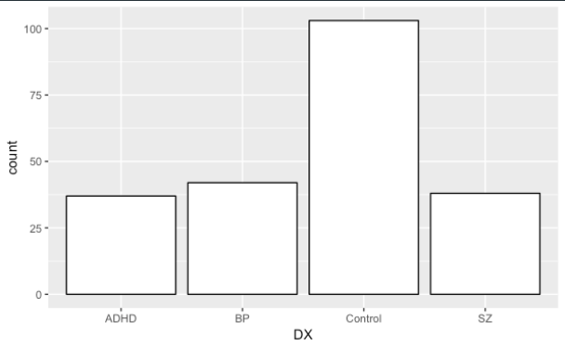
Exploratory Data Analysis - Sample Structure
Entire Sample
The data is unbalanced in terms of Control group and Patient group (ADHD, BP and SZ), as there are far more samples in Control group.
This kind of unbalanced distribution remind us of possible insignificance in our model.
We will talk about adjustments that we want to make in the future regarding the unbalanced dataset sample.

Slide 7
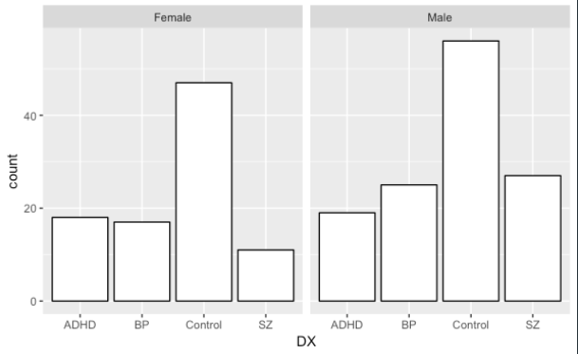
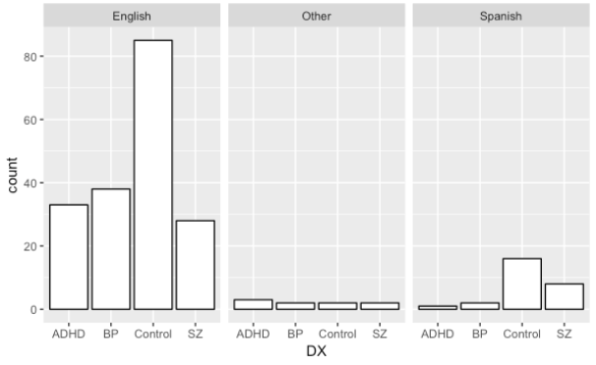
Exploratory Data Analysis - Predictor variables
Gender
Language
Slightly unbalanced in groups BP, Control and SZ
Unbalanced but approximately representative.
In LA, around 67% speaks English, 30% of people speaks Spanish and 3% of people speaks other languages
We consider Language as one of the irrelevant variables in the initial analysis

Slide 8
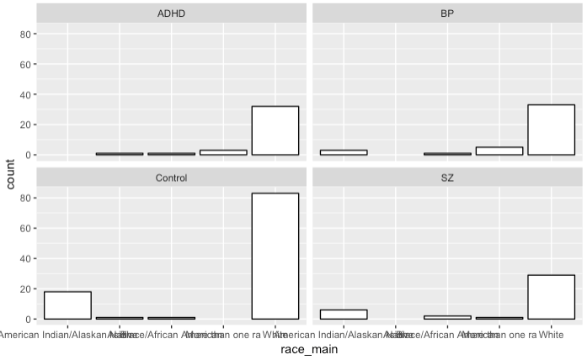
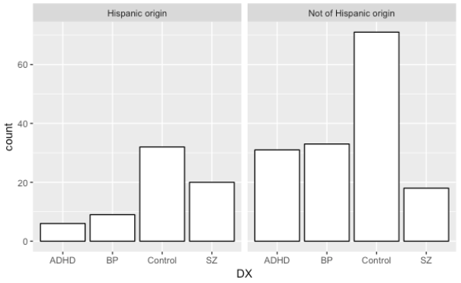
Exploratory Data Analysis - Predictor variables
Race
Ethnicity
American-Indian/Alaskan Black/African American More-than-one-ra
Native Asian White
More non-hispanic origin in groups except for SZ.
We want to study if this difference is caused by the unbalanced dataset or the difference between ethnicity using future data.

Slide 9
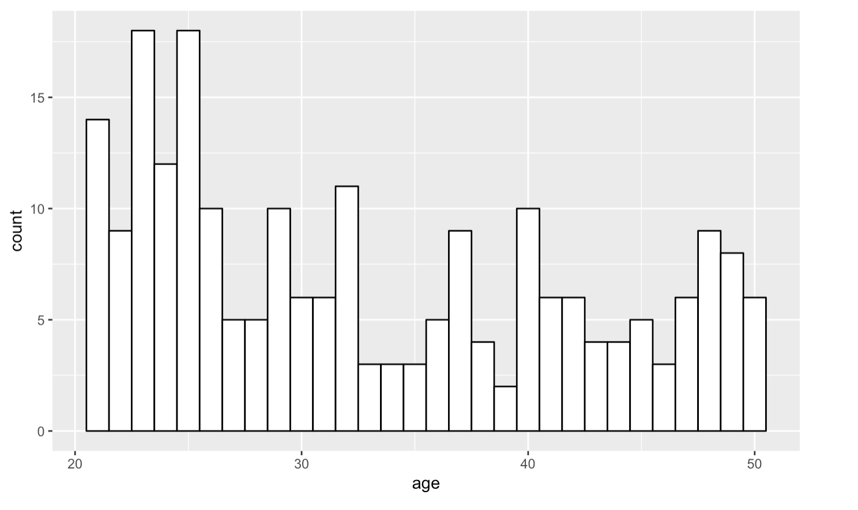
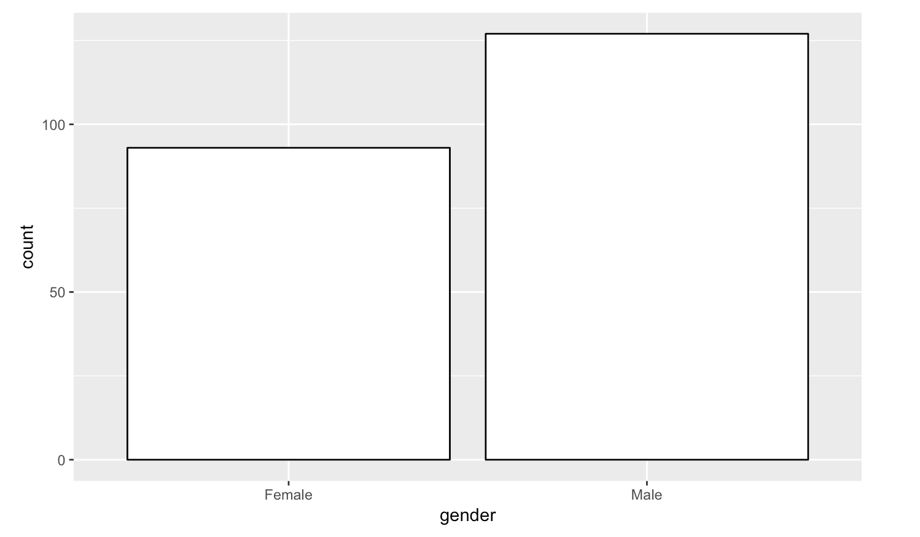
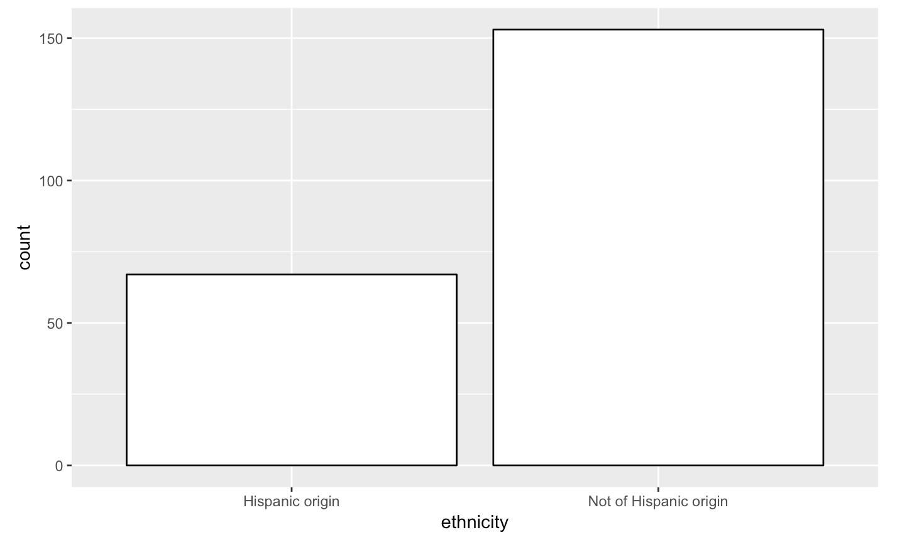
Exploratory Data Analysis - Predictor variables
Age
Gender
Ethnicity
Subject’s age ranges from 21 to 50.
93 Female subjects and 127 Male subjects.
67 Hispanic subjects and 153 Non-hispanic subjects.

Slide 10
Exploratory Data Analysis - Response Variables
Verbal Working Memory (WM) - the retention and manipulation of verbal information
Spatial Working Memory (WM) - the retention and manipulation of visuospatial information
Response - time spent on a task

Slide 11
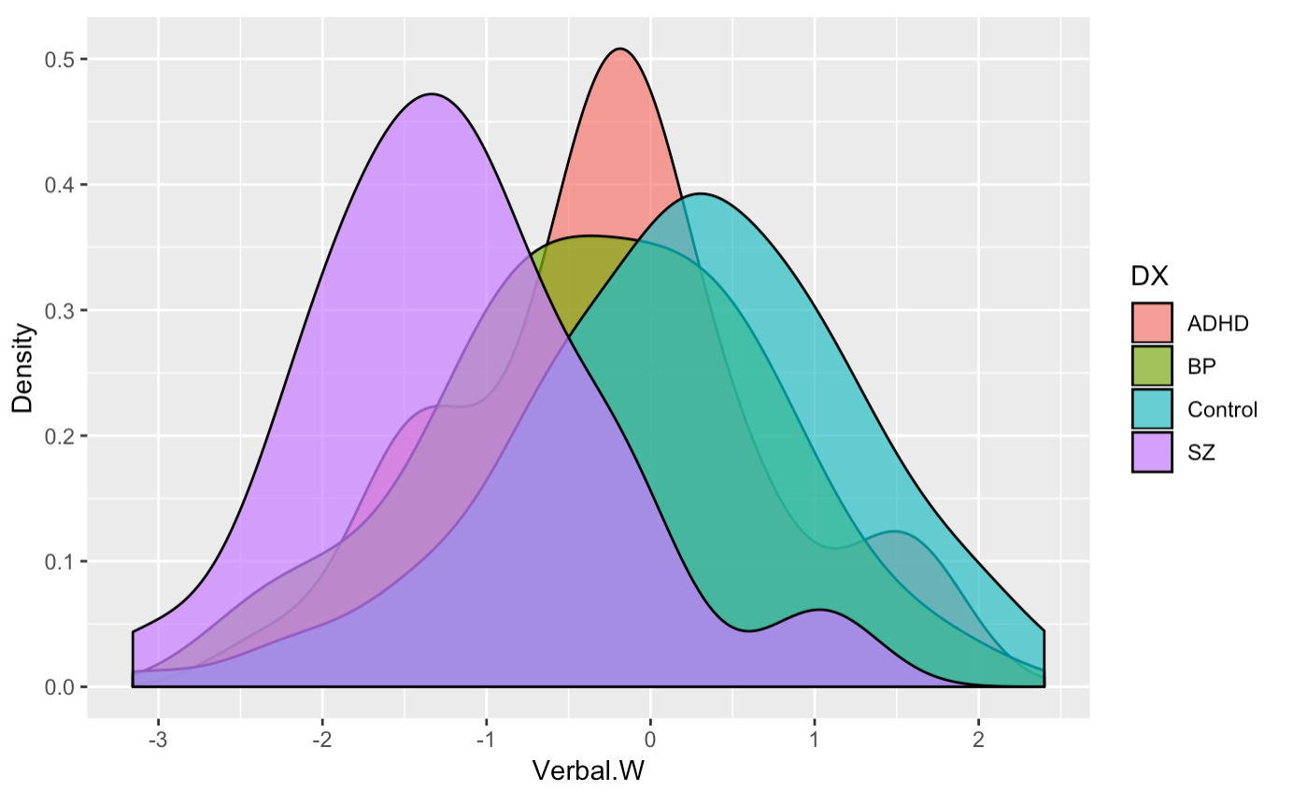
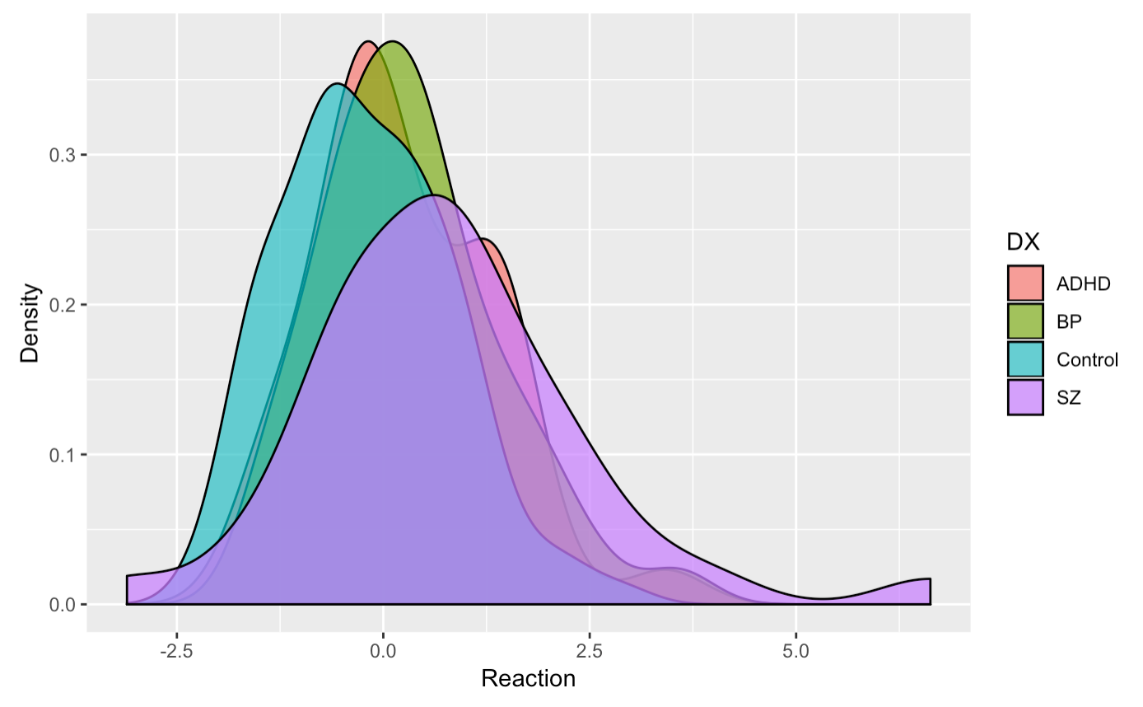
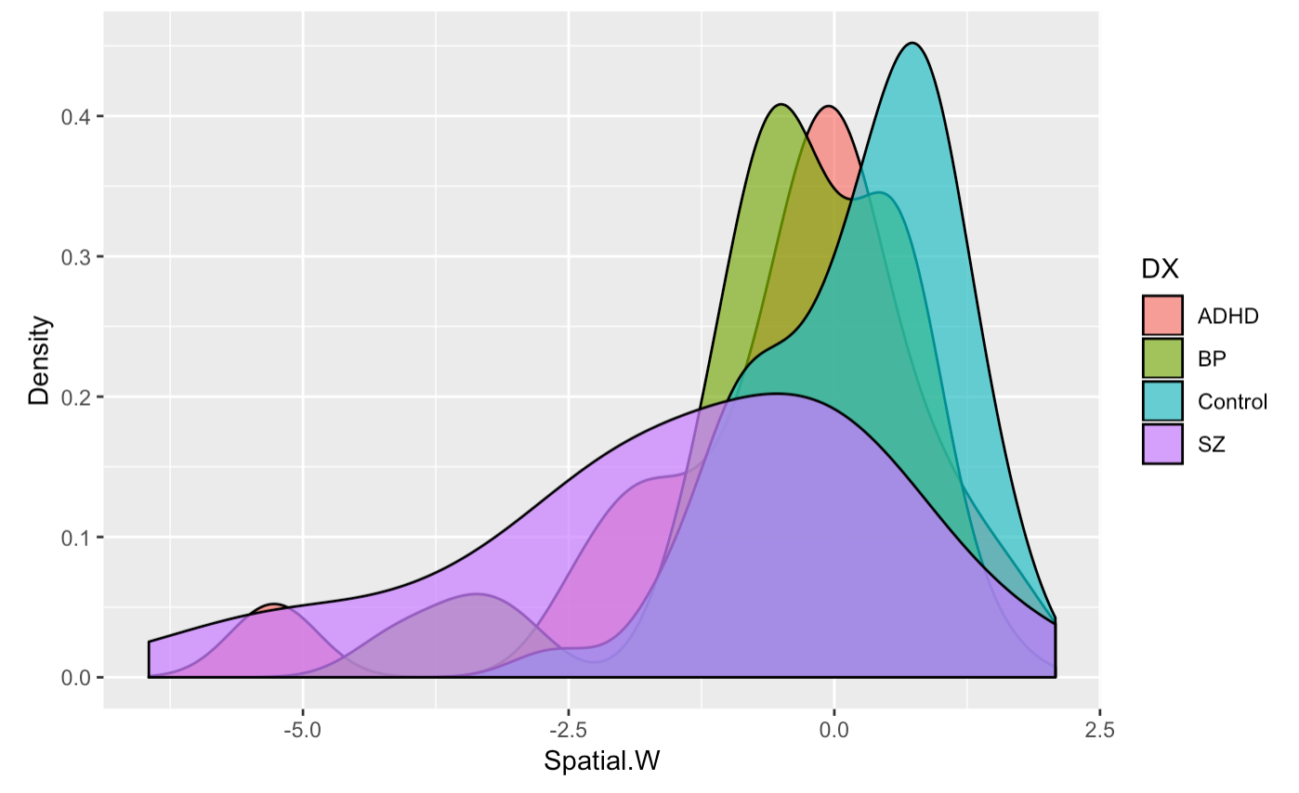
Exploratory Data Analysis - Response Variables
The three outcome variables for measuring cognitive ability are verbal WM, spatial WM, and reaction time. The control group universally exceeds the groups with diagnosis.
Notes:
Because our second qustion is concerned with model behavior regarding different diagnosis, in the last step of exploratory analysis, we shift our focus to response variables and its relationship to diagnosis

Slide 12
Question One
Predict the relationship between cognitive ability with demographics, fMRI and MRI data.

Slide 13
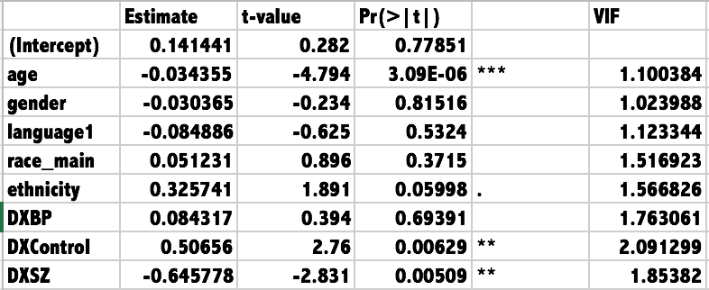
DX Models - Verbal Working Memory
Multiple R-squared: 0.3013
Adjusted R-squared: 0.2748
F-statistic: 11.37 on 8 and 211 DF
p-value: 2.275e-13
Significant Variables:
Age
DXControl
DXSZ
Notes:
DX is the diagnosis

Slide 14
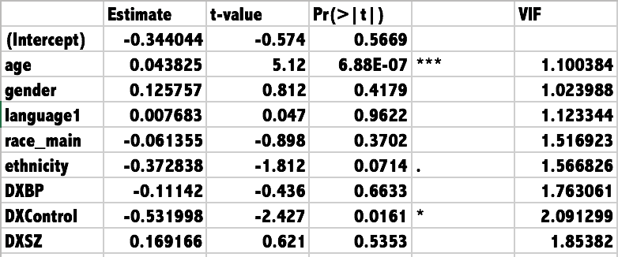
DX Models - Reaction Time
Multiple R-squared: 0.2086
Adjusted R-squared: 0.1786
F-statistic: 6.95 on 8 and 211 DF
p-value: 4.017e-08
Significant Variables:
Age
DXControl

Slide 15
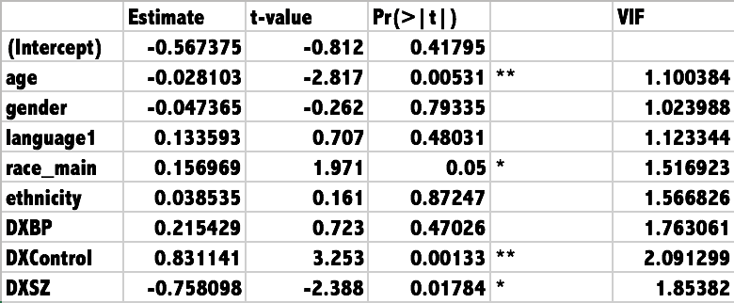
DX Models - Spatial Working Memory
Multiple R-squared: 0.2276
Adjusted R-squared: 0.1983
F-statistic: 7.77 on 8 and 211 DF
p-value: 3.975e-09
Significant Variables:
Age
DXControl
Race
DXSZ

Slide 16
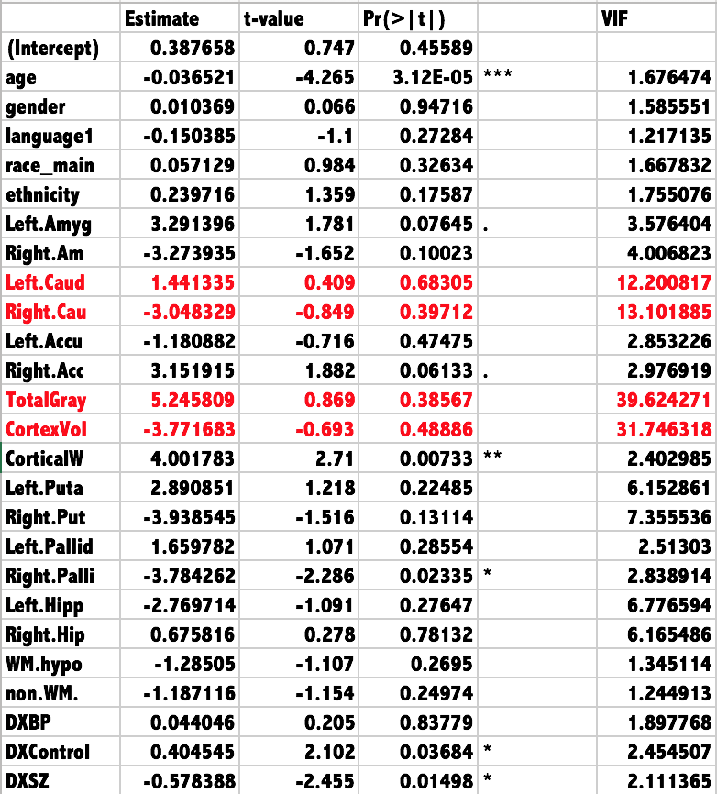
fMRI, MRI and DX Models - Verbal W.M.
Multiple R-squared: 0.3981
Adjusted R-squared: 0.3205
F-statistic: 5.133 on 25 and 194 DF
p-value: 1.31e-11
Significant Variables:
Age
CorticalW
Right.Palli
DxControl
DXSZ
Notes:
CorticalWhiteMatterVolume
Right.Pallidum

Slide 17
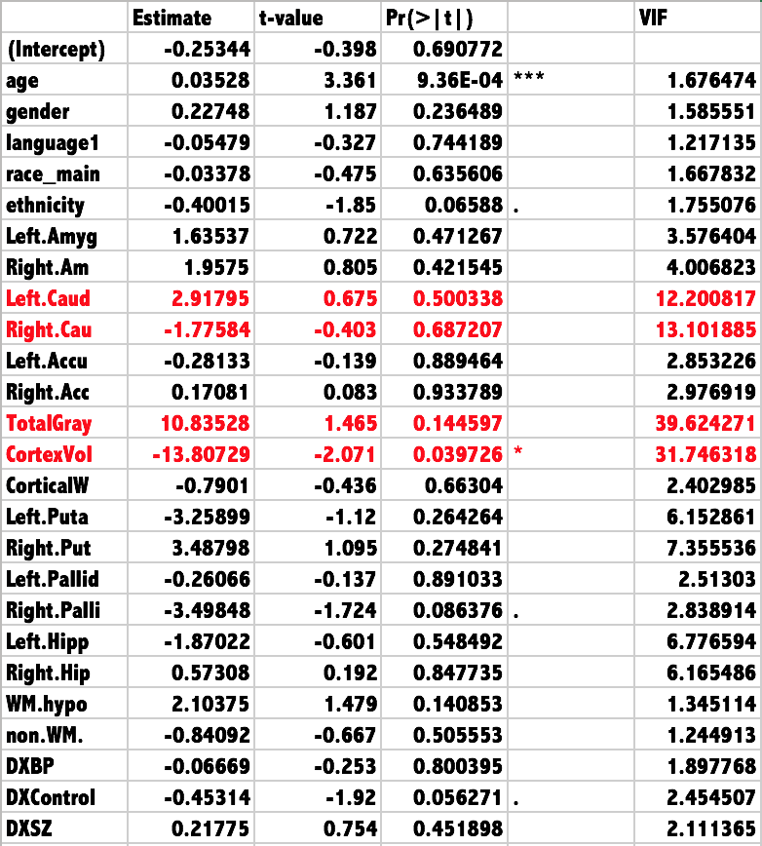
fMRI, MRI and DX MODELS - REACTION
Multiple R-squared: 0.2817
Adjusted R-squared: 0.1891
F-statistic: 3.043 on 25 and 194 DF
p-value: 8.01e-06
Significant Variables:
Age
CortexVol

Slide 18
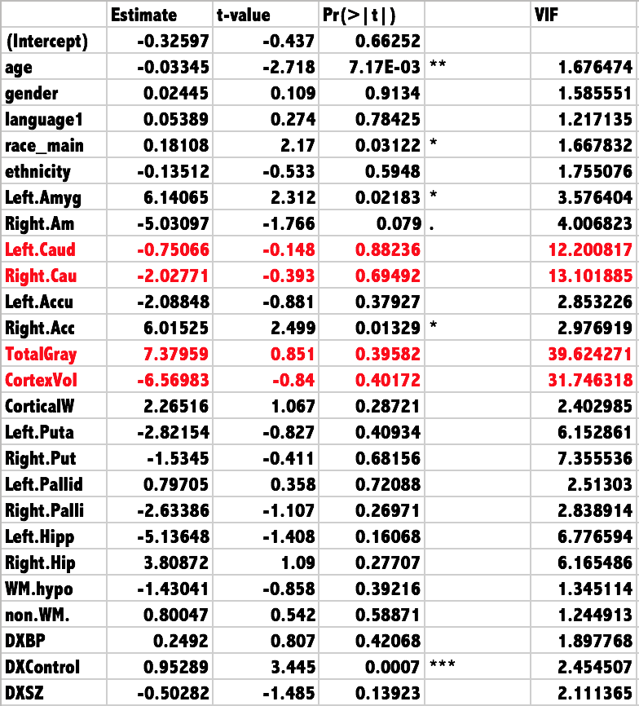
fMRI, MRI and DX MODELS - SPATIAL W.M.
Multiple R-squared: 0.2906
Adjusted R-squared: 0.1992
F-statistic: 3.179 on 25 and 194 DF
p-value: 3.353e-06
Variables dropped:
Right.Cau
TotalGray
Significant Variables:
DXControl
Age
Race
Left.Amyg
Right.Acc
Notes:
Right.Caudate
TotalGrayVol
Left.Amygdala
Right.Accumbens.area

Slide 19
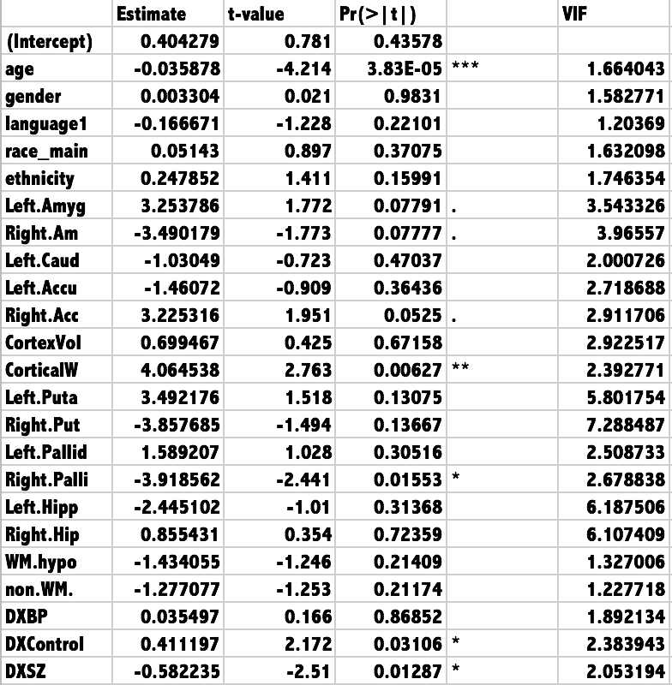
fMRI and MRI MODELS AFTER MODIFICATION- VERBAL W.M.
Multiple R-squared: 0.3941
Adjusted R-squared: 0.323
F-statistic: 5.543 on 23 and 196 DF
p-value: 3.927e-12
Significant Variables:
Age
CorticalW
Right.Palli
DXControl
DXSZ

Slide 20
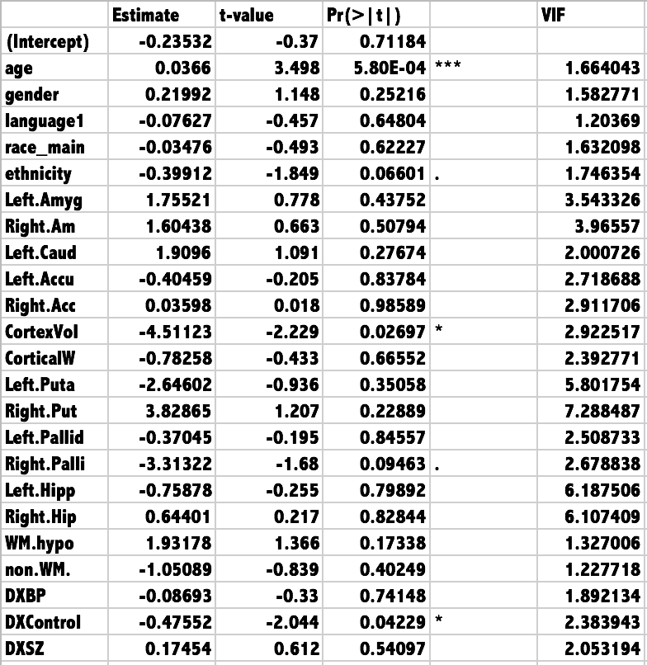
fMRI and MRI MODELS AFTER MODIFICATION- REACTION
Multiple R-squared: 0.2736
Adjusted R-squared: 0.1884
F-statistic: 3.21 on 23 and 196 DF
p-value: 5.158e-06
Significant Variables:
Age
CortexVol
DXControl

Slide 21
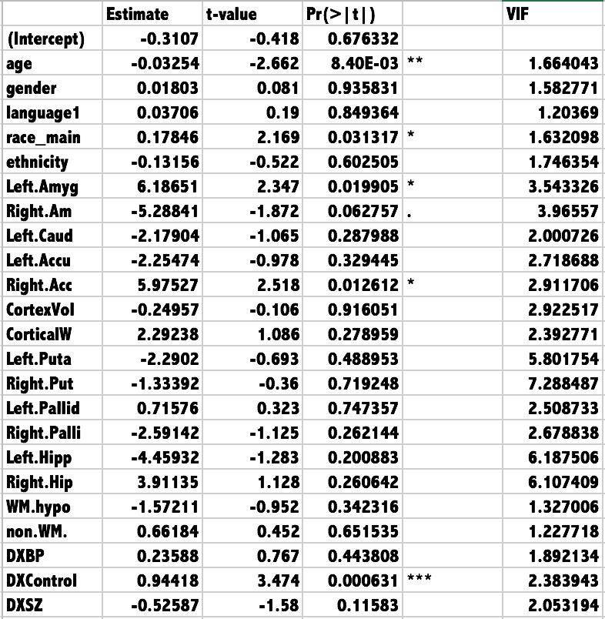
fMRI and MRI MODELS AFTER MODIFICATION- SPATIAL W.M.
Multiple R-squared: 0.2877
Adjusted R-squared: 0.2041
F-statistic: 3.442 on 23 and 196 DF
p-value: 1.252e-06
Significant Variables:
Age
Race
Right.Acc
DXControl
Left.Amyg
Notes:
Left.Amygdala
Right.Accumbens.area

Slide 22
RESULTS
When using data from all patients, model with Demographics, DX, fMRI, MRI predictors after dropping the highly correlated variables give a better fit, (adjusted R^2 = 0.323 )
Adjusted R^2 is as following.
 | Demographic + DX | Demographic + DX + fMRI + MRI Before | Demographic + DX+ fMRI + MRI After
Verbal W.M. | 0.2748 | 0.3205 | 0.323
Reaction | 0.1786 | 0.1891 | 0.1884
Spatial W.M. | 0.1983 | 0.1992 | 0.2041

Slide 23
Question Two
Build a model using only controls (subjects with no mental diseases) to predict cognitive ability on patients with mental diseases.

Slide 24
Problem 2:
Predicting Cognitive Ability Using Control Model
First Model: Using only demographic data as predictors to build a model using controls to predict cognitive ability
Test on diagnosed patients to see difference between actual v.s. predicted
 | Adjusted R^2
Verbal W.M. | 0.1403
Reaction | 0.1085
Spatial W.M. | 0.04679

Slide 25
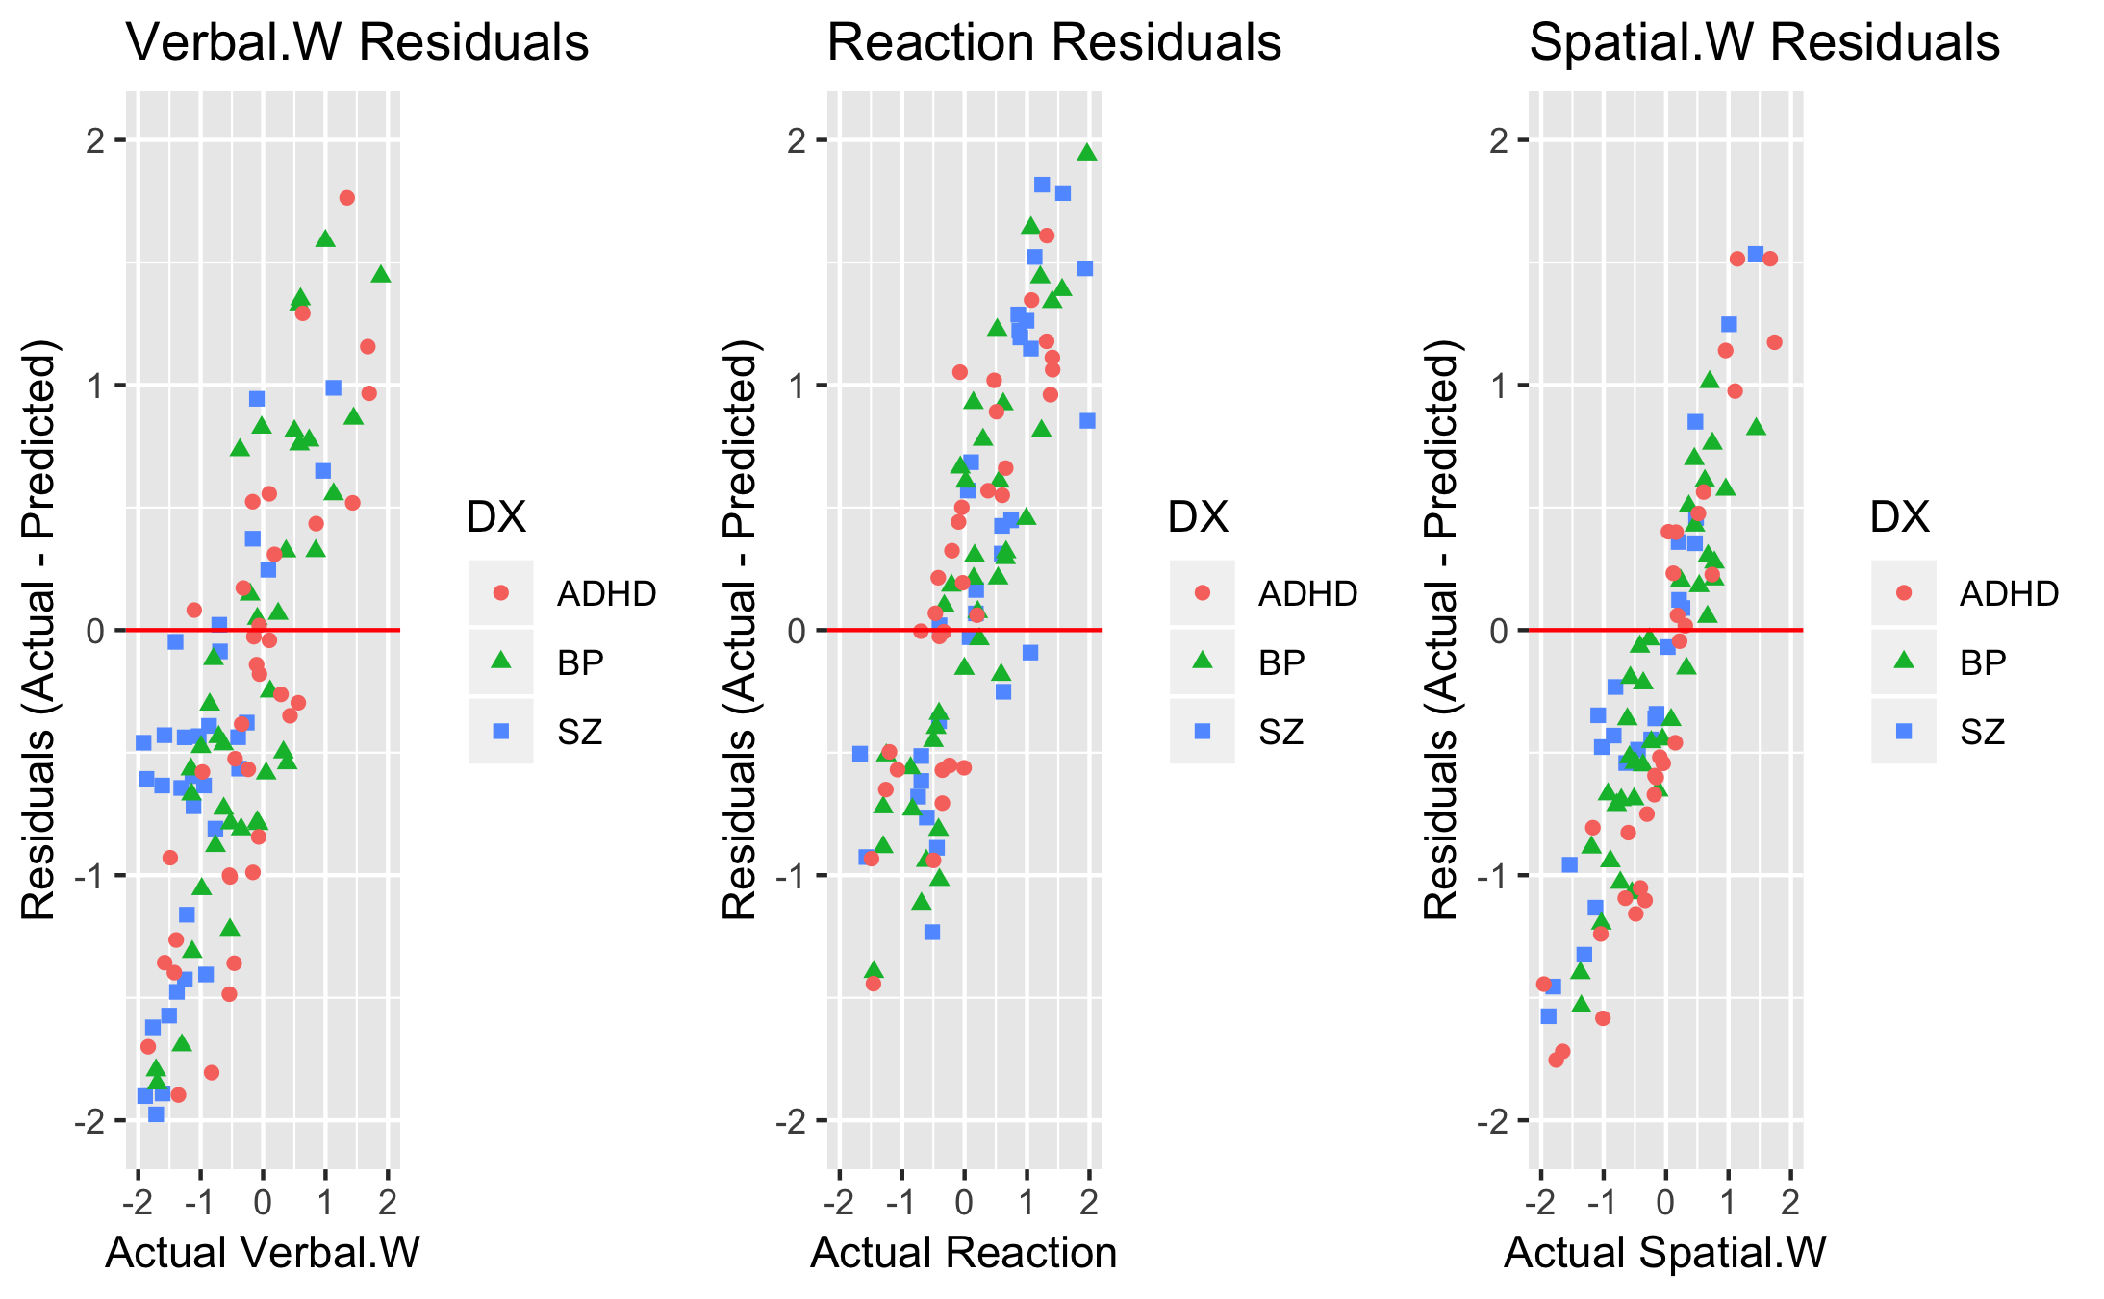
Predicting Cognitive Ability Using Control Model with Demographics

Slide 26
Did the Model Over-predict for Diagnosed Patients?
i.e., are the residuals (actual - predicted) < 0?
Verbal.W
Reaction
Spatial.W
 | ADHD | BP | SZ
No | 12 | 6 | 6
Yes | 25 | 26 | 32
 | ADHD | BP | SZ
No | 24 | 26 | 25
Yes | 13 | 16 | 13
 | ADHD | BP | SZ
No | 13 | 14 | 9
Yes | 24 | 28 | 29

Slide 27
Model 2
2nd model: Using Demographic predictors, MRI and fMRI predictors
(excluding the ones with high multicollinearity)
Significant Variables:
Verbal.W -- Age, ethnicity
Reaction Time -- Cortex. Vol
Spatial.W -- Race, Left.Amyg
 | Adjusted R^2
Verbal W.M. | 0.1524
Reaction | 0.08428
Spatial W.M. | 0.1136

Slide 28
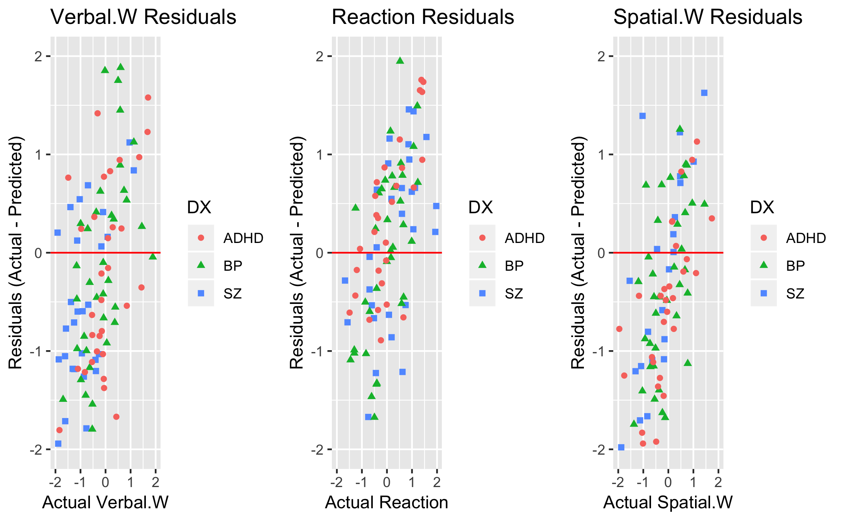
Predicting Cognitive Ability Using Control Model with Demographics, MRI, & fMRI

Slide 29
Did the Model Over-predict for Diagnosed Patients?
Verbal.W
Reaction
Spatial.W
 | ADHD | BP | SZ
No | 14 | 16 | 10
Yes | 23 | 26 | 28
 | ADHD | BP | SZ
No | 25 | 27 | 25
Yes | 12 | 15 | 13
 | ADHD | BP | SZ
No | 9 | 13 | 11
Yes | 28 | 29 | 27
The model built on control patients expects diagnosed patients to have:
higher Verbal.W and Spatial.W scores than they actually have
faster Reaction times than they actually have
Is the difference due to the diagnosis?

Slide 30
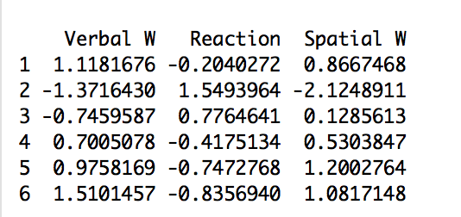
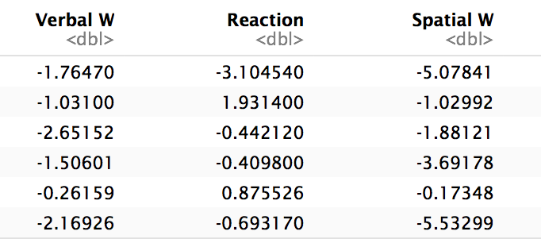
Partial Results of Predicted Values for Subjects with ADHD, SZ and BD
Predicted Values
Actual Values

Slide 31

Residuals and SSE
Partial data of the residuals of the subjects with mental disorders predicted from the model using only controls.

Slide 32
Question Three
Explore other relationships within the data set.

Slide 33
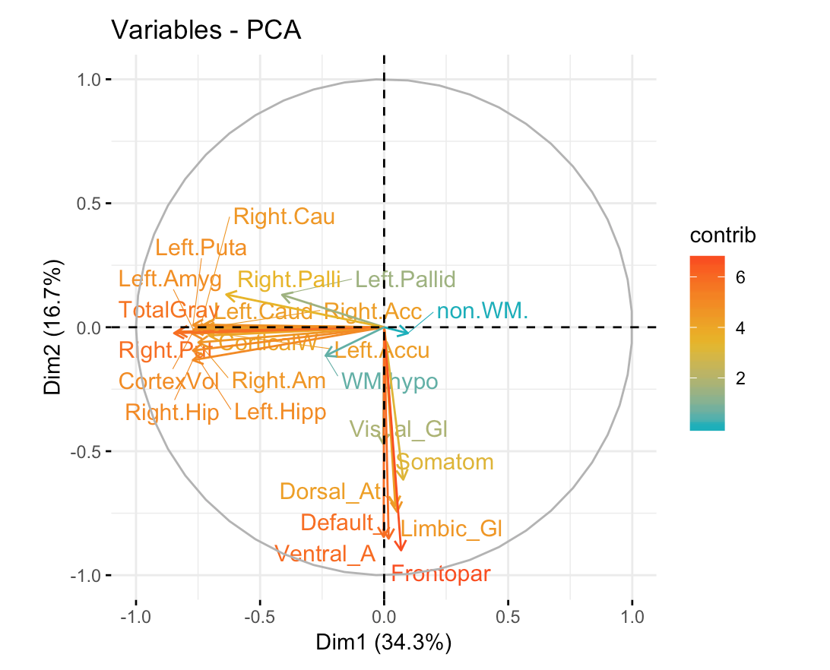
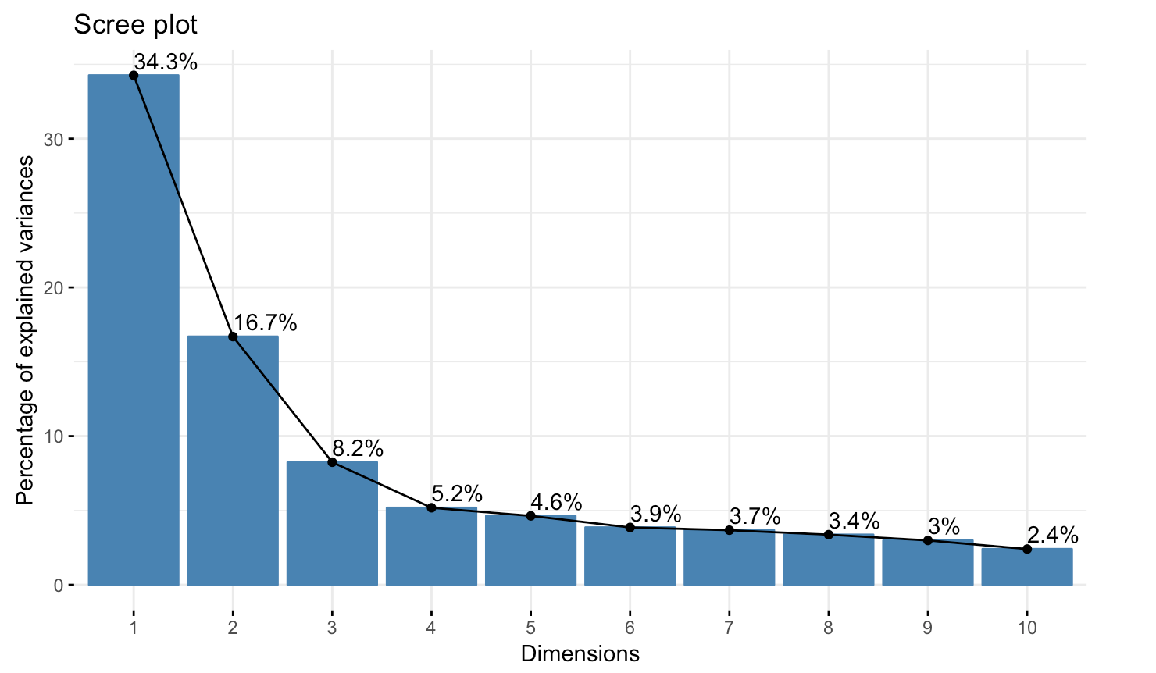
Problem 3:
Principal Component Analysis of MRI and fMRI variables

Slide 34
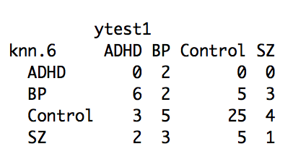
KNN Prediction of Mental Disorder Based on cognitive ability, MRI and fMRI data
Actual Dataset:
Control | SZ | BP | ADHD
108 | 38 | 42 | 37
46.8% | 17.2% | 19.1% | 16.8%
Prediction Percentage :
30% Testing -- 66 observations
70% Training --154 observations
Accuracy Percentage:
53%, not bad considering we have a limited data set and a lot of variables
Need improvement
Control | SZ | BP | ADHD
37 | 11 | 16 | 2
56.1% | 16.6% | 24.2% | 3.1%

Slide 35
Discussion
Four redundant variables were found: total gray volume, total cortex volume, left caudate and right caudate. Conceptually, total cortex volume includes the gray volume. Left caudate and right caudate are symmetrical in the brain and serve a similar function in the memory processing. Those can explain their high VIF. So we excluded Total Gray Volume and Right Caudate from all the models.
Models have given credit to those significant variables, their corresponding functions to individual cognitive measurements can be found in literatures.
Age - universally significant.
Cortex Volume - reaction time.
Race and Left Amygdala - spatial working memory.
Notes:
Studies have shown that older adults put more effort into focusing during encoding, in order to compensate for a reduced ability to hold information in working memory.
Cortex volume can be seen as an indicator of the size of brain connectivities. Intuitively, bigger brain means smarter brain.
Amygdala is the emotion center. As memory is storaged with emotions, it serves an importatn role in memory processing
Left amygdala is especially known to be in charge of details
https://reliawire.com/amygdala/

Slide 36
Limitations & Future Directions
Unbalanced data set:
More males than females,
More non-hispanic than hispanic
Small age range
Adjusted R squared number is not ideal, we might improve it with more data.
Demographic variables can have significant influence over brain structures. Our model can be improved with more profound examination of their interactions.

