Slide 1
Team Orange
Personas and Use Cases
Daniel Dorrity
Andrew Woods
Tomomi Takeuchi
Frano Čaveliš

Slide 2
User Segmentation
Divided User categories
The common attribute between users
One common element ties all the users
Notes:
(Introduction, the purpose of user segmentation)
(Explain how attributes like age, gender, technical prowess are important factors, but we found one common element)

Slide 3
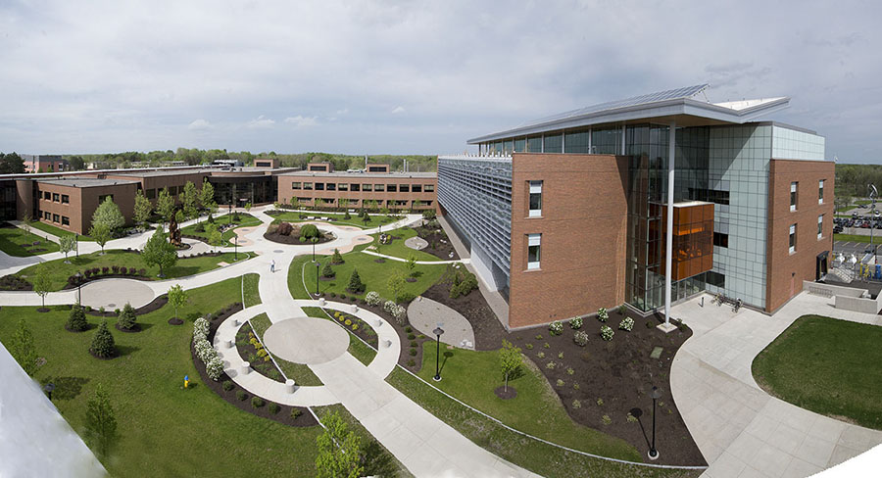
Campus Relation
The attribute which influences
the data displayed has a direct
correlation to the campus relation
Affiliated with the college as a student
Affiliated with the college as a Staff/Faculty member
Unaffiliated with the college
Notes:
Like in the word document, you should explain the logic behind why we choose college affiliation to divide our groups. Here is the excerpt from the document:
Affiliated with the College as a Student – This user will use the interactive blackboard as a means of information gathering (Finding a professor, his room number, etc…). This group mostly encompasses students who want to inform themselves more about the college.
Affiliated with the College as a Staff/Faculty Member – This user has more privileges than the average student and can edit his or her bio in the files in addition to viewing them. This group is comprised of the professors who review and edit their info displayed on the board, and different IT service staff who can access and edit the files for maintenance.
Unaffiliated with the College – This is a branch of different users which can still interact with the blackboard for viewing purposes, these users can be visitors, alumni, seniors, children, etc. Each of them can be a different persona.

Slide 4

The Student Persona
Persona Attributes:
Resourceful, Technologically Adept, Possesses knowledge about the Campus ranging from clueless to well informed
Purpose: The Student’s desire to use our device is proportionate to his year level. Freshmen will use the board more often.

Slide 5
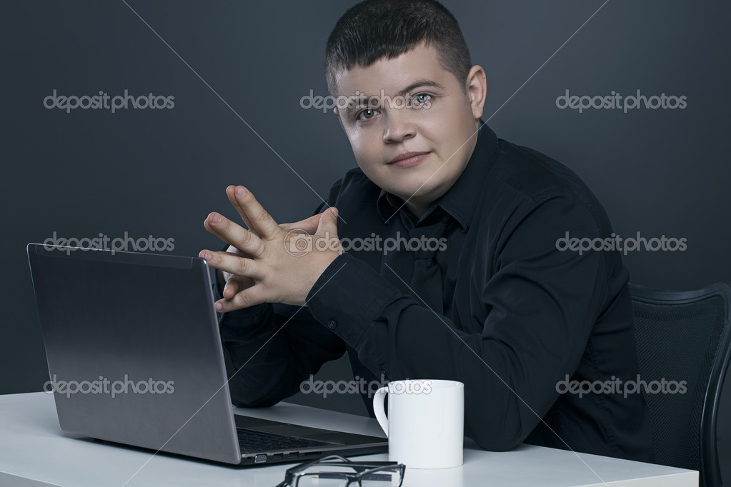
The IT Staff Persona
Persona Attributes:
Technologically apt, has a unique and different thought process, responsible, ready for critical situations
Purpose:
Viewing, editing and creating the data. Also will care for the application's operating status.

Slide 6
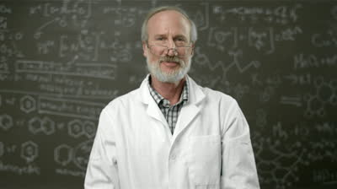
The Professor Persona
Persona Attributes:
Respectable, Literate, Not so adept at technology but willing to learn, prideful of his achievements
Purpose:
The professor can use the interactive board to view any information displayed there, but also request to change any background information displayed.

Slide 7
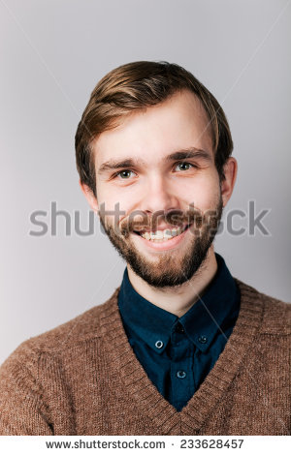
The Visitor Persona
Persona Attributes:
Curious, Unpredictable, Easily Impressed
Purpose:
There can many "visitors". It can be someone who isn't connected with the college or an Alumni.
The goal is to intrigue them with the board’s functionalities.

Slide 8
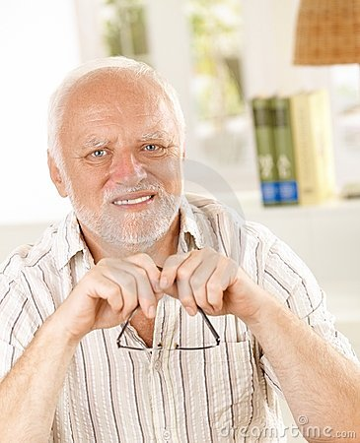
The Senior Persona
Persona Attributes:
Slow, Technologically Inept, Requires a lot more visual guidance
Purpose:
Challenges the design up to the point of creating an interactive system for people with no base technical skills

Slide 9
Questions?
Thank you for your time!
Team Orange
Daniel Dorrity
Andrew Woods
Tomomi Takeuchi
Frano Čaveliš

