Slide 1

“This presentation is for informational purposes only and may not be incorporated into a contract or agreement.”

Slide 2
The following is intended to outline our general product direction. It is intended for information purposes only, and may not be incorporated into any contract. It is not a commitment to deliver any material, code, or functionality, and should not be relied upon in making purchasing decision. The development, release, and timing of any features or functionality described for Oracle’s products remains at the sole discretion of Oracle.

Slide 3


Slide 4
Christian Shay
Principal Product Manager
.NET and Windows
“This presentation is for informational purposes only and may not be incorporated into a contract or agreement.”

Slide 5
Introducing:
.NET Stored Procedures for Oracle Database 10g Release 2 and Oracle Developer Tools for Visual Studio .NET

Slide 6
Agenda
Oracle Developer Tools for Visual Studio .NET
  Overview
  Demo - drill down
Oracle Database Extensions for .NET
  Overview
  Demo – My First SP
  Tuning and Data Access
  Demo – Data Access in a SP
  Demo – Debugging a .NET SP

Slide 7


Windows Development Environment Support
Oracle Developer
Tools for VS.NET
IIS
(ASP
ASP.NET)
MTS/
COM+
C++, C#,
VB .NET
Application
Develop
Deploy
Visual Studio
Environment
Application
IIS
Deploy
Database
Development
ODP.NET
Oracle DB
Extensions
For .NET
Oracle Services for MTS

Slide 8
Oracle Developer Tools for Visual Studio .NET
Tightly integrated “Add-in” for Visual Studio .NET
Oracle is a premier-level partner in the Microsoft Visual Studio Industry Partner (VSIP) Program
Available for free download now
  http://otn.oracle.com/dotnet

Slide 9
Develop on Windows, Database on any Platform
Windows
Oracle Developer
Tools for VS.NET
Linux
Visual Studio
Environment
Unix
Windows
Other
Oracle 10g, 9i, or 8i

Slide 10
Benefits
Easy to learn and intuitive
Leverage SQL Server development experience
Powerful features that enhance productivity – e.g. designers, auto code generation
Exposes latest and greatest Oracle functionality
Stay in Visual Studio for project lifecycle

Slide 11
Feature Overview
Oracle Explorer – browse and alter schema
Wizards and Designers
Automatic code generation
PL/SQL Editor with IntelliSense
Oracle Data Window
Oracle Query Window (ad hoc SQL)
.NET Stored Procedure Deployment Wizard
Integrated help system – SQL, PL/SQL keywords

Slide 12

D E M O N S T R A T I O N
Oracle Developer Tools - Drill Down

Slide 13
Oracle Explorer
Tree control, similar to “Server Explorer”
View Oracle schema objects
Generate SQL for schema objects
Filter hides unwanted schema objects
A starting place for most tasks
  View, alter, create schema objects
  Auto generate code
  View and edit Oracle data
  Run stored procedures and functions

Slide 14
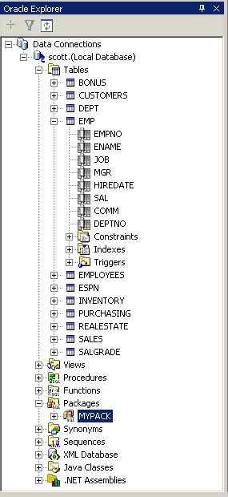
Oracle Explorer

Slide 15
Designers and Wizards
Table Designer
View Designer
Stored Procedure/Function Wizard
Package Wizards
Sequence Designer
Synonym Designer
Trigger Designer
Data Adapter Wizard

Slide 16
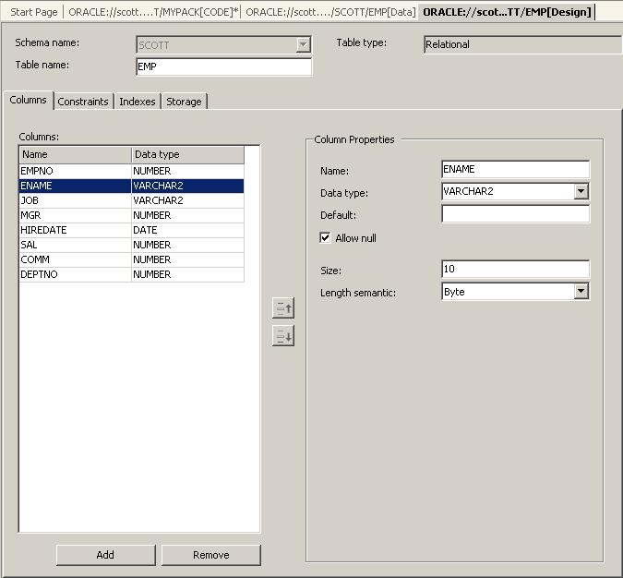
Table Designer

Slide 17
Automatic Code Generation
Drag and drop a schema object from Oracle Explorer
Generated code uses OracleDataAdapter class (ODP.NET)
Data Adapter Wizard can be run to customize
Generate “typed datasets” as needed

Slide 18
PL/SQL Code Editor
Syntax Coloring
Collapsible regions
IntelliSense
Context sensitive help for SQL/PLSQL keywords
Intelligent error display in task list
Context-sensitive help for Oracle error numbers

Slide 19
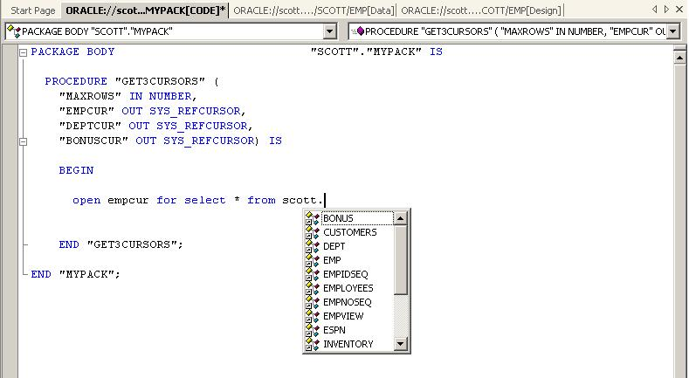
PL/SQL Code Editor

Slide 20
Data Window
View and update table data
Run stored procedures and view data
Supports Oracle data types
View complex data types such as Ref Cursors

Slide 21
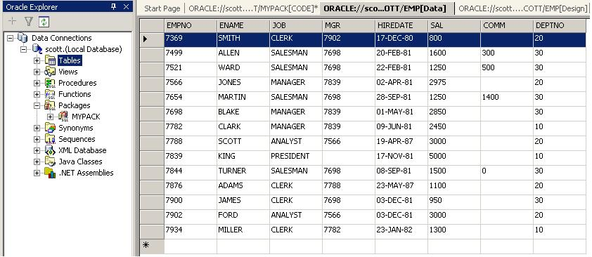
Data Window

Slide 22
Oracle Query Window
Execute “ad hoc” SQL
Drag and drop objects from Oracle Explorer to generate SQL
Result of select statements in grid or text format
Execute multiple statements in a row
Run scripts (“@myscript.sql”)

Slide 23
Integrated Online Help
Getting started
Walkthroughs
Oracle Developer Tools Reference Guide
Context sensitive help for UI elements
Context sensitive SQL and PLSQL keywords
Oracle Error Manual
Oracle SQL Reference Guide
Oracle PL/SQL Reference Guide

Slide 24
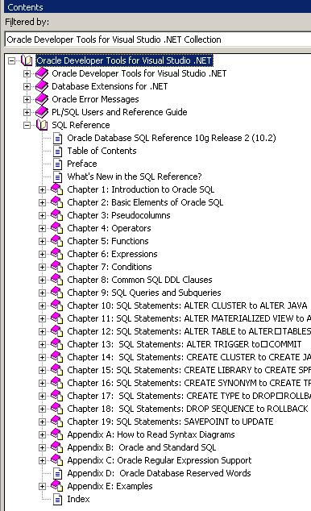
Integrated Online Help

Slide 25
Coming Soon – CY 2005
PL/SQL Debugging
Visual Studio .NET 2005 support
Many other features

Slide 26
Agenda
Oracle Developer Tools for Visual Studio .NET
  Overview
  Demo - drill down
Oracle Database Extensions for .NET
  Overview
  Demo – My First SP
  Tuning and Data Access
  Demo – Data Access in a SP
  Demo – Debugging a .NET SP

Slide 27
Oracle Database Extensions for .NET
Oracle 10g Release 2 on Windows
Write Microsoft Visual C# or Visual Basic .NET stored procedures/functions
Build assembly in Visual Studio .NET
Deploy from Visual Studio .NET using .NET Deployment Wizard

Slide 28
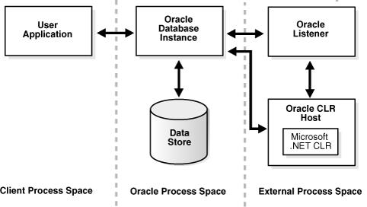
Architecture

Slide 29

Write .NET Stored Procedures for Oracle
Oracle Developer
Tools for VS.NET
Visual Studio
Environment
Client
Application
Develop
Invoke
C#,VB.NET,C++
Server Project
(Use ODP.NET
if required)
Invoke
Stored
Procedure,
SQL ..
Build
Deploy
Assembly
foo.dll
(proc sp)
Oracle DB
Extensions
for .NET
Stored Proc

Slide 30
Supported Platforms
Windows only
.NET Framework 1.1
Oracle 10.2 or later

Slide 31
When to use
Ease of development
Computationally intensive code
Leverage .NET programming expertise
Leverage existing .NET code libraries
Windows platform only

Slide 32
Install
“Custom” install of “Oracle Database Extensions for .NET” is required
DBCA performs configuration
CLR Service created and started
  Service is named <OracleHomeName>ClrAgnt

Slide 33
Creating a .NET Stored Procedure
Use Visual Studio .NET to build a .NET procedure or function in the usual way
If data access is required, use ODP.NET classes
Result is a .NET assembly
Run .NET Stored Procedure Deployment Wizard (included with Oracle Developer Tools)
Call .NET stored procedure as you would any other Oracle stored procedure

Slide 34
Stored Procedure Requirements
Be declared a public static method.
Not be a constructor or a destructor.
Use parameter types that are compatible with the Oracle native database types.

Slide 35
Security Levels
Safe - Access only to database resources.
External - Read or write to local files, and access to network resources such as sockets and internet nodes
Unsafe- Unrestricted execution including execution of unmanaged code. It is a superset of all other security levels.

Slide 36
D E M O N S T R A T I O N
Your First .NET SP

Slide 37
OraCLRAgent Service
Multithreaded Agent Architecture
  Optimized for security and performance
  A separate multithreaded process is started for each system identifier
  Each TNS listener that is running on a system listens for incoming connection requests for a set of SIDs.
  As system load thresholds are met, additional processes are spawed

Slide 38
Performance Tuning
  Edit Service <OracleHomeName>ClrAgnt
  Example: ORACLE_HOME\bin\oraclragnt.exe agent_sid=CLRExtProc max_task_threads=5

Slide 39
Performance Tuning
max_sessions – (25) Number of maximum sessions
max_task_threads – (6) Number of maximum task threads
max_dispatchers – (2) Number of maximum dispatchers

Slide 40
ODP.NET Server Side Differences
Failover/Notifications, Transaction and Connection classes have differences
No transactions can be started, committed, or rolled back from within a .NET SP that uses the default connection of the caller
Regular transaction symantics apply if a new connection is opened in the SP

Slide 41
D E M O N S T R A T I O N
.NET SP Data Access

Slide 42
D E M O N S T R A T I O N
.NET SP Debugging

Slide 43
Next Steps
.NET Developer Center - http://otn.oracle.com/dotnet
Visit our booth in the demogrounds:
  Oracle Database 10g area - Moscone South
More .NET and Windows sessions:
  ODP.NET: New Features in ADO.NET 2.0 and Oracle Database 10g Release 2
    – NEXT! (Today 4:30 PM 304 Moscone South)
  Oracle Database on Windows: Best Practices
  Thursday, 2:30PM in 304 Moscone South
  OTN Ask the Experts
  Wednesday, 4PM – OTN Lounge, Moscone West
E-mail me: christian.shay@oracle.com

Slide 44
Q
&
A
Q U E S T I O N S
A N S W E R S

Slide 45
“This presentation is for informational purposes only and may not be incorporated into a contract or agreement.”

