Slide 2
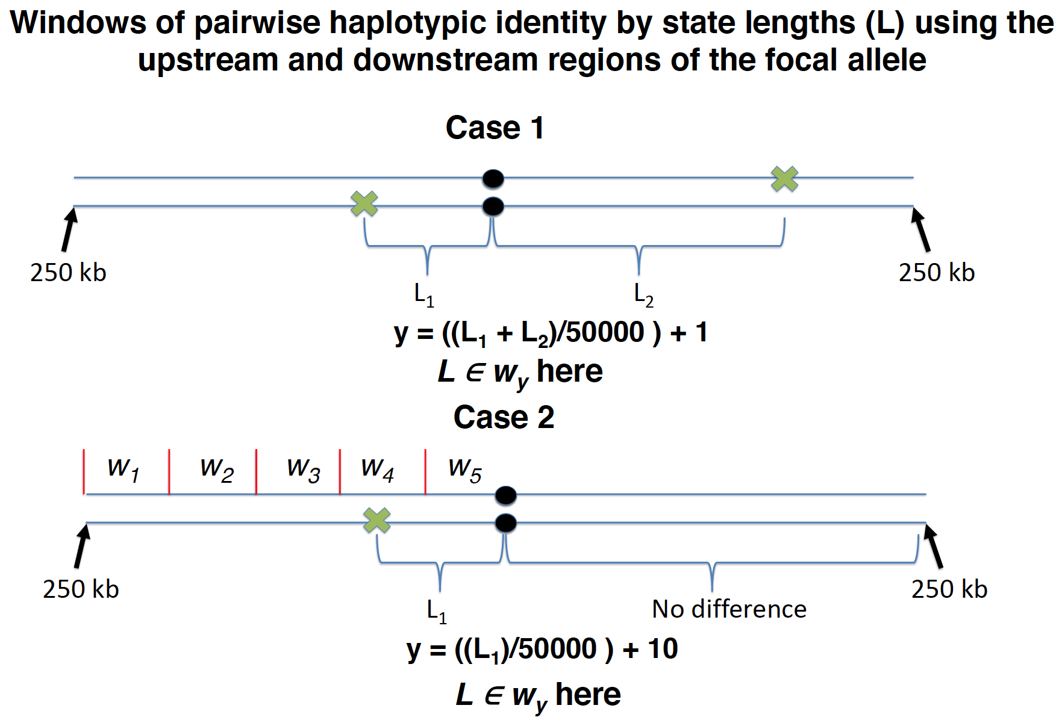
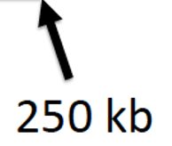
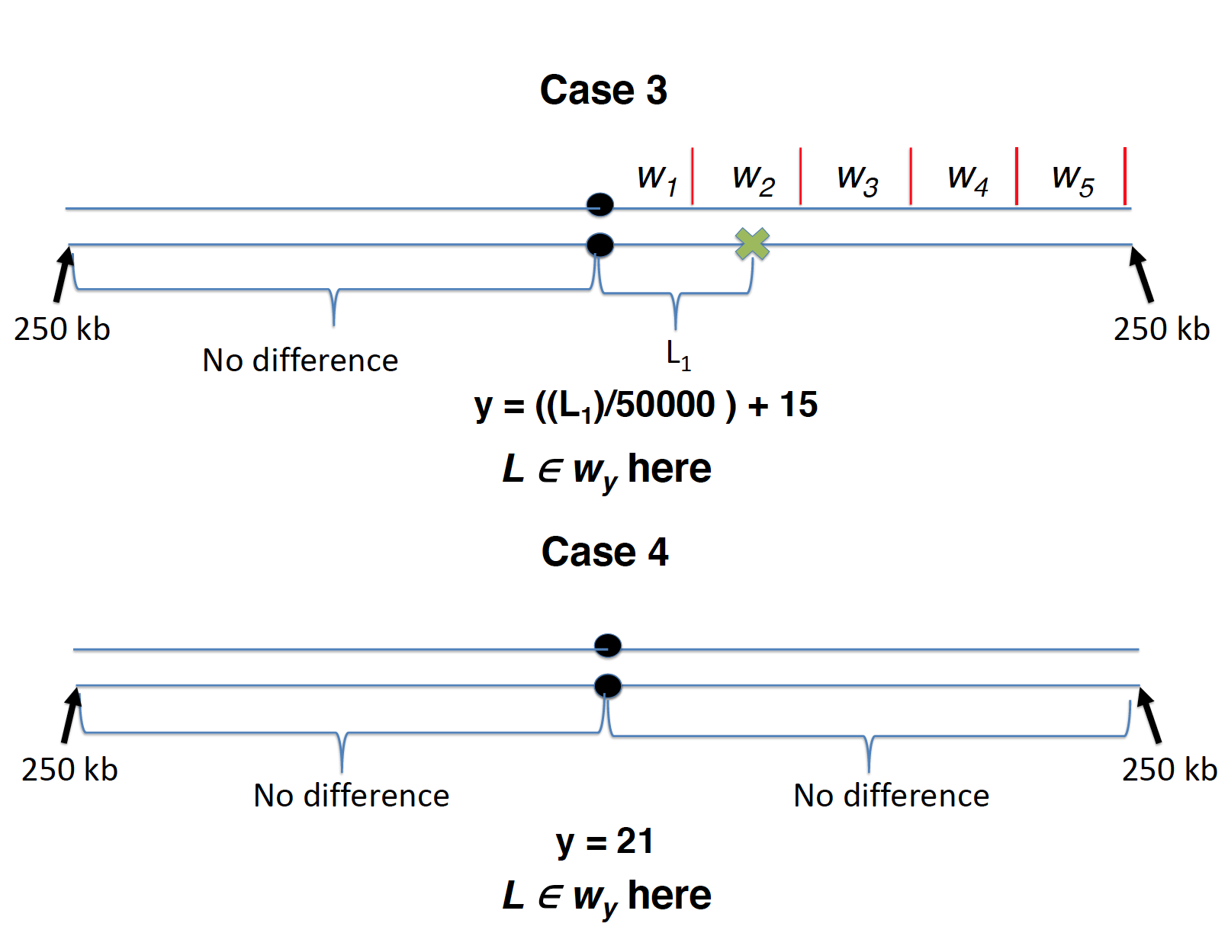
Strategy ‘One Haplotype End’
Strategy ‘Both Haplotype Ends’
Case 1
w₁ w₂ w₃ w₄ w₅
L₁
y = L₁/50000
L ∈ w_{y} here
Case 2
w₁ w₂ w₃ w₄ w₅
No difference
y = 6
L ∈ w_{y} here

Slide 3
Strategy ‘One Haplotype End’
Strategy ‘Both Haplotype Ends’
Case 1
Windows of pairwise haplotypic identity by state lengths (L’) using the upstream and downstream regions of the focal allele
w₁ w₂ w₃ w₄ w₅
Case 1
250 kb
250 kb
L₁
L₂
250 kb
L₁
y = ((L₁ + L₂)/50000 ) + 1
L’ ∈ w_{y} here
y = L₁/50000
Case 2
L ∈ w_{y} here
w₁ w₂ w₃ w₄ w₅
Case 2
250 kb
L₁
No difference
250 kb
w₁ w₂ w₃ w₄ w₅
y = ((L₁)/50000 ) + 10
L’ ∈ w_{y} here
Case 3
w₁ w₂ w₃ w₄ w₅
250 kb
No difference
250 kb
No difference
L₁
250 kb
y = 6
y = ((L₁)/50000 ) + 15
L’ ∈ w_{y} here
L ∈ w_{y} here
Case 4
250 kb
No difference
No difference
250 kb
y = 21
L’ ∈ w_{y} here

