Slide 1
AI Presentation Dave Ortego & Michael Amos
Csc 690
DR Doran
20 Nov 2018

Slide 2
Overview
Four elements
Understand
Design
Implement
Evaluate
Nuts and Bolts

Slide 3
Understand
Understand Problem
Demonstrate AI
Computer Game
Gravity based mechanics
Threshold design
Taken from: https://www.nlm.nih.gov

Slide 4
Design (plan)
Multiple Objects Interact Independently
AI Agent – attracted toward goal object
Chase Objects - also attracted to goal object
Goal Object – will “blink” if threshold of objects reached

Slide 5
Design (actual)
Multiple Objects Interact Independently
AI Agent – attracted toward goal object
Goal Object appears random – has a gravity effect on AI Agent
Ricochet Object – independent of goal object effects

Slide 6
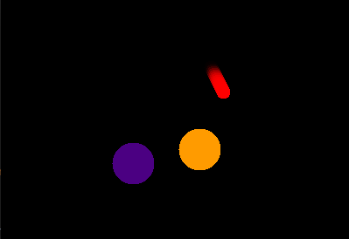
Implement
Coded in Java
Limited human Interaction
Game Play in Brief
3 Objects: the AI agent, the ricochet object, and the goal object.
The AI agent moves toward the goal while trying to avoid the ricochet object.
When the ricochet object gets too close to the AI agent, the agent “backpedals” away from the ricochet object.

Slide 7

Implement
AI Agent
Moves towards the goal object, no matter where the goal is on the screen.
Moves away from the ricochet object when the ricochet object crosses its path.

Slide 8

Implement
Ricochet Object
Bounces around the screen, ricocheting off the edges of the window frame.
The only “free agent” of the program. This object never changes its state for the whole program.

Slide 9
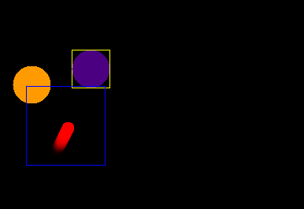
Evaluate
AI Avoidance (Invisible bounds)
The AI agent and ricochet object possess invisible bounds to activate the AI agent’s avoidance behavior.

Slide 10
Nuts & Bolts
Random spawning point (x, y) generated.
Assign point (x, y) to goal object.
AI pursues and contacts goal object.
Random spawning point (x, y) generated.

Slide 11
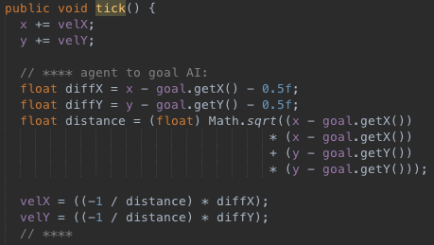
Nuts & Bolts Heuristic: Attractive Algorithm

Slide 12
Questions?

