Slide 1
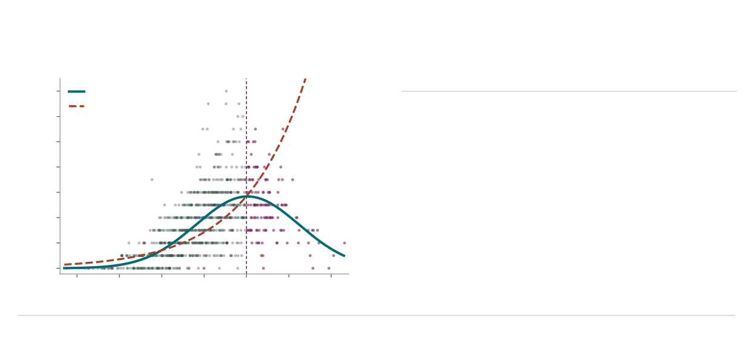
A Count offspring for each parent
B Weight the same parents
Saved observations from the one-trait teaching example.
High group: breeding value above +1 SD.
Weight
Group share
Mean (SD)
14
Curved model
Line on log scale
12
One per parent
15.3%
0.00
10
Counted offspring
20.4%
+0.38
8
Surviving offspring (number)
Curved model
21.3%
+0.41
6
4
Line on log scale
37.1%
+0.70
2
122 of 800 parents belong to the high group.
0
They produced 585 of 2,862 recorded offspring.
−3
−2
−1
0
1
2
3
Breeding value for height (SD)
Each dot is a parent. All 88 parents with zero offspring remain in the population and contribute zero to the count-weighted mean.

