Slide 1
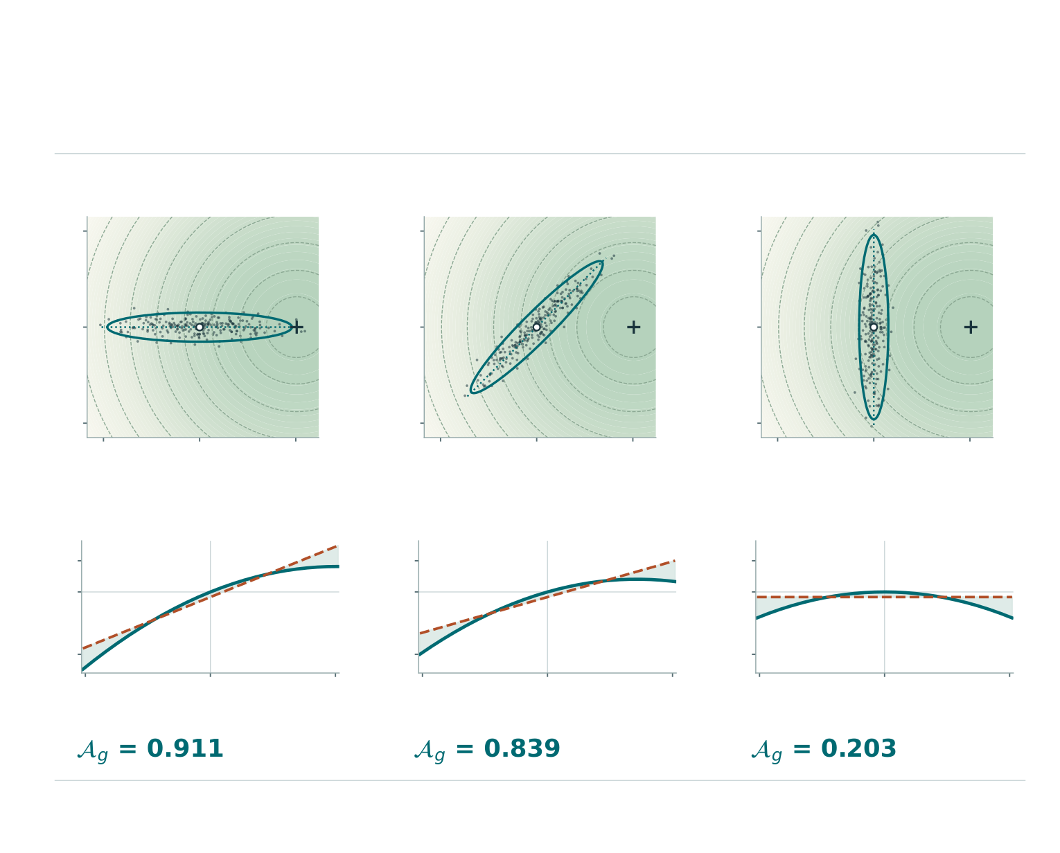
01 / GEOMETRY IN TRAIT SPACE
What changes when the breeding-value cloud turns?
The surface, population mean and two principal variances stay fixed. Only the direction of genetic variation changes.
0° Towards the peak
45° Oblique to the slope
90° Across the slope
1
1
1
Across the slope
0
0
0
−1
−1
−1
−1
0
1
−1
0
1
−1
0
1
Towards the peak
Towards the peak
Towards the peak
Side view along the long axis
Solid: fitness surface · Dashed: fitted plane
0.5
0.5
0.5
0.0
0.0
0.0
Relative log fitness
−1.0
−1.0
−1.0
−1
0
1
−1
0
1
−1
0
1
Distance along the long axis
Distance along the long axis
Distance along the long axis
Dots are equally weighted parents. The ellipse contains 90% of the model population; + marks the fitness peak.
The index uses both traits. At 90° the slice is flat to first order, but the cloud still has some width towards the peak.

Slide 2
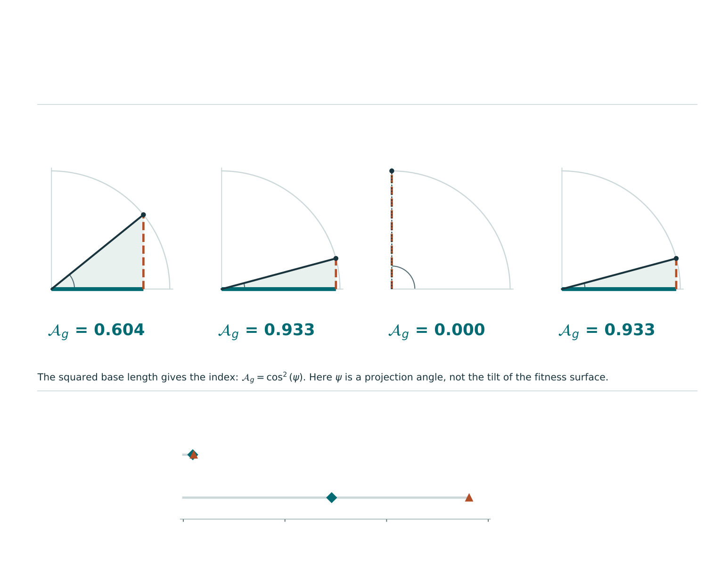
02 / GEOMETRY OF THE VARIANCE SHARE
What does the angle measure?
Each triangle divides variation in log fitness into the part described by a plane and the part left by curvature.
A Broad, on slope
B Narrow, on slope
C Narrow, at peak
D Broad, farther away
Angle 39.0°
Angle 15.0°
Angle 90.0°
Angle 15.0°
Base: linear SD | Height: curvature SD | Diagonal: total SD, scaled to 1 in every panel.
Now weight the same parents by their expected offspring
Surface / plane
B Narrow cloud
0.093 / 0.103 (+10%)
D Broad cloud
1.459 / 2.812 (+93%)
0
1
2
3
Distance moved by the mean parental breeding value
B and D have the same triangle. Their offspring-weighted means move different distances, in the same trait units.

