Slide 1
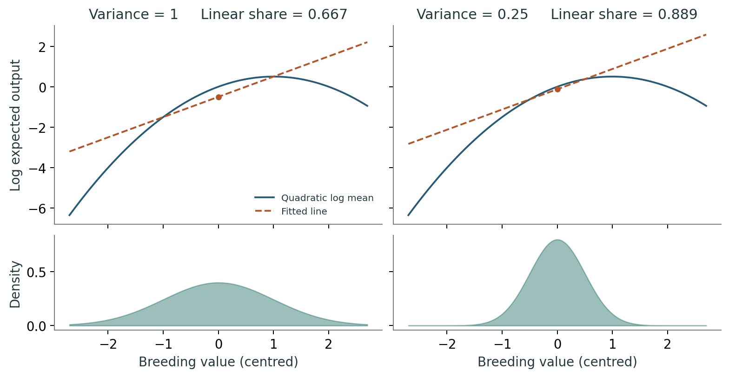
01 · THE QUESTION
How much fitness variation can a straight line describe?
The same fitness curve can give different answers in two populations.
Compare the outcome at each breeding value with the frequency of that value.
ORTIZ-BARRIENTOS & COOPER / GRADUATE TUTORIAL
Notes:
Start with variation in reproductive output. Ask students what they would need to know about each plant and about the population. Refer to the teaching notes, pages 1–2.

Slide 2
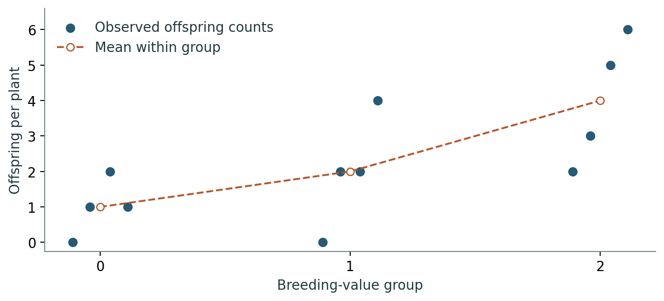
02 · THE OUTCOME
Average offspring counts before taking logs
Two plants with the same breeding value leave 0 and 4 surviving offspring. Their mean is 2.
A log of that mean exists. The average of their individual log counts does not.
ORTIZ-BARRIENTOS & COOPER / GRADUATE TUTORIAL
Notes:
A breeding value sums average allelic effects on a trait in a specified population. The individual outcome can vary at the same breeding value. The plot shows sample means, not the full population curve.

Slide 3
03 · ONE SURFACE, TWO POPULATIONS
Which breeding values occur most often?
Both populations have log expected output y = x − x²/2. Their means agree. Only their variances differ.
Read the density panel before comparing the fitted lines.
ORTIZ-BARRIENTOS & COOPER / GRADUATE TUTORIAL
Notes:
The tangent at zero is y=x. The population regression line has slope 1 and intercept −G/2. The intercept changes because the mean quadratic contribution changes.

Slide 4
04 · VARIANCE CALCULATION
Slope contributes one factor of G; curvature contributes two
For a normal breeding value centred at zero, L = bX and Q = HX²/2. Symmetry gives Cov(L,Q) = 0.
Vlin = b²G
Vquad = H²G²/2
ORTIZ-BARRIENTOS & COOPER / GRADUATE TUTORIAL
Notes:
Ask for the variance of X². E[X⁴] − E[X²]² equals 3G² − G² = 2G² for a normal distribution. Symmetry alone does not give that fourth moment.

Slide 5
05 · POPULATION REGRESSION
A larger share can accompany less linear variance
At G = 1, the line accounts for 2/3 of the variance. At G = 1/4, it accounts for 8/9.
The linear variance fell fourfold. The quadratic variance fell sixteenfold.
ORTIZ-BARRIENTOS & COOPER / GRADUATE TUTORIAL
Notes:
State the target: population regression of the quadratic log conditional mean on breeding value, with an intercept. At zero slope and positive quadratic variance the regression R² is zero, but correlation with a constant is undefined.

Slide 6
06 · A SELECTION PREDICTION
Does a 97% fit bound the error in selection?
In the paper’s example, G = 1, slope b = 2 and curvature H = −1/2. The linear share is 4/(4 + 1/8).
Before showing the shift, ask which quantity selection uses as its weight.
ORTIZ-BARRIENTOS & COOPER / GRADUATE TUTORIAL
Notes:
The share is 32/33, about 97%. The linear fit minimises squared error in log expected output. Selection weights by expected reproductive output on its original scale.

Slide 7
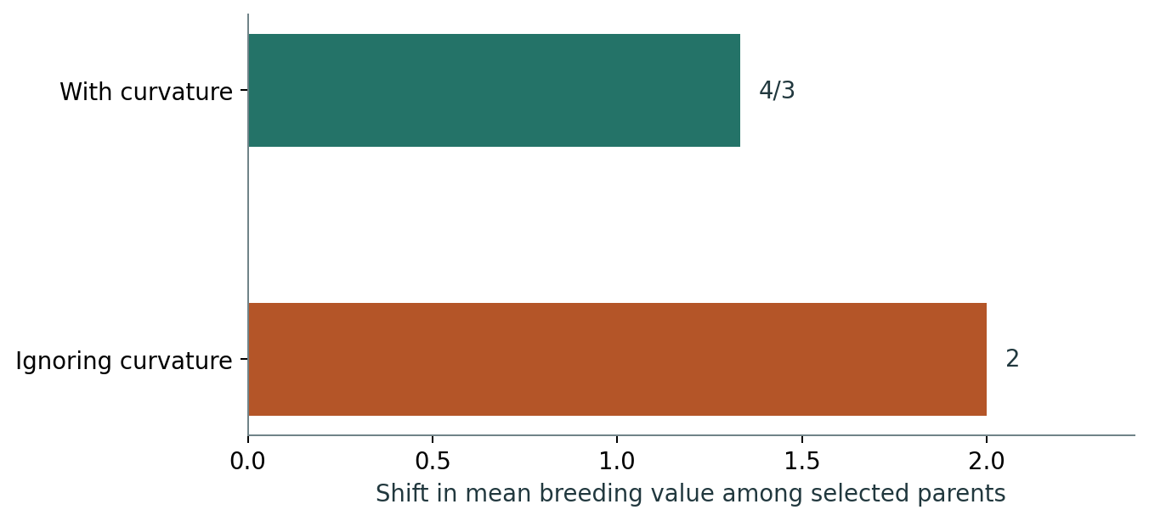
07 · THE PARENTAL MEAN
The exact shift is 4/3; ignoring curvature gives 2
Multiply the original normal density by expected output. Completing the square gives a new mean of 4/3.
(2 − 4/3)/(4/3) = 50% overestimate
ORTIZ-BARRIENTOS & COOPER / GRADUATE TUTORIAL
Notes:
The denominator is the exact shift. Neither calculation predicts the offspring mean without transmission assumptions. This is a good stopping point for a 35-minute class.

