Slide 1
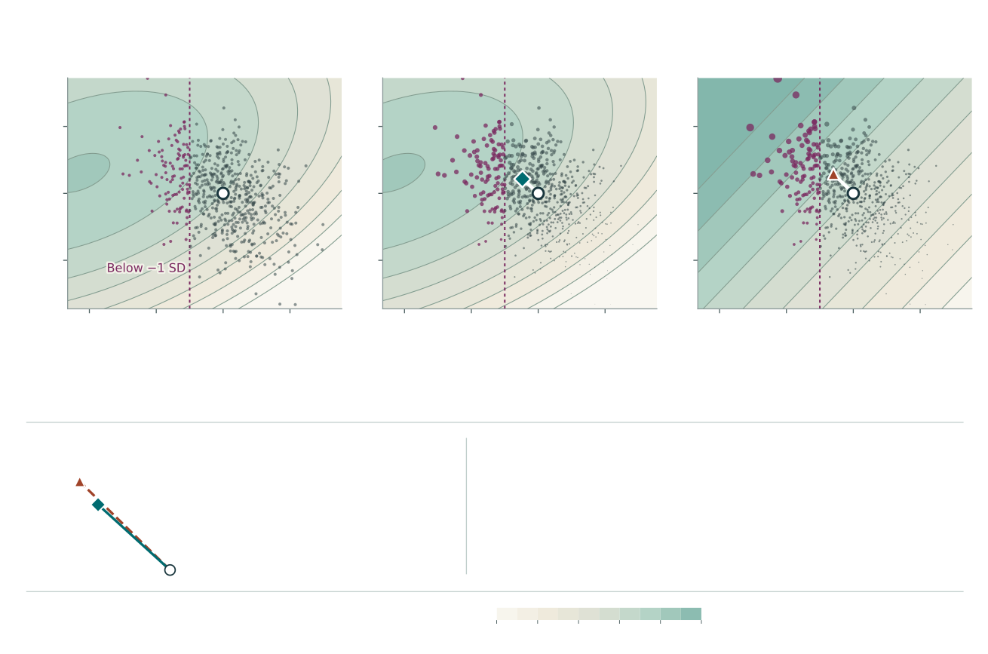
A
Count parents
B
Count expected offspring
C
Use the linear prediction
Each parent has the same weight.
Area shows relative expected offspring.
Area shows relative predicted offspring.
2
Trait 2 breeding value (SD)
0
−2
−4
−2
0
2
−4
−2
0
2
−4
−2
0
2
Trait 1 breeding value (SD from the starting mean)
15.9% of parents
28.5% of expected output
34.1% of predicted output
Purple: trait 1 below −1 SD. The same 600 parents are shown; all 20,000 determine the percentages and means.
D
Where does the parental mean end up?
What the plane gets wrong
Distance from starting mean
The plane explains 90.2% of variation in log expected output.
Curved surface
0.64
It gives too much weight to parents with low trait 1 values.
Linear plane
0.83
It overestimates the distance the mean shifts by 30%.
Start
Distance uses both traits in SD units.
Map colour: log expected output relative to the starting mean
Darker = more expected offspring.
−3
−2
−1
0
1
2

