Slide 1
OpenCV in ROS
ROS 4 Engineers
Eric Dortmans
Fontys Hogeschool ICT

Slide 2
Contents
OpenCV
OpenCV & ROS
Object detection
Camera calibration
Camera perspective correction
Pose & size estimation

Slide 3
OpenCV

Slide 4

OpenCV
Open Source Computer Vision Library
http://opencv.org/
https://github.com/opencv
Written in C++
C++, C, Python, Java and MATLAB interfaces
more than 2500 optimized algorithms

Slide 5

Python API
Python
https://www.python.org/
https://learnxinyminutes.com/docs/python/
https://learnpythonthehardway.org/book/
OpenCV-Python Tutorials
https://opencv-python-tutroals.readthedocs.io/
https://pythonprogramming.net/loading-images-python-opencv-tutorial/
http://www.pyimagesearch.com/category/tutorials

Slide 6
Python
Indents instead of {}
def bigger(a, b):
if a > b:
return a, b
else:
return b, a
class Person:
def __init__(self, name):
self.name = name
def whoami(self):
return "You are " + self.name
if __name__ == "__main__":
person = Person("John")
name = p.whoami()
max, min = bigger(12, 100)

Slide 7
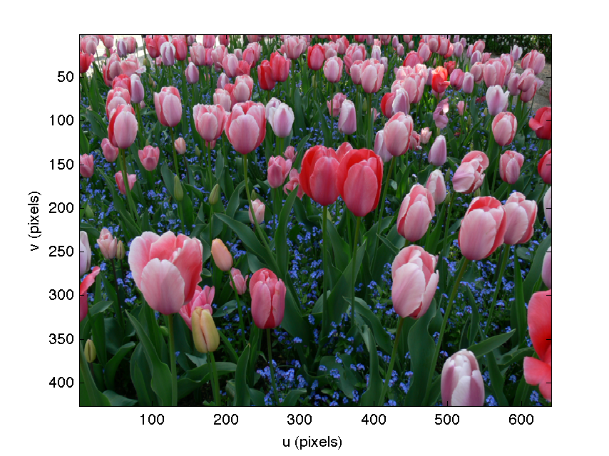
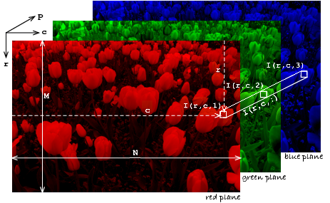
Image
Numpy array (3 channels, uint8: 8 bits/pixel)
height, width = image.shape[:2]
(blue, green, red) = cv2.split(image)
[0, 0]

Slide 8
Input & Output with OpenCV
Input
cv2.VideoCapture(…).read()
Reads frame from webcam or video file
cv2.imread
Reads image from file
Output
cv2.imwrite
Writes image to file

Slide 9
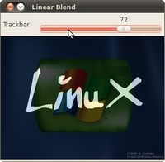
GUI
Display images
cv2.imshow
Trackbars
cv2.createTrackbar
Mouse
cv2.setMouseCallback

Slide 10
Image Processing
Colorspace conversions
Geometric Transformations
Smoothing
Thresholding
Edge detection
Contour detection
Morphological operations
…..and much, much more

Slide 11
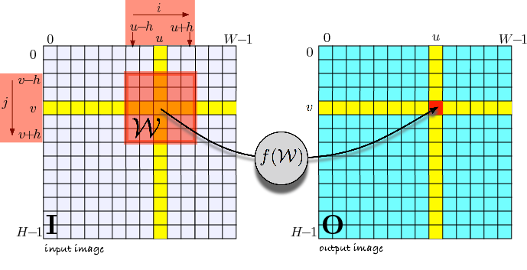
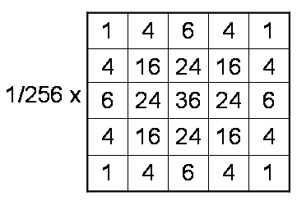

Image Processing
Convolution (2D, spatial): Kernel Image
$$⊗$$
Example: Gaussian kernel:
http://setosa.io/ev/image-kernels/
http://aishack.in/tutorials/image-convolution-examples/

Slide 12
Drawing & Writing on images
cv2.line
cv2.rectangle
cv2.polyline
cv2.circle
cv2.ellipse
cv2.drawContours
cv2.putText

Slide 13
Opencv & ROS

Slide 14
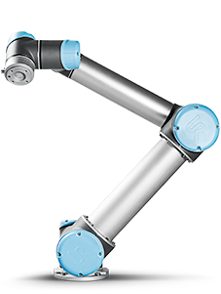
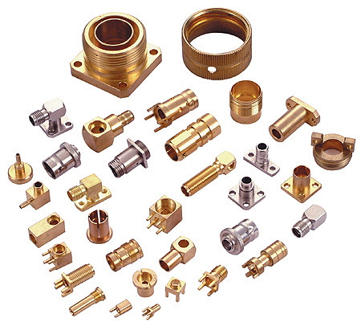
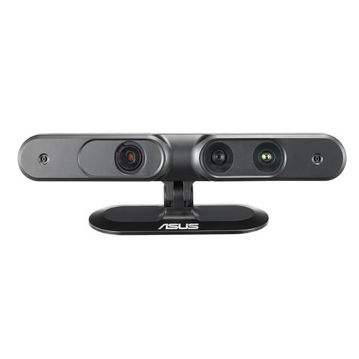



Computer Vision in ROS
Image
Pose

Slide 15
Image Acquisition in ROS
http://wiki.ros.org/Sensors/Cameras
USB camera node:
http://wiki.ros.org/usb_cam
camera_node
camera_info
sensor_msgs/CameraInfo
image_raw
sensor_msgs/Image

Slide 16
Image Processing in ROS
sensor_msgs/Image
image_raw
ip_node
camera_info
TF
sensor_msgs/CameraInfo
sensor_msgs/Image
geometry_msgs/PoseArray
<proprietary message>

Slide 17
opencv_apps
Ready to use OpenCV based ROS nodes
No programming required
http://wiki.ros.org/opencv_apps

Slide 18
Writing opencv Ros nodes

Slide 19
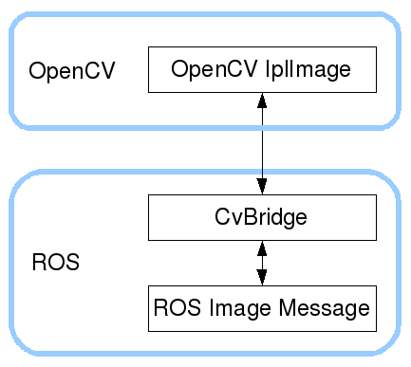
ROS OpenCV Bridge
ROS image differs from OpenCV image
http://wiki.ros.org/vision_opencv

Slide 20
ROS node in Python
#!/usr/bin/env python
import rospy
from std_msgs.msg import String
def chatCallback(msg):
rospy.loginfo(rospy.get_caller_id() + "I heard %s", msg.data)
def listener(): rospy.init_node("listener", anonymous=True)
rospy.Subscriber("chatter", String, chatCallback, , queue_size=10)
rospy.spin()
if __name__ == '__main__':
listener()

Slide 21
ROS Image Processing node
#!/usr/bin/env python
import rospy
import cv2
import numpy as np
from sensor_msgs.msg import Image
from cv_bridge import CvBridge, CvBridgeError
class image_processor: def __init__(self):
self.bridge = CvBridge()
self.image_sub = rospy.Subscriber("image_topic", Image, self.imageCallback, queue_size=1)
self.image_pub = rospy.Publisher("image_topic_2", Image, queue_size=1)
def imageCallback(self, ros_img_msg):
cv_image = self.bridge.imgmsg_to_cv2(ros_img_msg, "bgr8") # TODO: code to process cv_image
self.image_pub.publish(self.bridge.cv2_to_imgmsg(cv_image, "bgr8"))
if __name__ == '__main__': rospy.init_node('image_processor', anonymous=True)
ip = image_processor() rospy.spin()
cv2.destroyAllWindows()
OpenCV-Python library
OpenCV-Python Image is a Numpy array
ROS OpenCV bridge

Slide 22
Object detection with OpenCV

Slide 23
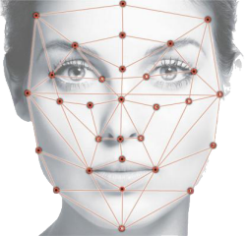
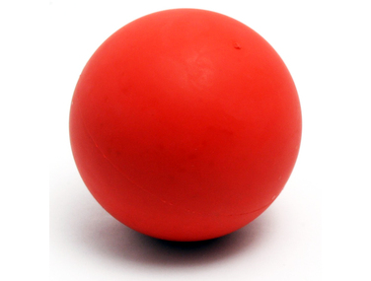
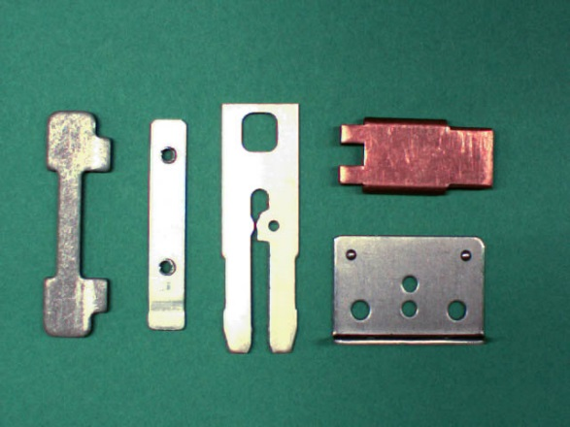
Objects
Normal
Colored
Featured
Industrial / Metal
Colorless
False features
reflections
scratches
dirt

Slide 24
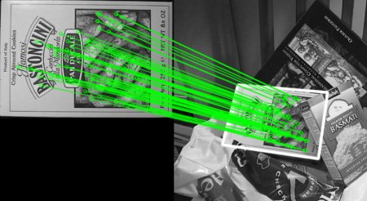
Object Detection using Features

Slide 25
Object Detection using Shape
RGB
cv2.cvtColor
cv2.cvtColor
Gray
HSV
cv2.Canny
Edges
cv2.threshold
cv2.inRange
Blobs
cv2.findContours
cv2.findContours
Contours
cv2.arcLength
cv2.moments
cv2.approxPolyDP
cv2.contourArea
cv2.HuMoments
Contour Features
cv2.minAreaRect

Slide 26
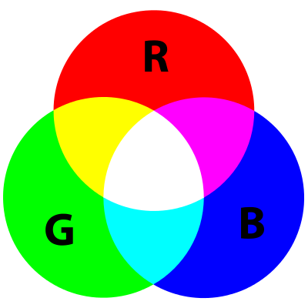
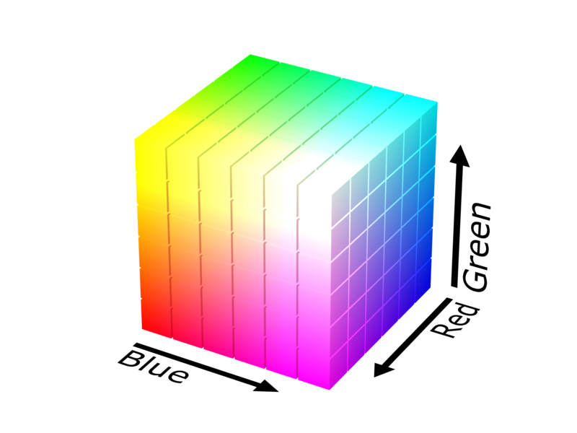
RGB
BGR in OpenCV

Slide 27
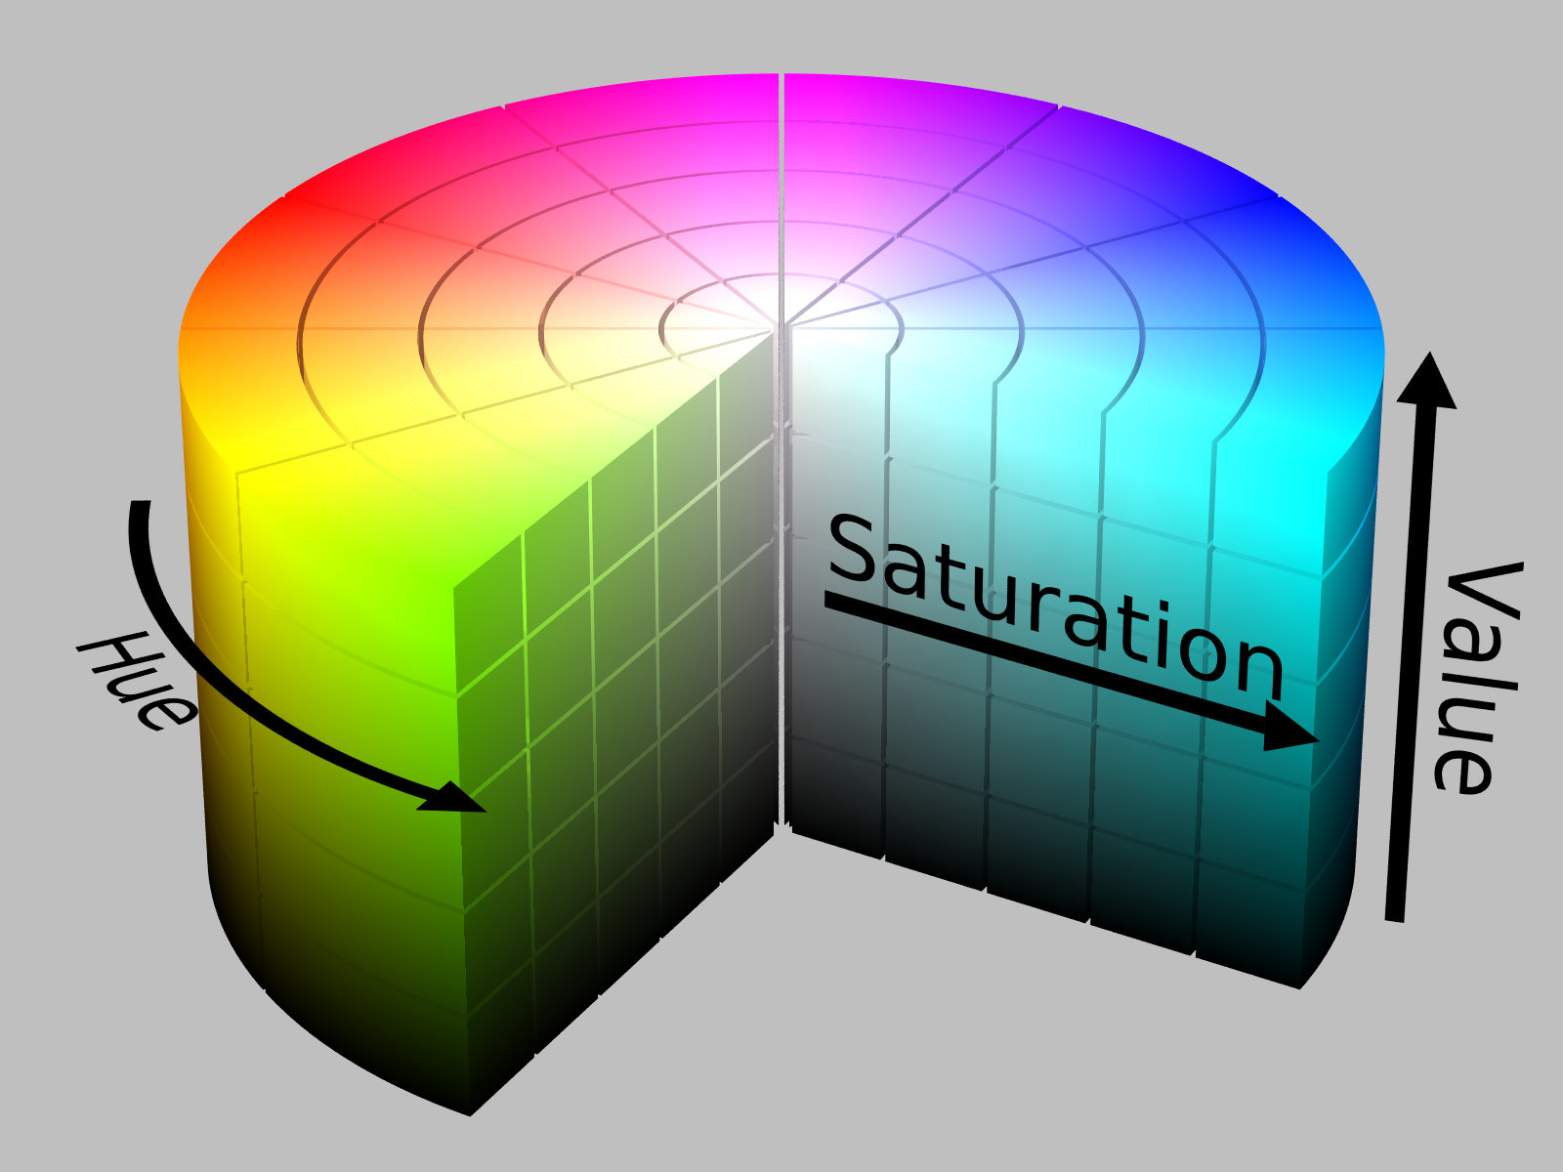
HSV
cv2.cvtColor(image,cv2.COLOR_BGR2HSV)
Better then RGB for selecting color range

Slide 28

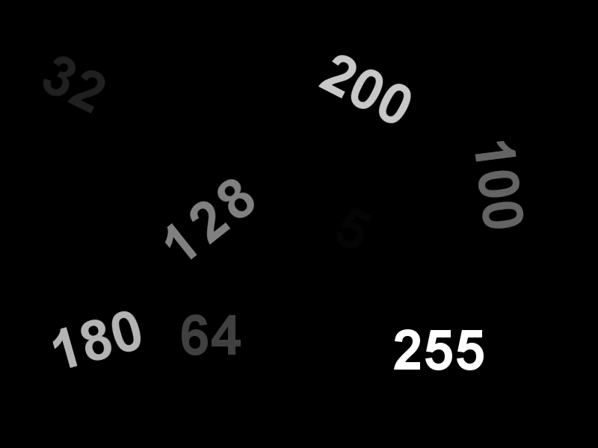
Grayscale
cv2.cvtColor(image, cv2.COLOR_BGR2GRAY)

Slide 29
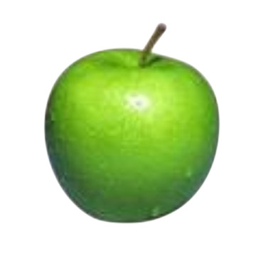

Contours from Colors
RGB
cv2.cvtColor
HSV
cv2.inRange
Blobs
cv2.findContours
Contours

Slide 30
Contours from edges / blobs
RGB
cv2.cvtColor
Gray
cv2.Canny
cv2.threshold
Edges
Blobs
cv2.findContours
Contours

Slide 31

RGB

Slide 32
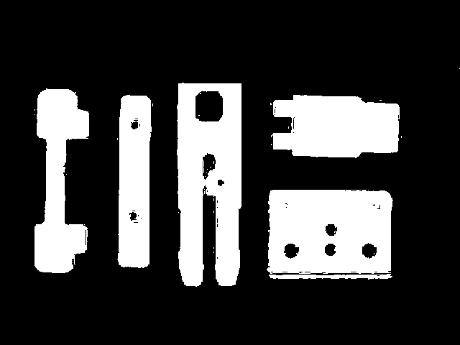
Blobs from color thresholding
cv2.inRange(hsv, …)

Slide 33
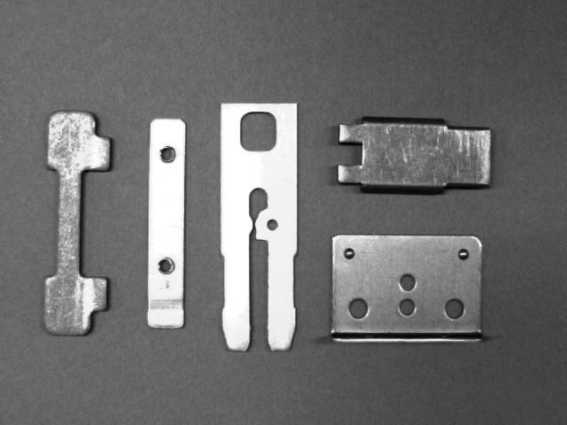
Grayscale

Slide 34
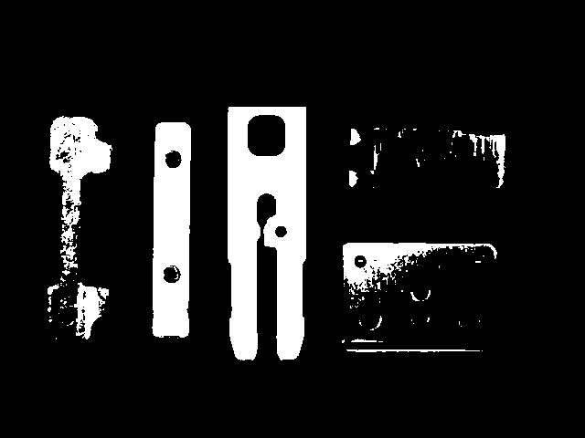
Blobs from grayscale thresholding
cv2.threshold(gray_image, …)

Slide 35
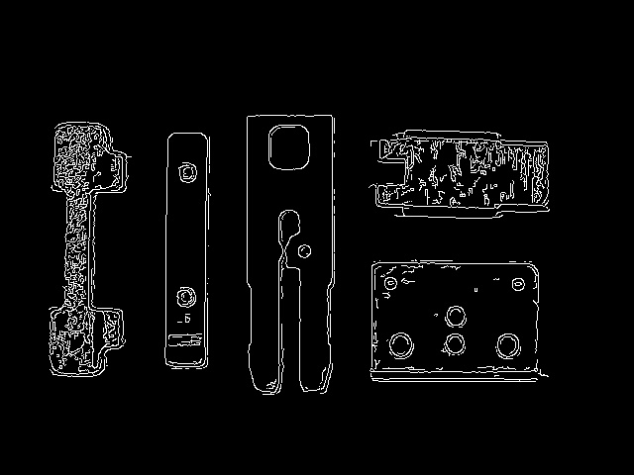
Edges from grayscale
cv2.Canny(gray, …)

Slide 36
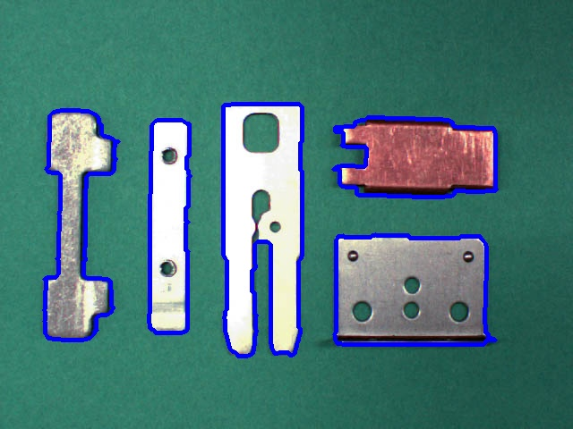
Contours
cv2.findContours(edges, …)

Slide 37
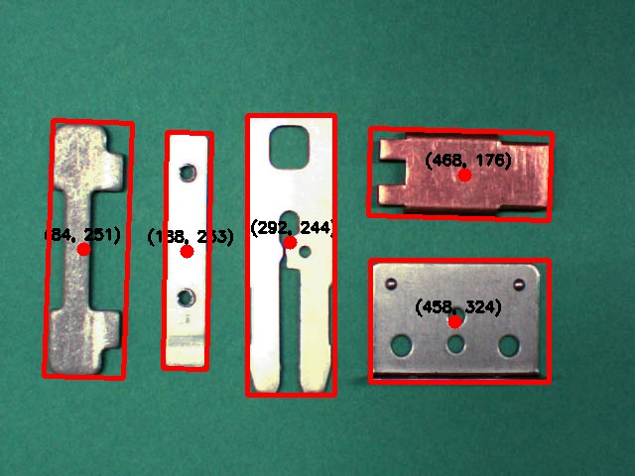
Contour features

Slide 38
Contour features
Moments of the contour area
moments = cv2.moments(contour)
Centroid
cx = int(moments['m10']/moments['m00'])
cy = int(moments['m01']/moments['m00'])
https://opencv-python-tutroals.readthedocs.io/en/latest/py_tutorials/py_imgproc/py_contours/py_table_of_contents_contours/py_table_of_contents_contours.html

Slide 39
Contour features
Area
cv2.contourArea(contour)
Perimeter
cv2.arcLength(contour, True)
Polygon sides/corners
cv2.approxPolyDP(contour, …)

Slide 40
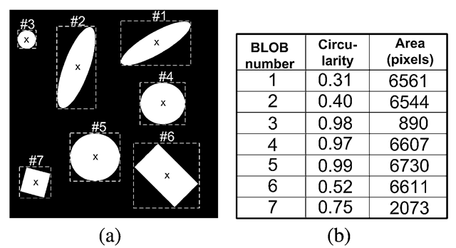
Contour features
Circularity
4*math.pi*area/perimeter**2
http://what-when-how.com/introduction-to-video-and-image-processing/blob-analysis-introduction-to-video-and-image-processing-part-1/

Slide 41
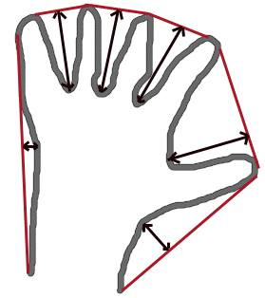
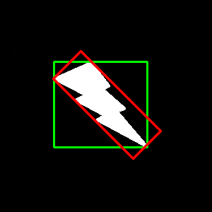
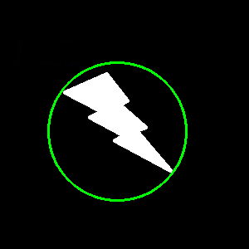
Contour features
Convex Hull
cv2.convexHull(contour)
Bounding Rectangle
cv2.boundingRect(contour)
cv2.minAreaRect(contour)
Minimum Enclosing Circle
cv2.minEnclosingCircle(contour)

Slide 42
Contour shape matching
Hu moments
cv2.HuMoments(cv2.moments(image))
invariant to image scaling, rotation, mirroring
“affine invariant”
Compare two contours
cv2.matchShapes(contour1, contour2, …)
Based on Hu-moments

Slide 43
Camera calibration

Slide 44
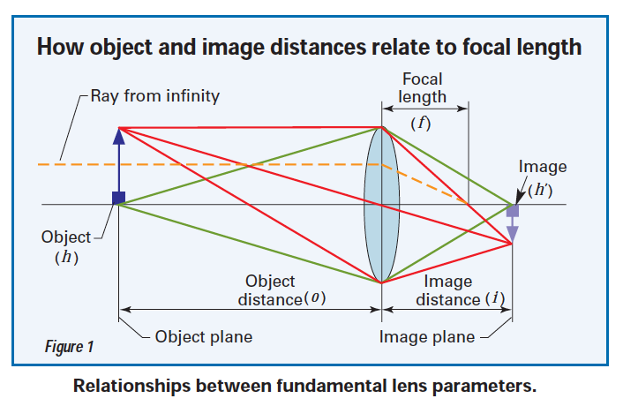
Camera
http://machinedesign.com/sensors/lessons-machine-vision-eye-working-distance-and-depth-field

Slide 45

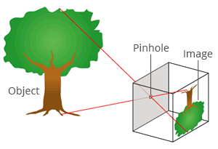

Pinhole Camera Model
(cx, cy): center of image
fx, fy: focal length in x and y direction
https://ksimek.github.io/2013/08/13/intrinsic/

Slide 46
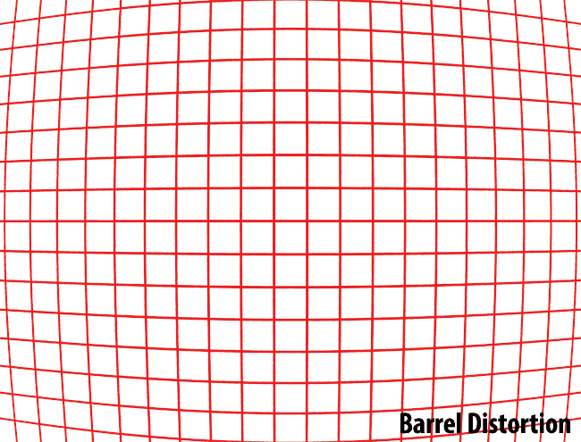
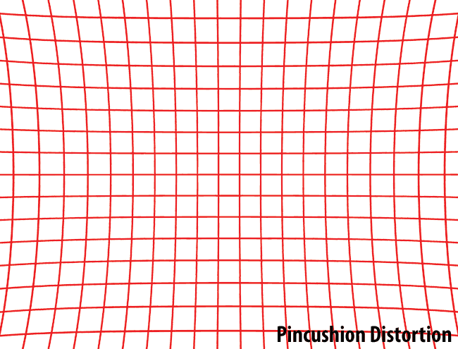
Distortion
https://photographylife.com/what-is-distortion

Slide 47
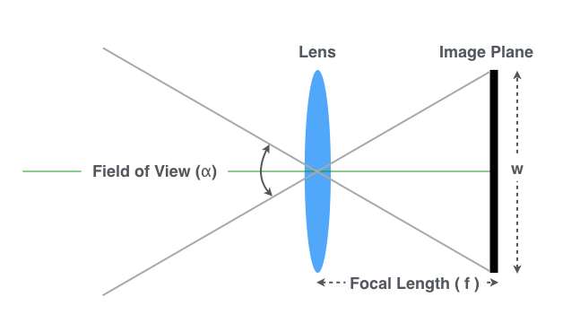
Focal lenght estimation
f = sqrt(w**2 + h**2) / 2 / tan(DFOV/2)
w, h : width and height of image (pixels)
DFOV: Diagonal Field of View (degrees)
https://www.learnopencv.com/approximate-focal-length-for-webcams-and-cell-phone-cameras/

Slide 48
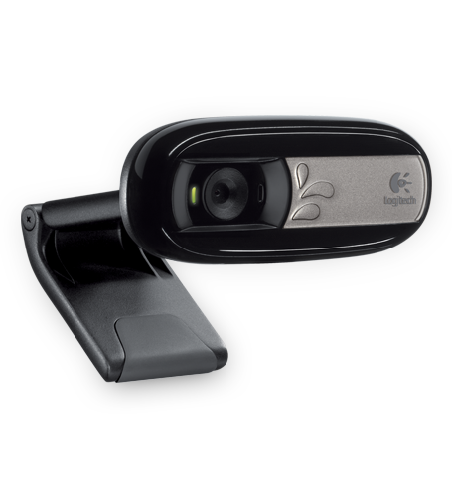
Example: Logitech C170 webcam
Optical Resolution: 640x480 pixels
Focal Length: 2.3 mm
Diagonal FOV: 58 degrees
Estimated: f = 722 pixels
Pixel size = 2.3 / 722 = 3.2 um
http://www.comx-computers.co.za/LOG-C170-specifications-94376.htm

Slide 49
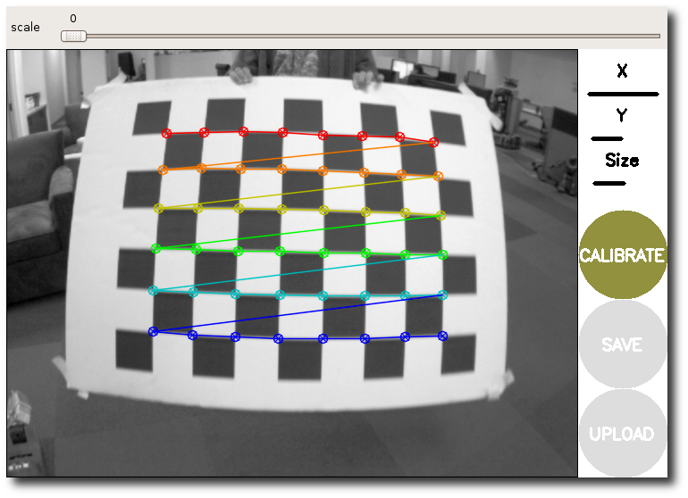
ROS Camera Calibration
http://wiki.ros.org/camera_calibration
Finds camera matrix and distortion coefficients

Slide 50
ROS Camera Calibration result
~/.ros/camera_info/<camera-name>.yaml
image_width: 2448
image_height: 2050
camera_name: prosilica
camera_matrix:
rows: 3
cols: 3
data: [4827.94, 0, 1223.5, 0, 4835.62, 1024.5, 0, 0, 1]
distortion_model: plumb_bob
distortion_coefficients:
rows: 1
cols: 5
data: [-0.41527, 0.31874, -0.00197, 0.00071, 0]
rectification_matrix:
rows: 3
cols: 3
data: [1, 0, 0, 0, 1, 0, 0, 0, 1]
projection_matrix:
rows: 3
cols: 4
data: [4827.94, 0, 1223.5, 0, 0, 4835.62, 1024.5, 0, 0, 0, 1, 0]

Slide 51
ROS Camera Model support
image_geometry package
image_geometry.PinholeCameraModel
image
image_processing_node
(using image_geometry)
camera_info
http://wiki.ros.org/image_geometry
http://docs.ros.org/api/image_geometry/html/

Slide 52
Image Rectification in ROS
http://wiki.ros.org/image_proc
image_raw
image_proc
camera_info
image_rect

Slide 53
Camera perspective correction

Slide 54
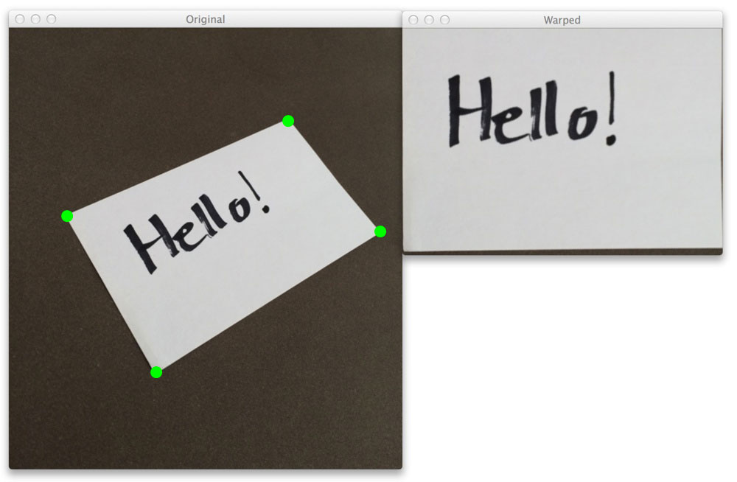
Bird’s eye view
Homography (from > 3 corresponding points)
cv2.getPerspectiveTransform
cv2.findHomography
cv2.warpPerspective
http://www.learnopencv.com/homography-examples-using-opencv-python-c/
http://www.pyimagesearch.com/2014/08/25/4-point-opencv-getperspective-transform-example/

Slide 55
POSE and size estimation

Slide 56
Size versus Distance
Y/Z = y/f
Object
Y
f
y
Z
Image

Slide 57
Size or Distance estimation
Size of object (mm): Y = Z * y/f
f: focal length (pixels)
y: size of object in image (pixels)
Z: distance to object (mm)
Distance camera to object (mm): Z = Y * f/y
f: focal length (pixels)
y: size of object in image (pixels)
Y: real size of object (mm)

Slide 58

Markers / Fiducials
Objects with known shape and size
Attached to table or object
Reference Size, and ID
Reference for Pose tracking
Reference for Perspective Correction
http://wiki.ros.org/ar_track_alvar

Slide 59
ROS TF
world
camera
robot
lookupTransform
marker
object

