Slide 1


Safety Network
Collaborative Emergency Network

Slide 2
Safety Network
Chosen challenge:
From Curious Minds Come Helping Hands
The issue we are facing:
Lack of information in emergency situations.
Our solution:
Develop an application which finds in real time people in danger and hazardous areas

Slide 3


Safety Network: information coming from users
DANGER
OK
OK
Hazard area

Slide 4
Safety Network: information coming from users
OK
OK
Hazard area
Hazard area

Slide 5
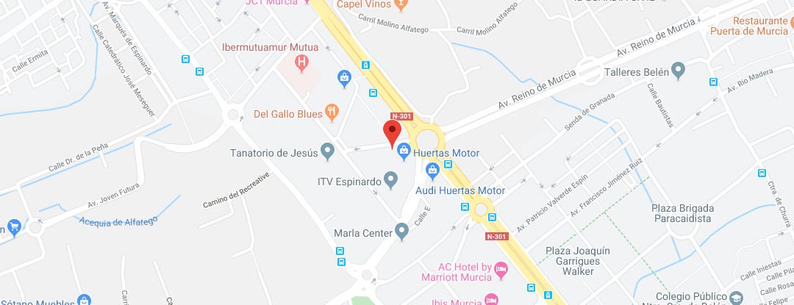

Safety Network: example of alert propagation

Slide 6

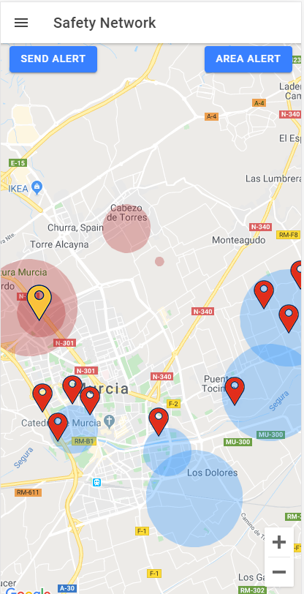
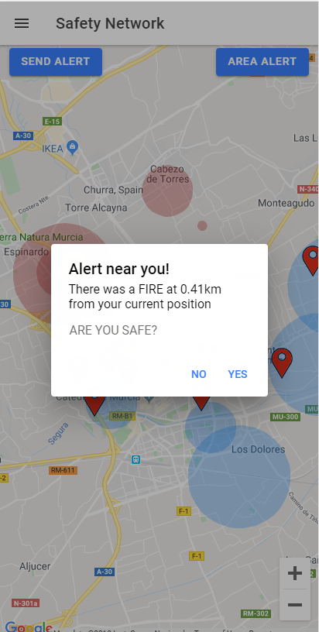
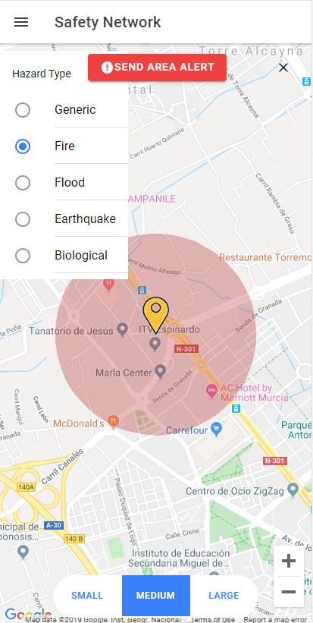
Safety Network: our application

Slide 7


Safety Network: information getting into the system from national emergency services APIs
Hazard area

Slide 8

Safety Network: neuronal network
Neuronal network in tensorflow
Previous alerts records
Possible hazard area

Slide 9
Safety Network: External generic API
Our system has the possibility of external Reading/writing of alerts so that any other system can be integrated with us:
http://BASE_URL/api/alerts/FireAlert
http://BASE_URL/api/alerts/FloodAlert?latitude38,006480&longitude=-1,145728

Slide 10
Safety Network
Resources:
Our page on SpaceApps:
https://2019.spaceappschallenge.org/challenges/living-our-world/curious-minds-come-helping-hands/teams/auto/
Our code repository:
https://github.com/javieraviles/spaceappschallenge

