Slide 1
ZaloPay Auth
Thanh Tran

Slide 2
Agenda
Issue at Zalo Admin App
Solution
Implement
Integration
Investigate Zalo Admin App

Slide 3





Issue at Zalo Admin App
User

Slide 4
Issue at Zalo Admin App
User
A lot of username/password
Need Single Sign on
SO
Hard to control user
Roles
Deactive user
Hard to audit log
Zalo Admin App
Each Admin App has difference way to control Roles/Resource

Slide 5
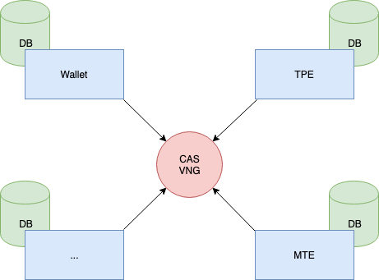
Investigate Zalo Admin App
Use CAS VNG
Each Service have their DB

Slide 6



Solution
Authentication &
Authorization Service
Gateway
Service to Track The Log

Slide 7
Solution Authentication & Authorization Service
Keycloak

Slide 8
Solution Authentication & Authorization Service
Identity Brokering
VNG CAS

Slide 9
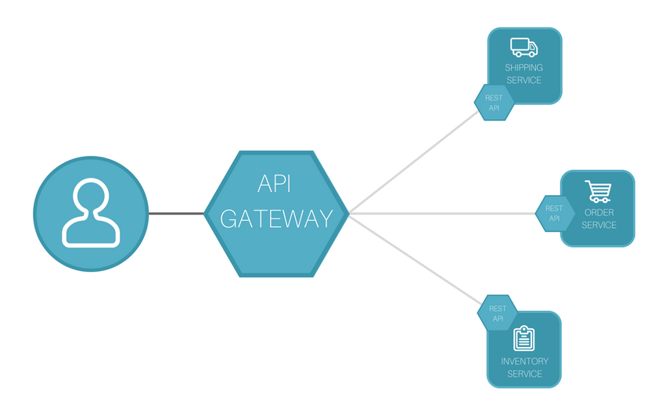
Solution Gateway
Kong API Gateway

Slide 10

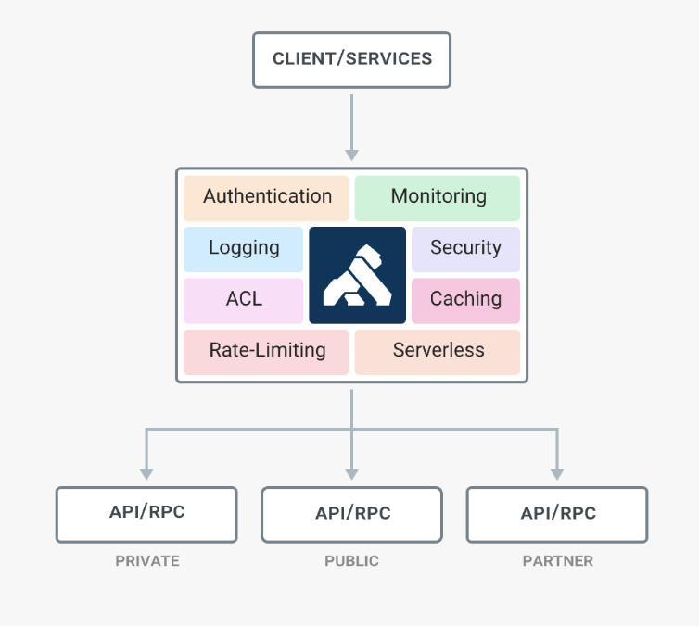
Solution Gateway

Slide 11
Solution Service to track the logs
Zalopay Auth
Kong Http-log Plugin : https://docs.konghq.com/hub/kong-inc/http-log/

Slide 12
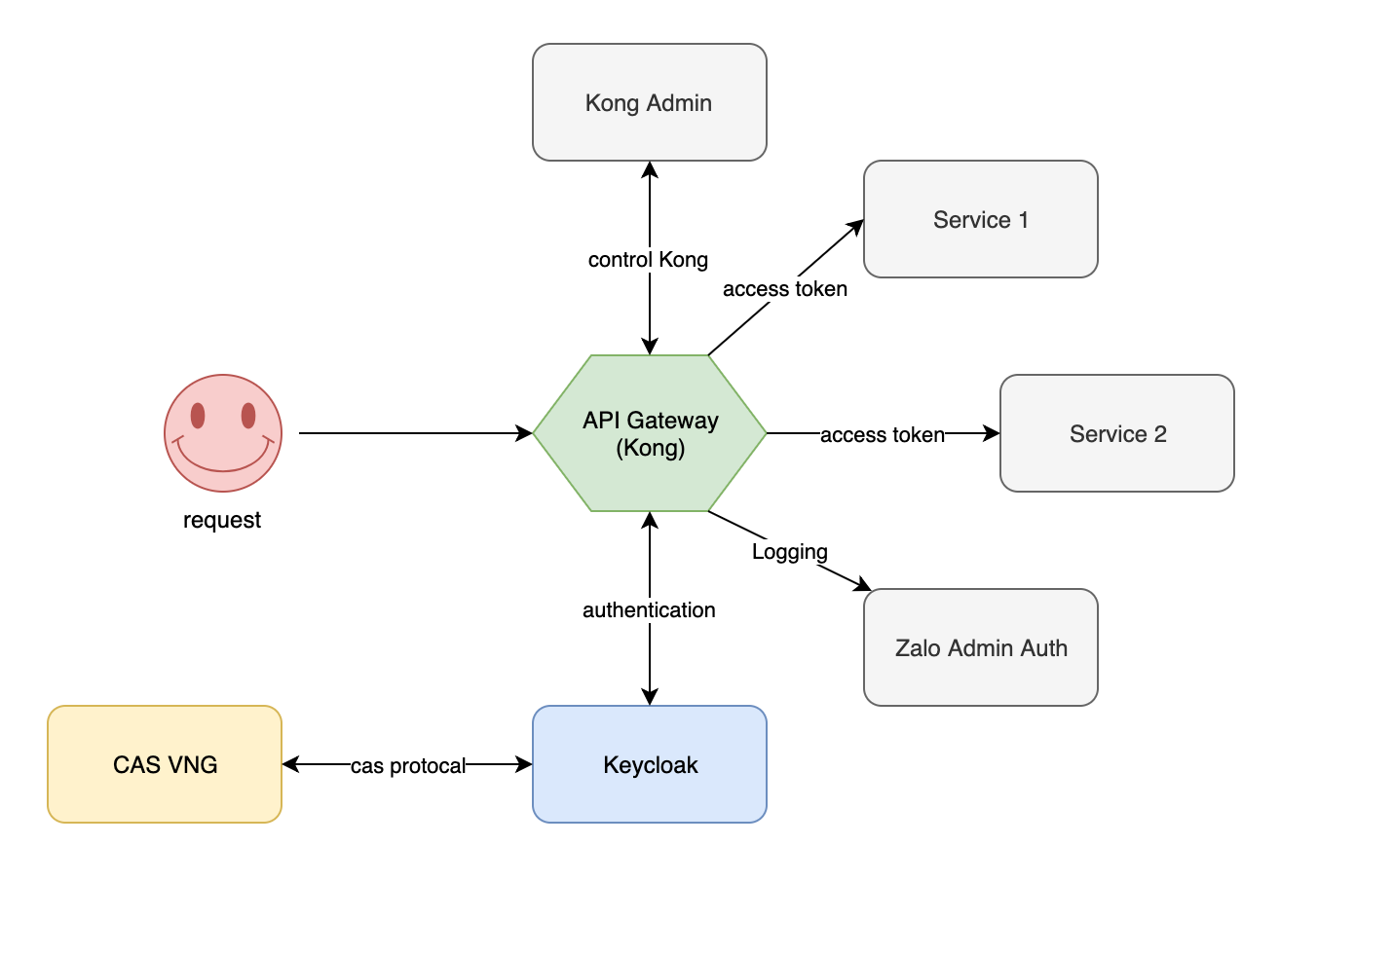
Solution System Design

Slide 13
Implement Zalopay Auth
Frond End
React + Redux
Ant Design Pro
Back End
Spring framework
Keycloak
Plus CAS protocal
Kong gateway
Plus OIDC Plugin

Slide 14
Implement Zalopay Auth
Demo

Slide 15
Integration
Read x-access-token from request header and get
User Info
Roles

