Slide 1
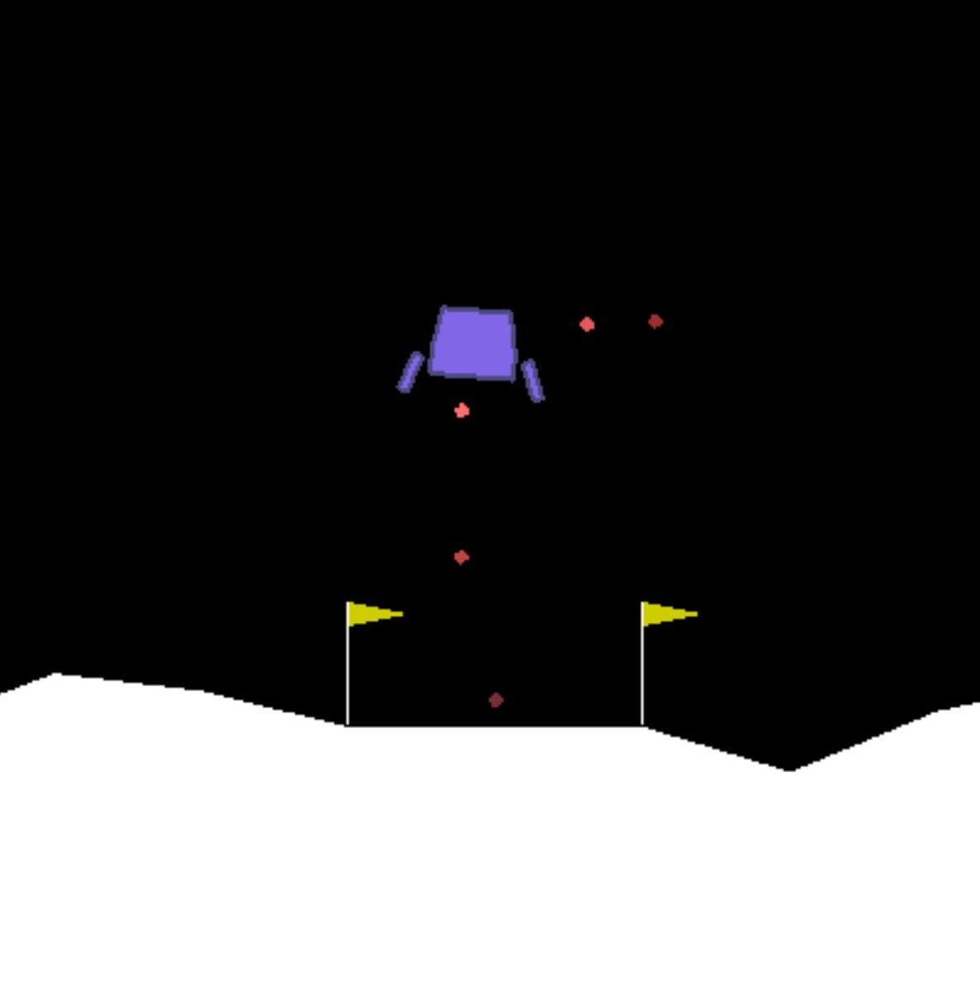
Lunar Lander Problem with RL
Doruk Özer 70192
Alper Koç 82556

Slide 2
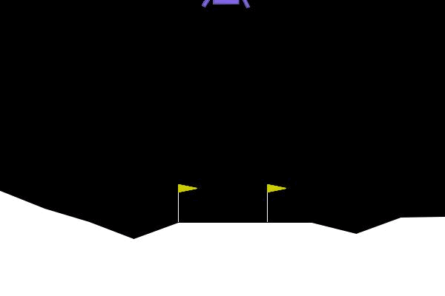
Solving Lunar Lander Problem with RL Techniques
Notes:
In this project , we implement and analyzed two different RL techniques, which are variations of Deep Qlearning and Policy gradient methods, on OpenAI Gym’s LunarLander environment. The environment simulates the situation where a lander needs to land at a specific location under low-gravity conditions with different landscapes. The main goal of the agent is to land to landing pad softly enough and fuel efficiently

Slide 3

Problem Definition
x coordinate of the lander
y coordinate of the lander
The horizontal velocity
The vertical velocity
The orientation in space
The angular velocity
Left leg touching the ground
Right leg touching the ground
Do nothing
Fire left orientation engine
Fire right orientation engine
Fire main engine.
action
space
reward
−100 ∗ (d_{t} − d_{t-1}) − 100 ∗ (v_{t} − v_{t-1}) −100 ∗ (ω_{t} − ω_{t-1}) + hasLanded(s_{t})
Notes:
We used the state, action space definition and reward function stated in the “Solving The Lunar Lander Problem under Uncertainty using Reinforcement Learning” paper.
The enivornemnt’s state space defination is continuous which describes the agent’s location in the space as in real physics, while the action space is consisted of four discrete actions.
In addition, the reward function ensures that the agent has both a good posture in mid-air and reach the landing pad as quickly as possible which defines our utilities to be maximized in long term.

Slide 4
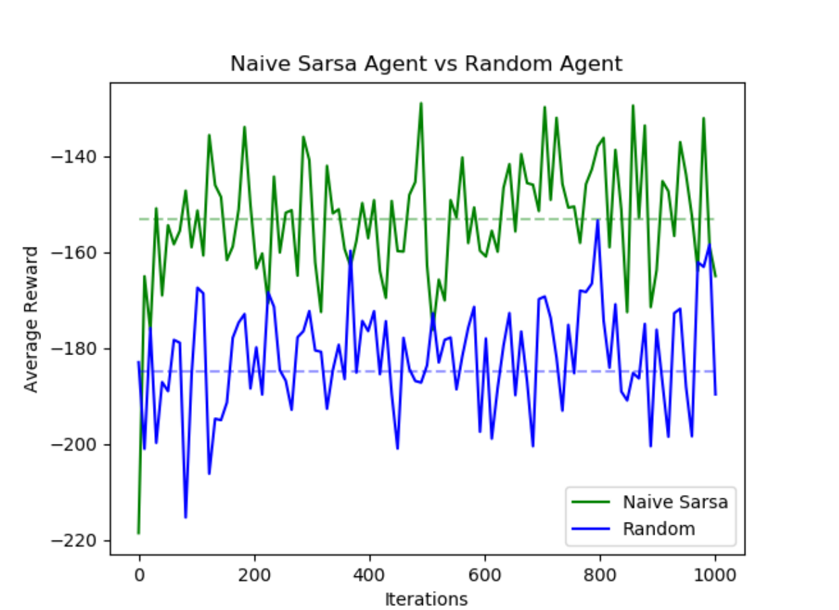
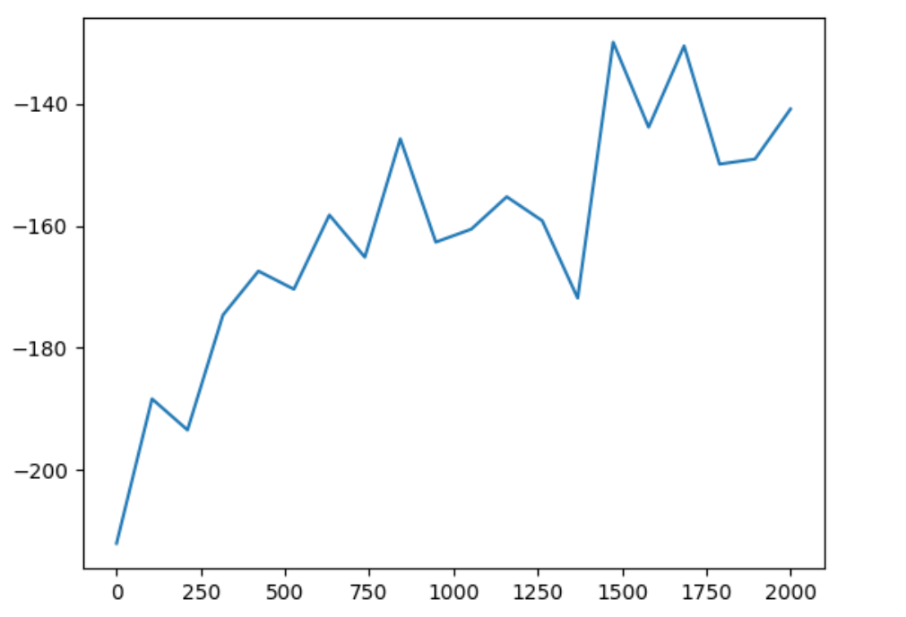
SARSA on Lunar Lander
Average Score over last 100 moves
Episode
Notes:
In the action space definition there are six continuous state variables and two boolean state variables which makes the state space complexity too high. So the state space is far too large to explore within a reasonable number of training episodes. It explains the poor performance we are seeing, in the figure comparing the naïve sarsa agent with random agent. Their performance measures are approximately shares the same variance and uncertinity. The most common solution to dimensionalty problems is to replace the table with a linear approximation function.

Slide 5
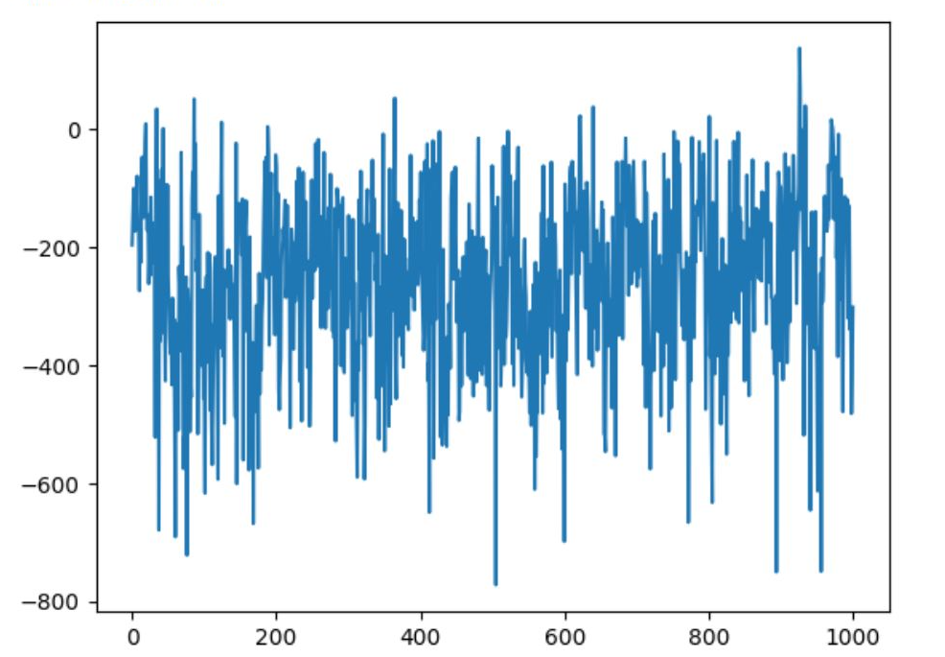
Linear Function Approximation
-Linear Relationship between features and state action pairs
-Dimensionality of the problem
-The Lunar Lander environment may introduce external factors or events that lead to discontinuities.
Average Score over last 100 moves
Episode
Notes:
In linear approximation function rather than attempting to store a map of how states and actions alter the expected return the values of state action pairs are approximated.
Linear approximation approach assumes that the relationship between features of state space and values of state action pairs are independent and has a linear relationship. However the actions may have combined non –linear affect on the state space. For example, the gravitational forces, thrusts from the engines, and aerodynamics, have non-linear relationships.
The Lunar Lander environment also introduce external factors or events that eventually leads to discontinuities in environment and state space. such as agent can hit an obstacle or any touching event with the landscape makes the boolen values change that leads to discontinuities in state space and poor performance.

Slide 6
DQN and Variants
Nonlinear function approximators may in fact diverge:
-States Are Correlated
-Single Step Gradients
-Learning Targets Are Non–Stationary
-Maximization Bias
Solutions:
-Batch Learning
-(Prioritized) Experience Replay
-Dueling Architecture
-Double Learning
Notes:
Since Simple models, like linear models, can cope with simple environments, it cant cope with environment of the Lunar Lander which contains non-linearity and discontiuities . So we propose DQN models in order to cope with this non-linear environment.
Linear Approximation methods has the same convergence guarantees as tabular methods while Nonlinear function approximators may in fact diverge due to the correlations between states, single step gradients, non stationary targets and maximization bias. In order to overcome these disadvantages, there are different implementation of DQN methods. First batch learning overocomes the single step gradient update issues. Second there are DQN implementations with experience replay, or prioritized experience replay to break correlations between states. Third implementations with dueling architectures improves the stationarity of the targets by representing the individual actions relative to the value of the state. Fourth double learning is proposed in order to overcome the maximization bias.
We implemented those solutions in addition to standard DQN with standard exp replay implemented in the Lunar Lander paper.

Slide 7
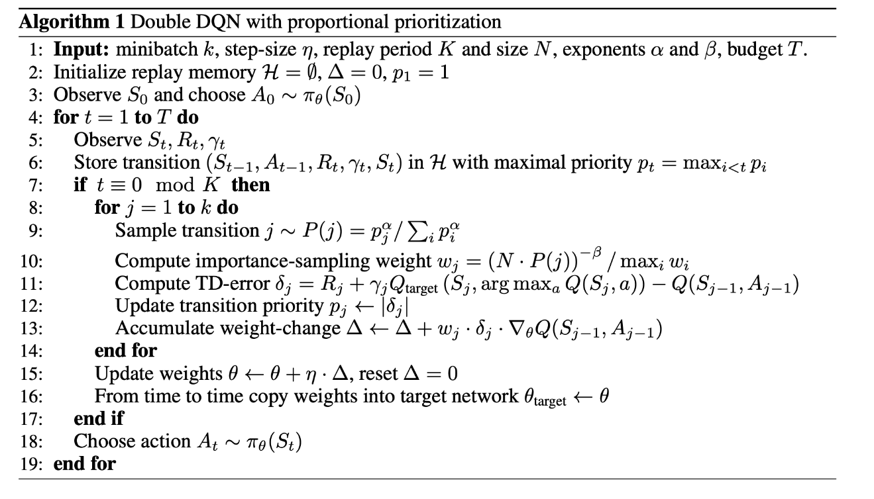
Prioritized Experience Replay
α =0.2, β=0.8.
Notes:
We implemented Prioritized Experience replay in the same way it mentioned in the Prioritized Exp Replay paper.
The prioritization is made according to the squared TD errors. Then, we chose the alpha and beta values after experimentation as alpha equals to 0.2 and beta 0.8. Alpha arranges the priotorization coeffiecent (making alpha 0 means no priotorization) and beta arranges the coeffients of the weights of the gradients (making beta 1 means low weights). The weights are given to the graidents because some samples with high priority can dominate the sampled transitions from the experience replay.

Slide 8
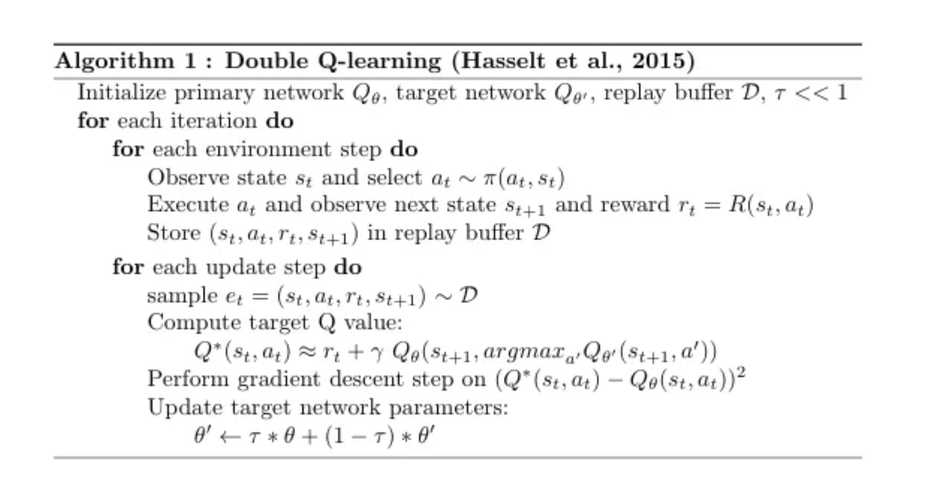
Double Learning
Notes:
We implemented the double learning as it is described in the lecture notes

Slide 9
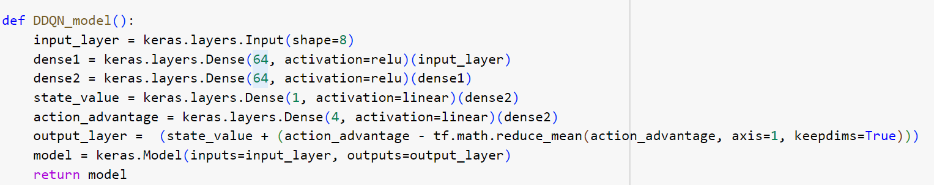
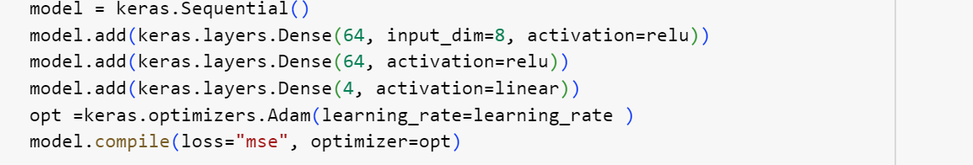
Dueling Architecture vs DQN
Notes:
We added dueling architecture on the top of the original DQN architecture mentioned in the Lunar Lander paper. In addition, we stayed loyal to the hyperparameters stated for the DQN architecture such as learning rate, number of neurons in each layerfor both DQN and Dueling DQN approaches in the implementation.

Slide 10
DQN with annealing ε-greedy Policy
- DQN
- Dueling DQN
- Prioritized DQN
- Prioritized Dueling DQN
Double DQN
Double Dueling DQN
Prioritized Double DQN
Prioritized Double Dueling DQN
Notes:
in order to observe the effects of using priotorized experience replay, dueling architecture and double learning in Lunar Lander problem we conducted experiments with the combinations of these approaches and compared their average rewards over last 100 moves within each episode.
The policies for each variant uses epsilon greedy policy that anneals and converges to deterministic policy over time that ensures the exploration in the first start

Slide 11


Experimental Results Seed 0
Dueling Architecture | Prioritized Experience Replay | Double Learning | Final Average Reward
 |  |  | -157
 |  |  | -141
 |  |  | -106
 |  |  | -142
 |  |  | -230
 |  |  | -107
 |  |  | -161
 |  |  | -123
Notes:
The first experiment showed us the best results are given by Priotorized Dueling DQN and Dueling Double DQN and the worst result is given by Double DQN.
There are remarkable observations when the approaches are compared. First dueling versions of every method performed better then it’s non-dueling versions. Second, priotorized exp replay performed better for both dqn and dueling dqn variants but performed worse for double dueling architectures. Third double learning agents performed worse except the dueling architecture

Slide 12
Why Dueling Better ?
Not all states are equally important for decision-making.
Estimating value of states are easier
Stable targets
= Faster Convergence
Notes:
First reason of why dueling out-performed when compared to non-dueling versions is , in a case where the agent learned how to save itself before crashing outside the landing pole the first actions won’t make many difference in this kind of scenarios. So, all states are contributed differently in decision making. Then it’s better to learn the value of those states in the early start of that trainind episodes opposed to action values. This case can be quite common.
Second, this results showed that estiamation of value of a state is possibly easier then estimating the state action pairs alone. In this kind of large state space the possibility of encountering the same action in the same state is a low possibility. Since even if we conduct fully explorative policy we might not be able to encounter the same state action pair, it is better to use dueling architecture which asseses the value of the state and it improves the generalization of the state values.
Third, the effect of subtracting of the value of the state in the advantage estimate
improves stability. This approach also captures the even smaller differences across states, which is beneficial when there is a case such that both action choices can lead to same results.
Considering this reasons dueling architecuture leads to faster convergence

Slide 13
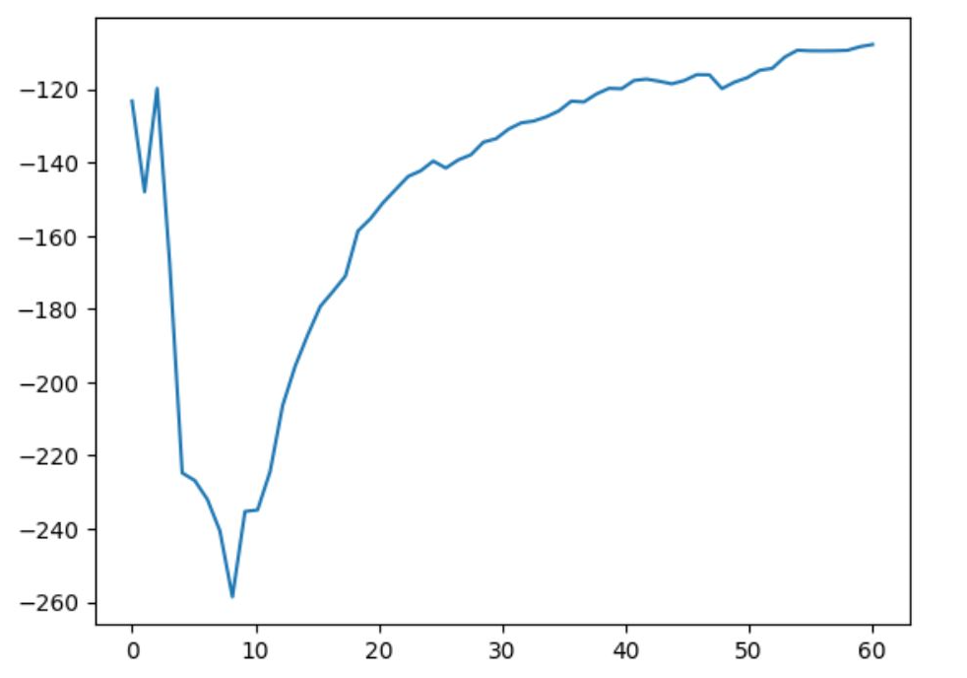
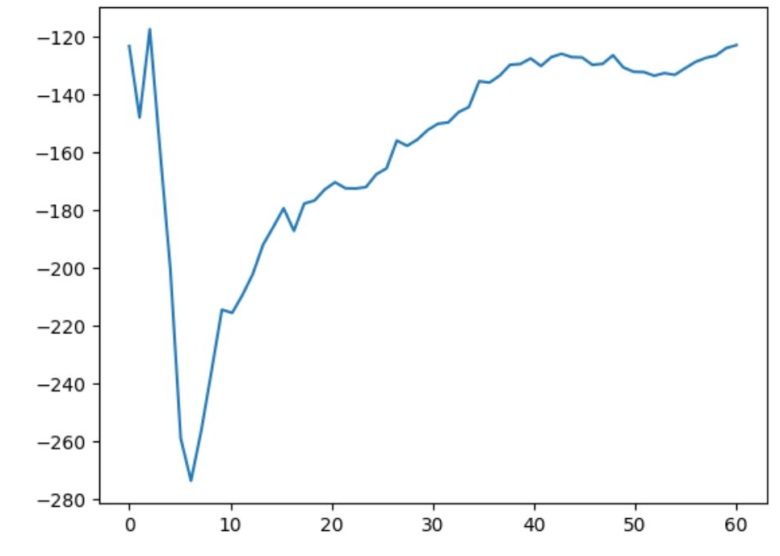
Prioritized Experience Replay for Double Dueling Architectures
- Exploration dominates the first steps of training
Double Dueling DQN
Prioritized Double Dueling DQN
Notes:
Prioritized Experience Replay may focus more on replaying samples that have higher TD errors, which are typically associated with states where the agent has already explored. It can be said that exploration is continuing and the states that have high priority may be the states that has no crucial affects on the landing. So the performance would be enhanced after it learns the states with high TD erros and start to sample the states with more effect on the utilities.

Slide 14
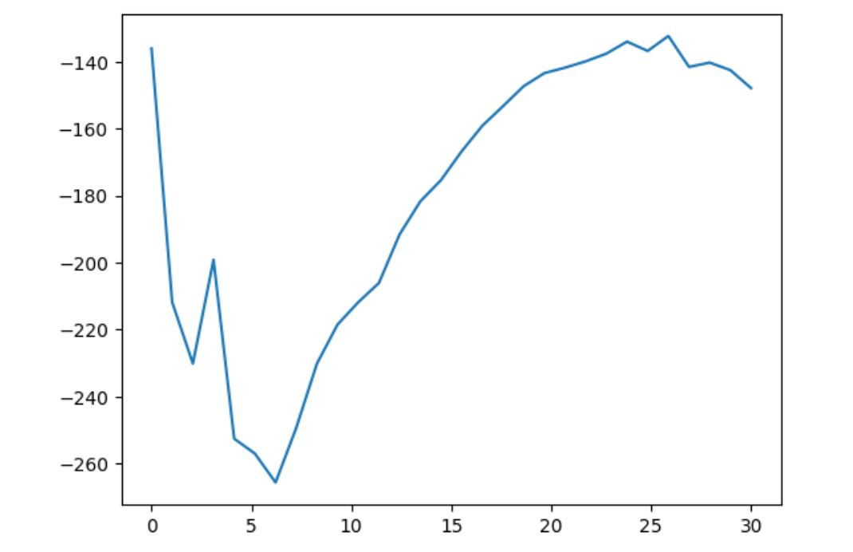
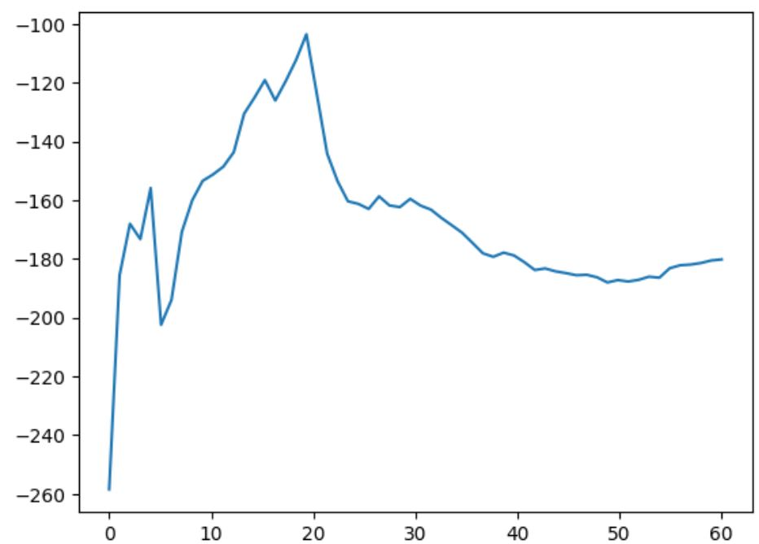
Double Learning for DQN
Dimensionality of State Space and Action Pairs & Samples
Double learning also performed worse for prioritized dueling architecture.
DQN
Double DQN
Notes:
Double Learning may require a large amount of training data to accurately estimate the values for all state-action pairs. The reason why double learning failed may be the sampled states are inefficient for both networks to be trained.
As I mentioned in the previous slide priorotiziaton performed worse for double dualing architectures, and double learning also performed worse for the case prioritized dueling architecture. Considering both cases, it can be inferred that the explortation continues for the states have the most affect on the utilities and dimensionality both are dominating the performance of the agent during training.

Slide 15


Experimental Results Seed 1
Dueling Architecture | Prioritized Experience Replay | Double Learning | Final Average Reward
 |  |  | -126
 |  |  | -102
 |  |  | -144
 |  |  | -161
 |  |  | -180
 |  |  | -184
 |  |  | -116
 |  |  | -104
Notes:
We experiemented all of the combiantations again with different seeds. The avarage results were better than the first experiments.
The observations for the dueling architecture was the same except the priotorized DQN versions.
Second, observations for priorotorized experience replay, was completely opposite since prioritization boosted the performance of dueling double DQNs and performed worse for other cases. Third, double learning performed better in the case of priorotorized dueling DQNs and performed worse for DQN and dueling DQN versions.

Slide 16
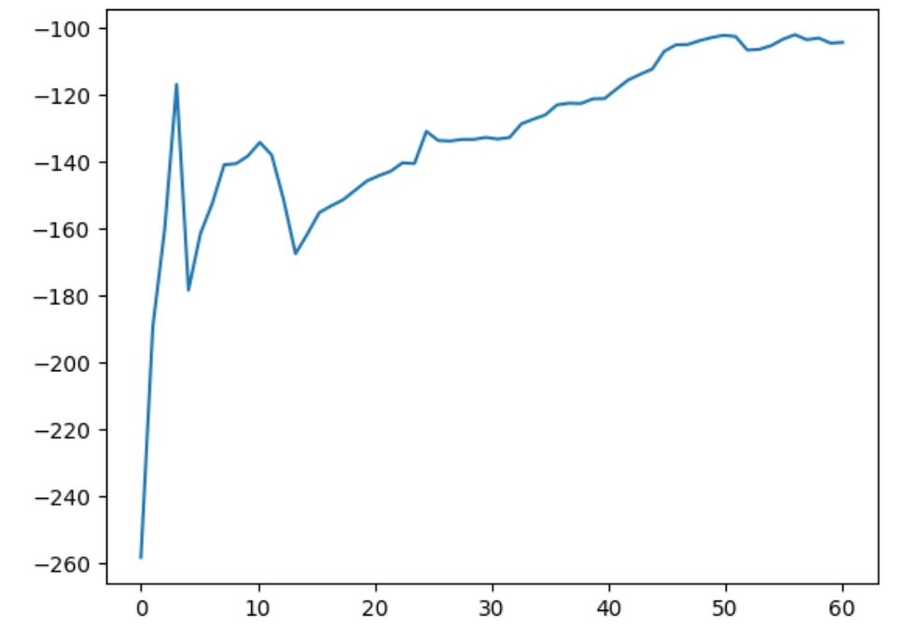
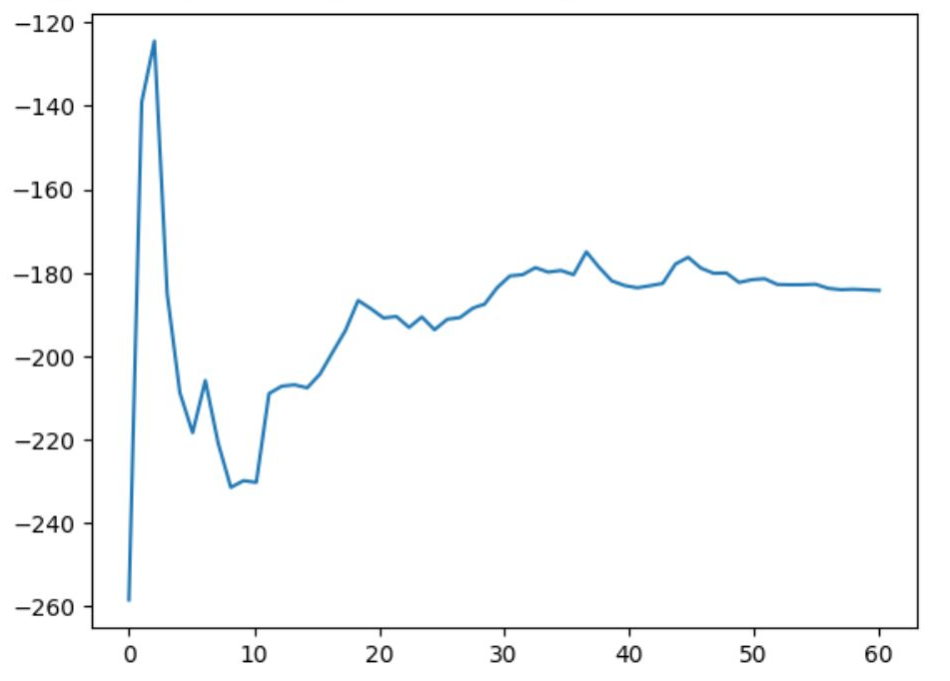
Effects of Prioritization
- Prioritization performed the best for dueling double learning and failed otherwise.
Prioritized Double Dueling DQN
Double Dueling DQN
Notes:
The results for prioritization was completely opposite for this experiment.
This time our agent was lucky enough to learn the states that had more TD errors quickly so it explored and learned faster the crucial states that affected the utilities the most. What I mean is, the states that sampled via prioritization was the most suitable and good states for the dueling double architectures and learned the states where the agent’s landing is mostly affected.

Slide 17
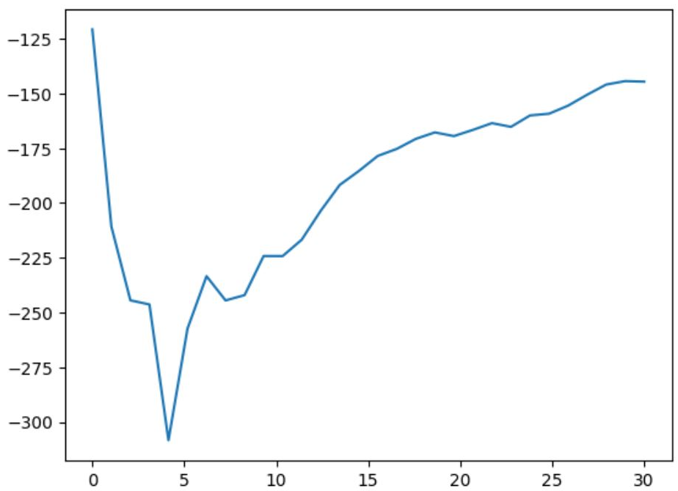
Effects of Double Learning
- Faster convergence
Prioritized Double Dueling DQN
Prioritized Dueling DQN
Notes:
Based on the effects of double learning and previous experiement it can be said that double learning and prioritization are in relation for lunar lander problem. In addition, double learning seemed to eliminated the maximization bias for the sampled states from priorotozied exp replay

Slide 18
Experimental Results Average
Dueling Architecture | Prioritized Experience Replay | Double Learning | Final Average Reward
 |  |  | -141
 |  |  | -121
 |  |  | -125
 |  |  | -151
 |  |  | -205
 |  |  | -145
 |  |  | -138
 |  |  | -113
Notes:
Finalally avarages for two experiments are taken.
The observations for dueling architecture is preserved where dueling architectures always performed better than non dueling ones.
Secondly, the observations for prioritized experience replay and double learning was similar to the second experiment .

Slide 19
Double & Prioritized Experience Replay
Affects the performance of Early Training
In accordance
Boosts the performance
Notes:
Based on the observations, for early training, if the sampled states are crucial for agent to learn how to maximize the utilities then reducing the maximization bias and prioritization works in harmony and boosts the performance of the agent in terms of rewards.

Slide 20
Policy Gradient Methods
-REINFORCE: Monte Carlo Policy Gradient
-A2C - Monte Carlo Algorithm
Solutions: -A2C - Temporal Difference Algorithm
Notes:
In policy gradient methods, agent is to Maximize the “expected” reward of model. The main focus in these methods is reinforcing good actions, meaning increasing the probabilities of actions that yield higher returns, in order to develop the optimal policy. We implemented those solutions in our model.

Slide 21
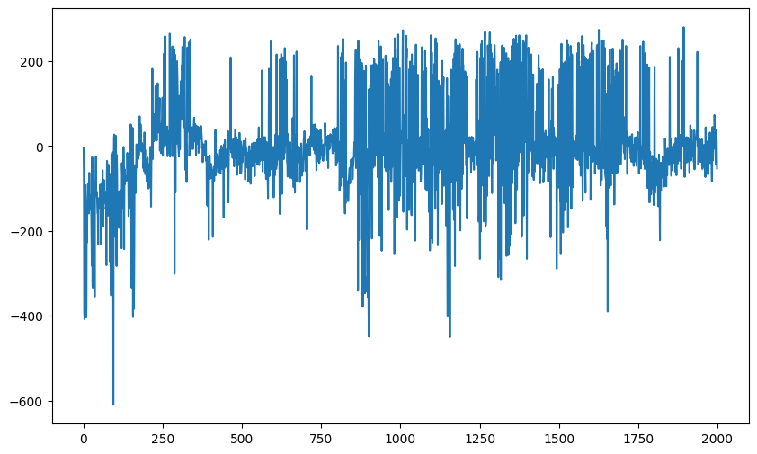
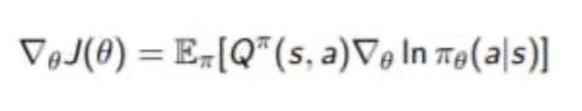
REINFORCE
Score
Actions with higher expected reward have a higher probability value for an observed state.
Episode
Notes:
Among these methods, the simplest version is the REINFORCE algorithm, which serves as the foundation for all models.
The most suitable update is achieved using the Monte Carlo method. Therefore, we are able to measure the accumulated future reward from real sample trajectories.
However, this method presents us with two disadvantages: high variance and noisy gradient, due to stochasticity of the environment’s dynamics and the policy. I intentionally did not place the graph on the screen with an average score of episodes, as the variance can be seen explicitly.

Slide 22
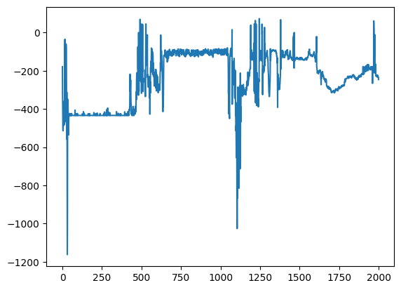
A2C
Score
A2C algorithms varies drastically with minor changes in hyperparameters
Episode
Notes:
In this model, The policy is updated based on the advantage function and parameters are adjusted to increase the probabilities of actions that have a higher advantage. The advantage function represents the difference between the estimated state value and the expected value under the current policy.Therefore, It provides information about how much better or worse an action is compared to the average action. During the implementation of the project, that has two different outputs (policy and state value). In these methods, the beginning is very important, especially in models,, the iterations must proceed well in the initial stage, in order to obtain good results in the continuation of iteration. Even just changing the number of seeds can create huge differences in the model. The studies were repeated many times to get the most optimal results.

Slide 23
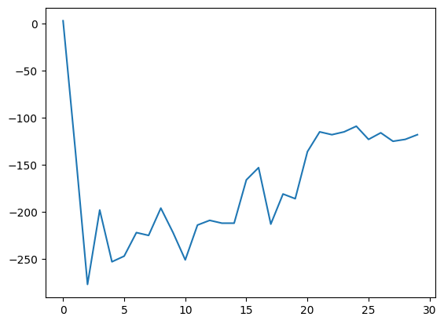
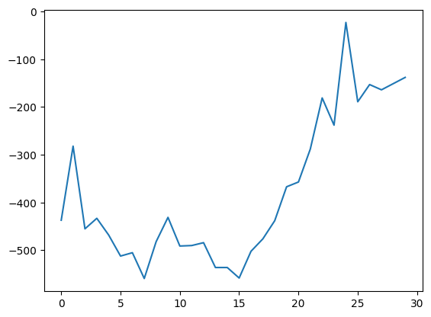
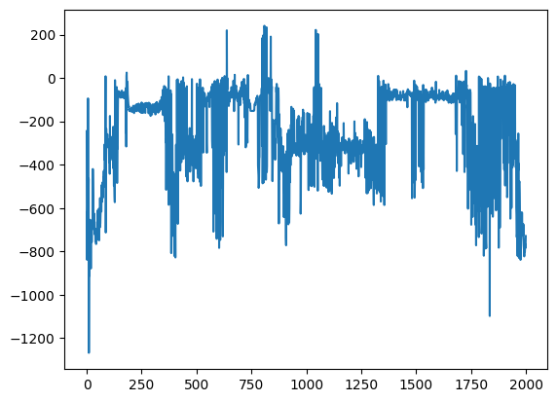
A2C - MC | A2C - MC | A2C - MC | A2C - MC
Seed 0 | Seed 1 | Seed 0 | Seed 1
Episode 30 | Episode 30 | Episode 2000 | Episode 2000
Notes:
This the our model results.

Slide 24
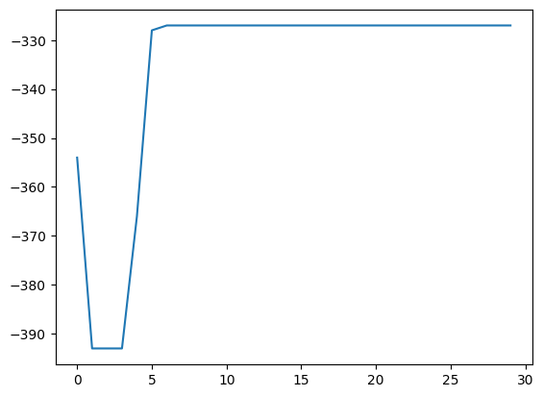
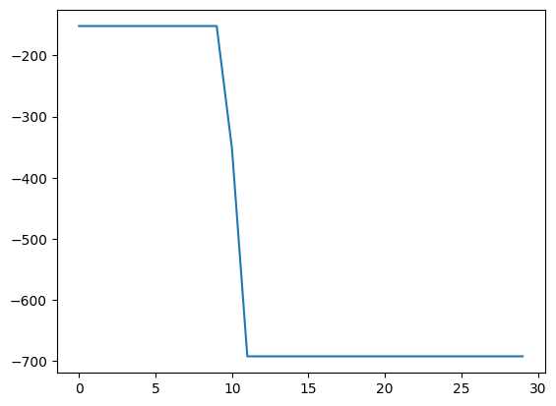
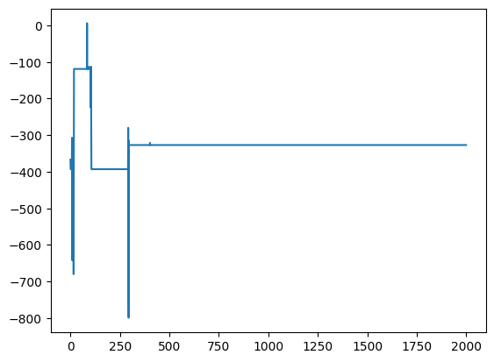
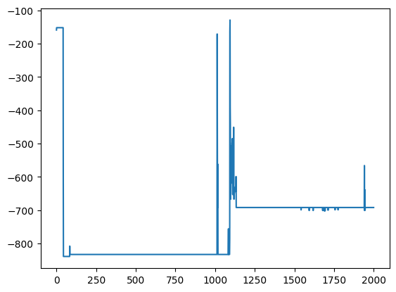
A2C - TD | A2C - TD | A2C - TD | A2C - TD
Seed 0 | Seed 1 | Seed 0 | Seed 1
Episode 30 | Episode 30 | Episode 2000 | Episode 2000

Slide 25
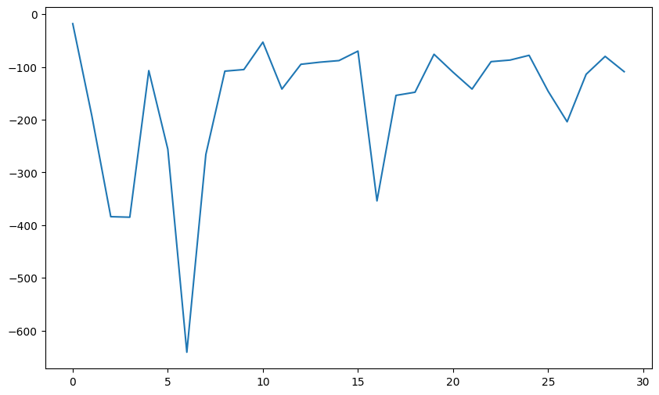
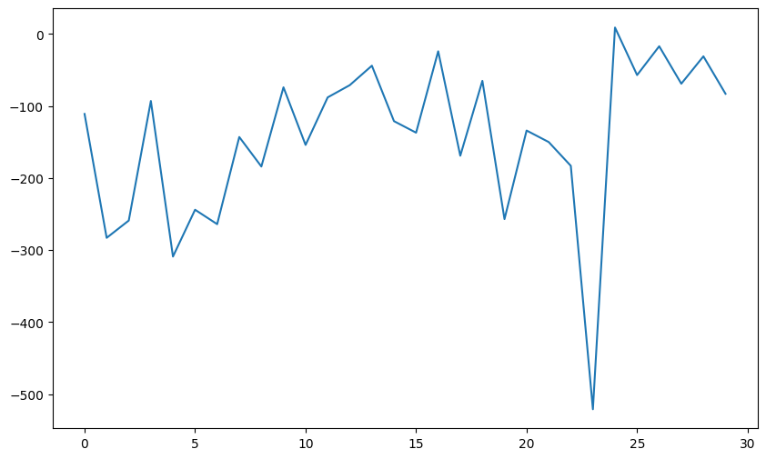
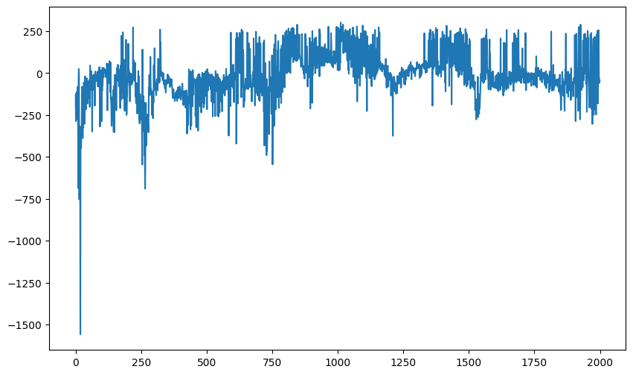
REINFORCE | REINFORCE | REINFORCE | REINFORCE
Seed 0 | Seed 1 | Seed 0 | Seed 1
Episode 30 | Episode 30 | Episode 2000 | Episode 2000

Slide 26
 | REINFORCE | A2C - MC | A2C - TD
SEED 0 | -110 | -123 | -330
SEED 1 | -88 | -132 | -695
AVERAGE SEED | -99 | -127.5 | -512.5
Notes:
These are our comparision of our results. I thought TD would give a better result for our models, especially because it depends on the number of n but is so affected by hyperparameters, it's really hard to catch the best solution. But I found the best solution in REINFORCE especially

Slide 27
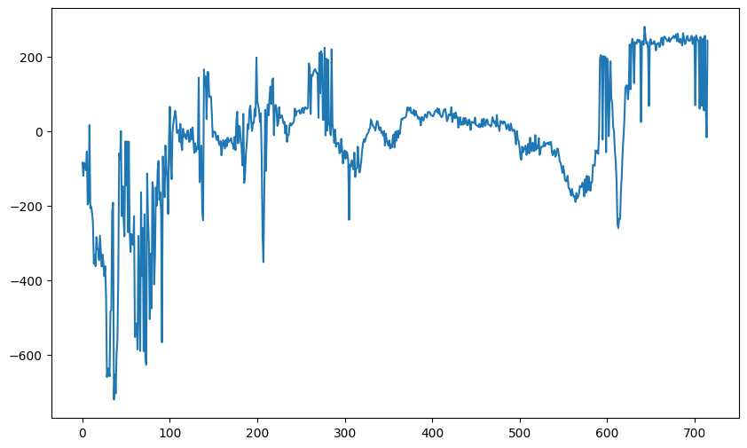
REINFORCE
Seed 0
Episode 715
Episode 1 Reward: -188.0326601398739 Episode 2 Reward: -126.74834129887515 Episode 3 Reward: -99.37418368324369 Episode 4 Reward: -230.00519718562023 Episode 5 Reward: -108.00553294671468 Episode 6 Reward: -72.06123115122858 Episode 7 Reward: -539.8897583671603 Episode 8 Reward: -118.06282694621609 Episode 9 Reward: -26.83853137113877 Episode 10 Reward: -258.5131807316393 Episode 11 Reward: -129.85006518384495 Episode 12 Reward: -289.2888222078417 Episode 13 Reward: -317.0914671051709 Episode 14 Reward: -412.97519929952057 Episode 15 Reward: -75.80944243378691 Episode 16 Reward: -150.88508133174582 Episode 17 Reward: -56.27446079872322 Episode 18 Reward: -276.01695468059006 Episode 19 Reward: -69.43830806867034 Episode 20 Reward: -105.95442845020905 Episode 21 Reward: -168.23126867223607 Episode 22 Reward: -119.22622581784645 Episode 23 Reward: -523.3719930571723 Episode 24 Reward: -290.9245922172179 Episode 25 Reward: -198.81201546549642 Episode 26 Reward: -425.1115672569812 Episode 27 Reward: -392.20322777282786 Episode 28 Reward: -171.20799688157894 Episode 29 Reward: -52.79132783306618 Episode 30 Reward: -274.86557413354194
Notes:
Reinforce Algorithm converges in fewer steps when compared to other algorithms. In episode 715, it can reach average of last one hundred episodes is nearly two hundred scores. The off-policy methods are designed to address different shortcomings with tradeoffs in simplicity and convergence. For example, some off-policy methods improve exploration and some methods improve the target policy without generating new samples.This gif on the right is our 30 episode output. Thank you for listening.

Slide 28
References
Schaul, T., Antonoglou, & Silver. (2016). Prioritized Experience Replay. arXiv.
Gadgil, S., Xin, Y., & Xu, C. (2020). Solving The Lunar Lander Problem under Uncertainty using Reinforcement Learning. 2020 SoutheastCon, 2, 1-8.
Barto, A. & Sutton, S. (2018)Reinforcement Learning: An Introduction, MIT Press, Cambridge
Winder, P. Reinforcement Learning Industrial Applications of Intelligent Agents. (2020).https://books.google.com.tr/books/about/Reinforcement_Learning.html?id=SdcHEAAAQBAJ&redir_esc=y

