Slide 1
CMP682 — Final Project
MissVARPath
Missense Variant Pathogenicity Prediction
Doruk Topcu · Alihan Sağöz
Hacettepe University · 2026

Slide 2
Three questions
Every missense variant goes through a battery of in-silico predictors — PolyPhen-2, SIFT, REVEL, CADD, AlphaMissense, DITTO. Each disagrees with the others; most were trained on overlapping ClinVar data — the same database we use to label our targets.
1.
Can a meta-classifier do better than any single predictor by combining them?
2.
How much of any improvement is data-circularity — predictors trained on ClinVar, evaluated on ClinVar?
3.
Can we predict pathogenicity from raw data alone — without using any pre-existing predictor's score?
2 / 21

Slide 3
Data
21,872
ClinVar / OpenCRAVAT missense variants
5,468 × 4
perfectly balanced 4-class — Benign / Likely-benign / Likely-pathogenic / Pathogenic
777 → 208
raw schema → numerical features after preprocessing
5,428
strict-VUS rows in the curated pro-set
Four task definitions used in the project
4-class
original ClinVar label space
2-class
Likely-* collapsed into definitive labels → 10,936 / 10,936
3-class (with VUS)
Benign-side / Pathogenic-side / VUS
5-class (with VUS)
all four ClinVar labels + VUS — essentially balanced
3 / 21

Slide 4
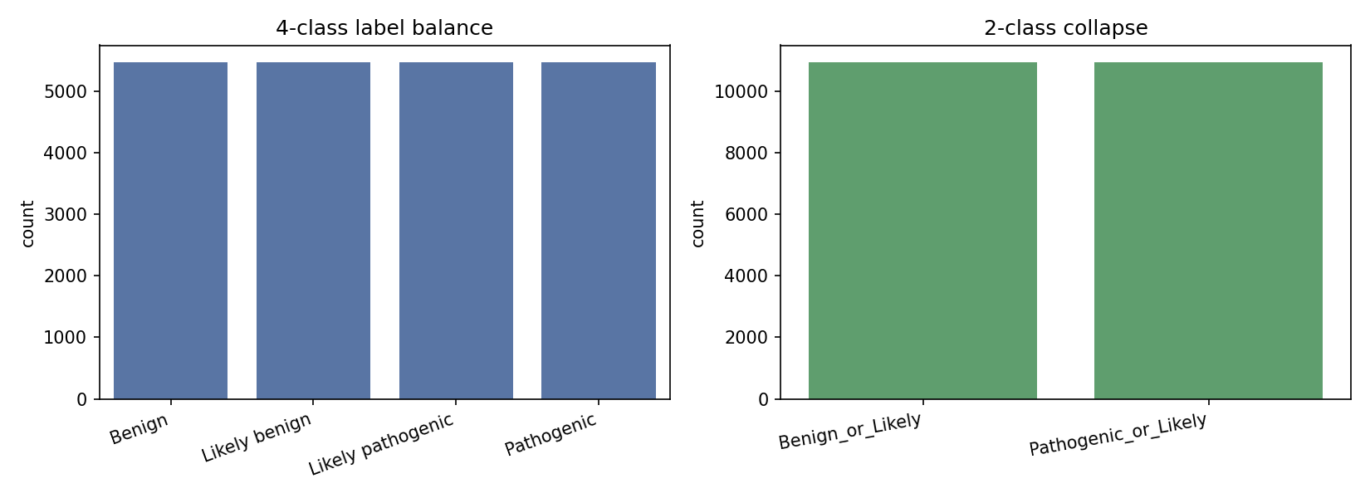
Label balance — by design
5,468 rows per ClinVar class in the 4-class space; 10,936 / 10,936 in the 2-class collapse. Any class-imbalance effect is gone by construction.
4 / 21

Slide 5
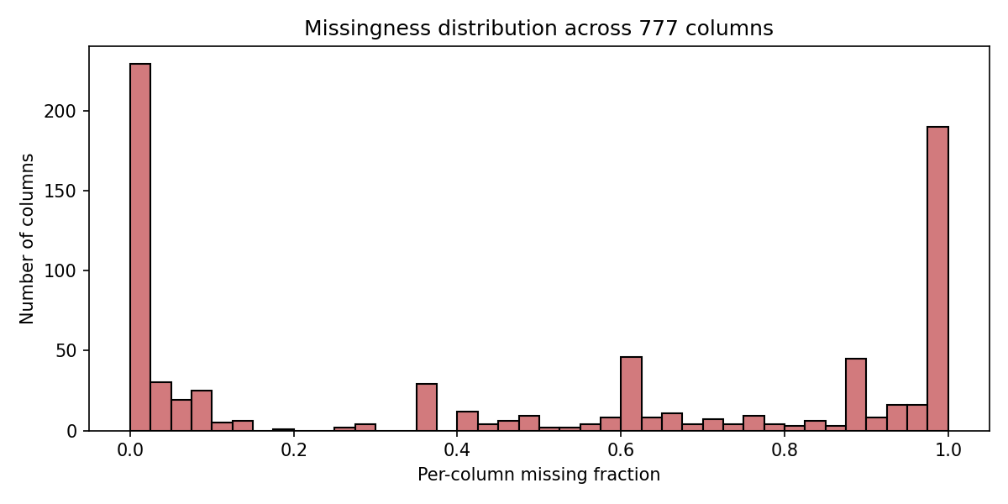
Missingness across the 777-column raw schema
Per-column missing fraction. Everything above the 50% threshold is dropped during preprocessing — 134 columns lost that way. 208 numerical features survive.
5 / 21

Slide 6
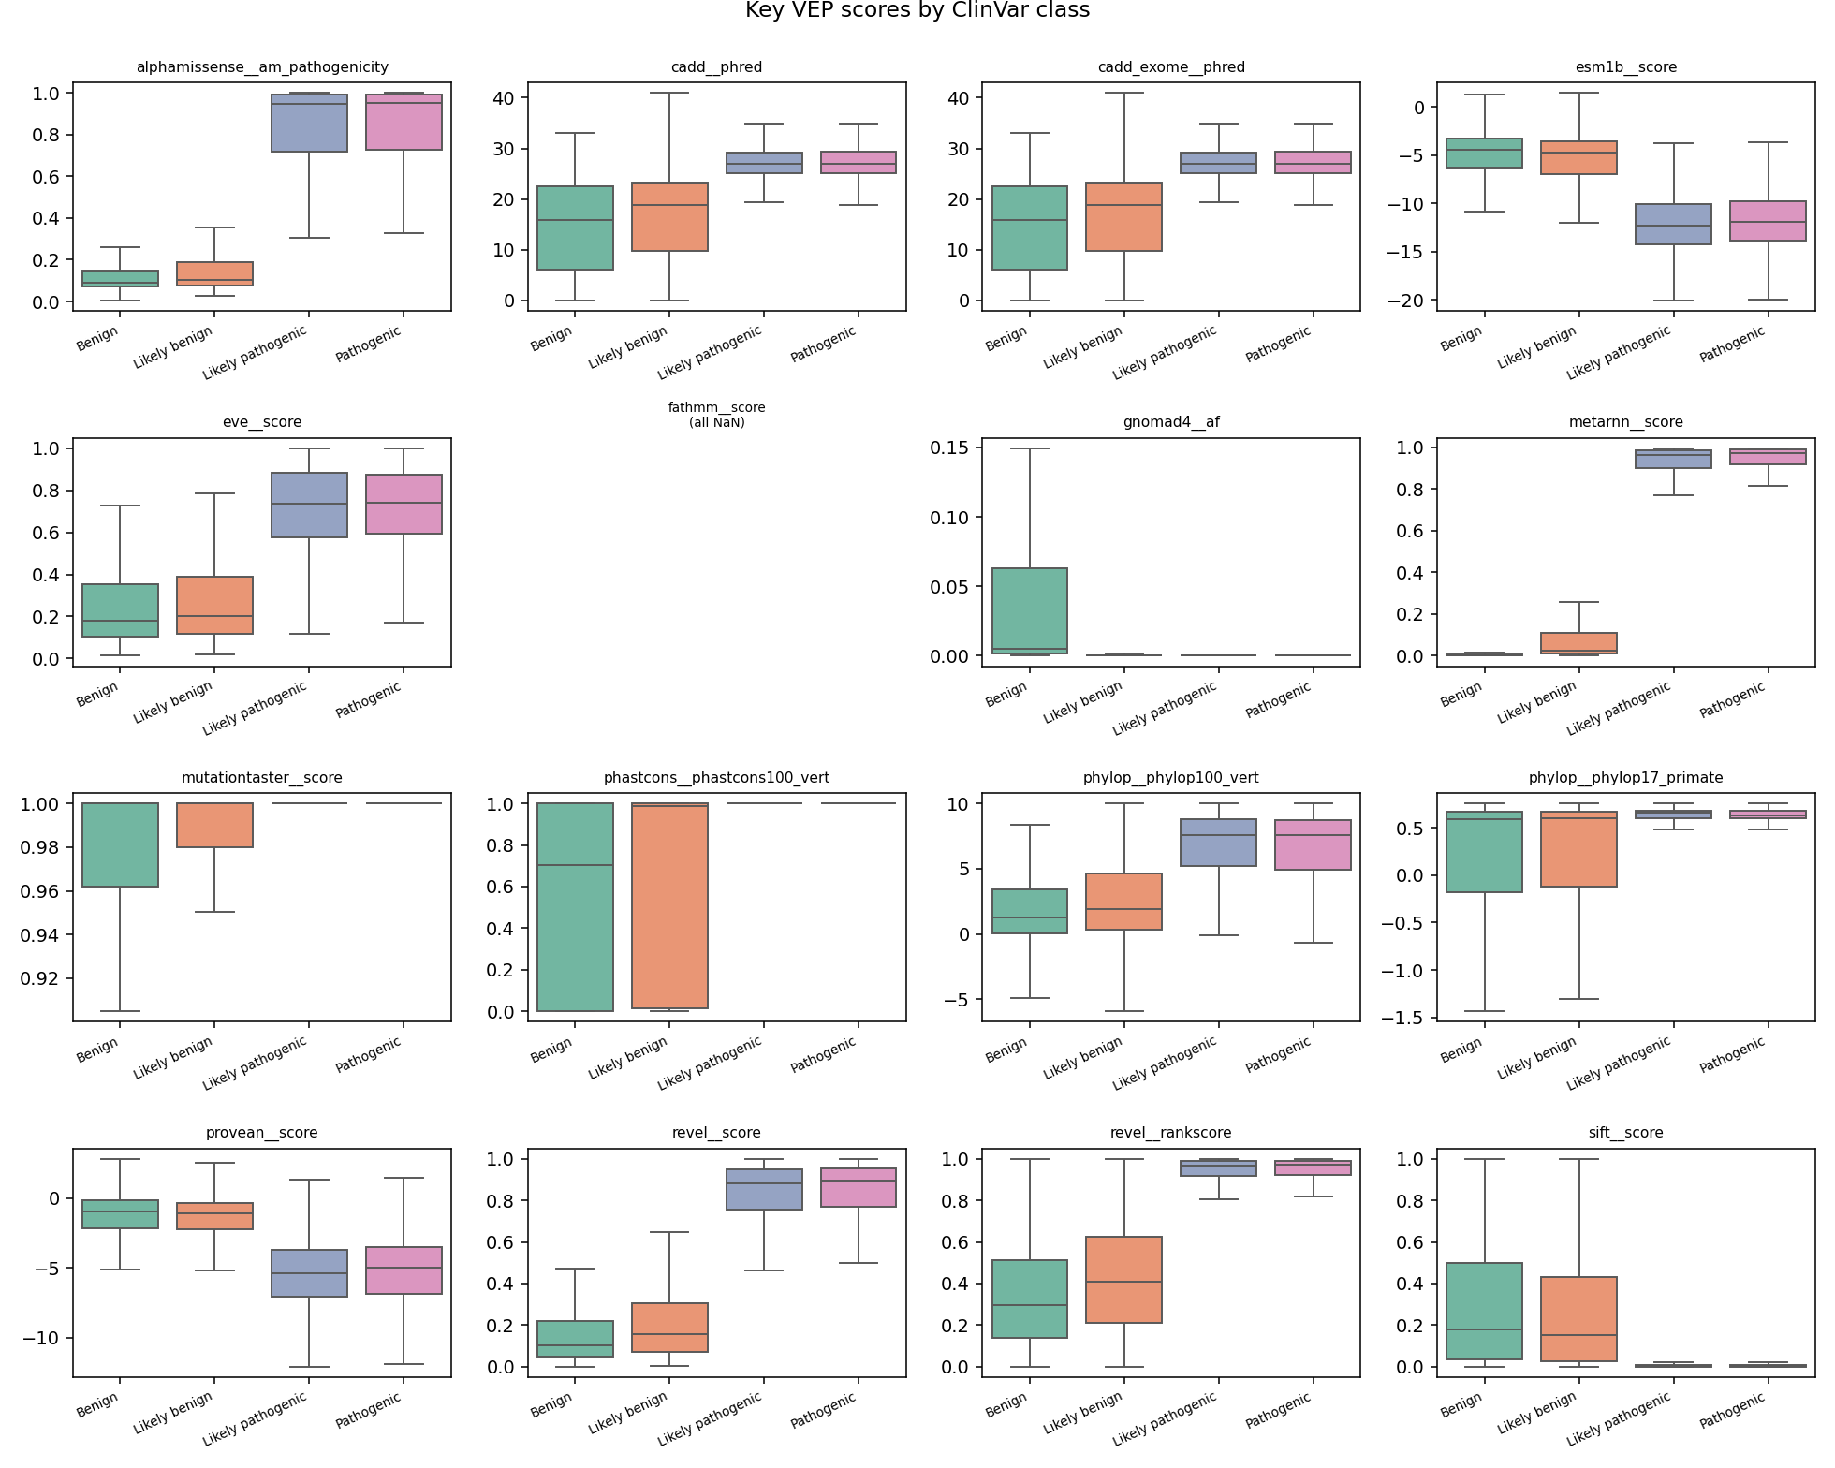
Do the predictor scores actually separate classes?
Boxplots of headline VEP scores stratified by the 4-class label. DITTO, MetaRNN, REVEL, AlphaMissense all separate cleanly; gnomAD AF runs the other way — high frequency means benign (the ACMG BS1 rule).
6 / 21

Slide 7
Methods
Model suite — 11 estimators
Evaluation regimes — 5 cuts
Classical / linear
KNN
NearestCentroid
CosineSimilarity (custom)
DecisionTree
LDA
QDA
LinearSVC
RidgeClassifier
SGDClassifier
Ensembles
AdaBoost
HistGradientBoosting
Canonical
stratified 80/20 holdout + 5-fold CV
Augmented
+ 196 k-mer + 10 BLAST locus-neighbour features
Gene-stratified
no gene appears in both train and test folds
No-VEP / VUS
drop every learned-predictor + conservation score
Raw-only
keep only population AF, position, sequence composition
RANDOM_STATE = 42 throughout. Per-model grid-search tuning by 5-fold CV macro-F1; AdaBoost grid stopped at combo 23/27 (compute budget).
7 / 21

Slide 8
Headline numbers
4-class macro-F1
2-class macro-F1
0.795
0.987
HistGradientBoosting · 21,872 variants · 208 features
HistGradientBoosting · 10,936 / 10,936 collapse
8 / 21

Slide 9
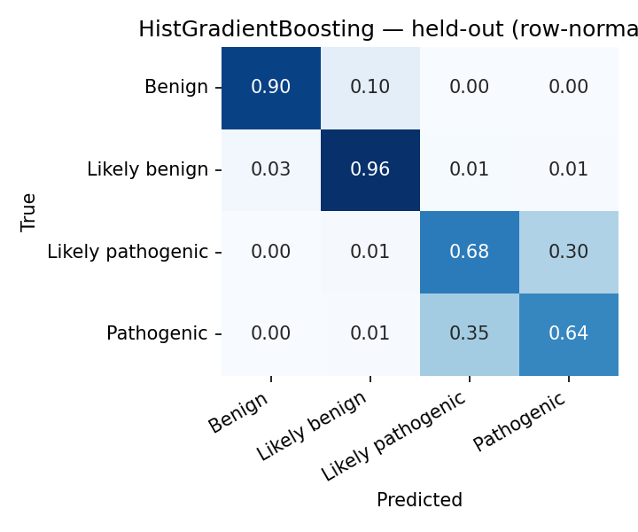
Where the error lives — 4-class confusion matrix
Held-out, row-normalized. Definitive Benign / Pathogenic call near-perfect (>0.93 / 0.79). Residual difficulty is the Pathogenic ↔ Likely-pathogenic boundary.
9 / 21

Slide 10
Stress tests — bounding the data-circularity
Regime | 4-class F1 | 2-class F1
Canonical tuned (headline) | 0.795 | 0.987
Augmented (k-mer + BLAST) | 0.795 | 0.990
Gene-stratified CV | 0.766 | 0.987
No-VEP, k-fold | 0.773 | 0.976
No-VEP, gene-stratified | 0.761 | —
Raw-only (no predictor, no conservation) | 0.721 | 0.934
DITTO removed | 0.791 | —
Graceful degradation across regimes: HistGB loses 0.027 to gene-stratified CV, 0.022 to no-VEP, 0.074 to raw-only. The 2-class task is essentially insensitive to all stresses.
10 / 21

Slide 11
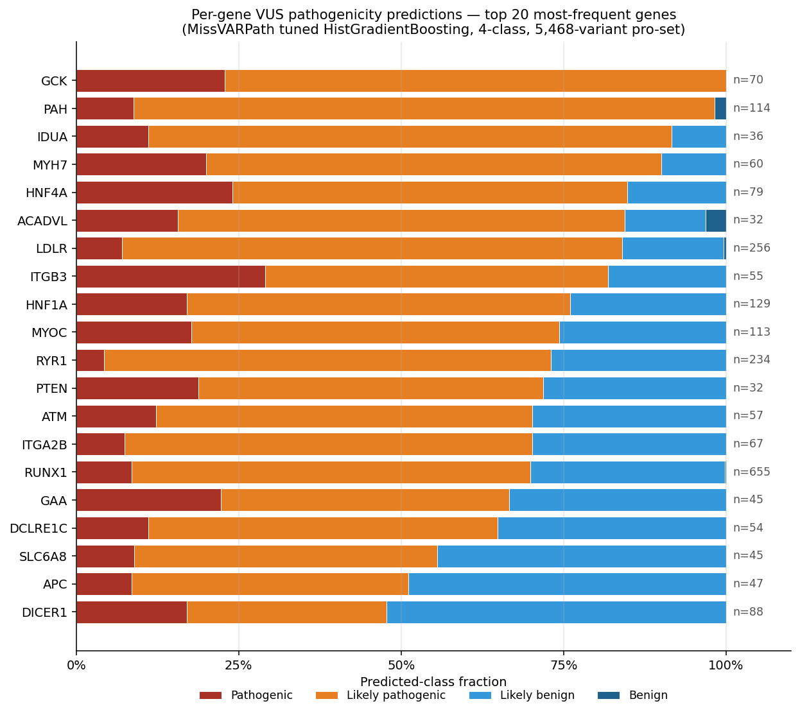
Real VUS deployment — per-gene predictions
Top-20 most-frequent genes in the 5,468-variant pro-set, stacked by 4-class prediction. GCK 100%, PAH 99%, MYH7 90%, LDLR 84% pathogenic-side.
11 / 21

Slide 12
VUS deployment — the four numbers
Applying the tuned HistGradientBoosting to 5,468 strict-VUS variants annotated through the same pipeline.
62% / 38%
80%
pathogenic-side / benign-side split on 2-class head
of predictions have max probability > 0.9
87%
95.4%
of 4-class predictions hedge into Likely-* — only 13% definitive
cross-task agreement (4-class collapsed vs. 2-class head)
12 / 21

Slide 13
VUS as a class
With VUS added as a labelled class
2-class no-VUS
0.987
3-class with VUS
0.946
4-class no-VUS
0.795
5-class with VUS
0.798
Adding VUS as a 5th class does NOT hurt overall macro-F1 — it slightly improves it. MCC improves by +0.022.
VUS reaches F1 = 0.901 — between Benign and Likely-benign in difficulty. One of the cleanest classes to recognise.
13 / 21

Slide 14
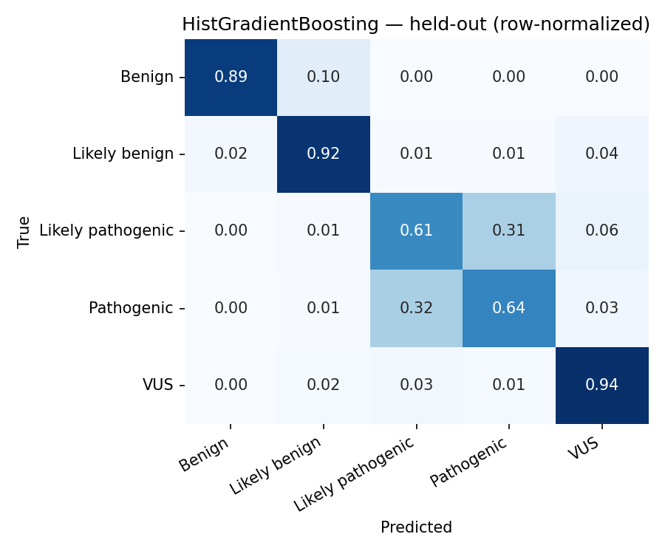
5-class confusion matrix — where VUS sits
Held-out, row-normalized. VUS row reaches 0.94 diagonal — cleaner than Pathogenic (0.64) or Likely-pathogenic (0.61). VUS misclassifications hedge into Likely-*, not into definitive calls.
14 / 21

Slide 15
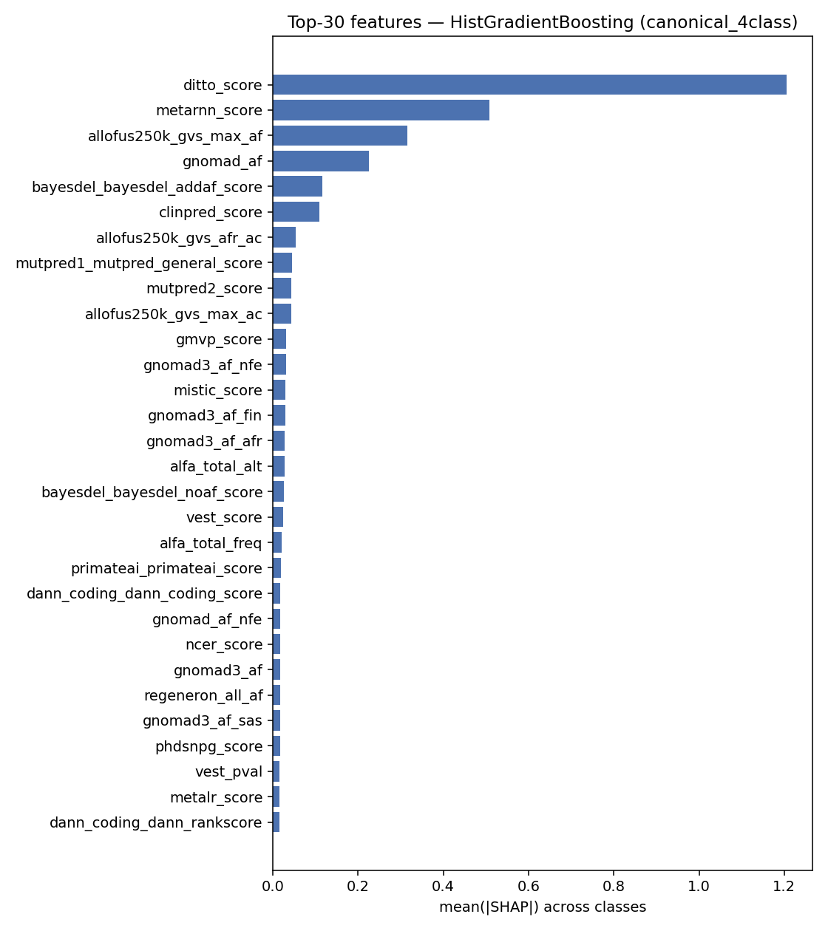
What drives the booster — SHAP top-30
Canonical 4-class HistGradientBoosting. DITTO leads, MetaRNN second, then population allele frequencies — the model is using both predictor scores and frequency data.
15 / 21

Slide 16
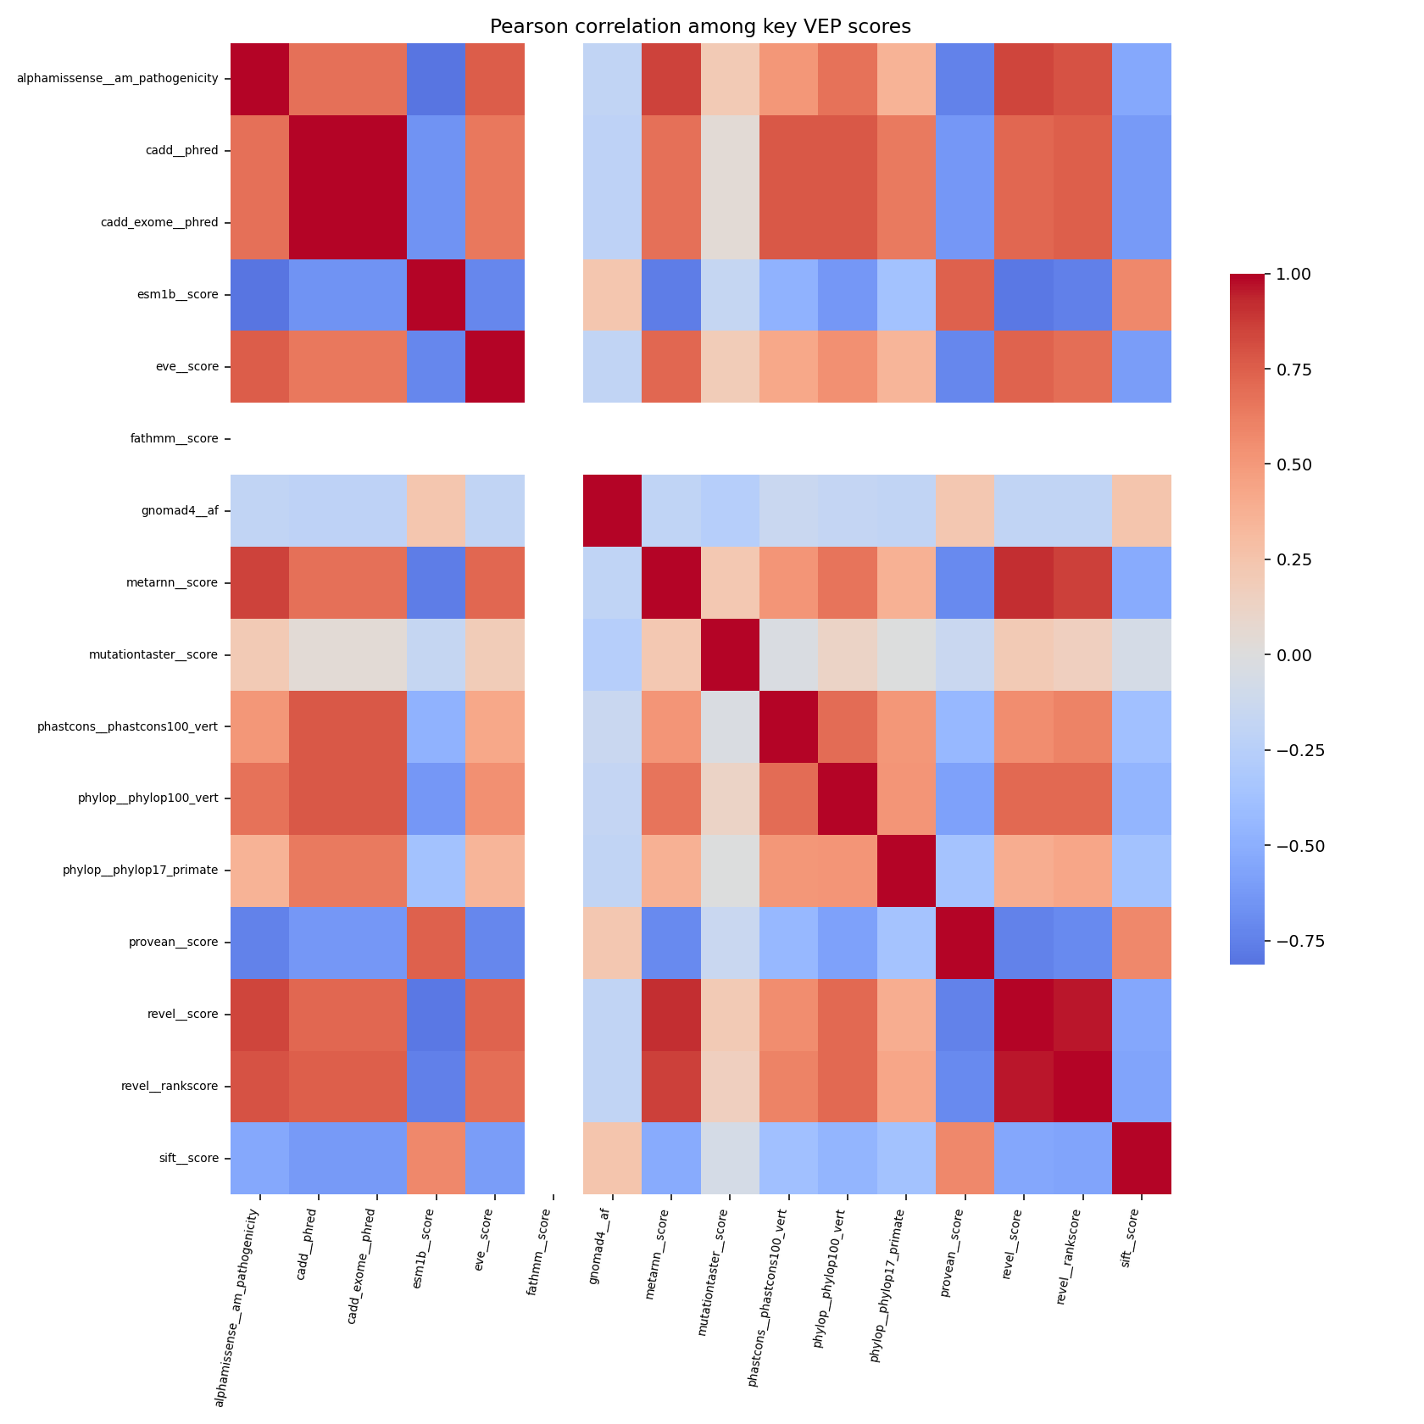
Predictor correlation — the redundancy structure
Pearson correlation among key VEP scores + gnomAD AF. Predictor scores form a tight cluster; gnomAD AF sits in its own corner — the structural reason predictors substitute for each other, but population AF does not.
16 / 21

Slide 17
Useful vs. waste — feature ablation
Group | 4-class | 2-class | 5-class | 3-class | n feat
population_af | +0.0471 | +0.0025 | +0.0405 | +0.0054 | 47
functional | -0.0012 | -0.0005 | +0.0266 | +0.0469 | 4
other_vep | +0.0133 | -0.0002 | +0.0137 | +0.0073 | 56
cadd | -0.0054 | -0.0005 | -0.0001 | -0.0015 | 4
ditto | +0.0039 | +0.0046 | +0.0001 | +0.0033 | 1
metarnn | +0.0014 | +0.0005 | +0.0045 | +0.0005 | 2
bayesdel | -0.0045 | -0.0002 | -0.0004 | -0.0003 | 4
position | -0.0044 | +0.0002 | +0.0018 | +0.0029 | 2
revel | -0.0018 | +0.0005 | -0.0044 | -0.0015 | 2
chasmplus | +0.0026 | +0.0011 | +0.0028 | -0.0002 | 68
alphamissense | -0.0015 | +0.0005 | -0.0028 | -0.0017 | 1
conservation | +0.0018 | -0.0007 | -0.0001 | +0.0000 | 17
Greyed rows: HistGB |Δ| < 0.005 across every task. 8 of 12 groups (97 of 208 features) are waste at the group level.
17 / 21

Slide 18
Per-feature permutation — the redundancy story
Removing a 'waste' group is cheap — but individual features inside those groups are still highly predictive. Group LOO measures replaceability, not informativeness.
ditto_score
metarnn_score
0.133
0.048
individual macro-F1 weight (4-class)
individual macro-F1 weight (4-class)
Inter-predictor redundancy. Remove DITTO and MetaRNN compensates; remove MetaRNN and DITTO compensates. Only by removing several correlated meta-classifiers together does the redundancy buffer collapse — which is what Lean B exploits.
18 / 21

Slide 19
Lean B — 45% smaller, 0.012 cost
Lean B drops 95 of 208 features, keeping ditto_score and metarnn_score (the per-feature winners).
At most 0.012 macro-F1 cost on any task. Several models (KNN, NearestCentroid, CosineSimilarity) actually improve on the lean subset.
19 / 21

Slide 20
Future directions
·
Cross-database validation
replicate Lean B numbers on HGMD or a held-out ClinVar snapshot
·
True homology BLAST
blastp on UniRef50 with the amino-acid substitution applied
·
Finish the AdaBoost tuning grid
the partial 23/27 grid was halted for compute budget
·
Probability calibration
Platt or isotonic regression so predict_proba is a usable risk score
·
Gene-stratified VUS-as-class
test whether VUS-detection survives without same-gene leakage
·
Variant-level error analysis
manual review of the Pathogenic ↔ Likely-pathogenic confusion region
20 / 21

Slide 21
Thank you
Doruk Topcu · Alihan Sağöz
Google Collab – MissVarPath EDA: https://colab.research.google.com/drive/1Mk_cXAjRAKlRVjWplSdtV9DCR-t0P0iU
Google Collab – Full code: https://colab.research.google.com/drive/1ceyQjc73Gsm2bfclc7PznBS_dQ0EB74a#scrollTo=cell-0001
Datasets & Other files to run the full model: https://drive.google.com/drive/folders/1Sy5dnzYGiwCGXYRMXiCGnyJt04SuOphv?usp=sharing
21 / 21

