Slide 1
Artificial Intelligence CSE: 4633/6633 Project Presentation on Sudoku Solver
Team Members:
Dorwin Jenkins
John Tweedy
Rawshan Ara

Slide 2
Table of contents
Introduction
Project goals
Methods and algorithms used
Discussion and analysis of results
Challenges encountered and how to overcome them
Potential future work

Slide 3
Introduction
What is Sudoku
-Sudoku is a popular logic-based number puzzle game
-The objective is to
- fill a 9x9 grid with digits
-where each column, each row, and each of the nine 3x3 sub grids
contains all the digits from 1 to 9.
-The game typically starts with some cells already filled in, and the player's objective is to fill in the remaining cells while following the rules of the game.
-Sudoku puzzles come in varying levels of difficulty and are known for their ability to challenge and stimulate the mind.

Slide 4
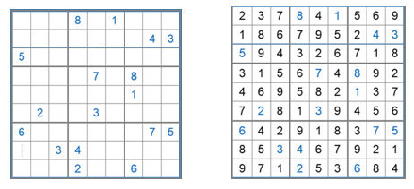
Sudoku puzzle (https://www.researchgate.net.publication)

Slide 5
Project Goals
-To implement an AI engine to solve a sudoku puzzle.
-To use various search algorithms such as backtracking.
-To create a user interface where we can see the sudoku puzzle visually.

Slide 6

Related work
Over the years there have been numerous works and research on sudoku solvers. Some of the approaches and related works are given below:
-Nikolas Pilavakis produced an app that can recognize a sudoku puzzle using the phone’s camera and find the solution using a backtracking algorithm.
https://project-archive.inf.ed.ac.uk/ug4/20201867/ug4_proj.pdf
-Vamsi, Gangadharabotla, and Sai used computer vision techniques to solve sudoku puzzles. They implemented OpenCV to preprocess and extract an image, apply OCR to detect numerical data from the extracted image using Tesseract, and finally feed the data to the neural network (tensor flow) model to get the desired output.
https://ieeexplore.ieee.org/document/9432326

Slide 7
-Weiss applied a Genetic algorithm to solve a puzzle whose size is larger than 9×9.
https://micsymposium.org/mics_2009_proceedings/mics2009_submission_66.pdf
-Jana, Mallik, Khan, Maji, and Pal developed a 3D sudoku solver. They proposed two different solvers for solving 3D sudoku puzzles of size 9×9×9.
https://ieeexplore.ieee.org/document/10070095

Slide 8
Methods and Algorithms
First, we formulated the sudoku problem as a CSP(Constraint Satisfaction Problem).
Which has three properties:
-Variables
Each empty cell is on the board.
-Domains
Numbers between 1 and 9 except those used in the current column, row, or 3×3
sub-grids.
-Constraints
The same number will not appear twice in the same row, column, or any of the nine 3×3
sub-grids.

Slide 9
Then we use a backtracking algorithm. Backtracking is a depth-first-search algorithm that investigates the search space of potential solutions recursively until a solution is discovered that satisfies all the restrictions.
-The method begins by finding an empty cell(which is represented by 0).
-Check which number in the range 1 to 9 is safe to use in the cell.
-After finding the appropriate number it will fill the cell and backtrack to
fill the next cell.
-The process goes on recursively at each step until the cell is filled with numbers.
-At any point if it cannot fill a cell with a number it will return to the previous
cell and change that number to another valid choice.

Slide 10
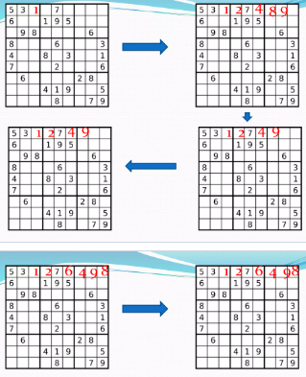
Backtracking
(slideshare.net)

Slide 11
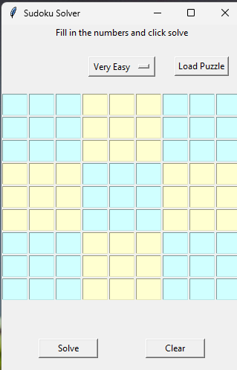
We also created a user interface to visualize the sudoku grid with input fields for the user to enter numbers.

Slide 12
Discussion and analysis of results
The AI engine we created can solve sudoku puzzles.
It worked with an empty grid,
We made five(5) different preset levels very easy, easy, medium, hard, and very hard which we can select from our UI and solve.
When we input numbers randomly sometimes it can solve that but there can be some which it cannot solve.
Computation time
Very easy | Easy | Medium | Hard | Very hard
Less than 1 second | Less than 1 second | Less than 1 second | 14 second | 24 second

Slide 13

Challenges encountered and how to overcome them
The code we implemented can solve puzzles that is created manually or even for the empty grid. However, it was not able to solve the puzzles when we input numbers randomly. One of the reasons is when we input numbers randomly it did not follow the rules of sudoku.
When we input fewer numbers that is the difficulty level is more it was taking too much time. To solve this problem we added a function to speed up hard puzzles that have to backtrack a lot.

Slide 14
Potential Future work
Our sudoku solver is working and able to solve puzzles when the inputs are given manually. In the future, we can add more functionality to this.
-Develop a user-friendly interface that involves drag and drop, auto-fill suggestions, and error checking mechanism.
-Produce 3D sudoku solver by using 2D sudoku solver.
- Read a puzzle from an image and solve it.

Slide 15

Questions?

