Slide 1
Data Visualization with PowerBI and Tableau
Student Name: Yi-Sin Yang
Student ID: 300368638

Slide 2

Agenda
Introduction
Power BI intro
Power BI Analysis Question
Power BI Analysis Charts
Tableau intro
Tableau Analysis Question
Tableau Analysis Charts
Comparative Analysis
Conclusion

Slide 3
Introduction
Data visualization is the process of describing information through visual rendering.
In this course, we have learned and implemented both Tableau and PowerBI, both tools are important for data visualization, and have a great advantage in leveraging our skills, in the following content, we will dive in to introduce both powerBI and Tableau and also the comparison between both powerful tools.

Slide 4
Introduction
By using these tools we can figure out the following analysis questions, including but not limited to:
Knowing the total sales in each region/state
Comparing the different numbers of populations in all states
Calculate the profit and figure out which has the highest profit
Understand the relationship between profit and sales
How does the data change over time in line chart
Any patterns in which values will affect another value

Slide 5
PowerBI intro
In PowerBI, we learned about the skills of implementing various charts, also by leveraging the data, we can make the chart more storytelling to users, in this course, we have learned
Bar chart/Pie chart/table chart/line chart
Map
Measure column
Conditional column
Merge/Append table
Transform data

Slide 6
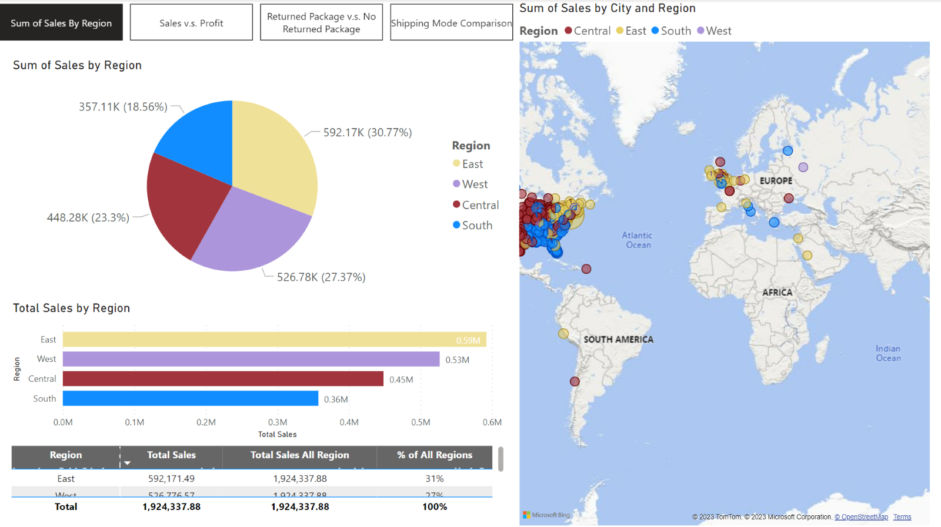
PowerBI Analysis Question - What are the highest and lowest sales among the regions
Answer:
In the map, there are more dots stamped on the East side of America, where the sales activities are highly concentrated. The detailed table shows the exact information when investigate the sales figures in numbers, the East contributing almost 31% of sales amount in the country, however the East region only weighted 19%.

Slide 7
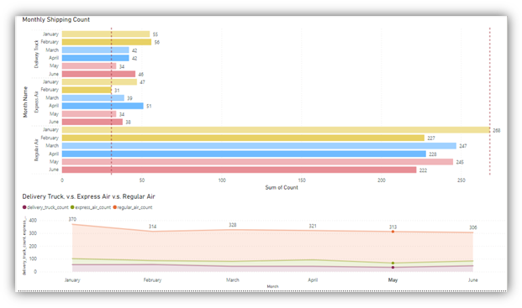
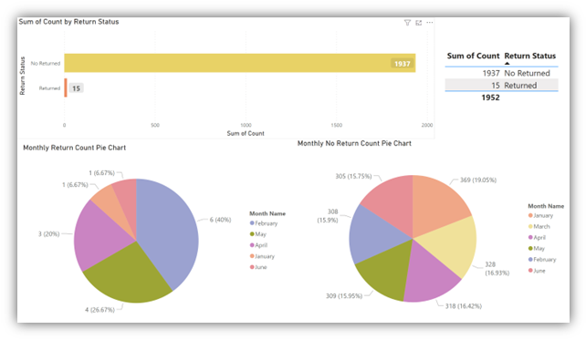
PowerBI Analysis Charts

Slide 8
Tableau intro
In Tableau, we can easily connect to nearly any data source, and it allows for analyzing big data, which is also easy to use, in this course we have learned
Create calculate field
Mapping location
Create dashboard
Create stories
Build pie chart, bar chart, filled map
Trend line
Forecasting

Slide 9
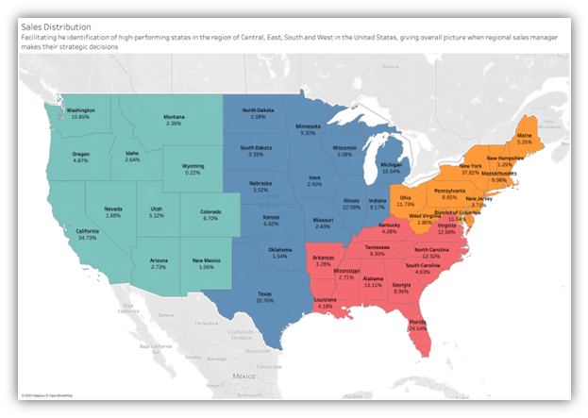
Tableau Analysis Example- What is sales weighting in regions? Where ha s the highest among the country?
Answer:
ach region is separated in four colors to better visualization. As a result, California contributes almost 55% to the West, Illinois has 22% to the Central, Florida has 24% to the South and New York has close to 38% to the East. California is dominating the sales weighting in the West. Therefore, we should not be surprised most of the companies would like to set their feet in California, so same for regional sales manager of super store will also allocate more resources to fulfill the sales and demands in California.

Slide 10
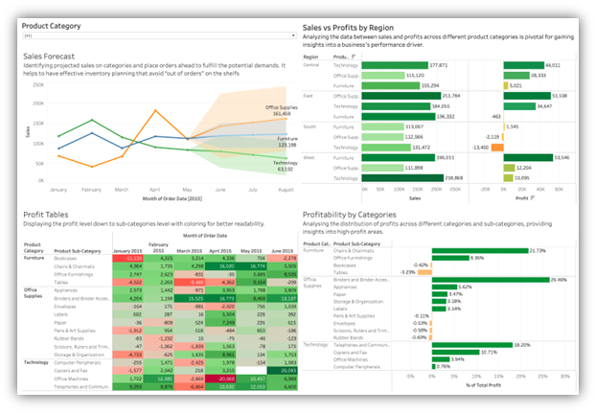
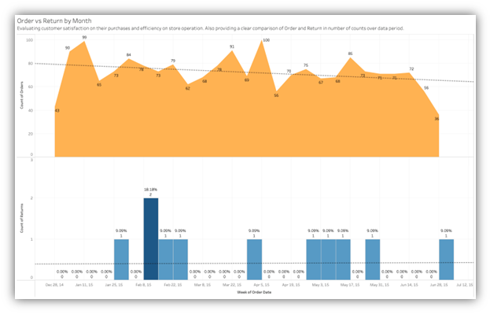
Tableau Analysis chart

Slide 11
Comparative Analysis
 | Tableau | PowerBI
User interface | User friendly | Similar to Microsoft environment, also user friendly
Cost | high | modern
Customization | high | low
Data handling | 100GB for workbooks | 1GB per datasets
Deployment | Flexible | Only as SaaS model

Slide 12
Conclusion
Both Tableau and PowerBI are great visualization tools, and the choice between choosing either Tableau or PowerBI needs to be based on the situation, such as pricing, and working environment, data compatibility, after comparison, we can make the best decision for our data analysis. Overall, these tools have a huge evaluation in the software industry.
Finally, sincerely appreciate to my team members Mino, who is dedicated into the project work, with his help, the we can do the whole project efficiently.

Slide 13
Thank you!

