Slide 1
Semantic activation and semantic neighbourhood shape the genericness of role nouns in German
Dominic Schmitz¹, Viktoria Schneider¹, Janina Esser²
¹ Heinrich-Heine-Universität Düsseldorf
² Association for Diversity in Linguistics

Slide 2
Masculine Generics in German
in German, role nouns such as Anwalt ‘lawyer’ can be used as generic forms
generic forms are not different from explicit masculine forms in their orthographic or phonological form
they are used to describe individuals of all genders in singular and plural contexts
generic forms are traditionally assumed to “abstract away” notions of gender; to be “gender-neutral” (Doleschal, 2002)
word | referent gender(s) | grammatical gender | number
Anwalt | male | masculine | singular
Anwalt | male or female | masculine
Anwältin | female | feminine
Anwälte | male | masculine | plural
Anwälte | male and/or female | masculine
Anwältinnen | female | feminine
target word
paradigm

Slide 3
Previous Research
however, previous research has cast doubt on the gender-neutral use of masculine generics
most (if not all) behavioural studies on the subject find one overall result → masculine generics are not gender-neutral but show a clear bias towards the explicit masculine reading (e.g. Demarmels, 2017; Garnham et al., 2012; Gygax et al., 2008; Irmen & Kurovskaja, 2010; Irmen & Linner, 2005; Koch, 2021; Misersky et al., 2019; Stahlberg & Sczesny, 2001; Trutkowski, 2018)
even though a masculine generic may be used by a speaker with the intention of considering all genders…
…this intention is not fully translated by the receiver’s comprehension system
instead, a reading favouring male individuals is received
Notes:
many/most speakers are unaware of the masculine generic’s male bias

Slide 4
Research Questions
Q1 Do masculine generics show a male bias or is the bias reported in previous research an artefact of behavioural methods?
NDL: Naive Discriminative Learning
Q2 Which features of the underlying representations lead to the (dis)similarities of masculine and feminine forms?
LDL: Linear Discriminative Learning

Slide 5
Part 1
NDL & the male bias

Slide 6
Method: Target Items
113 target items were adapted from a study on the influence of stereotypical and grammatical information on the representation of gender in language (Gabriel et al., 2008)
all target items were role nouns
explicit masculine & generic masculine | explicit feminine | translation
Anwalt | Anwältin | ‘lawyer’
Bäcker | Bäckerin | ‘baker’
Dekan | Dekanin | ‘dean’
Historiker | Historikerin | ‘historian’
Maurer | Maurerin | ‘mason’
Professor | Professorin | ‘professor’
Wärter | Wärterin | ‘guard’

Slide 7
Method: Target Items
113 target items were adapted from a study on the influence of stereotypical and grammatical information on the representation of gender in language (Gabriel et al., 2008)
all target items were role nouns
all target items have a common explicit feminine form
explicit masculine & generic masculine | explicit feminine | translation
Anwalt | Anwältin | ‘lawyer’
Bäcker | Bäckerin | ‘baker’
Dekan | Dekanin | ‘dean’
Historiker | Historikerin | ‘historian’
Maurer | Maurerin | ‘mason’
Professor | Professorin | ‘professor’
Wärter | Wärterin | ‘guard’

Slide 8
Method: Corpus
10 million sentences were extracted from the Leipzig Corpora Collection’s (Goldhahn et al., 2012) subcorpus “News” → 1 million for each year from 2010 to 2019
from the 10 million sentences, the following was sampled:
800,000 sentences without any target words
30,000 sentences with target words
the overall frequency for each target word in our corpus is relative to its overall frequency in the 10 million sentences sample, for example
a target with more than 20,000 occurrences is represented by 600 samples
a target with less than 200 occurrences is represented by 100 samples

Slide 9
Method: Corpus
using data from news websites allowed us to strictly control genre
thus, our results cannot be potential artefacts of ‘genre confusion’, i.e. of chance due to an uncontrolled mix of different styles and genres
however, this indicates that chances are given that other sources/genres/styles might lead to different results

Slide 10
Method: Annotation
the 30,000 sentences containing target words were manually annotated by two authors and two assistants, all of which were native speakers of German
for each target word occurrence, it was annotated whether the form was
masculine or feminine; singular or plural; explicit or generic
the 800,000 sentences without and the 30,000 sentences with target words were then automatically analysed and annotated using the RNNTagger software (Schmid, 1999)
tagged information consisted of words’ base forms and information on inflectional grammar
the manually compiled annotation and the automatic annotation were finally brought together for sentences with target words

Slide 11
Method: Distributional Semantics
Distributional Hypothesis (e.g. Harris, 1954) difference in meaning ↔ difference in distribution
difference in meaning is measured via semantic vectors
one way to arrive at a word’s semantic vector is Naïve Discriminative Learning (NDL) (Baayen & Ramscar, 2015)

Slide 12
Method: Naive Discriminative Learning
taking the 830,000 annotated sentence corpus as a starting point, we computed semantic vectors for bases and inflectional functions using NDL
NDL follows the Rescorla-Wagner rules (Rescorla & Wagner, 1972; Wagner & Rescorla, 1972)
most importantly, these rules state that
outcomes are predicted by cues
the associative strength between an outcome and a cue is represented by a single number
we used each sentence to predict each individual outcome within the sentence by the other bases/inflectional functions in that sentence

Slide 13
Method: Naive Discriminative Learning
all
lawyer
lawyer
PLURAL
cues
outcomes
be
PLURAL
villain
nice
Example: All lawyers are nice.
 | all | lawyer | PLURAL | be | nice | villain | evil
lawyer
villain

Slide 14
Method: Naive Discriminative Learning
all
lawyer
lawyer
PLURAL
cues
outcomes
be
PLURAL
villain
nice
Example: All lawyers are nice.
 | all | lawyer | PLURAL | be | nice | villain | evil
lawyer | +
villain

Slide 15
Method: Naive Discriminative Learning
all
lawyer
lawyer
PLURAL
cues
outcomes
be
PLURAL
villain
nice
Example: All lawyers are nice.
 | all | lawyer | PLURAL | be | nice | villain | evil
lawyer | + | +
villain

Slide 16
Method: Naive Discriminative Learning
all
lawyer
lawyer
PLURAL
cues
outcomes
be
PLURAL
villain
nice
Example: All lawyers are nice.
 | all | lawyer | PLURAL | be | nice | villain | evil
lawyer | + | + | +
villain

Slide 17
Method: Naive Discriminative Learning
all
lawyer
lawyer
PLURAL
cues
outcomes
be
PLURAL
villain
nice
Example: All lawyers are nice.
 | all | lawyer | PLURAL | be | nice | villain | evil
lawyer | + | + | + | +
villain

Slide 18
Method: Naive Discriminative Learning
all
lawyer
lawyer
PLURAL
cues
outcomes
be
PLURAL
villain
nice
Example: All lawyers are nice.
 | all | lawyer | PLURAL | be | nice | villain | evil
lawyer | + | + | ++ | +
villain

Slide 19
Method: Naive Discriminative Learning
all
lawyer
lawyer
PLURAL
cues
outcomes
be
PLURAL
villain
nice
Example: All lawyers are nice.
 | all | lawyer | PLURAL | be | nice | villain | evil
lawyer | + | + | ++ | + | +
villain

Slide 20
Method: Naive Discriminative Learning
all
lawyer
lawyer
PLURAL
cues
outcomes
be
PLURAL
villain
nice
Example: All lawyers are nice.
 | all | lawyer | PLURAL | be | nice | villain | evil
lawyer | + | + | ++ | + | + | - | -
villain | - | - | - | - | -

Slide 21
Method: Naive Discriminative Learning
repeating this procedure for 830,000 sentences, we obtained association weights for all target word bases, inflectional functions, and a huge number of other bases
taking these rows of association weights, we obtain semantic vectors of individual bases and inflectional functions (no. of cues: untrimmed 15023; trimmed 7511)
for example:
→ a word’s associations with other words and inflectional functions describe the word’s semantics
 | Apfel ‘apple’ | trinken ‘drink’ | Gabel ‘fork’ | Kartoffel ‘potato’ | Universum ‘universe’ | Stern ‘star’
essen ‘eat’ | 0.3 | 0.2 | 0.5 | 0.4 | 0.00002 | 0.000071
Astronomie ‘astronomy’ | 0.0003 | 0.0015 | 0.00704 | 0.0003 | 0.6 | 0.8

Slide 22

Vectors of Complex Word Forms
for complex word forms, their vector is the sum of the vectors of their parts, e.g. $\vec{apples} = \vec{apple}+\vec{plural}$
thus, e.g., the semantics of the target word paradigm Anwalt ‘lawyer’ consists of
accordingly, the plural forms are
target form | base |  | number |  | gram. gender |  | type
Anwalt | Anwalt | + | singular | + | masculine | + | generic
Anwalt | Anwalt | + | singular | + | masculine | + | explicit
Anwältin | Anwalt | + | singular | + | feminine | + | explicit
word form | base |  | number |  | gram. gender |  | type
Anwälte | Anwalt | + | plural | + | masculine | + | generic
Anwälte | Anwalt | + | plural | + | masculine | + | explicit
Anwältinnen | Anwalt | + | plural | + | feminine | + | explicit

Slide 23
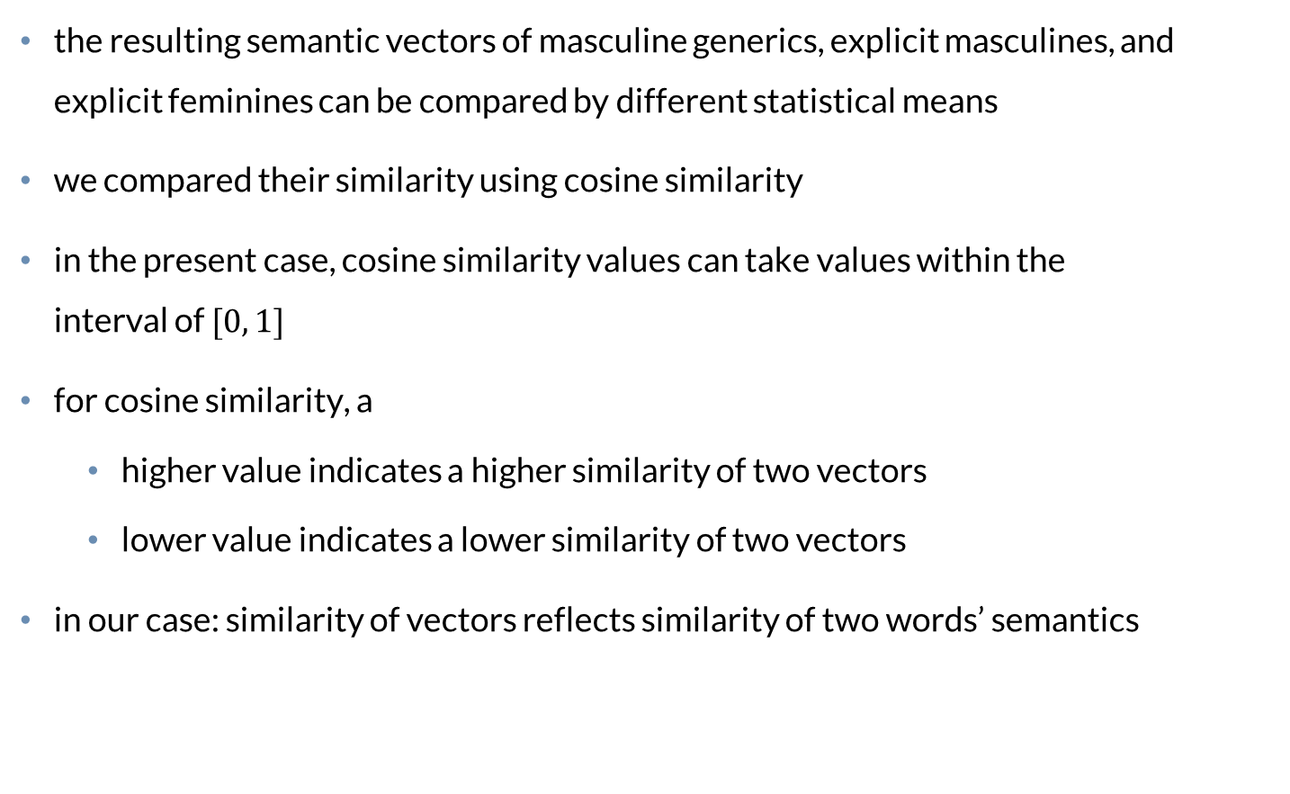
Analysis
the resulting semantic vectors of masculine generics, explicit masculines, and explicit feminines can be compared by different statistical means
we compared their similarity using cosine similarity
in the present case, cosine similarity values can take values within the interval of $[0, 1]$
for cosine similarity, a
higher value indicates a higher similarity of two vectors
lower value indicates a lower similarity of two vectors
in our case: similarity of vectors reflects similarity of two words’ semantics

Slide 24
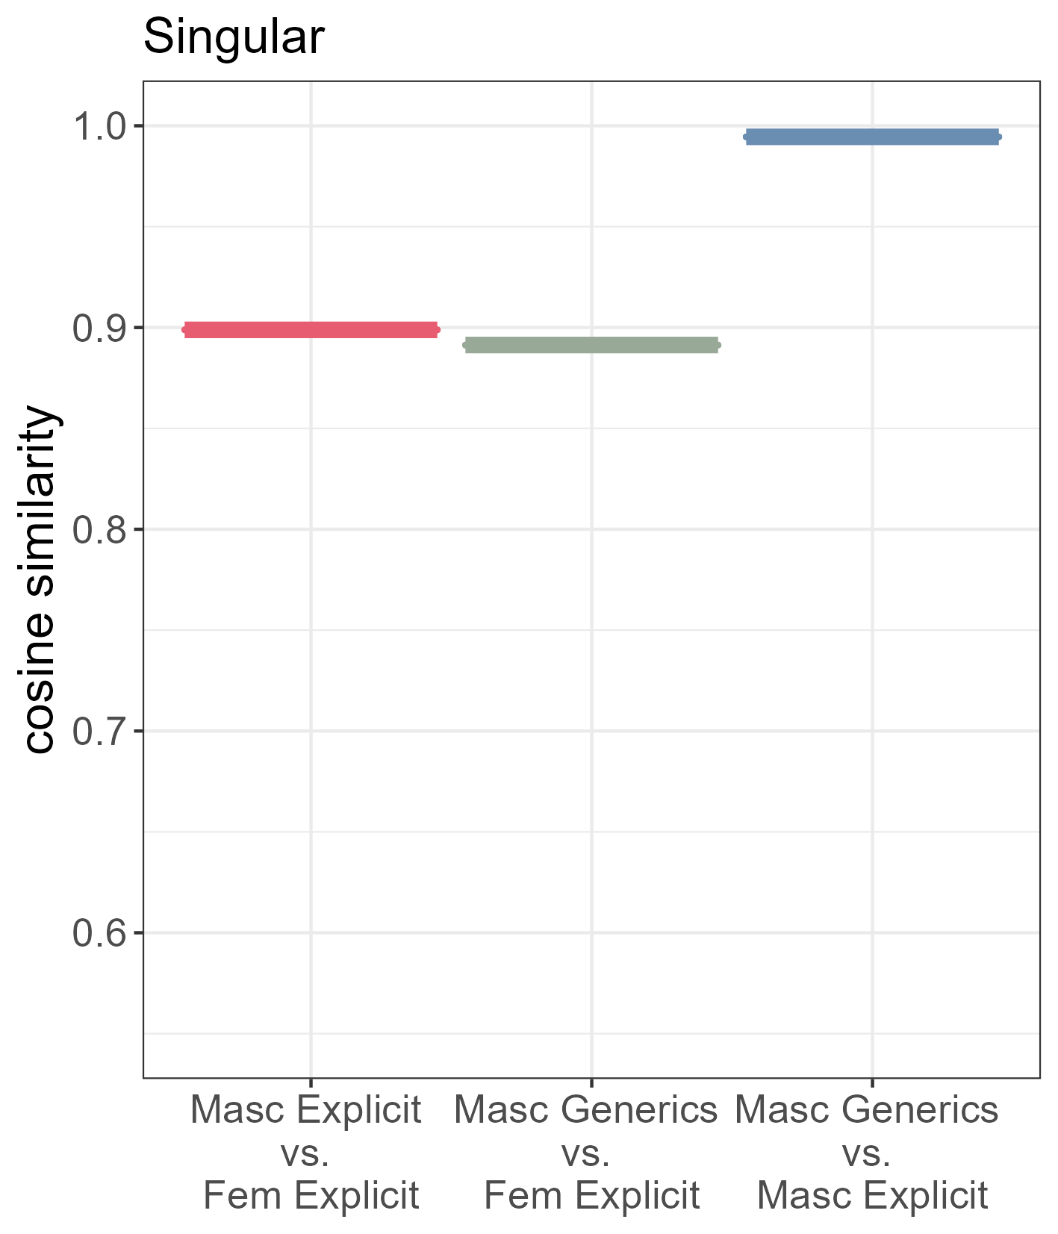
Results
masculine generics and the explicit masculine are semantically most similar
the explicit feminine is more similar to the explicit masculine than to masculine generics
all comparisons are highly significant
***
***
***

Slide 25
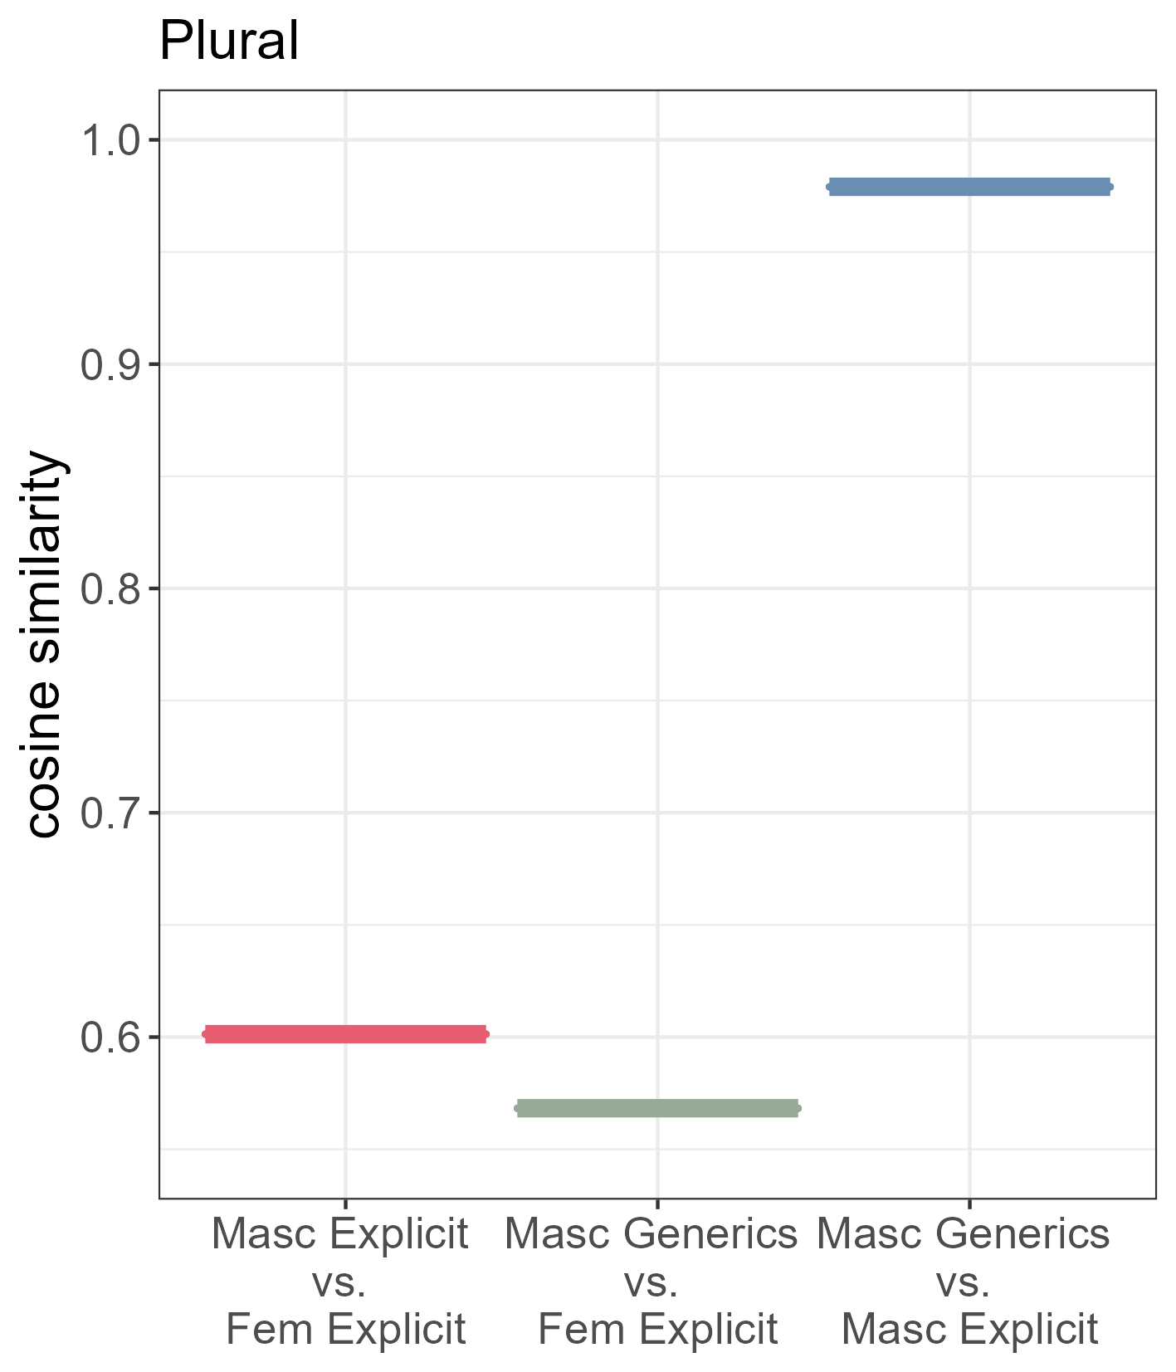
Results
masculine generics and the explicit masculine are semantically most similar
the explicit feminine is more similar to the explicit masculine than to masculine generics
all comparisons are highly significant
differences are more pronounced
***
***
***

Slide 26
Interim Summary
Q1 Do masculine generics show a male bias or is the bias reported in previous research an artefact of behavioural methods?
masculine generics do show a male bias

Slide 27
Part 2
LDL & underlying representations

Slide 28
Method: Linear Discriminative Learning
we simulate an individual’s comprehension by implementing a linear discriminative learning network (e.g. Baayen et al., 2019)
Step 1: semantic matrix
Step 2: cue matrix
 | cat | bus | eel
cat | 1.0 | 0.2 | 0.5
bus | 0.4 | 1.0 | 0.1
eel | 0.2 | 0.3 | 1.0
Step 3:
learning comprehension
 | #k{ | k{t | {t# | #bV | bVs | Vs# | #il | il#
cat | 1 | 1 | 1 | 0 | 0 | 0 | 0 | 0
bus | 0 | 0 | 0 | 1 | 1 | 1 | 0 | 0
eel | 0 | 0 | 0 | 0 | 0 | 0 | 1 | 1

Slide 29
Method: Linear Discriminative Learning
we simulate an individual’s comprehension by implementing a linear discriminative learning network (e.g. Baayen et al., 2019)
transformation matrix
cue
matrix
semantic matrix

Slide 30
LDL Measures
measures derived from the LDL implementation are
total semantic similarity
comprehension quality
semantic neighbourhood density
semantic activation diversity 1
semantic activation diversity 2

Slide 31
Results 1: LDL Measures

Slide 32
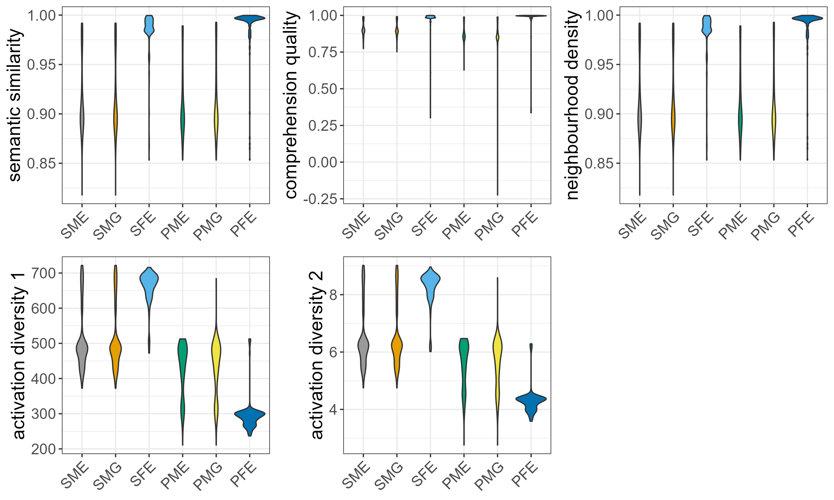
Results 1: LDL Measures

Slide 33
Results 1: LDL Measures

Slide 34
Results 1: LDL Measures

Slide 35
Results 1: LDL Measures

Slide 36
Results 1: LDL Measures

Slide 37
Results 1: LDL Measures
significant differences mostly found between masculine and feminine forms
feminine singular and feminine plurals show mostly similar patterns
 | singular |  |  | plural
 | generic masculine | explicit masculine | explicit feminine | generic masculine | explicit masculine | explicit feminine
total semantic similarity | identical |  |  | nearly identical
comprehension quality | nearly identical |  |  | similar
neighbourhood density | identical |  |  | nearly identical
activation diversity 1 | identical |  |  | nearly identical
activation diversity 2 | identical |  |  | nearly identical

Slide 38
Results 1: LDL Measures
significant differences only found between masculine and feminine forms
feminine singular and feminine plurals show mostly similar patterns
 | singular |  |  | plural
 | generic masculine | explicit masculine | explicit feminine | generic masculine | explicit masculine | explicit feminine
total semantic similarity | identical |  |  | nearly identical
comprehension quality | nearly identical |  |  | similar
neighbourhood density | identical |  |  | nearly identical
activation diversity 1 | identical |  |  | nearly identical
activation diversity 2 | identical |  |  | nearly identical

Slide 39
Results 1: LDL Measures
significant differences only found between masculine and feminine forms
feminine singular and feminine plurals show mostly similar patterns
 | singular |  |  | plural
 | generic masculine | explicit masculine | explicit feminine | generic masculine | explicit masculine | explicit feminine
total semantic similarity | identical |  |  | nearly identical
comprehension quality | nearly identical |  |  | similar
neighbourhood density | identical |  |  | nearly identical
activation diversity 1 | identical |  |  | nearly identical
activation diversity 2 | identical |  |  | nearly identical

Slide 40
Results 1: LDL Measures
significant differences only found between masculine and feminine forms
feminine singular and feminine plurals show mostly similar patterns
 | singular |  |  | plural
 | generic masculine | explicit masculine | explicit feminine | generic masculine | explicit masculine | explicit feminine
total semantic similarity | identical |  |  | nearly identical
comprehension quality | nearly identical |  |  | similar
neighbourhood density | identical |  |  | nearly identical
activation diversity 1 | identical |  |  | nearly identical
activation diversity 2 | identical |  |  | nearly identical

Slide 41
Results 1: LDL Measures
significant differences only found between masculine and feminine forms
feminine singular and feminine plurals show mostly similar patterns
 | singular |  |  | plural
 | generic masculine | explicit masculine | explicit feminine | generic masculine | explicit masculine | explicit feminine
total semantic similarity | identical |  |  | nearly identical
comprehension quality | nearly identical |  |  | similar
neighbourhood density | identical |  |  | nearly identical
activation diversity 1 | identical |  |  | nearly identical
activation diversity 2 | identical |  |  | nearly identical

Slide 42
Results 1: LDL Measures
significant differences only found between masculine and feminine forms
feminine singular and feminine plurals show mostly similar patterns
 | singular |  |  | plural
 | generic masculine | explicit masculine | explicit feminine | generic masculine | explicit masculine | explicit feminine
total semantic similarity | identical |  |  | nearly identical
comprehension quality | nearly identical |  |  | similar
neighbourhood density | identical |  |  | nearly identical
activation diversity 1 | identical |  |  | nearly identical
activation diversity 2 | identical |  |  | nearly identical

Slide 43
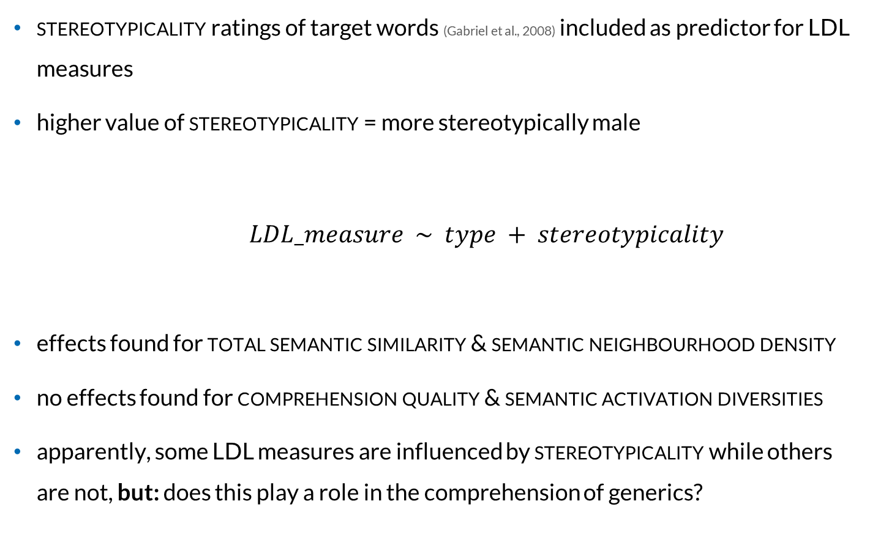
Results 2: Stereotypicality
stereotypicality ratings of target words (Gabriel et al., 2008) included as predictor for LDL measures
higher value of stereotypicality = more stereotypically male
$LDL_measure \sim type + stereotypicality$
effects found for total semantic similarity & semantic neighbourhood density
no effects found for comprehension quality & semantic activation diversities
apparently, some LDL measures are influenced by stereotypicality while others are not, but: does this play a role in the comprehension of generics?

Slide 44
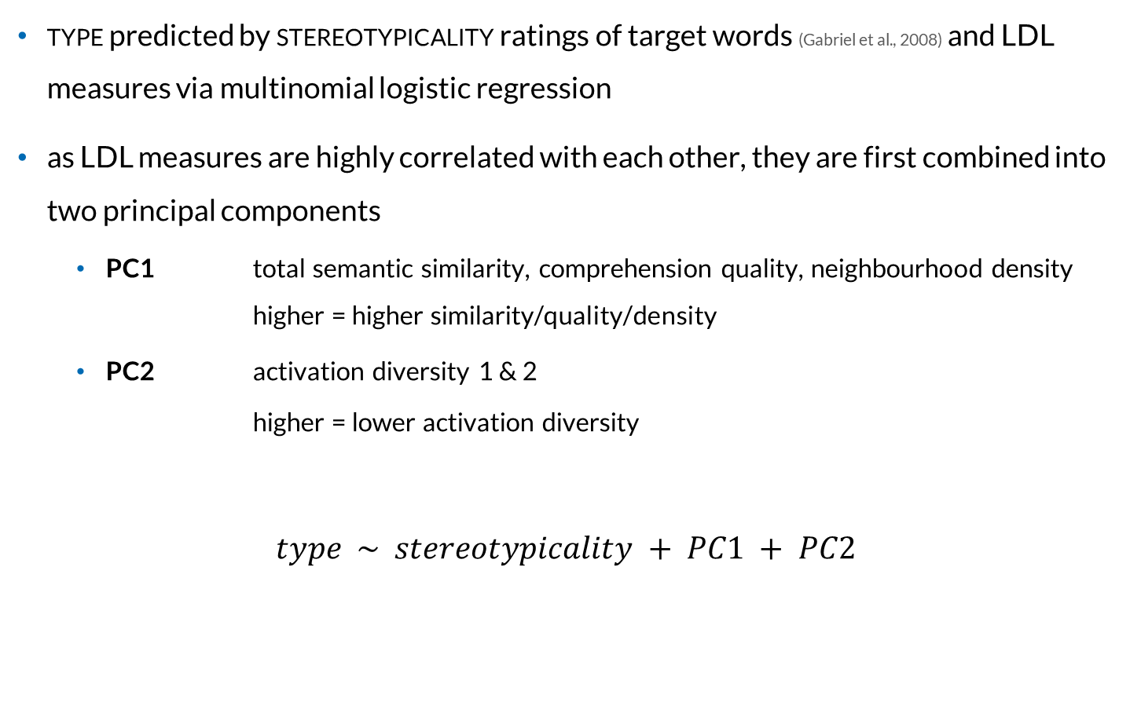
Results 3: Prediction of Type
type predicted by stereotypicality ratings of target words (Gabriel et al., 2008) and LDL measures via multinomial logistic regression
as LDL measures are highly correlated with each other, they are first combined into two principal components
PC1 total semantic similarity, comprehension quality, neighbourhood density higher = higher similarity/quality/density
PC2 activation diversity 1 & 2 higher = lower activation diversity
$$type \sim stereotypicality + PC1 + PC2$$

Slide 45
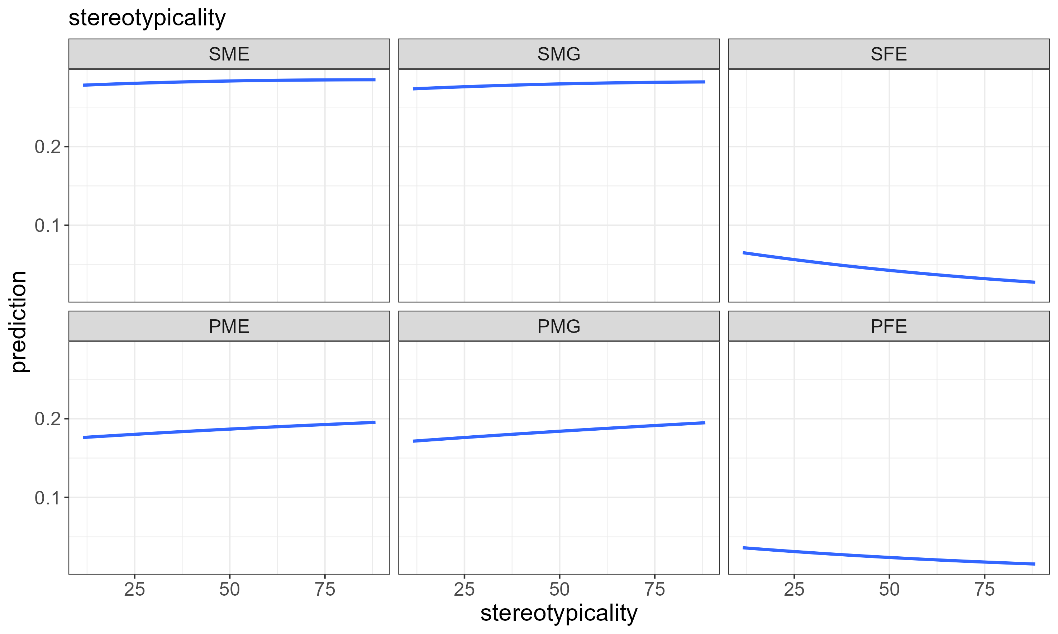
Results 3: Prediction of Type

Slide 46
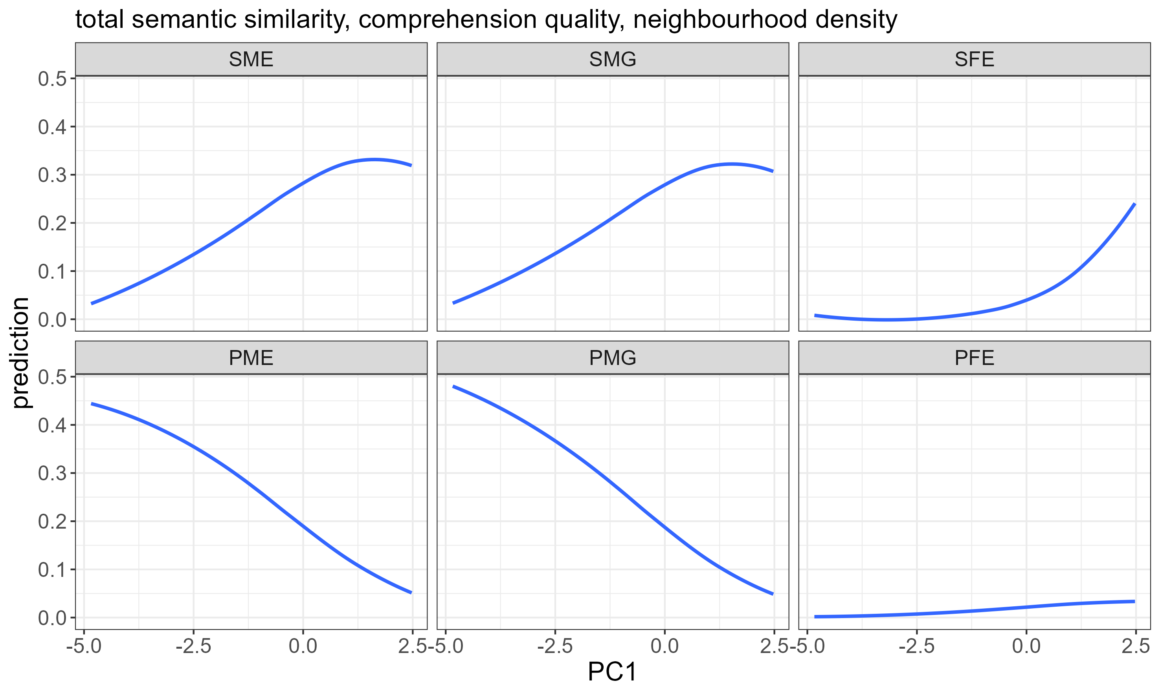
Results 3: Prediction of Type

Slide 47
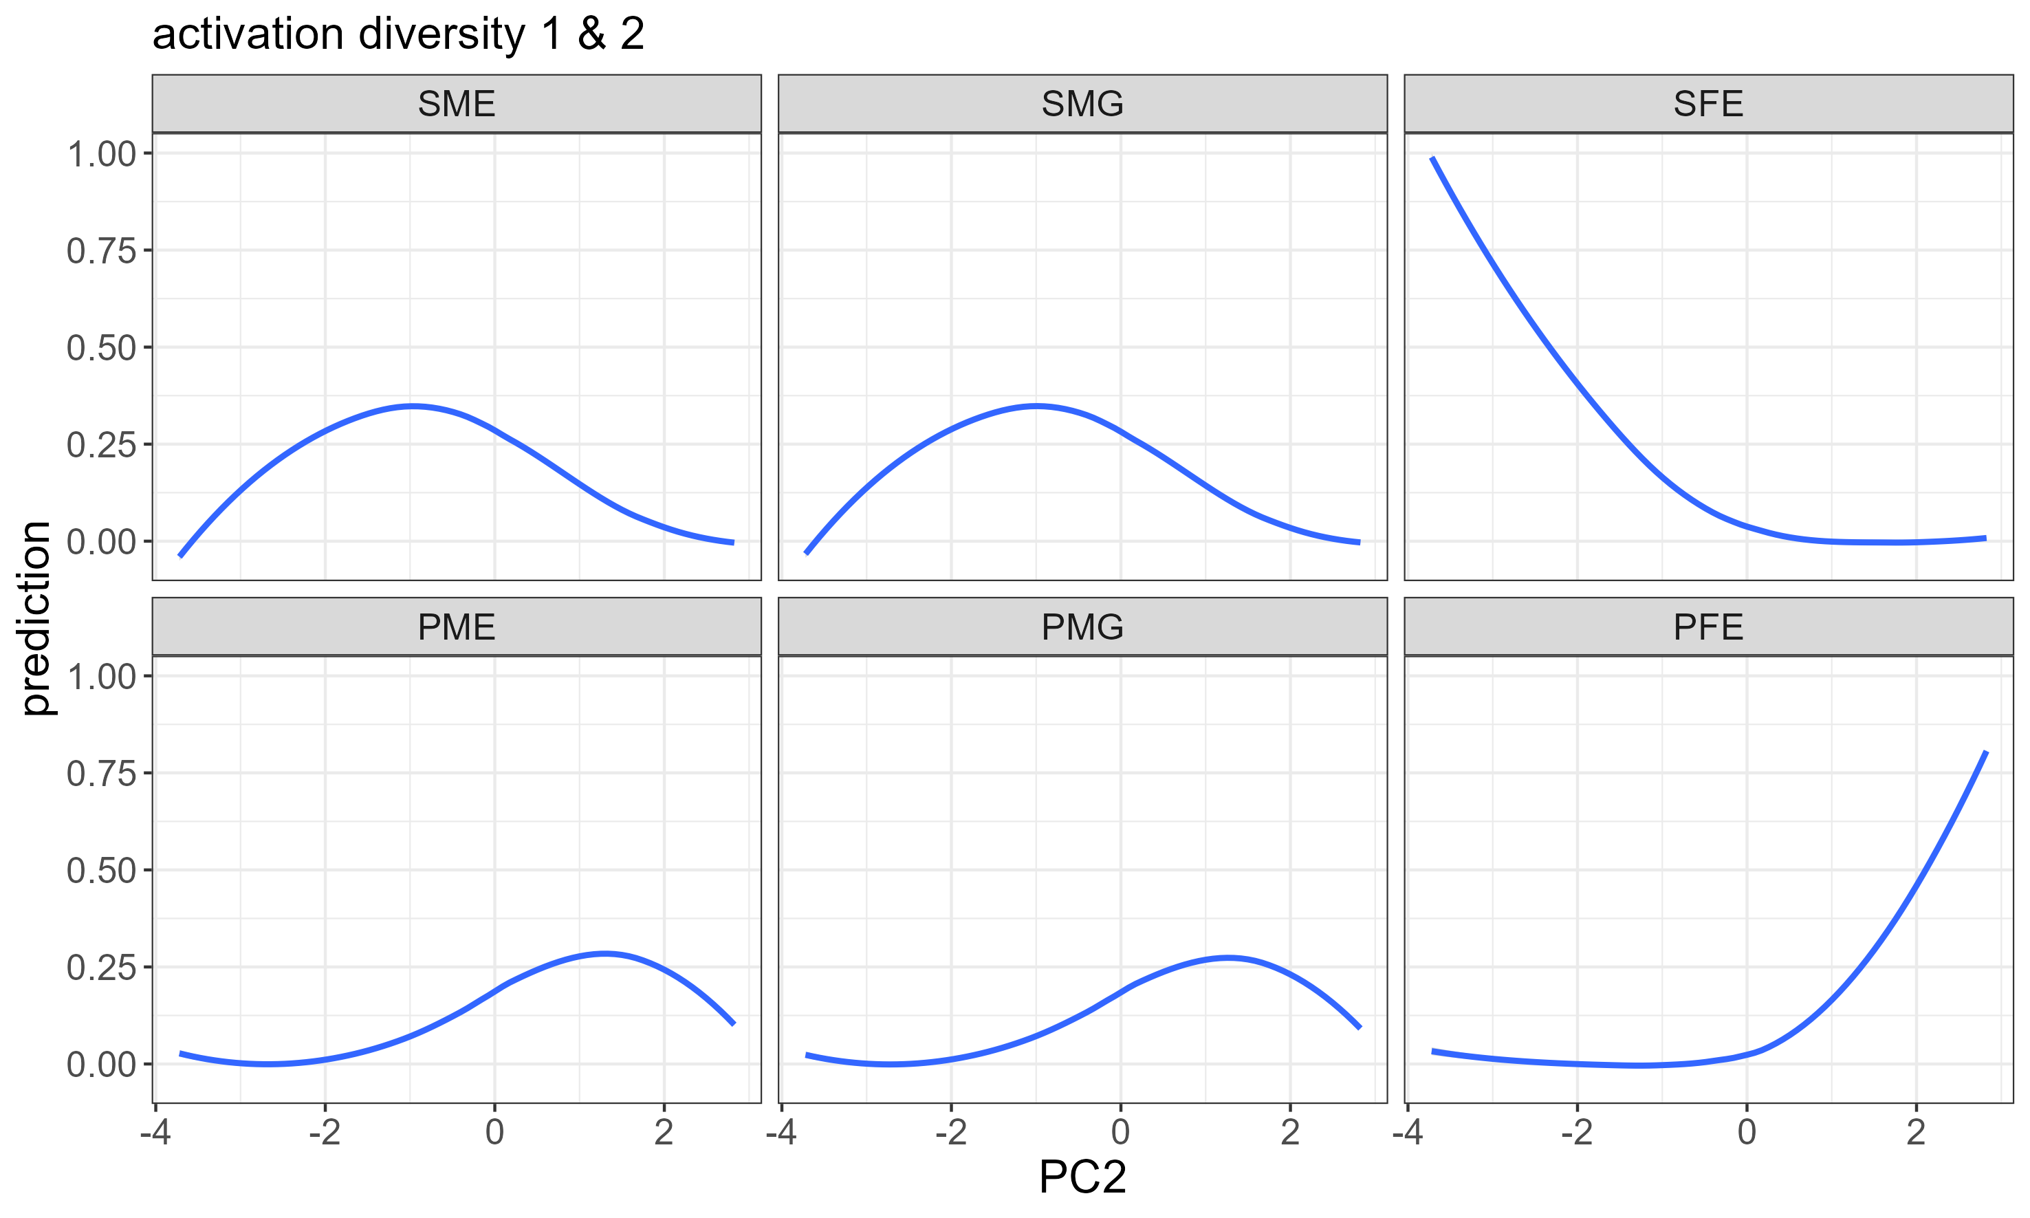
Results 3: Prediction of Type

Slide 48
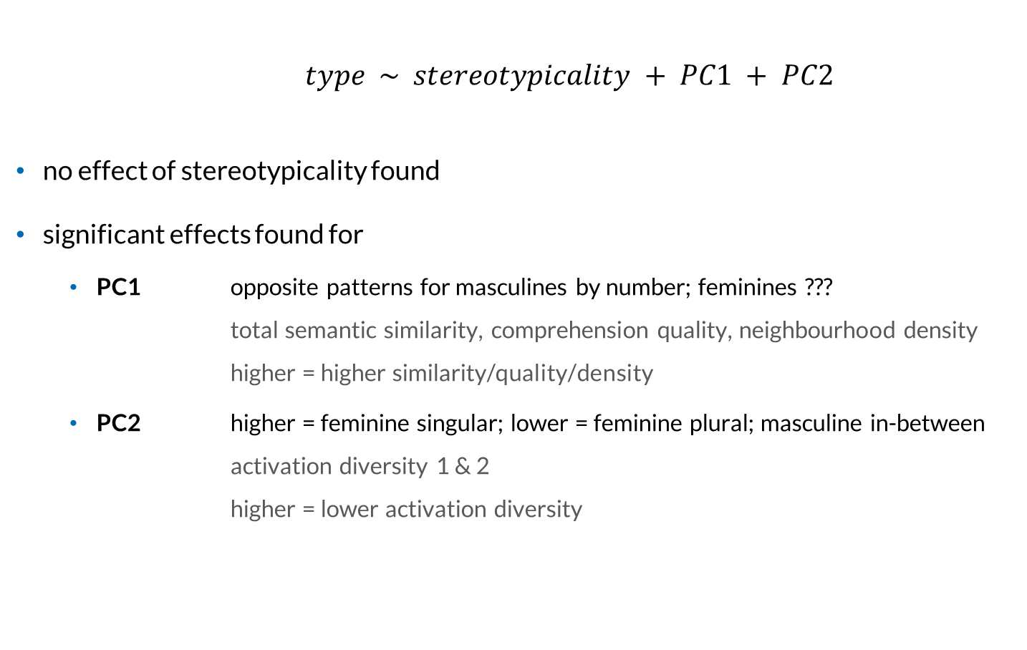
Results 3: Prediction of Type
$type \sim stereotypicality + PC1 + PC2$
no effect of stereotypicality found
significant effects found for
PC1 opposite patterns for masculines by number; feminines ??? total semantic similarity, comprehension quality, neighbourhood density higher = higher similarity/quality/density
PC2 higher = feminine singular; lower = feminine plural; masculine in-between activation diversity 1 & 2 higher = lower activation diversity

Slide 49
Interim Summary
Q2 Which features of the underlying representations lead to the (dis)similarities of masculine and feminine forms?
YES: all semantic LDL measures NO: stereotypicality

Slide 50
Discussion
our findings are in line with assumptions found in previous research
Stahlberg et al. (2001) masculine gender of generics has a semantic component of “maleness”
Irmen & Linner (2005) semantic similarity of masculine generics and explicits due to their resonance with the lexicon and each other
Gygax et al. (2012) and Gygax et al. (2021) masculine generics activate the underlying representations of masculine explicits, leading to a semantic activation of masculine explicits, thus a male bias

Slide 51
Conclusion
masculine generics show a clear male bias
the male bias is due to the similar semantic features of the masculine generic and masculine explicit forms
this leads to a ‘male bias’ in the language system itself
thus, our findings confirm the bias found in previous behavioural studies (e.g. Demarmels, 2017; Garnham et al., 2012; Gygax et al., 2008; Irmen & Kurovskaja, 2010; Irmen & Linner, 2005; Koch, 2021; Misersky et al., 2019; Stahlberg & Sczesny, 2001; Trutkowski, 2018)
future research will show
what exact effects this bias has on comprehension and/or production
whether the LDL measures computed for our data are predictive of behavioural measures
how (new) neutral forms perform (e.g. Anwält*innen, AnwältInnen)

Slide 52
Thank you!

Slide 53
References
Baayen, R. H., Chuang, Y.-Y., Shafaei-Bajestan, E., & Blevins, J. P. (2019). The discriminative Lexicon: A unified computational model for the lexicon and lexical processing in comprehension and production grounded not in (de)composition but in linear discriminative learning. Complexity, 2019, 1–39. https://doi.org/10.1155/2019/4895891
Baayen, R. H., & Ramscar, M. (2015). Abstraction, storage and naive discriminative learning. Handbook of Cognitive Linguistics, 39, 100–120. https://doi.org/10.1515/9783110292022-006
Demarmels, S. (2017). „Gesucht: Assistentin oder Sekretär der Geschäftsleitung“ – Gendersensitive Formulierungen in Stellenanzeigen aus der Perspektive der Textsorte. In Stellenanzeigen als Instrument des Employer Branding in Europa. https://doi.org/10.1007/978-3-658-12719-0_11
Doleschal, U. (2002). Das generische Maskulinum im Deutschen. Ein historischer Spaziergang durch die deutsche Grammatikschreibung von der Renaissance bis zur Postmoderne. Linguistik Online, 11(2). https://doi.org/10.13092/lo.11.915
Garnham, A., Gabriel, U., Sarrasin, O., Gygax, P., & Oakhill, J. (2012). Gender Representation in Different Languages and Grammatical Marking on Pronouns: When Beauticians, Musicians, and Mechanics Remain Men. Discourse Processes, 49(6), 481–500. https://doi.org/10.1080/0163853X.2012.688184
Goldhahn, D., Eckart, T., & Quasthoff, U. (2012). Building Large Monolingual Dictionaries at the Leipzig Corpora Collection: From 100 to 200 Languages. Proceedings of the 8th International Language Resources and Evaluation (LREC’12).
Gygax, P., & Gabriel, U. (2008). Can a group of musicians be composed of women? Generic interpretation of French masculine role names in the absence and presence of feminine forms. Swiss Journal of Psychology, 67(3), 143–151. https://doi.org/10.1024/1421-0185.67.3.143
Gygax, P., Gabriel, U., Sarrasin, O., Oakhill, J., & Garnham, A. (2008). Generically intended, but specifically interpreted: When beauticians, musicians, and mechanics are all men. Language and Cognitive Processes, 23(3), 464–485. https://doi.org/10.1080/01690960701702035
Gygax, P., Sato, S., Öttl, A., & Gabriel, U. (2021). The masculine form in grammatically gendered languages and its multiple interpretations: a challenge for our cognitive system. Language Sciences, 83, 101328. https://doi.org/10.1016/j.langsci.2020.101328

Slide 54
References
Harris, Z. S. (1954). Distributional Structure. WORD, 10(2–3), 146–162. https://doi.org/10.1080/00437956.1954.11659520
Irmen, L., & Kurovskaja, J. (2010). On the semantic content of grammatical gender and its impact on the representation of human referents. Experimental Psychology, 57(5), 367–375. https://doi.org/10.1027/1618-3169/a000044
Irmen, L., & Linner, U. (2005). Die Repräsentation generisch maskuliner Personenbezeichnungen. Zeitschrift Für Psychologie / Journal of Psychology, 213(3), 167–175. https://doi.org/10.1026/0044-3409.213.3.167
Koch, M. (2021). Kognitive Effekte des generischen Maskulinums und genderneutraler Alternativen im Deutschen – eine empirische Untersuchung. Master’s Thesis. Technische Universität Braunschweig.
Misersky, J., Majid, A., & Snijders, T. M. (2019). Grammatical Gender in German Influences How Role-Nouns Are Interpreted: Evidence from ERPs. Discourse Processes, 56(8), 643–654. https://doi.org/10.1080/0163853X.2018.1541382
Rescorla, R. A., & Wagner, A. R. (1972). A theory of pavlovian conditioning: Variations in the effectiveness of reinforcement and nonreinforcementy. In A. H. Black & W. F. Prokasy (Eds.), Classical conditioning II: Current research and theory (pp. 64–99). Appleton-Century-Crofts.
Schmid, H. (1999). Improvements in part-of-speech tagging with an application to German. In S. Armstrong, K. Church, P. Isabelle, S. Manzi, E. Tzoukermann, & D. Yarowsky (Eds.), Natural language processing using very large corpora (pp. 13–25). Springer. https://doi.org/10.1007/978-94-017-2390-9_2
Stahlberg, D., & Sczesny, S. (2001). Effekte des generischen Maskulinums und alternativer Sprachformen auf den gedanklichen Einbezug von Frauen. Psychologische Rundschau, 52(3), 131–140. https://doi.org/10.1026//0033-3042.52.3.131
Stahlberg, D., Sczesny, S., & Braun, F. (2001). Name Your Favorite Musician. Journal of Language and Social Psychology, 20(4), 464–469. https://doi.org/10.1177/0261927X01020004004
Trutkowski, E. (2018). Wie generisch ist das generische Maskulinum? Über Genus und Sexus im Deutschen. ZAS Papers in Linguistics, 59, 83–96. https://doi.org/10.21248/zaspil.59.2018.437
Wagner, A. R., & Rescorla, R. A. (1972). Inhibition in pavlovian conditioning: Application of a theory. In R. A. Boakes & M. S. Halliday (Eds.), Inhibition and learning (pp. 301–334). Academic Press Inc.

