Slide 1
Outline
Motivation
State-of-art ML
DL opportunities - Earth Science
DL challenges - Earth Science
Integration with Physical modeling
4 recommendations

Slide 2
Deep learning and process understanding for data-driven Earth system science

Slide 3
Motivation
Machine learning approaches are increasingly used to extract patterns and insights from the ever-increasing stream of geospatial data,
Current approaches may not be optimal when system behaviour is dominated by spatial or temporal context.
An argument is made for these contextual cues to be used as part of deep learning (an approach that is able to extract spatio-temporal features automatically) to gain further process understanding of Earth system science problems.

Slide 4
Motivation
For example, improving predictive ability of seasonal forecasting and modelling of long-range spatial connections across multiple timescales.
Deluge of Earth system data available already - in dozens of petabytes and increasing transmission rates from sensors representing fifteen or more orders of temporal and spatial magnitude.
Earth system data demonstrate all ‘four Vs’ of ‘big data’: volume, velocity, variety and veracity.

Slide 5
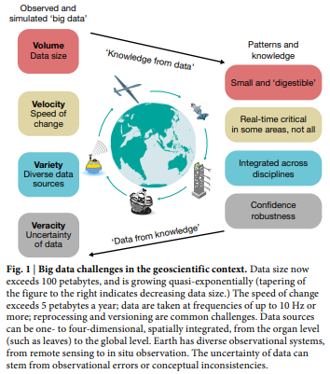
Challenges
Two major tasks in the coming years:
Extracting knowledge from the data deluge, and
Deriving models that learn much more from data than traditional data assimilation approaches can, while still respecting our evolving understanding of nature’s laws.

Slide 6
State-of-art Machine Learning
Machine learning has become a universal approach in geoscientific classification, regression and change/anomaly-detection problems.
Few pitfalls such as the risk of naive extrapolation, sampling or other data biases, ignorance of confounding factors, interpretation of statistical association as causal relation, or fundamental flaws in multiple hypothesis testing (‘P-fishing’) should be avoided.
Classical machine learning approaches benefit from domain-specific, hand-crafted features to account for dependencies in time or space but rarely exploit spatio-temporal dependencies exhaustively.
Notes:
An artificial neural network with one hidden layer was able to filter out noise, predict the diurnal and seasonal variation of carbon dioxide (CO2) fluxes, and extract patterns such as an increased respiration in spring during root growth
Another example is soil mapping, where measurements of soil properties and covariates exist at points sparsely distributed in space, and where a ‘random forest’, a popular and efficient machine learning approach, is used to predict spatially dense estimates of soil properties or soil types

Slide 7
State-of-art Machine Learning
For example, classifying a certain atmospheric situation as a hurricane or extratropical storm requires knowledge of the spatial context such as a storm’s geometry as constituted by pixels, their values, and their topology.
For instance, detecting symmetric outflow and a visible ‘eye’ is important for detecting hurricanes and assessing their strength, and this cannot be determined by localized, single-pixel values alone.
However, temporally dynamic properties (‘memory effects’) can be represented by hand-designed and domain-specific features in machine learning. Similarly, spatial context can also be incorporated.
Notes:
such as terrain shape and topographical or texture features from satellite images, to incorporate spatial context

Slide 8
State-of-art Machine Learning
Hand-designed features can be seen both as an advantage (control of the explanatory drivers) and as a disadvantage (tedious, ad hoc process, probably non-optimal)
However, the concerns related to the use of a restricted and subjective choice of features rather than an extensive and generic approach remain valid and important.
New developments in deep learning, however, no longer limit us to such approaches.
Notes:
such as terrain shape and topographical or texture features from satellite images, to incorporate spatial context

Slide 9
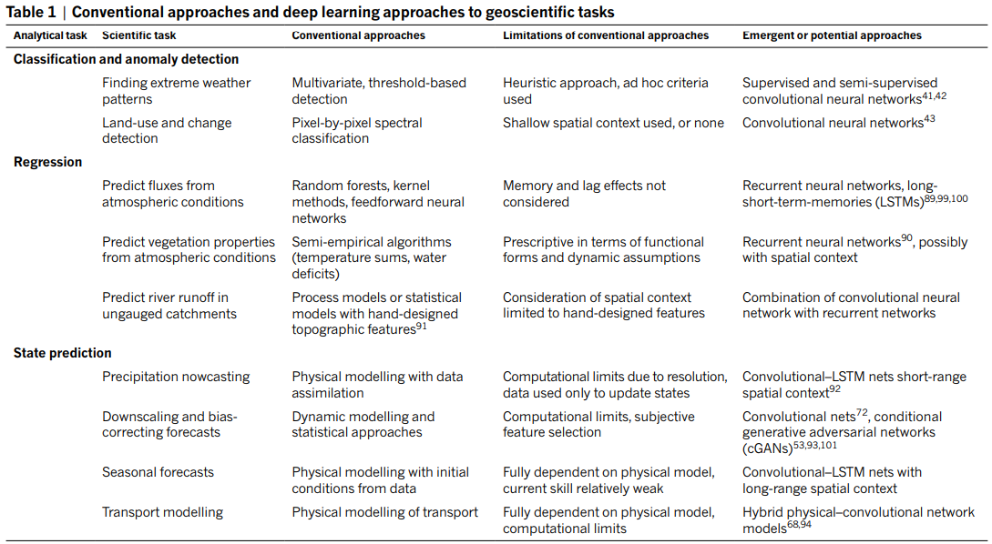
Deep Learning Opportunities - Earth Sciences

Slide 10
Deep Learning Opportunities - Earth Sciences
Two recent studies demonstrate the application of deep learning for extreme weather (hurricane detection) - already problematic for traditional machine learning.
Deep learning architectures can be applied to objectively extract spatial features to define and classify extreme situations (for example, storms, atmospheric rivers) in numerical weather prediction model output.
Rapid detection of such events and forecast simulations without using either subjective human annotation or methods that rely on predefined arbitrary thresholds for wind speed or other variables.
Notes:
such as terrain shape and topographical or texture features from satellite images, to incorporate spatial context

Slide 11
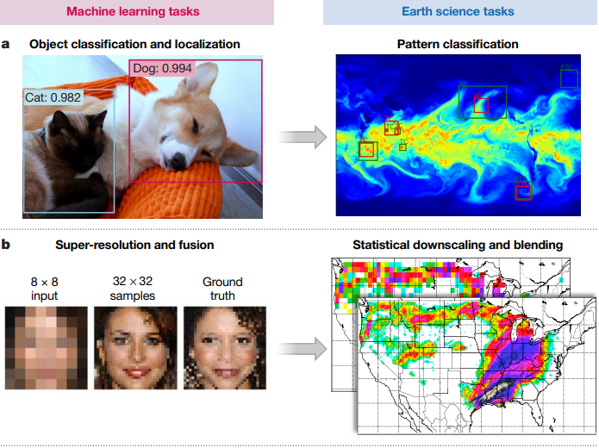
Deep Learning Opportunities - Earth Sciences
Object recognition in images links to classification of extreme weather patterns using unified convolutional neural network.
Super-resolution applications relate to statistical downscaling of climate model.

Slide 12
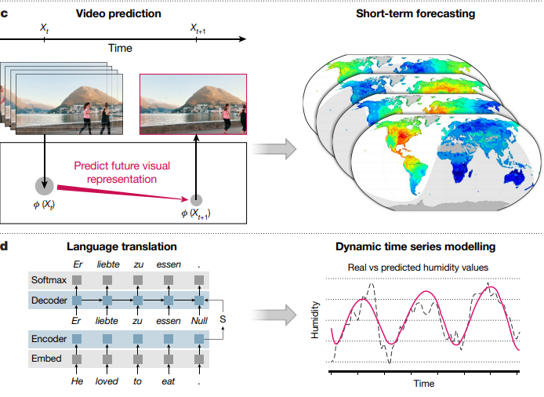
Deep Learning Opportunities - Earth Sciences
Video prediction is similar to short-term forecasting of Earth system variables.
Language translation links to modelling of dynamic time series.

Slide 13
Deep Learning Challenges - Earth Sciences
Interpretability,
Given their complexity, modern Earth system models are in practice often also not easily traceable back to their assumptions, limiting their interpretability - a potential weakness of deep neural networks.
Physical Consistency,
Deep learning models can fit observations very well, but predictions may be physically inconsistent or implausible, owing to extrapolation or observational biases, for example.

Slide 14
Deep Learning Challenges - Earth Sciences
Complex and uncertain data,
Deep learning methods are needed to cope with complex statistics, multiple outputs, different noise sources and high-dimensional spaces.
Limited labels,
Deep learning methods are needed to learn from few labelled examples while exploiting the wealth of information in related unlabelled observations.
Computational demand,
There is a huge technical challenge regarding the high computational cost of current geoscience problems.

Slide 15
Physical Modeling Integration
Historically, physical modelling and machine learning have often been treated as two different fields with very different scientific paradigms (theory-driven versus data-driven).
Yet, in fact these approaches are complementary, with physical approaches in principle being directly interpretable and offering the potential of extrapolation beyond observed conditions, whereas data-driven approaches are highly flexible in adapting to data and are amenable to finding unexpected patterns (surprises).
5 points of potential synergies.

Slide 16
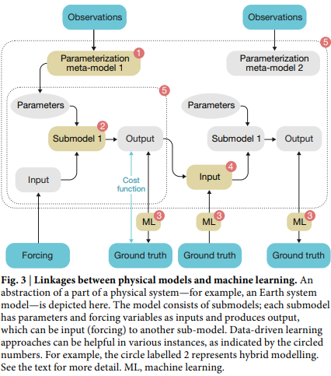
Physical Modeling Integration
Improving parameterizations,
Physical models require parameters, but many of those cannot be easily derived from first principles. Machine learning can learn parameterizations to optimally describe the ground truth.
Replacing a ‘physical’ sub-model with a machine learning model,
This leads to a hybrid model, which combines the strengths of physical modelling (theoretical foundations, interpretable compartments) and machine learning (data-adaptiveness).
Notes:
If formulations of a submodel are of semi-empirical nature, where the functional form has little theoretical basis (for example, biological processes), this submodel can be replaced by a machine learning model if a sufficient number of observations are available.

Slide 17
Physical Modeling Integration
Analysis of model–observation mismatch,
Machine learning can extract patterns from data automatically and identify those which are not explicitly represented in the physical model, improving physical model and theory.
Constraining submodels,
One can drive a submodel with the output from a machine learning algorithm, disentangling model error originating from the submodule of interest from errors of coupled submodules.

Slide 18
Physical Modeling Integration
Surrogate modelling or emulation,
Emulation of the full (or specific parts of) a physical model can be useful for computational efficiency and tractability reasons.
Machine learning emulators, once trained, can achieve simulations orders of magnitude faster than the original physical model without sacrificing much accuracy.
This allows for fast sensitivity analysis, model parameter calibration, and derivation of confidence intervals for the estimates.

Slide 19
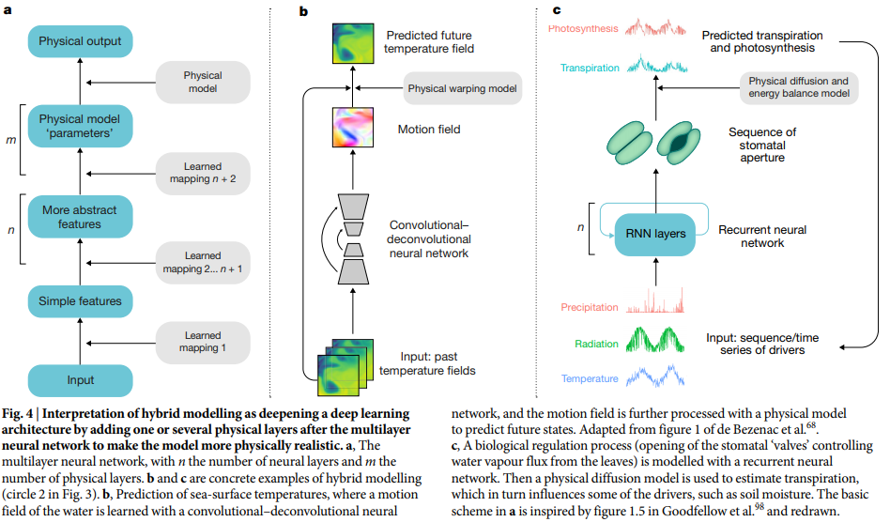
Hybrid Modeling

Slide 20
Four Key Recommendations
Recognition of the particularities of the data,
Multi-source, multi-scale, high-dimensional, complex spatio-temporal relations, including non-trivial and lagged long-distance relationships (teleconnections) between variables need to be adequately modelled.
Plausibility and interpretability of inferences,
Wide adoption of machine learning in the Earth sciences will be facilitated if models become more transparent and interpretable: their parameters and feature rankings should have a minimal physical interpretation, and the model should be reducible to or explainable by a set of rules, descriptors and relations.

Slide 21
Four Key Recommendations
Uncertainty estimation,
Models should define their confidence and credibility. Bayesian/ probabilistic inference should be integrated into models.
Testing against complex physical models,
The spatial and temporal prediction ability of machine learning should be, at least, consistent with the patterns observed in physical models. Therefore we recommend testing the performance of machine learning methods against synthetic data derived from physical models of the Earth system.

Slide 22
Conclusion
Machine learning in general and deep learning in particular offer promising tools to build new data-driven models for components of the Earth system and thus to build our understanding of Earth.
Data-driven machine learning approaches to geoscientific research will not replace physical modelling, but strongly complement and enrich it.

Slide 23
Future Challenges
Two major Earth system challenges in which little progress has been made recently
the parameterization of atmospheric convection and,
the description of the spatio-temporal dependency of ecosystems on climate and interacting geo-factors
Could be addressed using the hybrid modeling.

