Slide 1
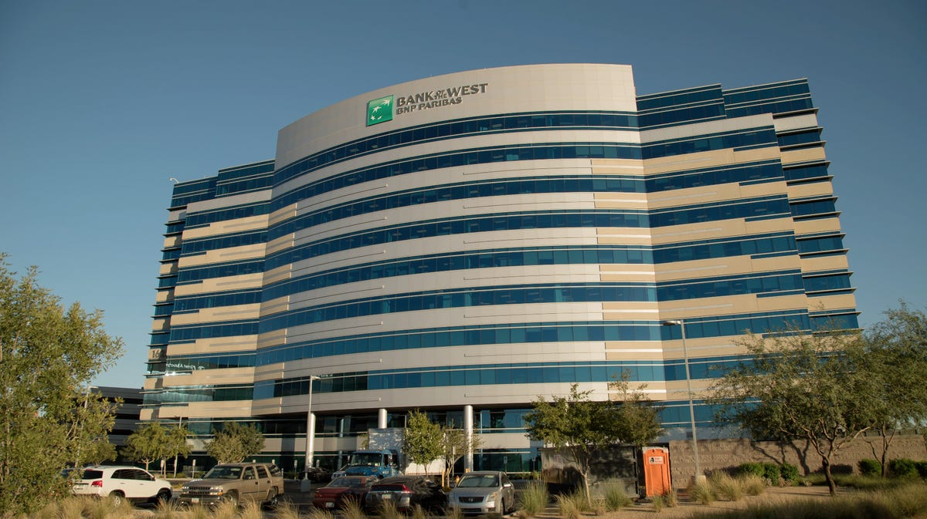
Bank of the West
Bank for millennium sustainability

Slide 2
PROBLEM
Waste diversion rates are too low
Individual habits are misaligned from system
Contamination is a problem

Slide 3
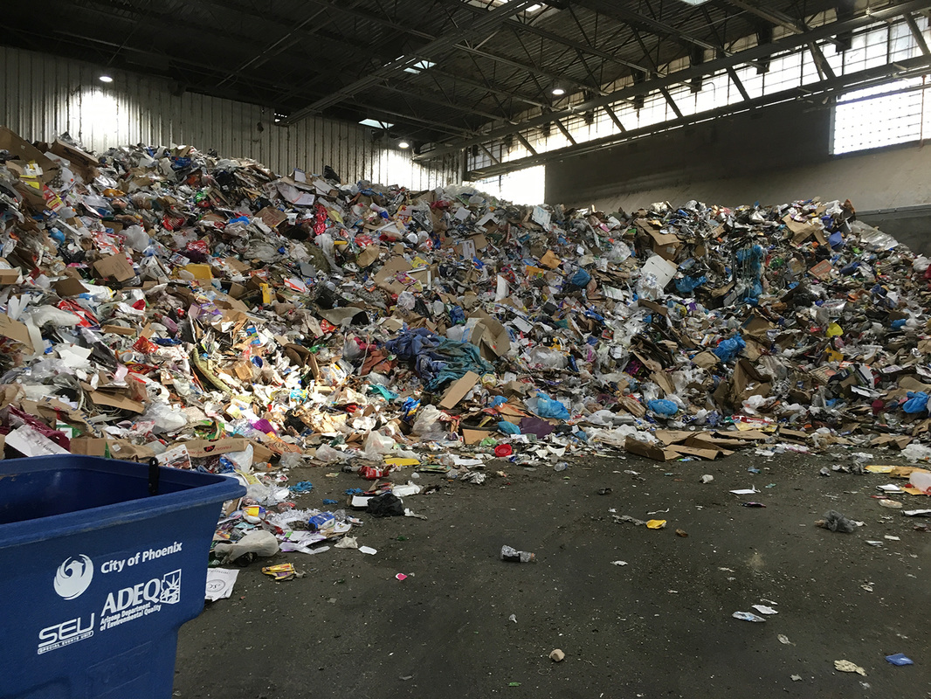
48%
recyclable waste are put in the trash
38%
processed recyclables bagged

Slide 4



SOLUTION
All customers can choose which sustainable program they want to invest their money in .
Incentivizing
With better ROI
Rounding Up Cents
for sustainable programs
Community Investment
For sustainable programs

Slide 5
MARKET SIZE & POTENTIAL
200
Billion +
11
Billion +
7
Billion +
Dollars Spent in US
on recycling annually
Dollars Wasted
by inefficient diversion
BotB
market potential

Slide 6
BUSINESS MODEL
upfront hardware system installation & long-term pre-processing
$15
per waste bin implementation
$5
per ton of solid waste pre-processing

Slide 8
COMPETITORS ADVANTAGES

Slide 9
FUTURE ROADMAP
scaling to future cities/states
hardware/sort implementation
improve data models
Better detection

