Slide 1
MINI PROJECT - 202040601
MedInventory – Medical Inventory System
Nishil Shah (12202130501045)
Parth Patel (12202130501049)
Guided By : Prof. Vraj Hingu

Slide 2
Introduction
Problem Statement
In today's healthcare facilities and pharmacies, managing medical inventory efficiently remains a critical challenge that directly impacts patient care and business operations. Traditional manual methods of tracking medical supplies, monitoring expiration dates, and maintaining optimal stock levels are prone to errors, time-consuming, and often result in significant financial losses. Healthcare providers struggle with stockouts of essential medicines, expired inventory, and inefficient resource allocation, which can compromise patient care quality and safety.
Currently, staff members spend considerable time on manual inventory counts, paperwork, and tracking expiration dates without real-time visibility into stock levels. This leads to emergency purchases at premium prices, wastage due to expired medications, and potential risks of distributing expired products to patients. The lack of automated alerts for low stock and near-expiry items forces reactive rather than proactive inventory management.
2

Slide 3
Introduction
Problem Objective
Inventory Management: Create a real-time medical inventory tracking system with automated alerts for low stock and expiring items.
Digital Transformation: Digitize manual inventory processes to reduce errors, save time, and improve efficiency in healthcare facilities.
Quality Control: Ensure patient safety by monitoring expiration dates and maintaining proper stock levels of medical supplies.
Data Analytics: Provide insights through dashboards, reports, and analytics for better inventory decision-making.
User Experience: Deliver an intuitive interface for healthcare staff to manage inventory with minimal training.

Slide 4
Literature Review
Related Work
Traditional Systems
Manual record keeping
Paper-based inventory tracking
High error rates and inefficiencies
Limited real-time visibility
Digital Transformation
Computerized systems (1990s-2000s)
Early database management systems
Basic stock tracking software
Limited automation capabilities
Modern Stack Implementation
MERN Stack Architecture
Real-time data synchronization
Cloud database integration
Responsive design principles

Slide 5
Literature Review
Related Work
Automation
Automated expiry tracking
Real-time notifications
5. Data Management
Advanced filtering
Export capabilities

Slide 6
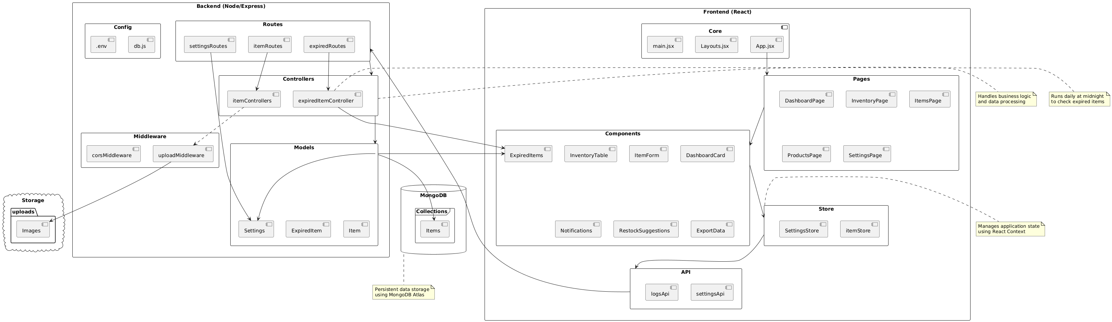
Architecture Diagram
System Design

Slide 7
Model Overview
Item Model : Manages active inventory items
ExpiredItem Model : Tracks expired inventory items
Settings Model : Manages application settings and preference
Key Relationships:
Item → ExpiredItem :
Items automatically move to ExpiredItem when expired
Item → Settings :
Settings control item thresholds
Notifications based on settings

Slide 8
Implementation
Technologies Used
The MedInventry is implemented using the following technologies and tools:
MERN Stack –
React.js (v19.0.0)
Express.js (v4.21.2)
MongoDB (Mongoose v8.10.0)
Node.js
Additional Frontend Libraries –
Lucide React – Icons
React Hot Toast – Notifications
TailwindCSS (v4.0.4)
Additional Backend Packages –
Multer - File upload handling
CORS - Cross-origin resource sharing
Dotenv - Environment variables

Slide 9
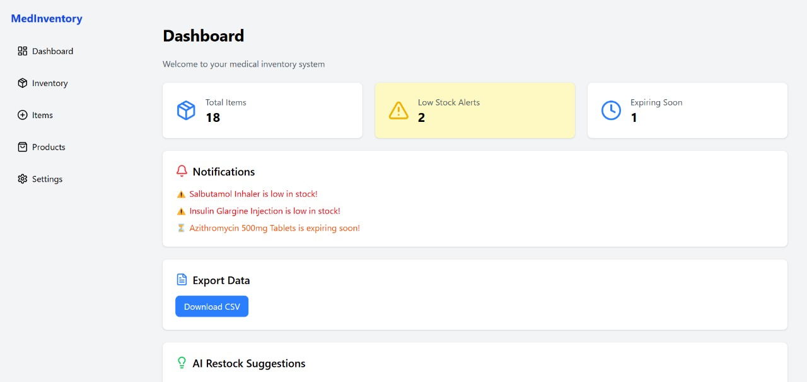
Implementation
ScreenShots

Slide 10
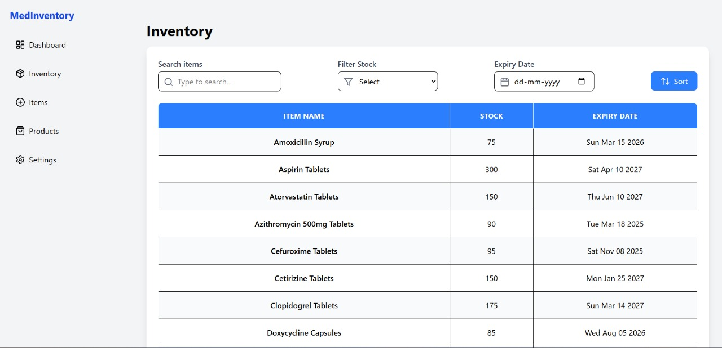
Implementation

Slide 11
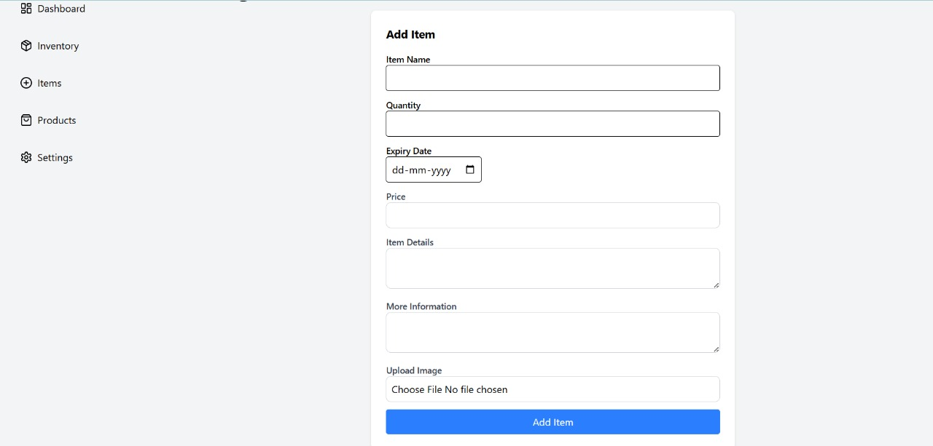
Implementation

Slide 12
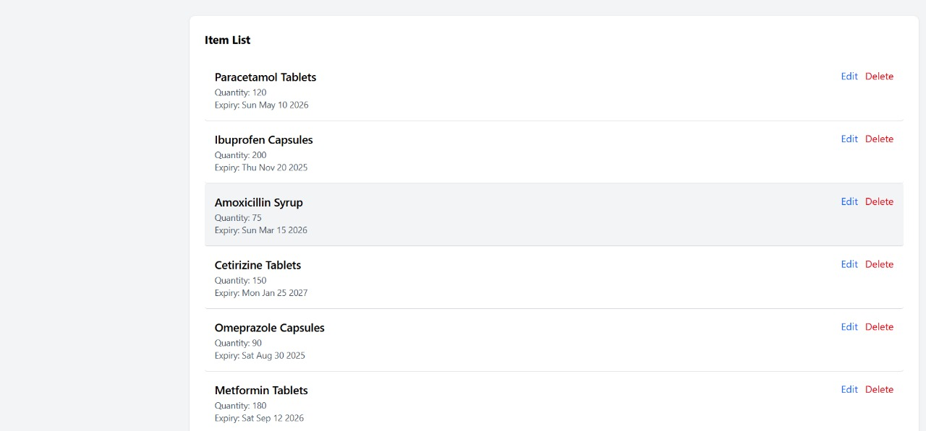
Implementation

Slide 13
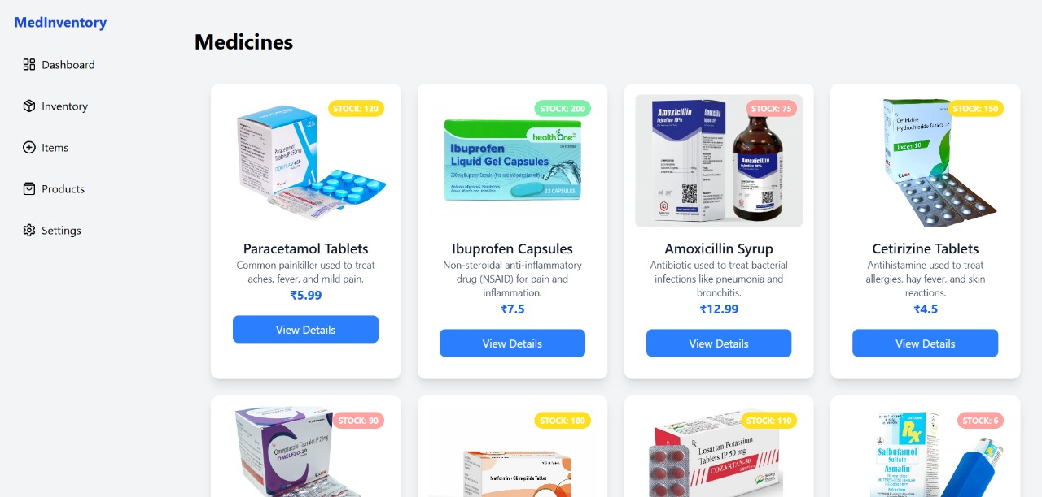
Implementation

Slide 14
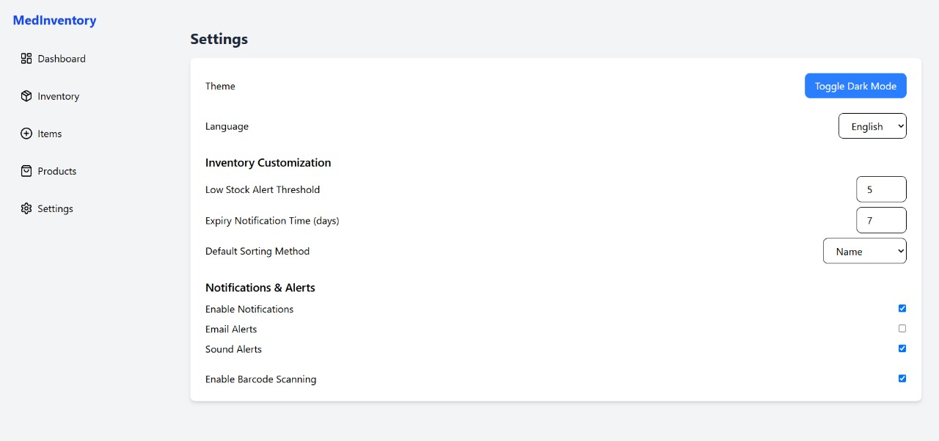
Implementation

Slide 15
Testing and Results
Key Performance Metrics for MedInventory System:
Test Case ID | Description | Expected Outcome | Actual Outcome | Status
TC-01 | Add Inventory Item | Item added successfully | Item created in DB | Pass
TC-02 | Update Inventory Quantity | Quantity updated successfully | Quantity changed in DB | Pass
TC-03 | Expiry Alerts | Notifications for expired items | Alerts received | Pass
TC-04 | Search and Filter | Correct items displayed | Results matched | Pass
TC-05 | Generate Reports | Report generated successfully | Report downloaded | Pass

Slide 16
Conclusion and Future Scope
Conclusion:
The Medical Inventory Management System provides an efficient and user-friendly platform for managing medical supplies, reducing wastage, and ensuring seamless inventory tracking. With its implementation, healthcare institutions can streamline their inventory processes, minimize errors, and improve resource utilization. The system integrates modern web technologies, ensuring a scalable and responsive user experience. By utilizing a database-driven approach, it offers real-time updates and inventory insights, enhancing overall operational efficiency.
Future Scope:
AI-Powered Demand Forecasting
Supplier and Order Management
Automated Alerts and Reports
Adding Medicine recommend system
Final Thoughts:
The development of this system marks a significant step toward digital transformation in medical inventory management. It not only simplifies stock tracking but also ensures optimal resource utilization, reducing inefficiencies and improving patient care. As technology evolves, continuous improvements and innovations will further enhance its capabilities, making it a vital tool for modern healthcare facilities.

Slide 17
References
Research Papers & Journals
1. OpenAI. (2024). https://chatgpt.com/c/67a391b5-edac-800f-befb-47fbe3472055
2. MongoDB Inc. (2024). MongoDB Documentation – https://www.mongodb.com/docs/
3. Express.js. (2024). Express Framework Guide - https://expressjs.com/en/guide/routing.html
4. React.js. (2024). React Developer Documentation – https://react.dev/learn
5. Node.js. (2024). Node.js Documentation – https://nodejs.org/docs/latest/api/

Slide 18

Q&A

