Slide 1
D2NN vs MPLC
Physics of Multi-Plane Phase Systems
for Atmospheric Turbulence Mitigation
Kim Lab · April 2026
λ = 1.55 μm · Cn² = 5×10⁻¹⁴ · 100m – 3km · 5-layer D2NN
1

Slide 2
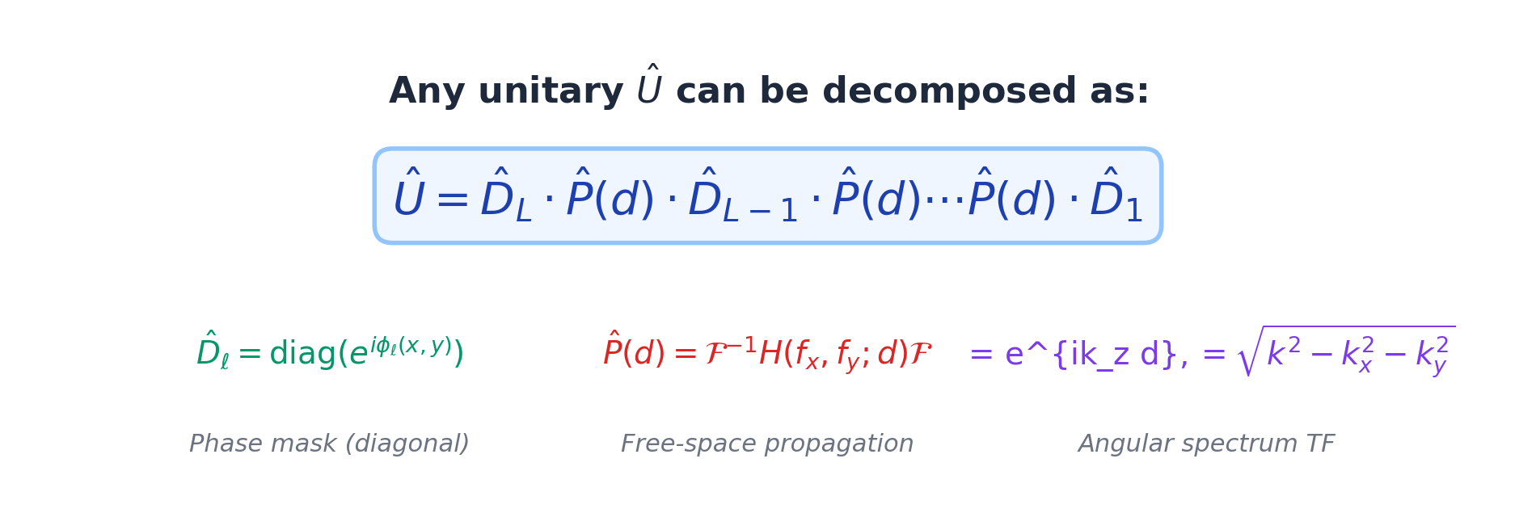
The Shared Foundation: Unitary Decomposition Theorem
Both D2NN and MPLC implement the same physics: cascaded phase masks with free-space propagation can realize any unitary spatial transformation (Reck et al. 1994, Morizur et al. 2010).
Key implication: With sufficient layers L, both systems can implement ANY mode transformation — the difference lies in how the phase masks are determined.
MPLC: masks designed analytically via wavefront matching algorithm
D2NN: masks trained end-to-end via stochastic gradient descent
2

Slide 3
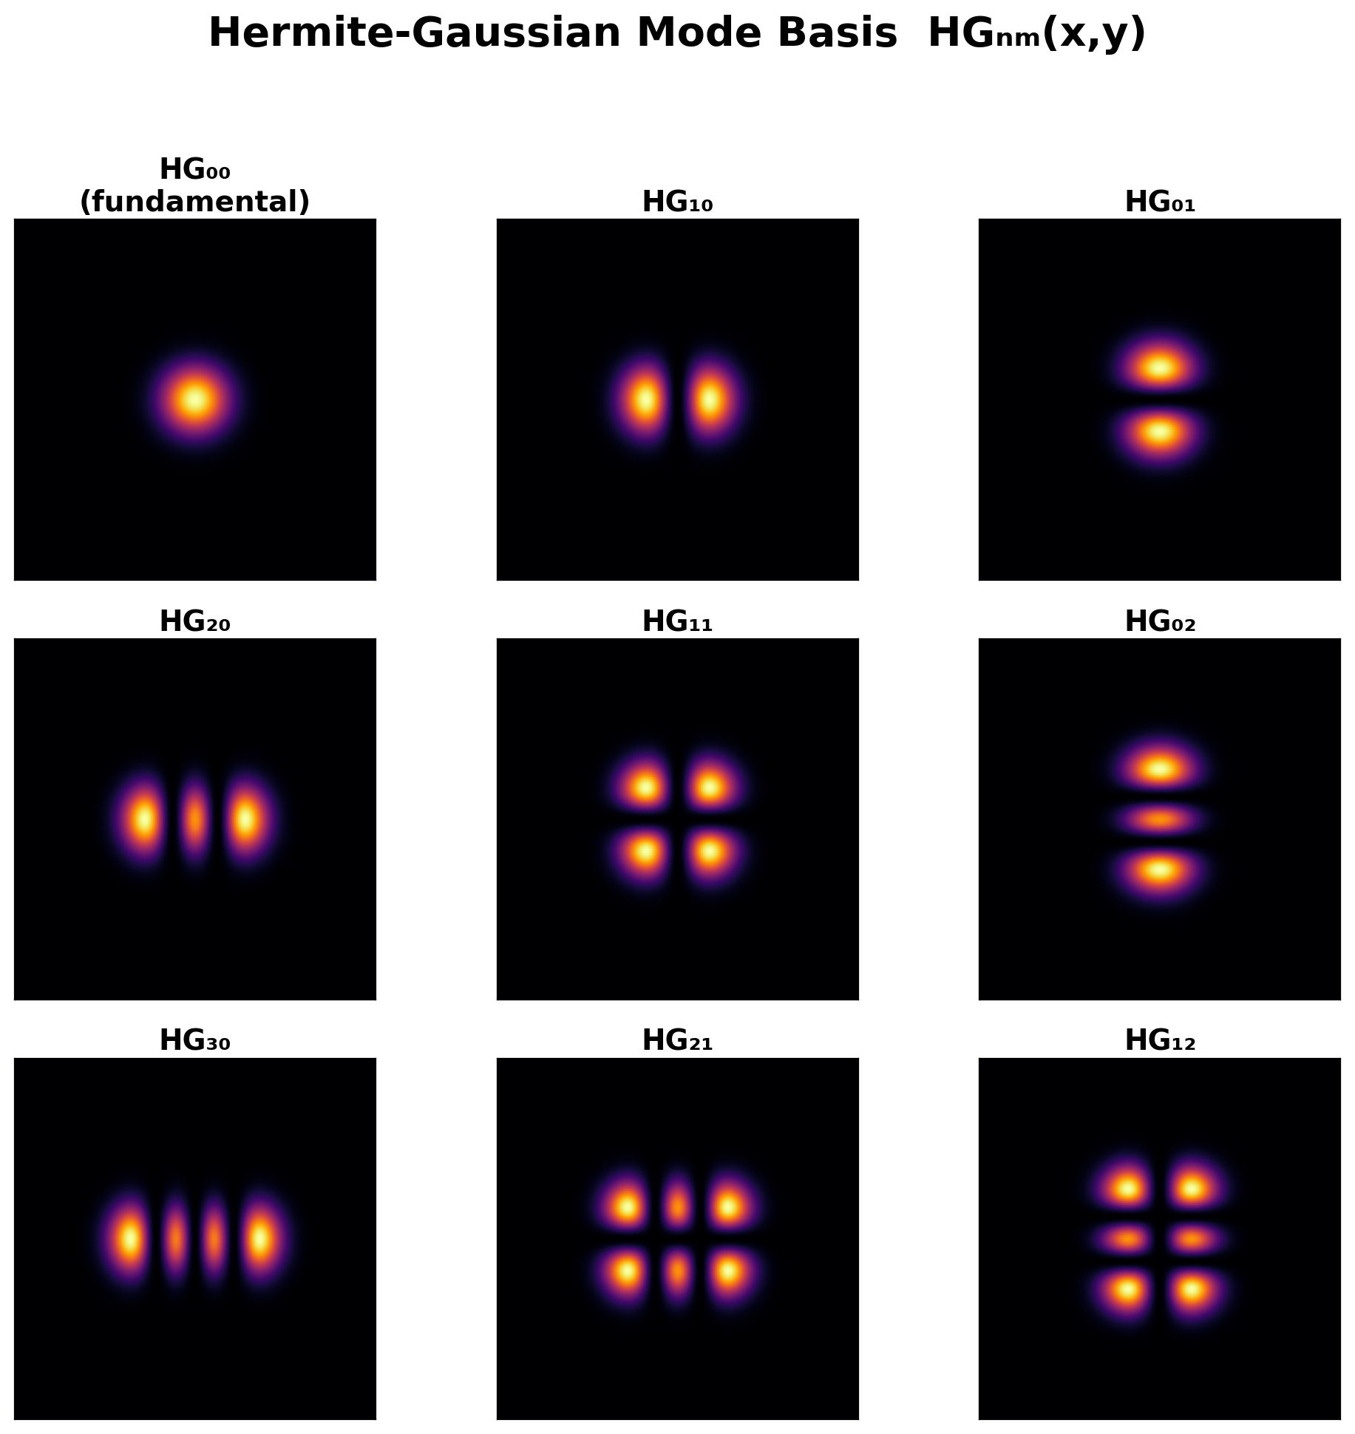
Hermite-Gaussian Mode Basis
Mode Decomposition
Any beam can be decomposed into orthogonal HG modes:
U(x,y) = Σ cₙ ψₙ(x,y)
where ψₙ = HG mode function
cₙ = complex mode coefficient
Turbulence redistributes energy across modes:
• Weak turbulence: most energy in HG₀₀ (fundamental)
• Strong turbulence: energy spreads to many higher-order modes
• Number of significant modes ≈ (D/r₀)²
MPLC sorts these modes spatially.
D2NN ignores mode structure entirely.
3

Slide 4
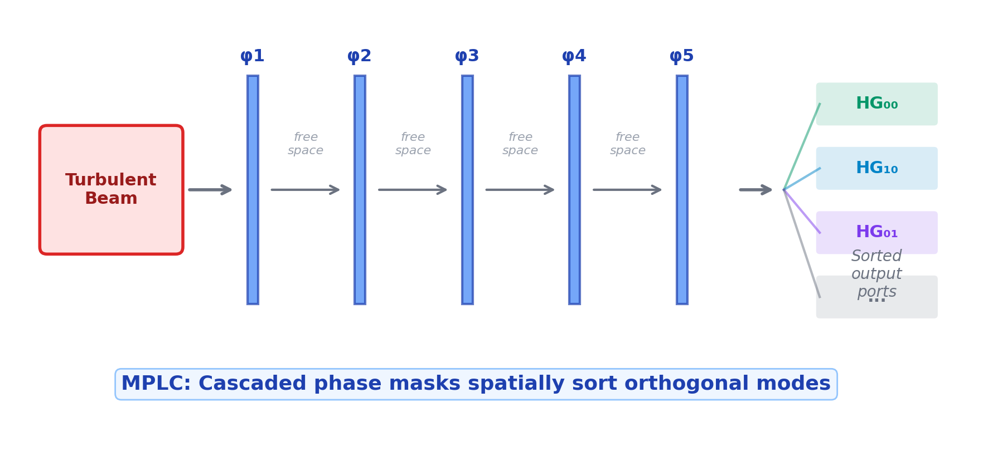
MPLC: Adaptive Mode Sorting Architecture
How it works: Each phase plane φₗ is designed so that after L planes, mode ψₙ emerges at spatial port n. The wavefront matching algorithm (Sakamaki et al.) iteratively optimizes each plane to maximize mode separation.
For turbulence compensation: requires coherent detection at each port + real-time DSP to measure cₙ and recombine. This makes it an active system with significant power consumption and latency requirements.
4

Slide 5
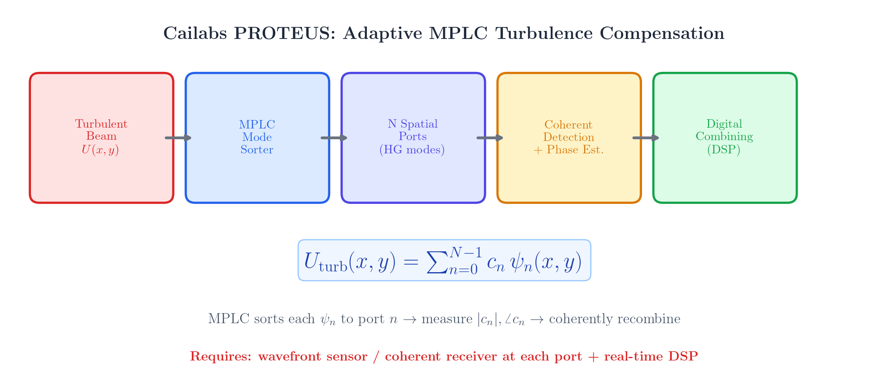
Cailabs PROTEUS: Commercial MPLC for FSO
Cailabs approach: MPLC sorts turbulent beam into N HG modes → coherent Rx per port → DSP recombines. Requires SLM or fixed MPLC + N photodetectors + FPGA. Cost: tens of k$.
5

Slide 6
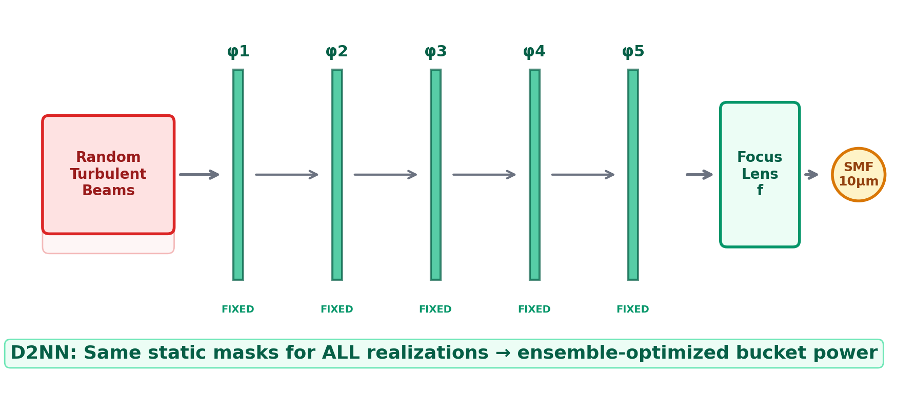
Our D2NN: Static Ensemble-Optimized Phase Masks
Loss Function
Key Differences from MPLC
L = −log( E_bucket / E_input + ε )
• Same masks for ALL turbulence realizations
• No mode decomposition or sensing
• Zero power consumption (passive)
• WF RMS unchanged — NOT wavefront correction
• Mechanism: energy redistribution + fade floor lifting
Directly maximizes absolute focal bucket power.
No vacuum reference. Throughput intrinsically preserved.
6

Slide 7
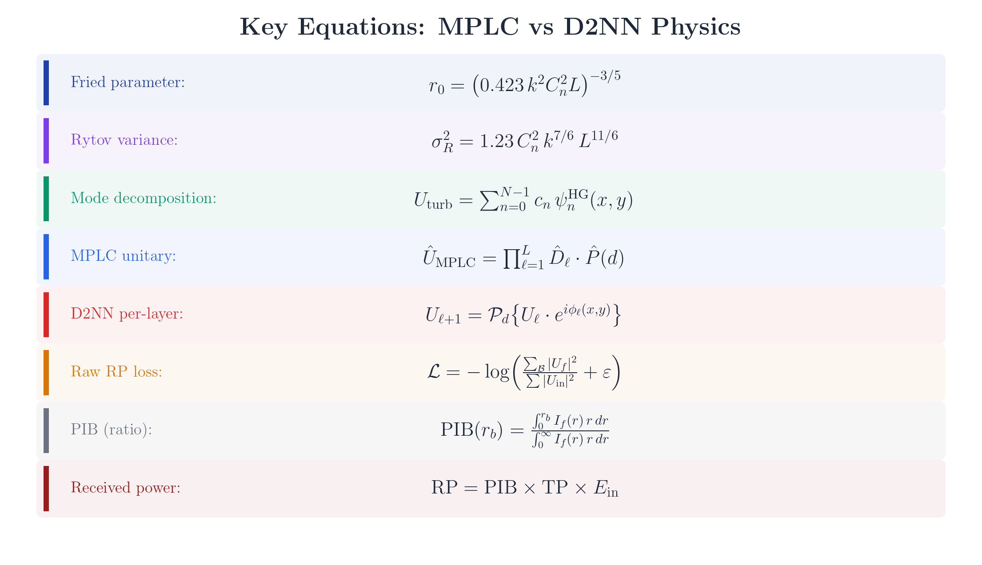
Physics Equations: MPLC vs D2NN
7

Slide 8
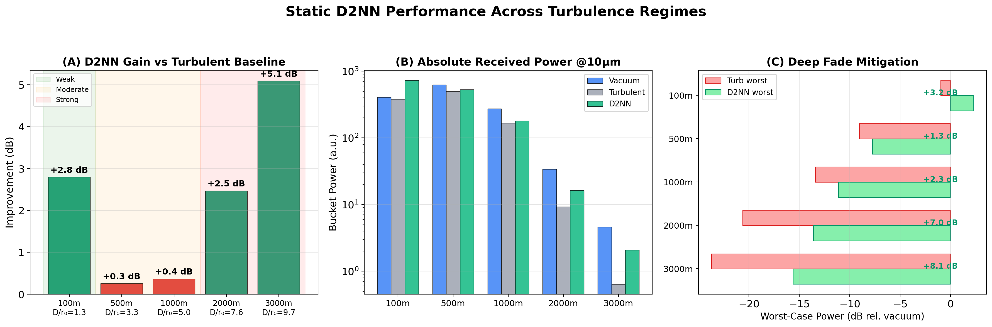
Distance Sweep Results: D2NN Received Power
Distance | D/r₀ | σᴿ² | Vac | Turb | D2NN | Δ (dB) | Fade Δ
100m | 1.26 | 0.015 | 405.6 | 382.1 | 728.4 | +2.8 | +3.2 dB
500m | 3.31 | 0.28 | 628.3 | 499.5 | 530.5 | +0.26 | +1.3 dB
1km | 5.02 | 1.0 | 275.1 | 166.0 | 180.9 | +0.37 | +2.3 dB
2km | 7.61 | 3.6 | 34.0 | 9.3 | 16.4 | +2.5 | +7.0 dB
3km | 9.70 | 7.5 | 4.6 | 0.64 | 2.08 | +5.1 | +8.1 dB
8

Slide 9
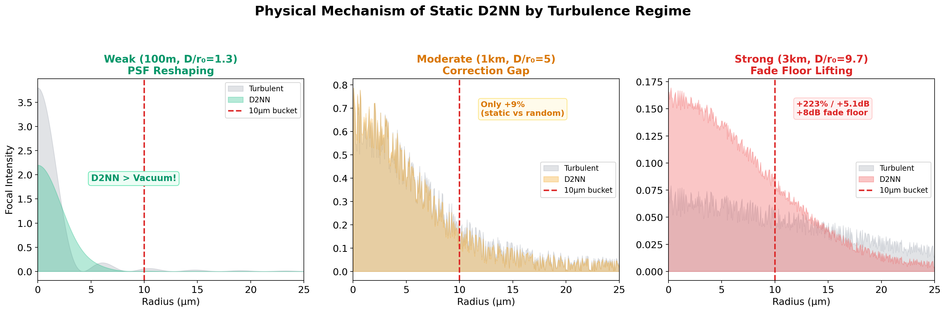
Physical Mechanisms by Turbulence Regime
Static D2NN cannot correct individual wavefronts. It performs ensemble-averaged energy redistribution: PSF reshaping (weak), statistical mode filtering (moderate), deep fade floor lifting (strong).
9

Slide 10
MPLC vs D2NN: Head-to-Head
 | MPLC (Adaptive) | D2NN (Static)
Design | Wavefront matching algorithm | SGD on turbulence ensemble
Operation | Mode decomposition → sorting | Energy redistribution
Adaptivity | Per-realization (real-time) | Fixed mask (static)
WF Correction | ✔ Yes | ✘ No (WF RMS unchanged)
Power | Active (sensing + DSP) | Zero (passive element)
Complexity | SLM + N detectors + FPGA | Fixed diffractive element
Weak Turb | Strehl → 1.0 | +91% RP (PSF reshaping)
Moderate Turb | Good (mode-limited) | +6–9% only (correction gap)
Strong Turb | Difficult (scintillation) | +77–223% (fade mitigation)
Cost | $$$ (tens of k$) | $ (one-time fabrication)
D2NN excels where MPLC struggles (deep turbulence / cost) and vice versa (moderate turbulence / accuracy)
10

Slide 11
Terminology and Hybrid Architecture
What to Call D2NN?
Proposed Hybrid: D2NN + MPLC
✘ "Turbulence compensation" (no WF correction)
✘ "Adaptive optics" (static, no feedback)
✔ "Turbulence-resilient passive beam shaping"
✔ "Static diffractive fade mitigation"
✔ "Ensemble-optimized spatial filter"
Stage 1 (passive): D2NN reduces fade depth, stabilizes beam
Stage 2 (active): MPLC mode correction on pre-stabilized beam
• D2NN reduces MPLC dynamic range requirement
• Lower MPLC update rate needed
• Graceful degradation if MPLC fails
• Simpler (fewer-mode) MPLC sufficient
+2.8 dB
+5.1 dB
+8.1 dB
0 W
< $100
D2NN Gain
(weak)
D2NN Gain
(strong)
Fade Floor
Improvement
D2NN Power
Consumption
D2NN
Cost
11

Slide 12
Key Takeaways
1
D2NN and MPLC share identical physics: cascaded phase masks + free-space propagation = unitary transformation
2
MPLC decomposes into HG modes and corrects adaptively; D2NN applies a fixed, ensemble-optimized spatial filter
3
D2NN is NOT wavefront correction — it's passive turbulence resilience via energy redistribution
4
D2NN advantage: zero power, $-cost, fabricate-once, effective in deep turbulence (+5.1 dB, +8 dB fade floor)
5
MPLC advantage: true per-realization mode correction, full wavefront recovery, but complex and expensive
6
Future: D2NN (passive pre-conditioning) + MPLC (active fine correction) = complementary hybrid architecture
12

