Slide 1
Static D2NN Distance Sweep
Received Power Analysis
f = 6.5mm | Raw RP Loss | Cn² = 5×10⁻¹⁴ | 100m – 3km
Kim Lab — April 2026

Slide 2
System Configuration
λ = 1.55 μm, 5-layer phase-only D2NN, inter-layer spacing = 10 mm
f = 6.5 mm focus lens (changed from 4.5 mm)
Airy radius: r_Airy = 1.22λf/D = 6.1 μm (vs 4.2 μm at f = 4.5 mm)
10 μm SMF bucket radius → 1.6 Airy radii
Loss function: L = –log(E_bucket / E_input + ε) — no vacuum reference
Key insight: larger f → better matched to D2NN correction bandwidth
Turbulence (100m–3km) → Aperture (D=2.048mm) → 5× D2NN Layers (10mm spacing) → Lens (f=6.5mm) → Focal Plane (10μm bucket)
2/10

Slide 3
Turbulence Regimes
Distance | D/r₀ | σᴿ² | Regime
100 m | 1.26 | 0.015 | Weak, near-DL
500 m | 3.31 | 0.28 | Moderate
1 km | 5.02 | 1.0 | Strong onset
2 km | 7.61 | 3.6 | Strong
3 km | 9.70 | 7.5 | Deep strong
Regime Interpretation
D/r₀ < 2: Aperture smaller than coherence
→ tilt-dominated, near diffraction-limited
D/r₀ ≈ 3–5: Multiple speckles form
→ random phase screen, moderate scintillation
D/r₀ > 7: Many speckle modes
→ deep fades, log-normal → exponential statistics
Key Equations
r₀ = (0.423 k² Cn² L)^(–3/5)
σᴿ² = 1.23 Cn² k^(7/6) L^(11/6)
where k = 2π/λ, L = propagation distance
3/10

Slide 4
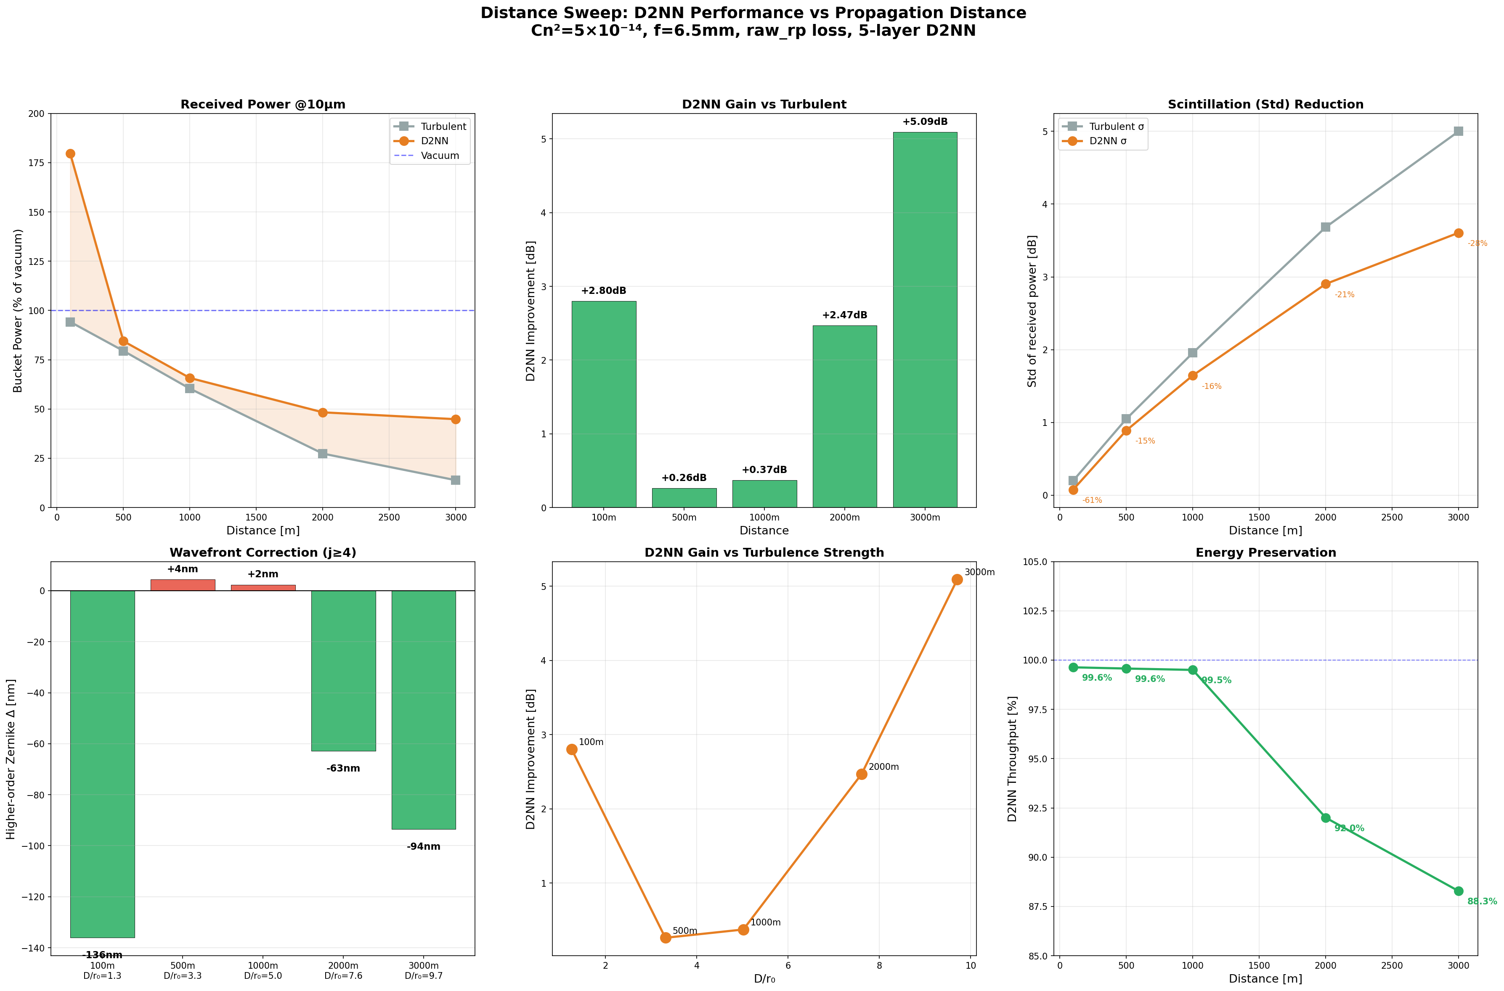
Main Results — Received Power
Distance | Vac Bucket | Turb Bucket | D2NN Bucket | Improvement
100 m | 405.6 | 382.1 | 728.4 | +91% (+2.8 dB)
500 m | 628.3 | 499.5 | 530.5 | +6.2% (+0.26 dB)
1 km | 275.1 | 166.0 | 180.9 | +9.0% (+0.37 dB)
2 km | 34.0 | 9.3 | 16.4 | +77% (+2.5 dB)
3 km | 4.6 | 0.64 | 2.08 | +223% (+5.1 dB)
4/10

Slide 5
Three Physical Regimes
Regime 1 — Weak (100 m)
PSF Reshaping
D2NN learns sidelobe-suppression
phase profile (NOT a lens)
Redistributes Airy sidelobe energy
into central core
Bucket exceeds vacuum:
728 vs 406 (mode reshaping)
Variance: 0.20 → 0.08 dB (−60%)
Phase-only unitary — total
energy conserved
Regime 2 — Moderate (500m–1km)
Correction Gap
Static mask = single spatial filter
vs ~(D/r₀)² ≈ 10–25 random
speckle modes
Cannot adaptively correct
random wavefronts
Improvement limited to +6–9%
(statistical mode filtering)
Fundamental limit of static
optical element
Regime 3 — Strong (2–3km)
Deep Fade Mitigation
Ensemble-optimized scatter
redirection
Mode conversion: maps diverse
turbulent inputs to optimized
output mode
+77% (2km) to +223% (3km)
Caution: large % on small
base ("denominator effect")
Key Insight: Static D2NN operates through three distinct mechanisms depending on turbulence strength
• Weak: Constructive interference reshaping — can exceed vacuum coupling (not energy creation, but mode matching)
• Moderate: Fundamental static-vs-dynamic mismatch — single mask cannot correct ~(D/r₀)² random modes
• Strong: Statistical optimization over ensemble — D2NN compresses the tail of the fade distribution
Common thread: mechanism is energy redistribution / mode conversion, NOT wavefront correction
5/10

Slide 6
Fade Mitigation — The Key Result
Distance | σ_turb (dB) | σ_d2nn (dB) | Var Reduc. | Min Turb (dB) | Min D2NN (dB) | Fade Mitig.
100 m | 0.20 | 0.08 | 60% | –0.97 | +2.25 | 3.2 dB
500 m | 1.05 | 0.89 | 15% | –9.05 | –7.73 | 1.3 dB
1 km | 1.96 | 1.65 | 16% | –13.4 | –11.1 | 2.3 dB
2 km | 3.68 | 2.90 | 21% | –20.6 | –13.6 | 7.0 dB
3 km | 5.00 | 3.61 | 28% | –23.7 | –15.6 | 8.1 dB
KEY: At 3 km, D2NN prevents 8 dB of deep fade — difference between link outage and recovery
• D2NN compresses the tail of the log-amplitude distribution
• Acts as a passive spatial diversity device with learned optimization
• Variance reduction grows with turbulence: 15% (moderate) → 28% (strong)
• Minimum received power improvement: 1.3 dB (500 m) to 8.1 dB (3 km)
• For FSO link budgets, fade mitigation often matters more than mean gain
6/10

Slide 7
Loss Function Design Insight
Raw Received Power Loss
L = –log( E_bucket / E_input + ε )
Prior Results (0401 Sweep)
PIB Loss:
• Throughput dropped to ~50%
• Received power DECREASED
• PIB metric gamed by scattering
This Sweep (Raw RP Loss)
RP Loss:
• Throughput preserved (0.88–0.996)
• Received power INCREASED
• Correct physics incentive
Note: E_b/E_in is bounded by [0,1]
for unitary phase-only D2NN —
log transform helps optimization,
not physics
Three Advantages:
No vacuum normalization pathology — PIB can be gamed by scattering energy
Throughput intrinsically rewarded: E_b/E_in = η × γ (throughput × concentration)
Log gradient compression: strong signal when bucket power is low
Throughput maintained 0.88 – 0.996 without explicit penalty
7/10

Slide 8
Why f = 6.5 mm Works Better
Parameter | f = 4.5 mm | f = 6.5 mm
Airy radius | 4.2 μm | 6.1 μm
Bucket / Airy | 2.4 radii | 1.6 radii
dx_focal | 3.4 μm | 4.9 μm
Bucket coverage | Captures most DL energy | Room for D2NN to improve
D2NN benefit | Limited headroom | Better matched to correction BW
f = 4.5 mm (Previous)
10 μm bucket = 2.4 Airy radii
→ Already captures most of the
diffraction-limited energy
→ Little room for D2NN to improve
fiber coupling efficiency
f = 6.5 mm (Current)
10 μm bucket = 1.6 Airy radii
→ Tighter bucket relative to PSF
→ D2NN correction bandwidth
better matched to geometry
→ More headroom for improvement
8/10

Slide 9
Caveats and Limitations
Static mask cannot adaptively correct random wavefronts — fundamental limit of passive optics
WF RMS unchanged (~442 nm) — mechanism is energy redistribution, NOT wavefront correction
Strong turbulence modeling (σᴿ² = 7.5): split-step valid but 500 test samples insufficient for heavy-tail fade statistics (need ~10⁴ for 99th percentile confidence)
Phase-only assumption: real devices have finite thickness, quantization, and absorption losses
Monochromatic: real laser has finite linewidth; broadband performance not tested
100 m "super-vacuum" result needs validation with real (non-ideal) lens model
9/10

Slide 10
Summary
▸ Static D2NN provides +6% to +223% received power improvement across 100 m – 3 km
▸ Three distinct mechanisms: PSF reshaping (weak), statistical filtering (moderate), fade mitigation (strong)
▸ Raw RP loss is the correct objective — PIB-based losses cause throughput collapse
▸ f = 6.5 mm better matched to D2NN than f = 4.5 mm
▸ Deep fade mitigation (8 dB at 3 km) most impactful for FSO link availability
▸ Mechanism is mode conversion / energy redistribution, NOT wavefront correction

