Slide 1
Static D2NN for FSO
Core Numbers
PIB보다 Received Power가 더 중요하다
Vacuum PIB@10um
96.0%
Turbulent PIB@10um
77.1%
Vacuum RP@10um
277.17
0403 loss sweep의 수치와 0404 physics report의 해석을 하나의 세미나 흐름으로 재구성
핵심 질문: 10 um focal bucket 안 absolute received power가 실제로 증가했는가
결론: TP-preserving losses만 baseline을 넘고, Raw RP loss가 +6.37%로 최고
Turbulent RP@10um
212.04
Best ΔRP
+6.37%
Sources: 0403 cross-strategy summary, 0404 loss strategy report

Slide 2
Question and Setup
0403/0404 seminar
System
Working Question
정적 phase-only D2NN가 sample-wise wavefront를 복원하지 못하더라도,
ensemble level에서 central bucket 안 absolute power를 조금 더 밀어 넣을 수 있는가?
TX
1 km turbulence
150 mm telescope
5-layer D2NN
f = 4.5 mm lens
10 um bucket
Wavelength 1.55 um, distance 1 km, Cn^2 = 5e-14
Detector proxy는 focal plane 10 um fiber bucket
Vacuum PIB@10um = 95.98%, turbulent PIB@10um = 77.11%
Vacuum RP@10um = 277.17, turbulent RP@10um = 212.04
따라서 회복해야 할 absolute headroom은 65.12 units
이번 발표는 'PIB가 올라갔다'가 아니라 'RP가 실제로 늘었는가'를 기준으로 모든 loss를 다시 읽는다.
Main Thesis
Normalized PIB alone can invert the ranking.
Received Power plus Throughput gives the physically honest ordering.
Source: 0403 cross-strategy summary JSON and 0404 system-parameter section

Slide 3
Why PIB Can Mislead
metric definitions
PIB
Received Power
Throughput
Bucket energy / total energy
ratio metric
Absolute energy inside
10 um focal bucket
Output energy / input energy
preservation ratio
RP ≈ PIB × TP × E_in
PIB-only loss는 denominator를 줄이는 방향으로도 숫자를 올릴 수 있다. 즉 '더 잘 모았다'가 아니라 '나머지를 더 많이 버렸다'가 가능하다.
0404의 결론: TP를 명시적으로 묶지 않으면 PIB gain은 catastrophic throughput collapse를 숨길 수 있다.
Source: 0404 'The Fundamental Problem: PIB vs Received Power'

Slide 4
0403 Loss Space
same data, different objectives
Strategy | Core objective | TP | PIB10 | RP10
AbsBucket+CO | absolute bucket + CO | 98.30% | 80.52% | 224.28
PIB+HardTP | PIB + quadratic TP penalty | 98.92% | 80.42% | 224.97
TP-PIB w=0.5 | PIB + weak TP penalty | 96.94% | 81.32% | 223.78
TP-PIB w=2.0 | PIB + strong TP penalty | 98.93% | 80.41% | 224.96
Raw RP | -log(E_b / E_in) | 98.59% | 80.83% | 225.54
Interpretation
0403에서는 optical setup과 data가 동일하고 loss만 바뀐다.
따라서 성능 차이는 metric design의 효과로 직접 읽을 수 있다.
모든 successful strategy는 TP를 97% 이상으로 유지한다.
Raw RP가 가장 직접적인 objective이고 실제로 최고 RP10을 만든다.
같은 80%대 PIB라도 RP는 223.78~225.54 범위로 갈린다. 0403의 포인트는 'PIB가 아니라 RP 기준으로 다시 정렬해야 한다'는 점이다.
Source: 0403 cross-strategy summary JSON

Slide 5
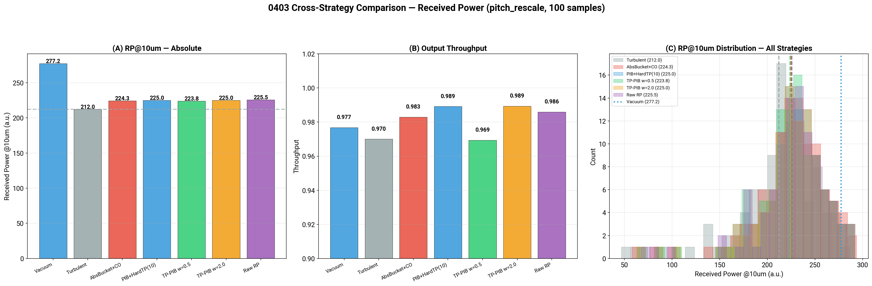
Cross-Strategy Result
0403 main result
Headline
Raw RP is best: RP10 225.54 (6.37% gain).
PIB+HardTP and TP-PIB w=2.0 are near-tied at 6.10% and 6.09%.
TP-PIB w=0.5 has the highest PIB10 (81.32%) but the lowest RP gain.
TP-preserving objectives all exceed the turbulent baseline.
Figure: 19_cross_strategy_received_power.png

Slide 6
Rank by RP, Not by PIB
metric ordering
왼쪽 그래프만 보면 TP-PIB w=0.5가 가장 좋아 보이지만, 오른쪽 RP ordering에서는 Raw RP가 최고다. 이것이 metric inversion이다.
Source: 0403 summary JSON; same data, same optics, only objective changes

Slide 7
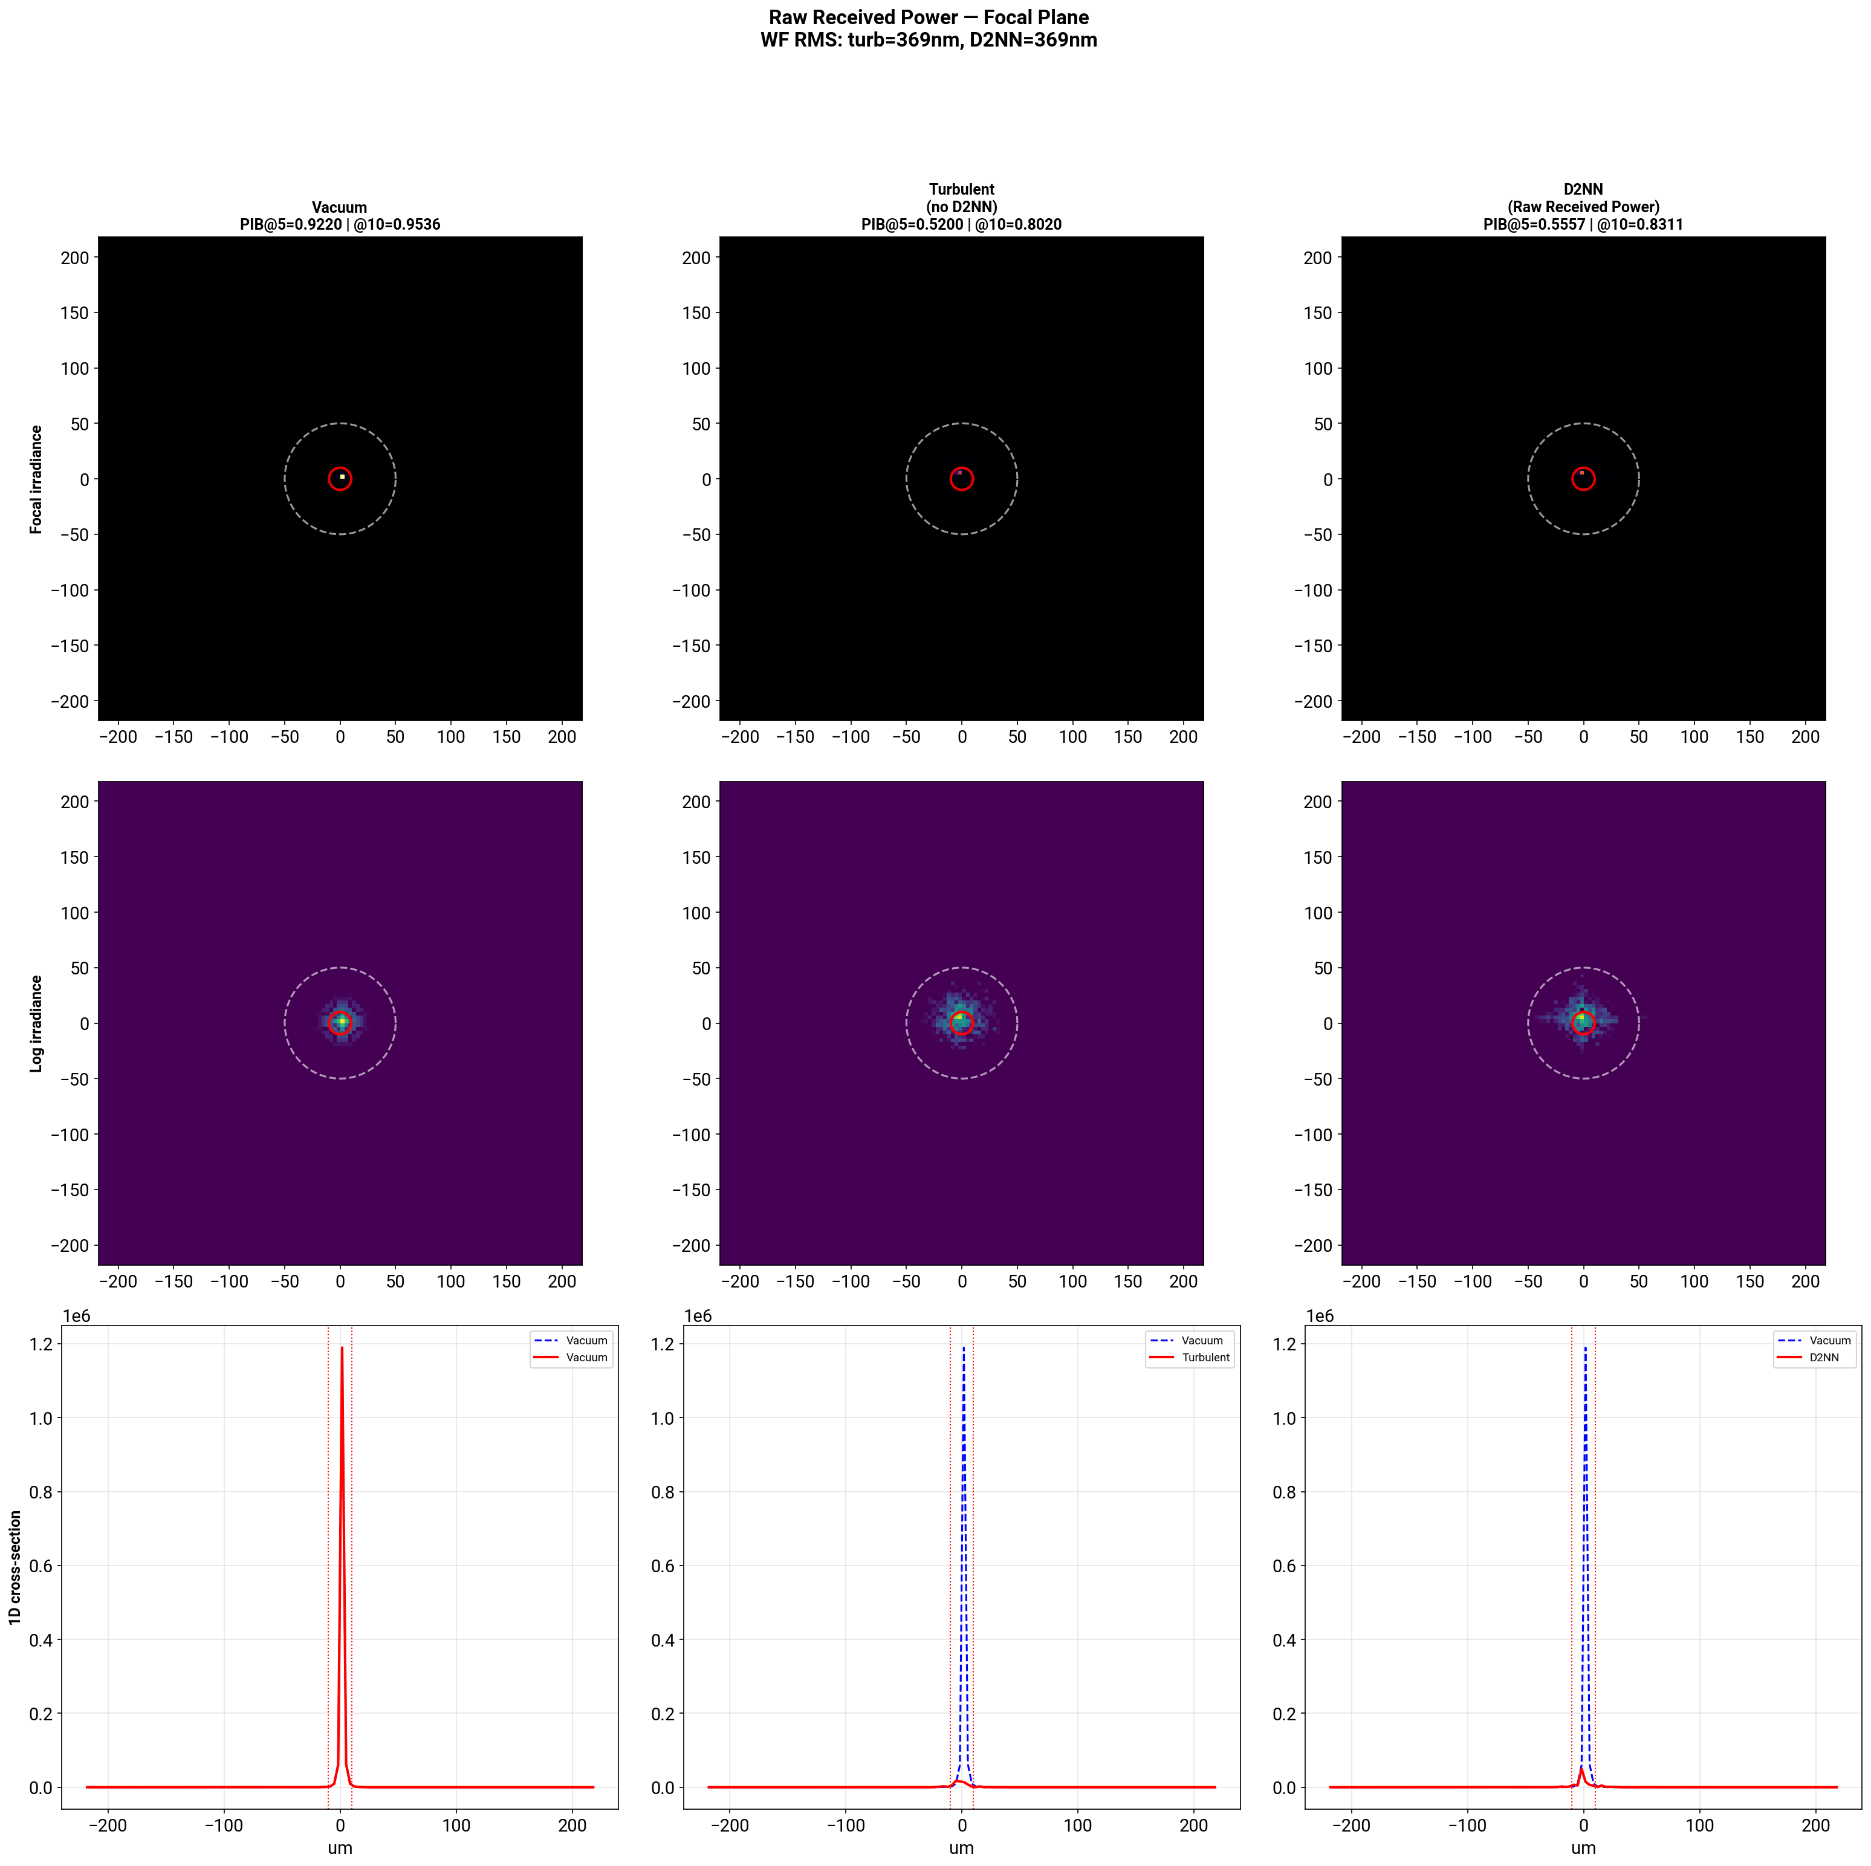
What the Best Strategy Actually Does
Raw RP focal pattern
Vacuum sets the ceiling: PIB10 95.98%, RP10 277.17.
Turbulent baseline sits at PIB10 77.11%, RP10 212.04.
Raw RP reaches PIB10 80.83% and RP10 225.54.
핵심 변화는 vacuum restoration이 아니라 central bucket 안으로 에너지를 조금 더 밀어 넣는 focal redistribution이다.
Interpretation
Best strategy도 vacuum에 가깝게 돌아가진 않는다. modest한 +6% gain은 오히려 물리적으로 더 정직한 결과다.
Figure: focal_raw_received_power/06_fig1_focal_plane_vacuum_vs_turbulent_vs_d2nn.png

Slide 8
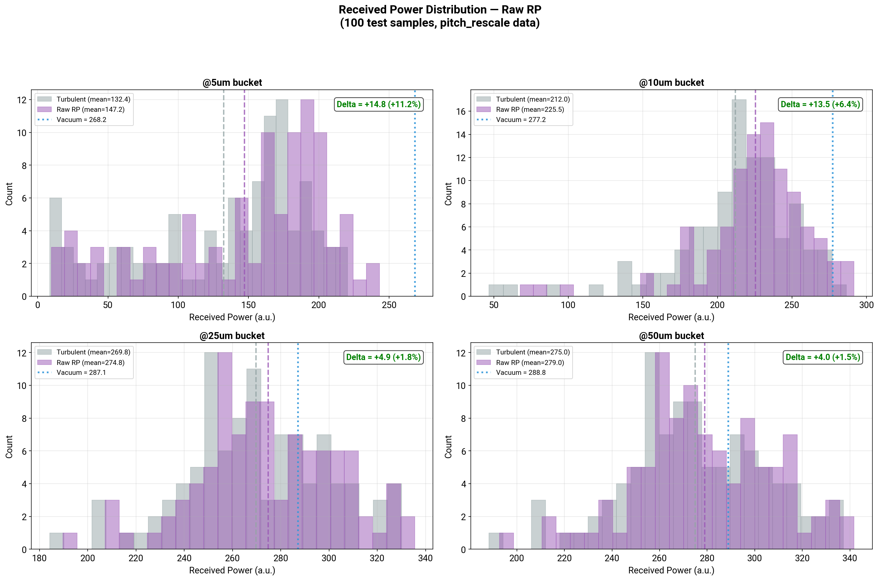
Improvement Is Distributional
Raw RP histogram and bucket-radius gains
5um improvement is largest: +11.21%.
10um objective improves by +6.37%.
25um and 50um gains shrink to +1.83% and +1.46%.
즉 total energy increase가 아니라 core tightening이 주효하다.
Figure: focal_raw_received_power/18_received_power_histogram.png

Slide 9
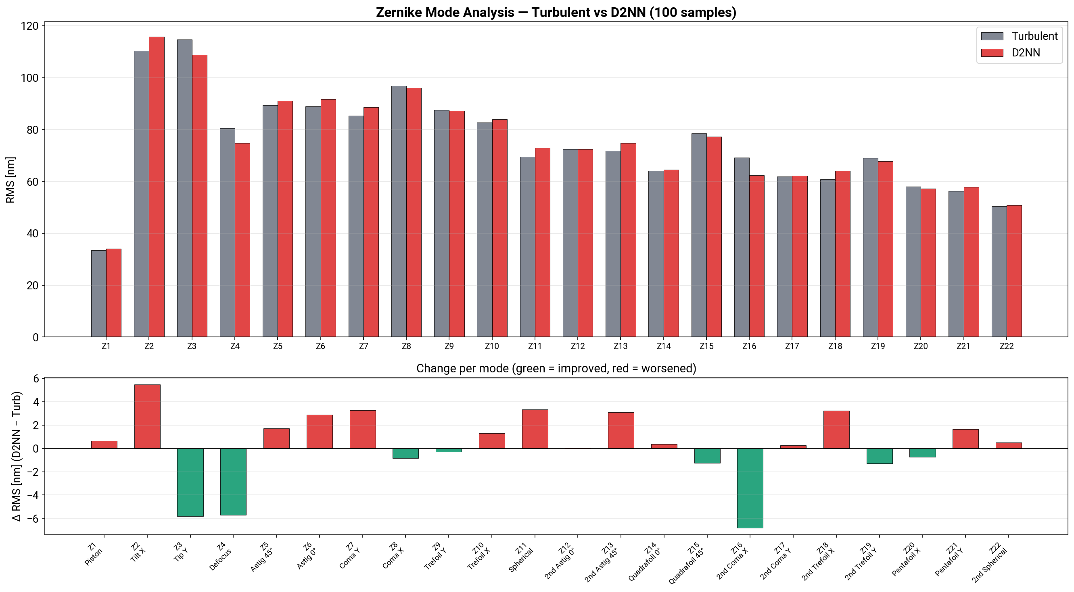
Why This Is Not Wavefront Correction
WF RMS and Zernike evidence
Metric | Turbulent | D2NN
WFRMS global-phase | 368.94 | 368.63
WFRMS piston-removed | 367.18 | 367.09
WFRMS tip/tilt removed | 328.07 | 331.38
Global-phase aligned WFRMS is 368.94 nm -> 368.63 nm, essentially unchanged.
Tip/tilt removed RMS even increases slightly.
Zernike delta per mode stays near zero rather than showing a correction signature.
따라서 이 장치는 adaptive corrector가 아니라 statistical mode filter로 읽는 편이 정확하다.
Sources: focal_raw_received_power/10_piston_removed_wfrms.json and /14_zernike_delta_per_mode.png

Slide 10
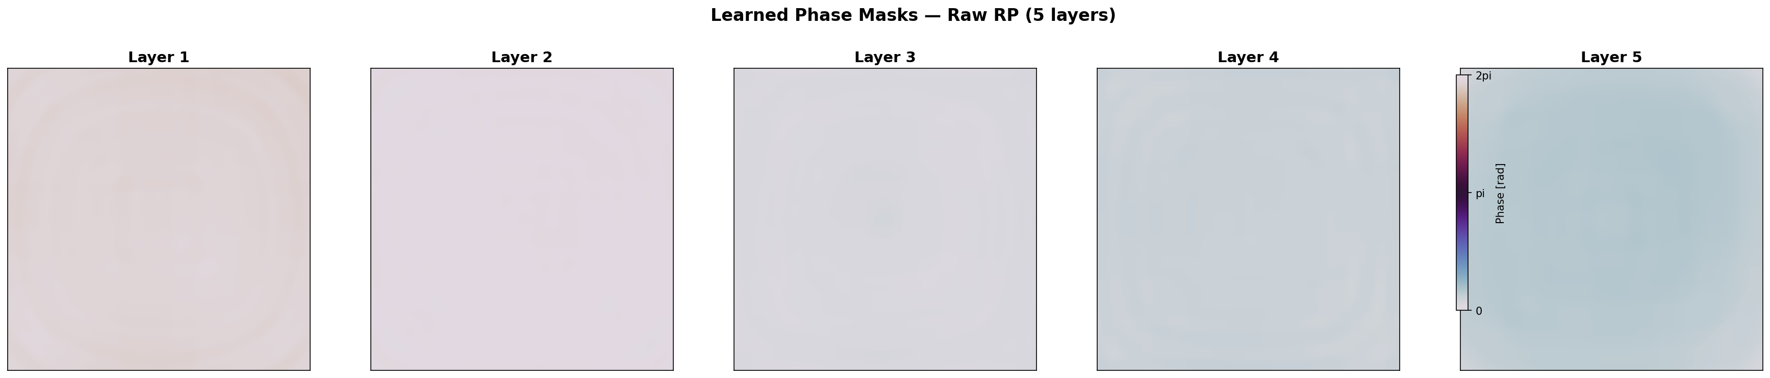
Physical Mechanism
TP-preserving focal energy redistribution
What the masks suggest
TP-preserving strategies learn mostly smooth, low-spatial-frequency phase profiles.
Sharp grating signatures that would support strong scattering are not dominant.
이 패턴은 TP 98%대 유지와 잘 맞고, aggressive energy dumping과는 다르다.
0404의 해석처럼 weak Fresnel-lens-like redistribution 또는 statistical mode filtering에 가깝다.
Operational reading
Wavefront conjugation보다 focal core와 halo 사이의 ensemble-average energy reshaping으로 보는 편이 맞다.
Figure: focal_raw_received_power/15_phase_masks_5layers.png

Slide 11
0404 Interpretation
how PIB-only objectives fail
PIB-only loophole
TP-aware closure
Observed attractor
Phase-only layers are pointwise unitary, but cascaded propagation can still redistribute energy angularly.
Finite computational window plus diffraction lets the model scatter aberrated energy out of the effective passband.
Then PIB rises because the denominator shrinks, even if RP falls.
Absolute-bucket and TP-penalized objectives make scattering expensive.
Now the optimizer must keep energy while improving concentration.
That is why successful strategies all stay near TP ≈ 0.98–0.99.
Different TP-aware formulas converge to roughly the same +6% RP regime.
This suggests a physical limit of the static phase-only architecture in this turbulence regime.
Objective shape matters less once the TP operating point is fixed.
0404의 요약: PIB는 단독 metric으로 쓰면 misleading하고, direct RP objective 또는 explicit TP constraint가 필요하다.
Source: 0404 sections on throughput catastrophe, TP-aware losses, and conclusions

Slide 12
How To Phrase the Claim
what to say, what to avoid
Say This
Avoid This
Static phase-only D2NN improves absolute received power inside a 10 um focal bucket by 5.5–6.4% over the turbulent baseline.
The successful regime is TP-preserving: throughput stays around 98% while RP rises.
The mechanism is focal energy redistribution or statistical mode filtering, not sample-wise phase conjugation.
Raw RP loss is the simplest and strongest objective among tested TP-aware losses.
Do not call this wavefront recovery, vacuum restoration, or full aberration correction.
Do not use PIB gain alone as evidence of better coupling.
Do not imply that static masks adapt to random time-varying turbulence sample by sample.
Do not hide throughput when comparing objective functions.
Claim wording aligned to 0404 conclusions and 0403 wavefront evidence

Slide 13
Seminar Takeaways
four numbers to remember
Best ΔRP
Operating TP
Best PIB10
Remaining Gap
+6.37%
98.59%
80.83%
15.15p
Raw RP is best overall
Successful losses stay near 98%
Still far below vacuum
Static limit remains large
Metric choice changes the ranking: PIB alone can invert the story.
TP-preserving losses converge to a modest but real +6% RP regime.
The observed gain is compatible with energy redistribution, not wavefront correction.
The large remaining gap to vacuum is itself a result: static phase-only D2NN has a structural ceiling here.
Summary numbers from 0403 summary JSON; interpretation from 0404

Slide 14
Next Experiments
what to do after this seminar
Step 1
Step 2
Step 3
Step 4
Seed robustness
Bucket sweep
Stronger turbulence
Distance sweep
rerun Raw RP and PIB+HardTP with multiple random seeds and quantify RP10 mean±std
evaluate 5, 10, 25 um objectives to map where core-vs-halo redistribution helps most
increase Cn^2 or deeper fades to check whether the +6% attractor survives
connect to run_distance_sweep_after_0404.sh and map where static gain collapses
Follow-up direction based on 0404 conclusions and existing distance-sweep script

Slide 15
Appendix: Detailed Reference Metrics
Q&A backup
Case | PIB10 | TP | RP10 | RP5 | RP25 | RP50
Vacuum | 95.98% | 97.68% | 277.17 | 268.18 | 287.11 | 288.77
Turbulent | 77.11% | 97.00% | 212.04 | 132.37 | 269.81 | 275.00
AbsBucket+CO | 80.52% | 98.30% | 224.28 | 145.31 | 274.48 | 278.55
PIB+HardTP | 80.42% | 98.92% | 224.97 | 145.87 | 275.35 | 279.73
TP-PIB w=2.0 | 80.41% | 98.93% | 224.96 | 145.85 | 275.39 | 279.75
Raw RP | 80.83% | 98.59% | 225.54 | 147.20 | 274.76 | 279.02
Source: 19_cross_strategy_summary.json

Slide 16
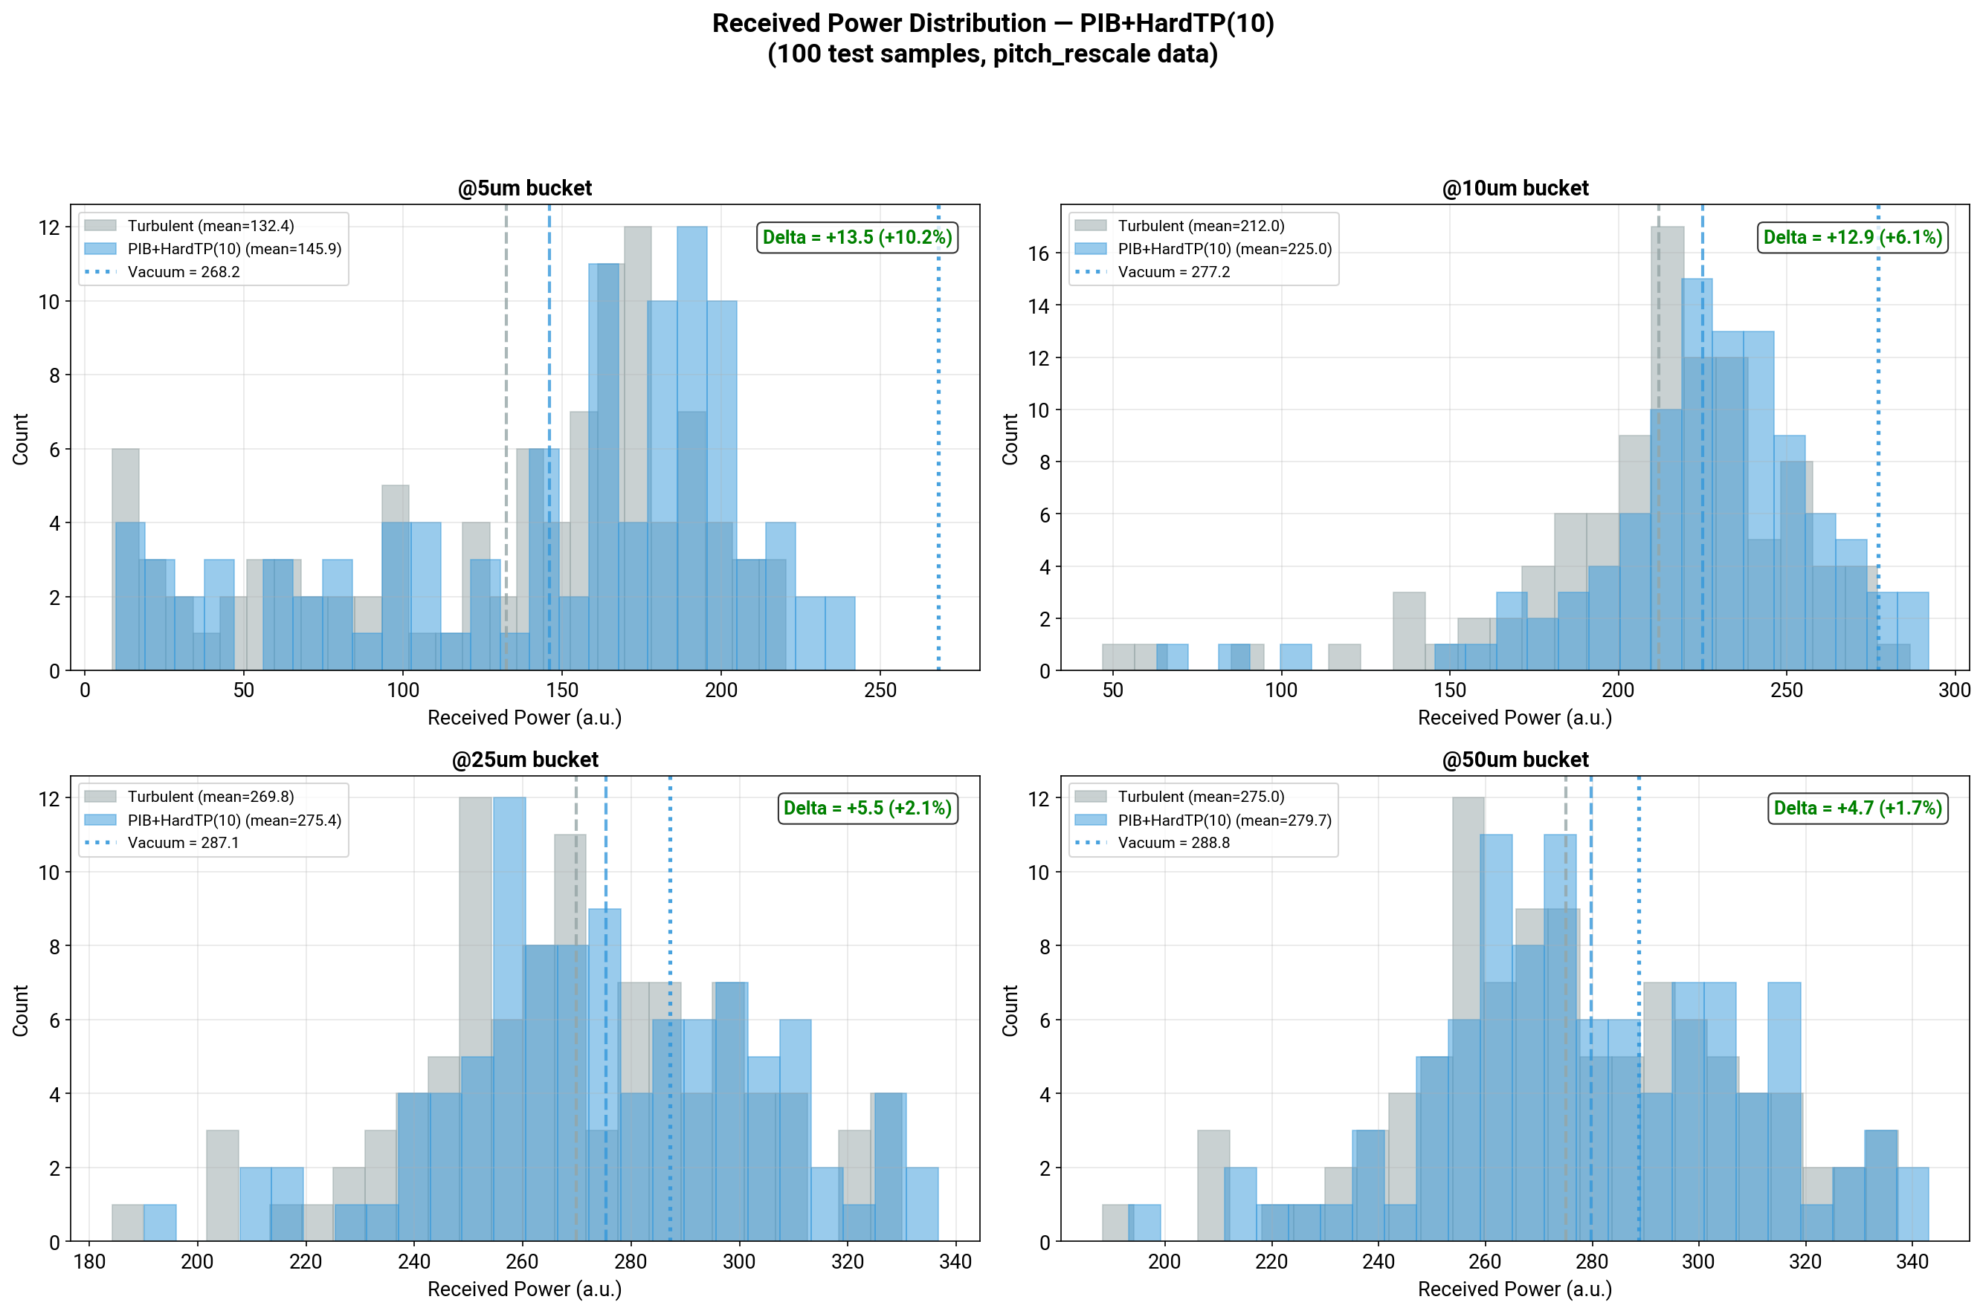
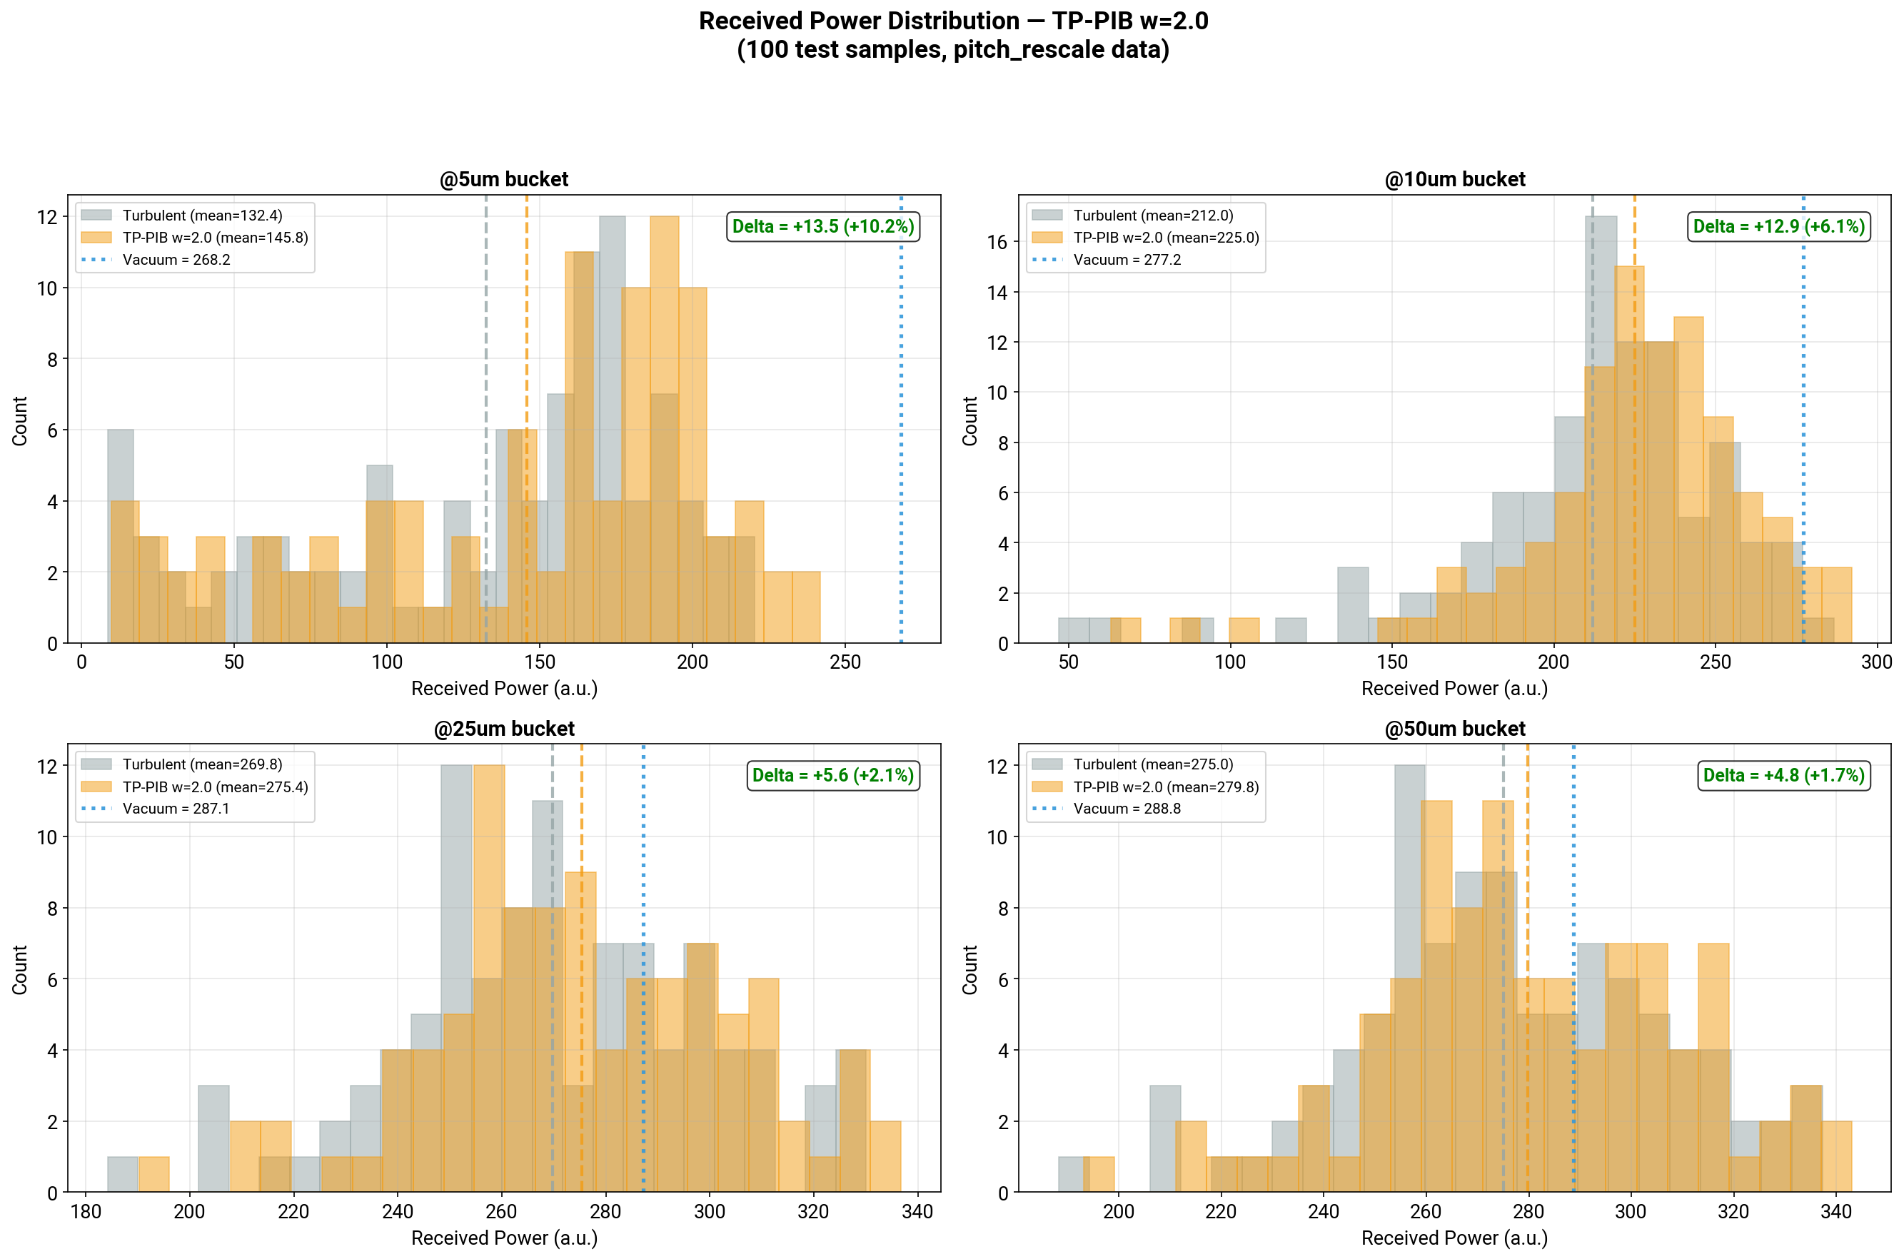
Appendix: Constraint Equivalence
two objectives, same operating point
PIB+HardTP
TP-PIB w=2.0
두 objective는 TP ≈ 0.99 근방에서 사실상 같은 constraint force를 만들고, 그래서 histogram과 mean performance가 거의 겹친다.
Figures: pib_hard_tp/18_received_power_histogram.png and focal_tp_pib_w2/18_received_power_histogram.png

