Slide 1
Presentation title
Optional subtitle

Slide 2
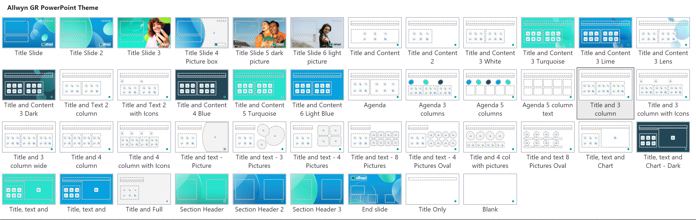
Help with the template
Using layouts to insert slides
The template includes a range of predefined layouts that you can insert for new slides. These have been designed to cater for text, text and images and for picture arrangements. There are also layouts for Title, Divider and other key slide types.
Choose a layout in the ‘New Slide’ button on the Home tab. Change the layout for a current slide using the ‘Layout’ list on the Home tab.
The layouts include different colour uses for title and text levels, to reflect the need on different background colours and imagery.
Refer to the brand guide for further information.

Slide 3
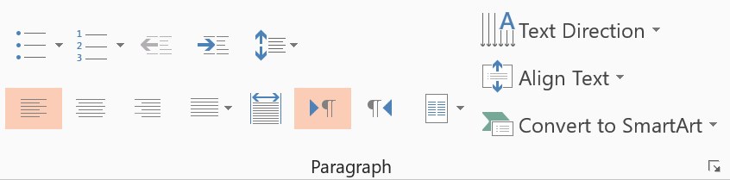
Help with the template
Using type levels in placeholder fields
The standard placeholder fields have predefined type levels. Move up or down the levels using the ‘Increase or Decrease indent’ buttons in the home tab.
Level one is for general text
Level two is for introduction paragraphs
Level three is for subheadings
Level four is the first level of bullets
Level five is the second level of bullets
Recommendations
We recommend you do NOT use the bullet button, as this does not apply the correct bullet formatting.
Note that a standard text box does not include the levels found in a placeholder. Text boxes are set with the recommended font and size.
Therefore, it is recommended that should copy an existing text placeholder on the slide, if you would like to insert a text box, to preserve the use of these levels.
Refer to the brand guide for further information.
Decrease list level
Increase list level

Slide 4
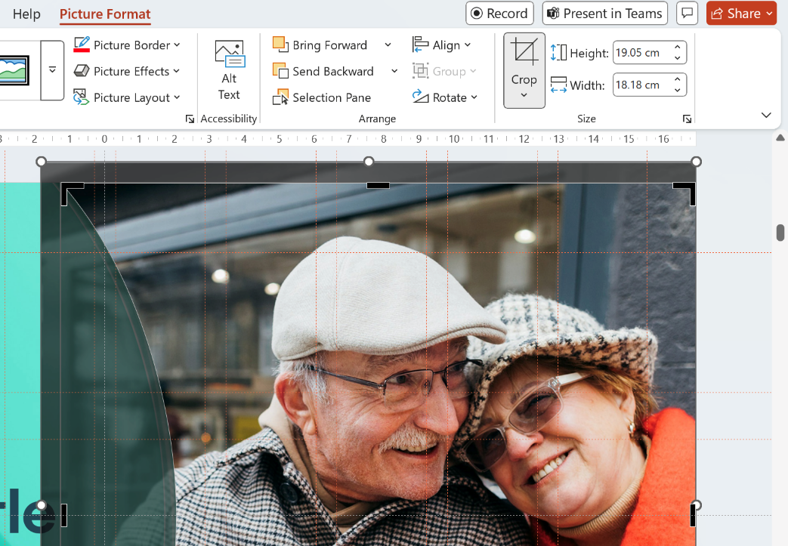
Help with the template
Working with pictures
Using the predefined picture fields
Picture placeholders appear in grey. Click the button in the middle of the field to import the picture you want to use. The picture field will automatically fill the field with the image.
Edit the position of the image using the crop tool, which is in the contextual ‘Picture Tools > Format’ menu. The crop tool allows you to enlarge, adjust position or crop the image to fit the picture area.
Changing an existing picture
To change an existing image, right-click the picture and choose ‘Change Picture > This Device’ to locate a new image to replace it.

Slide 5
Help with the template
Text formatting and footer details
Type levels
Always use the type levels in the predefined content placeholders, supplied with each layout.
This will help to enforce the right formatting, colour and font.
Text boxes
If you use text boxes, please note that they do NOT include the type levels. Any formatting must be manually applied, and we recommend you adhere to the brand rules.
Footers
The footer and page number can be modified or turned on or off.
The footer fields are not used in the supplied design, but are available.
To do this, go to ‘Insert tab > Header & Footer’ to see and edit the feature dialog.
Refer to the brand guide for further information.

Slide 6
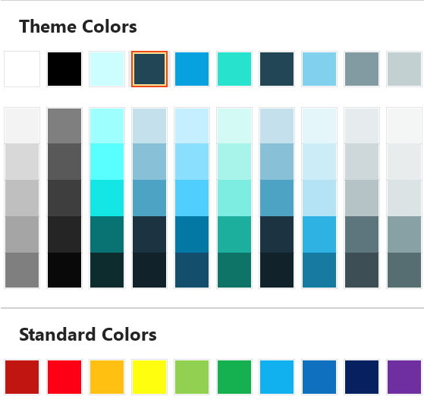
Help with the template
Using colour and the default palette
Colour palette
Always select a colour from the supplied colours at the top of the theme block.
Refer to the brand guide for further information.
The top row represents the correct brand colours and are automatically used in charts, shapes and diagrams.
The bank of tint colours is generated by PowerPoint and may not follow the exact brand colours. Use the top row as much as possible.
The Standard Colours row is supplied by PowerPoint and does not follow brand guidelines. Please avoid these colours in your presentations.

Slide 7
Presentation title
Optional subtitle

Slide 8
Presentation title
The full format picture is applied to the slide background. To do this, simply right-click the background and select ‘Format Background’ from the pop up menu that appears. In the format side panel, go to the ‘Fill’ settings and click on ‘Picture or Texture fill’, then click on the ‘Insert’ button. Locate and select the picture and it will be applied to the slide.
Optional subtitle

Slide 9

Presentation title
Optional subtitle

Slide 10

Presentation title
Optional subtitle

Slide 11
Presentation title
The full format picture is applied to the slide background. To do this, simply right-click the background and select ‘Format Background’ from the pop up menu that appears. In the format side panel, go to the ‘Fill’ settings and click on ‘Picture or Texture fill’, then click on the ‘Insert’ button. Locate and select the picture and it will be applied to the slide.
Optional subtitle

Slide 12
Agenda
Introduction text to agenda or section details as set put on the right.
 | Chapter name Page 00 |  | Chapter name Page 00
 | Chapter name Page 00 |  | Chapter name Page 00
 | Chapter name Page 00 |  | Chapter name Page 00
01
04
02
05
03
06

Slide 13
Agenda
01
02
03
04
05
Agenda topic
Description
Page 00
Agenda topic
Description
Page 00
Agenda topic
Description
Page 00
Agenda topic
Description
Page 00
Agenda topic
Description
Page 00

Slide 14
Agenda
01
02
03
04
Agenda topic
Description
Page 00
Agenda topic
Description
Page 00
Agenda topic
Description
Page 00
Agenda topic
Description
Page 00

Slide 15
Agenda
01
02
03
Agenda topic
Description
Page 00
Agenda topic
Description
Page 00
Agenda topic
Description
Page 00

Slide 16
Agenda
1.
Agenda topic
Descriptor
Page 00
2.
Agenda topic
Descriptor
Page 00
3.
Agenda topic
Descriptor
Page 00
4.
Agenda topic
Descriptor
Page 00
5.
Agenda topic
Descriptor
Page 00
6.
Agenda topic
Descriptor
Page 00
7.
Agenda topic
Descriptor
Page 00
8.
Agenda topic
Descriptor
Page 00
9.
Agenda topic
Descriptor
Page 00
10.
Agenda topic
Descriptor
Page 00

Slide 17
Example title
Optional subtitle
The standard placeholder includes predefined type levels.
Level one is for standard text
Level two is for subtitles to the text
Level three is the first bullet level
Level four is the second bullet level
Level five is the third bullet level

Slide 18
Example title
Optional subtitle
The standard placeholder includes predefined type levels.
Level one is for standard text
Level two is for subtitles to the text
Level three is the first bullet level
Level four is the second bullet level
Level five is the third bullet level

Slide 19
Example title
Optional subtitle
The standard placeholder includes predefined type levels.
Level one is for standard text
Level two is for subtitles to the text
Level three is the first bullet level
Level four is the second bullet level
Level five is the third bullet level
The standard placeholder includes predefined type levels.
Level one is for standard text
Level two is for subtitles to the text
Level three is the first bullet level
Level four is the second bullet level
Level five is the third bullet level

Slide 20
Example title
Optional subtitle
The initial text column uses level two for the text style
Level one is for standard text
Level two is for subtitles to the text
Level three is the first bullet level
Level four is the second bullet level
Level five is the third bullet level

Slide 21
Example title
Optional subtitle
The initial text column uses level two for the text style
Level one is for standard text
Level two is for subtitles to the text
Level three is the first bullet level
Level four is the second bullet level
Level five is the third bullet level

Slide 22
Example title
Optional subtitle
The initial text column uses level two for the text style
Level one is for standard text
Level two is for subtitles to the text
Level three is the first bullet level
Level four is the second bullet level
Level five is the third bullet level

Slide 23
Example title
Optional subtitle
The initial text column uses level two for the text style
Level one is for standard text
Level two is for subtitles to the text
Level three is the first bullet level
Level four is the second bullet level
Level five is the third bullet level

Slide 24
Example title
Optional subtitle
The initial text column uses level two for the text style
Level one is for standard text
Level two is for subtitles to the text
Level three is the first bullet level
Level four is the second bullet level
Level five is the third bullet level

Slide 25
Example title
Optional subtitle
The initial text column uses level two for the text style
Level one is for standard text
Level two is for subtitles to the text
Level three is the first bullet level
Level four is the second bullet level
Level five is the third bullet level

Slide 26
Example title
Optional subtitle
The initial text column uses level two for the text style
Level one is for standard text
Level two is for subtitles to the text
Level three is the first bullet level
Level four is the second bullet level
Level five is the third bullet level

Slide 27
Example title
Optional subtitle
The initial text column uses level two for the text style
The standard placeholder includes predefined type levels.
Level one is for standard text
Level two is for subtitles to the text
Level three is the first bullet level
Level four is the second bullet level
Level five is the third bullet level

Slide 28
Example title
Optional subtitle
The initial text column uses level two for the text style
The standard placeholder includes predefined type levels.
Level one is for standard text
Level two is for subtitles to the text
Level three is the first bullet level
Level four is the second bullet level
Level five is the third bullet level

Slide 29
Example title
Optional subtitle
The initial text column uses level two for the text style
The standard placeholder includes predefined type levels.
Level one is for standard text
Level two is for subtitles to the text
Level three is the first bullet level
Level four is the second bullet level
Level five is the third bullet level

Slide 30
Example title
Optional subtitle
The standard placeholder includes predefined type levels.
Level one is for standard text
Level two is for subtitles to the text
Level three is the first bullet level
Level four is the second bullet level
Level five is the third bullet level
The standard placeholder includes predefined type levels.
Level one is for standard text
Level two is for subtitles to the text
Level three is the first bullet level
Level four is the second bullet level
Level five is the third bullet level
The standard placeholder includes predefined type levels.
Level one is for standard text
Level two is for subtitles to the text
Level three is the first bullet level
Level four is the second bullet level
Level five is the third bullet level

Slide 31
Example title
Optional subtitle
The initial text column uses level two for the text style
The standard placeholder includes predefined type levels.
Level one is for standard text
Level two is for subtitles to the text
Level three is the first bullet level
Level four is the second bullet level
Level five is the third bullet level
The standard placeholder includes predefined type levels.
Level one is for standard text
Level two is for subtitles to the text
Level three is the first bullet level
Level four is the second bullet level
Level five is the third bullet level

Slide 32
Example title
Optional subtitle
The standard placeholder includes predefined type levels.
Level one is for standard text
Level two is for subtitles to the text
Level three is the first bullet level
Level four is the second bullet level
Level five is the third bullet level
The standard placeholder includes predefined type levels.
Level one is for standard text
Level two is for subtitles to the text
Level three is the first bullet level
Level four is the second bullet level
Level five is the third bullet level
The standard placeholder includes predefined type levels.
Level one is for standard text
Level two is for subtitles to the text
Level three is the first bullet level
Level four is the second bullet level
Level five is the third bullet level
The standard placeholder includes predefined type levels.
Level one is for standard text
Level two is for subtitles to the text
Level three is the first bullet level
Level four is the second bullet level
Level five is the third bullet level

Slide 33
Example title
Optional subtitle
Level one is for standard text
Level two is for subtitles to the text
Level three is the first bullet level
Level four is the second bullet level
Level five is the third bullet level
Level one is for standard text
Level two is for subtitles to the text
Level three is the first bullet level
Level four is the second bullet level
Level five is the third bullet level
Level one is for standard text
Level two is for subtitles to the text
Level three is the first bullet level
Level four is the second bullet level
Level five is the third bullet level
Level one is for standard text
Level two is for subtitles to the text
Level three is the first bullet level
Level four is the second bullet level
Level five is the third bullet level

Slide 34
Example title
Optional subtitle
The standard placeholder includes predefined type levels.
Level one is for standard text
Level two is for subtitles to the text
Level three is the first bullet level
Level four is the second bullet level
Level five is the third bullet level

Slide 35
Example title
Optional subtitle
The full format picture is applied to the slide background. To do this, simply right-click the background and select ‘Format Background’ from the pop up menu that appears. In the format side panel, go to the ‘Fill’ settings and click on ‘Picture or Texture fill’, then click on the ‘Insert’ button. Locate and select the picture and it will be applied to the slide.
The standard placeholder includes predefined type levels.
Level one is for standard text
Level two is for subtitles to the text
Level three is the first bullet level
Level four is the second bullet level
Level five is the third bullet level

Slide 36
Example title
Optional subtitle
The standard placeholder includes predefined type levels.
Level one is for standard text
Level two is for subtitles to the text
Level three is the first bullet level
Level four is the second bullet level
Level five is the third bullet level

Slide 37
Example title
Optional subtitle
The standard placeholder includes predefined type levels.
Level one is for standard text
Level two is for subtitles to the text
Level three is the first bullet level
Level four is the second bullet level
Level five is the third bullet level

Slide 38
Example title
Optional subtitle
The standard placeholder includes predefined type levels.
Level one is for standard text
Level two is for subtitles to the text
Level three is the first bullet level
Level four is the second bullet level
Level five is the third bullet level

Slide 39
Example title
Optional subtitle
The standard placeholder includes predefined type levels.
Level one is for standard text
Level two is for subtitles to the text
Level three is the first bullet level
Level four is the second bullet level
Level five is the third bullet level

Slide 40
Example title
Optional subtitle
Name Surname
Job title
Description text
Name Surname
Job title
Description text
Name Surname
Job title
Description text
Name Surname
Job title
Description text

Slide 41
Example title
Optional subtitle
Name Surname
Job title
Name Surname
Job title
Name Surname
Job title
Name Surname
Job title
Name Surname
Job title
Name Surname
Job title
Name Surname
Job title
Name Surname
Job title

Slide 42
Example title
Optional subtitle
The standard placeholder includes predefined type levels.
Level one is for standard text
Level two is for subtitles to the text
Level three is the first bullet level
Level four is the second bullet level
Level five is the third bullet level

Slide 43
Example title
Optional subtitle
The standard placeholder includes predefined type levels.
Level one is for standard text
Level two is for subtitles to the text
Level three is the first bullet level
Level four is the second bullet level
Level five is the third bullet level

Slide 44
Example title
Optional subtitle
The standard placeholder includes predefined type levels.
Level one is for standard text
Level two is for subtitles to the text
Level three is the first bullet level
Level four is the second bullet level
Level five is the third bullet level

Slide 45
Example title
Optional subtitle
The standard placeholder includes predefined type levels.
Level one is for standard text
Level two is for subtitles to the text
Level three is the first bullet level
Level four is the second bullet level
Level five is the third bullet level

Slide 46
Example title
Optional subtitle
The standard placeholder includes predefined type levels.
Level one is for standard text
Level two is for subtitles to the text
Level three is the first bullet level
Level four is the second bullet level
Level five is the third bullet level

Slide 47
Section title
01

Slide 48
Section title
02

Slide 49
Name Surname
Company position
00 00 00 0000
00 00 00 0000
Email.address@allwyn.com
www.allwyn.com
Lucerne – Allwyn HQ
Mühlenplatz 9
6004 Lucerne
Switzerland
Prague
Evropská 866/71, Vokovice
160 00, Prague 6
Czech Republi
London
3 Dering Street, 4th floor
London W1S 1AA
United Kingdom

