Slide 1
Extra 3 classes on Git and Github
Module 7_extra

Slide 2
Core concepts in Git
Module 7-2

Slide 3
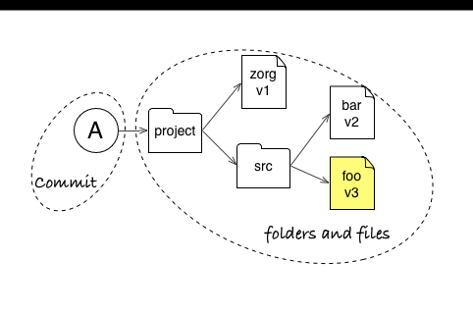
Core Concepts
Git stores snapshots (commits) of your repository

Slide 4
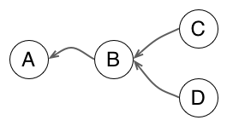
Core Concepts
Git represents relationships between commits as a graph

Slide 5
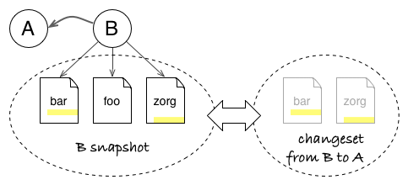
Core Concepts
Git can compute changesets between any two commits of your project

Slide 6
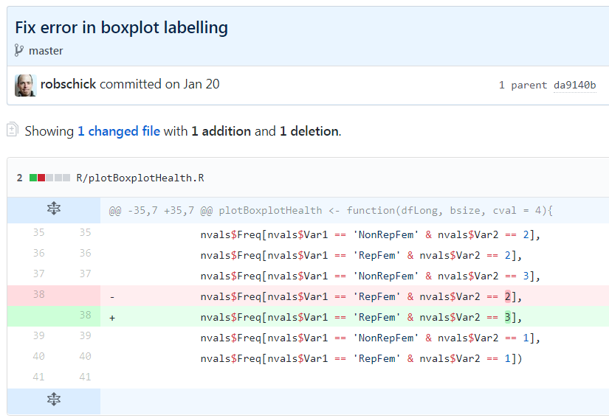
Core Concepts
Git sees changes at the level of lines in a text file

Slide 7
3 Core Concepts
Snapshot
Graph
Changeset

Slide 8
States of a git Repository

Slide 9
The Repository
Collection of files managed by git
History (all of it)
Encompassing file on the Operating System is considered the working directory
Can include files managed by git
Files ignored by git
Files not yet managed by git
Quasi-hidden .git folder
Since the repo contains all the history, keep the repos narrowly focused

Slide 10
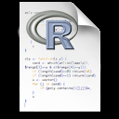
Three Local States
Working Directory
Staging Area
Repository (.git folder)
git add
git commit

Slide 11
Three Local States with Remote
Working Directory
Staging Area
Repository (.git folder)
Remote (GitHub)
git push

Slide 12
Basic Commands
Mastering a Basic Workflow

Slide 13
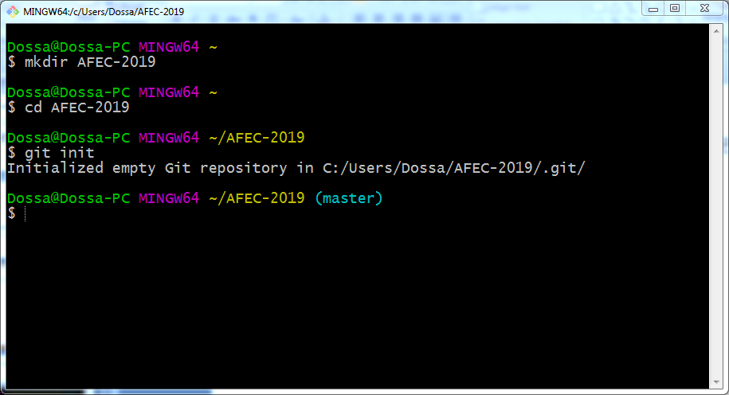
git init – Initialize an Empty Repo

Slide 14
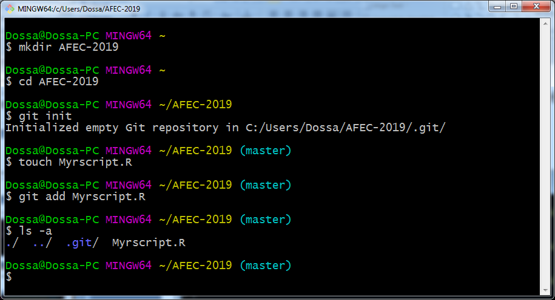
git add – Add a Document to the Staging Area

Slide 15
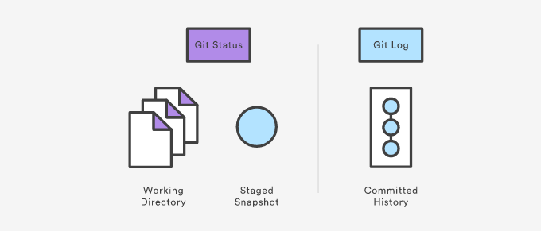
Viewing the Repo

Slide 16
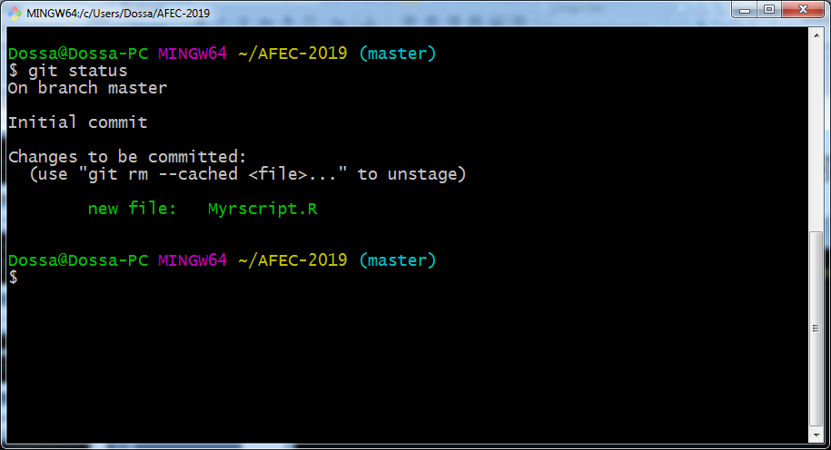
git status – What’s Happening?

Slide 17
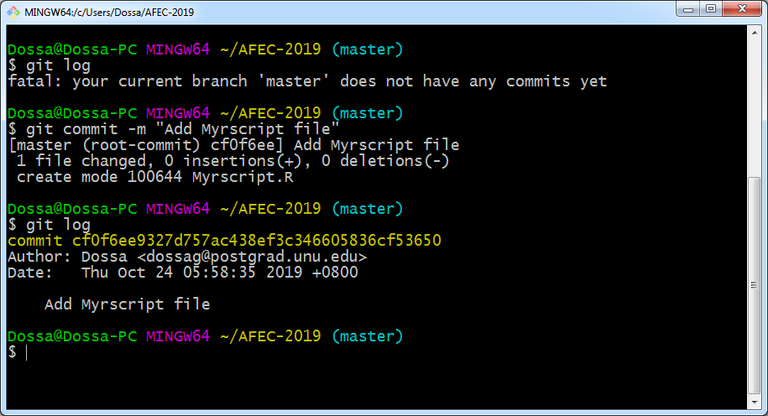
git log – To view the history of Repo

Slide 18
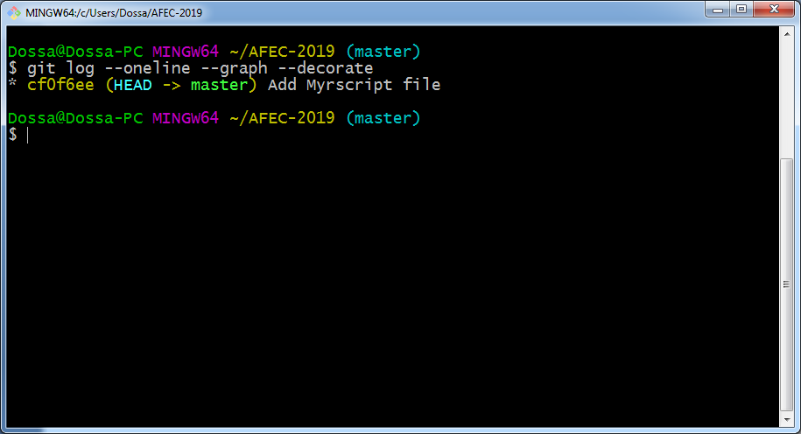
git log – With Options

Slide 19
git commit – Records changes in the Repo
git commit -m “Second check in of my R Script"

Slide 20
Ok, What Just happened?
sha-1 commit
What’s Changed

Slide 21
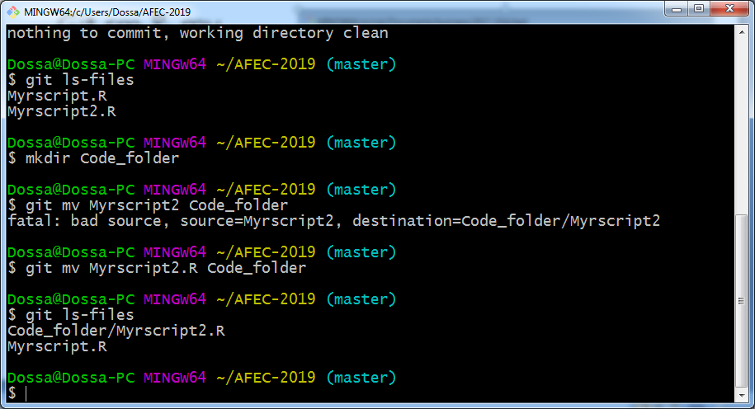
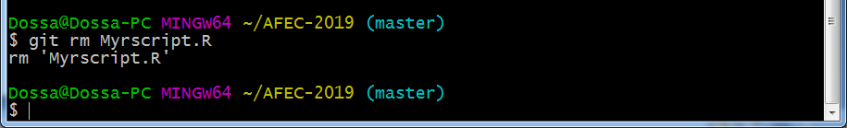
Git rm
Don’t delete or rename tracked files with the OS; use:
git rm
git mv

Slide 22
Git mv
Don’t delete or rename tracked files with the OS; use:
git mv

Slide 23
Lather, Rinse, Repeat

Slide 24
Good Commit Messages*
Be concise, yet evocative. At a glance, you should be able to see what a commit does. But there should be enough detail so you can remember (and understand) what was done
Describe the why, not the what. Since you can always retrieve the diff associated with the commit, the message doesn’t need to say exactly what changed. Instead it should provide a high-level summary that focuses on the reasons for the change

Slide 25
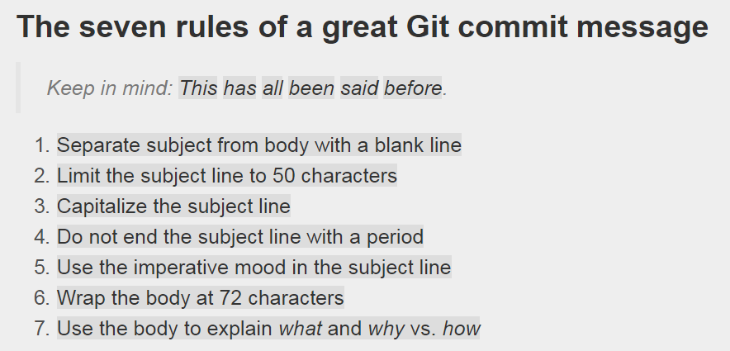
Good Commit Messages

Slide 26
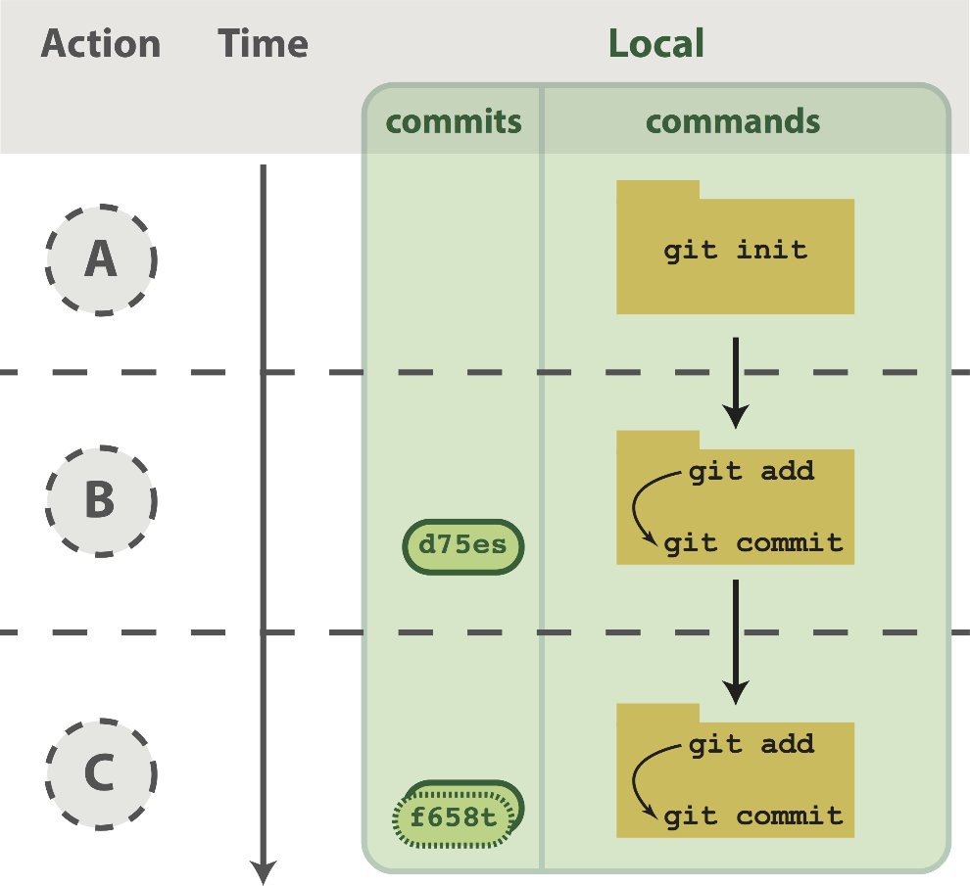
Workflow Visualized

Slide 27
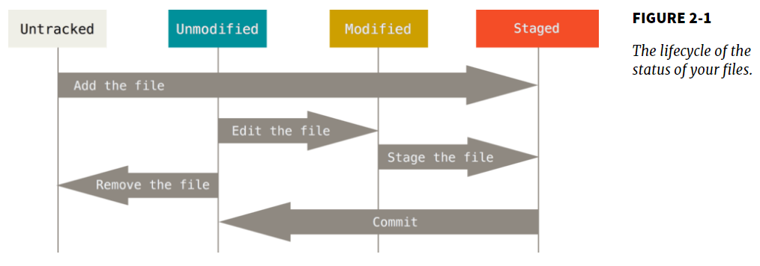
Lifecycle of status

Slide 28
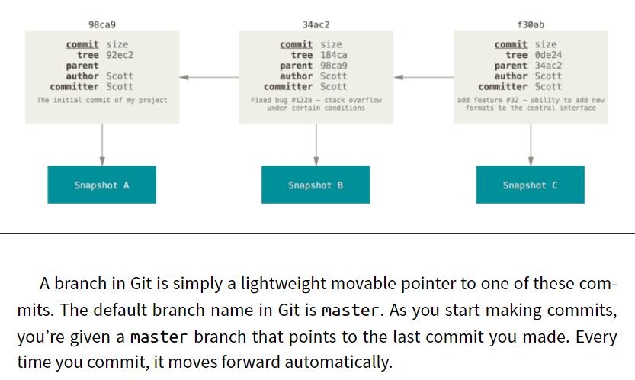
Commit Graph Visualized

Slide 29
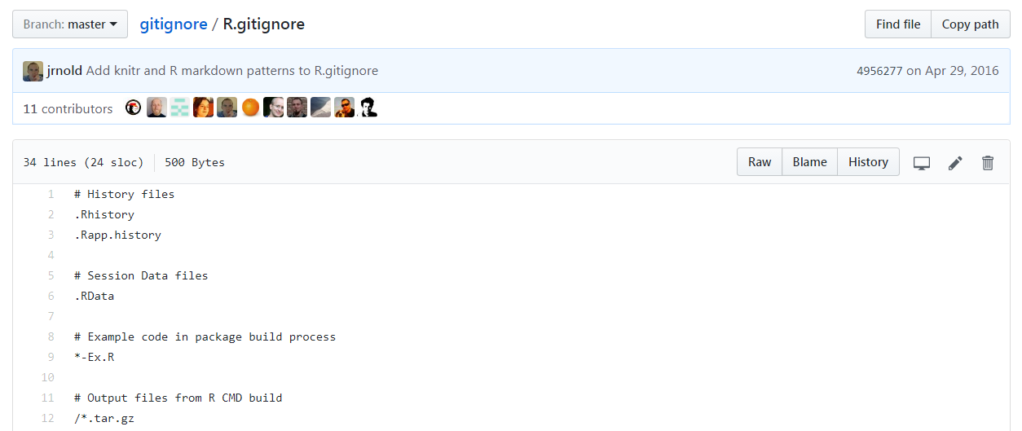
.gitignore

Slide 30
.gitignore
Make the code produce a plot file, say a pdf
Run the code
Make a .gitgnore file
.pdf
.Rout
Add & commit the .gitignore
Run ls (you should see the pdf and the Rout file)
Run git ls-files (you should not see the pdf and the Rout file)

Slide 31
Break Time?

Slide 32
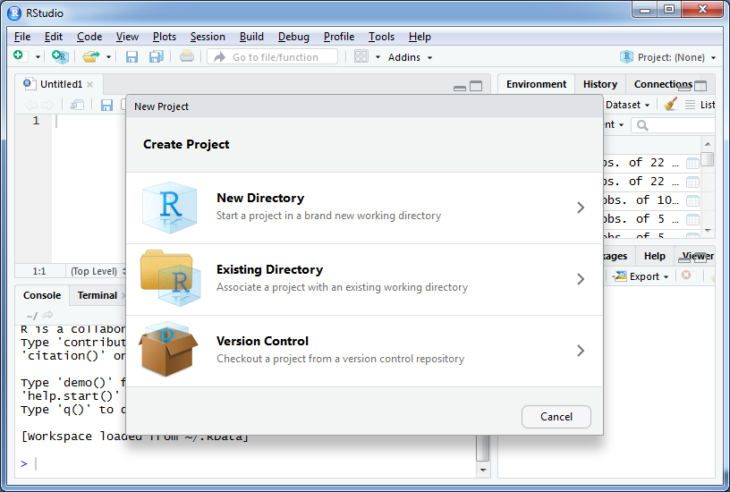
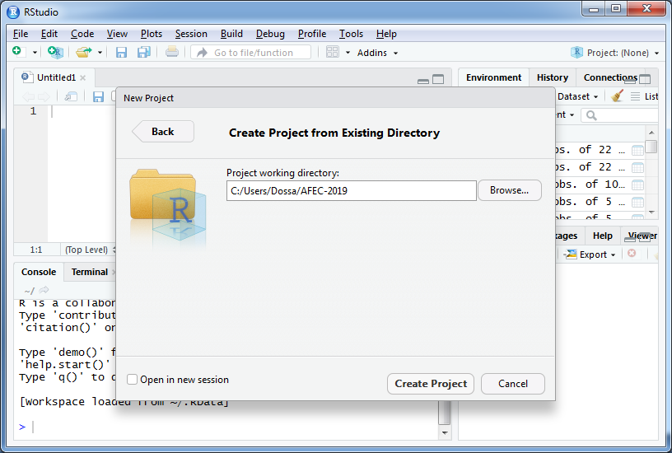
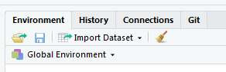
New R Project With Your Existing Repo

Slide 33
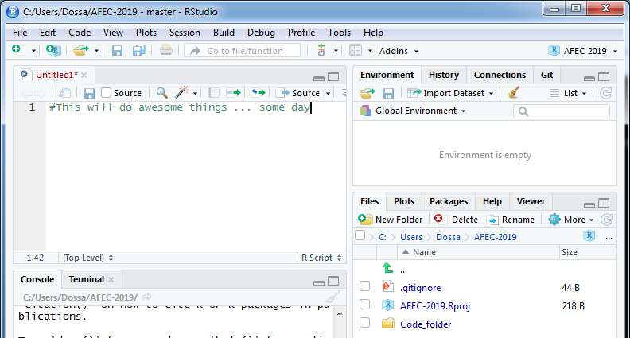
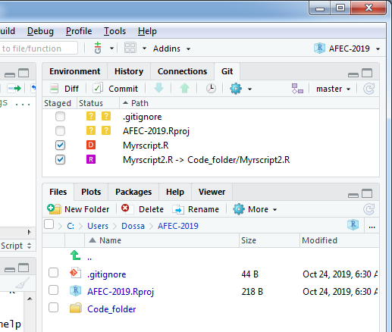
Make the Changes in RStudio
push/pull greyed out
Add / made changes

Slide 34
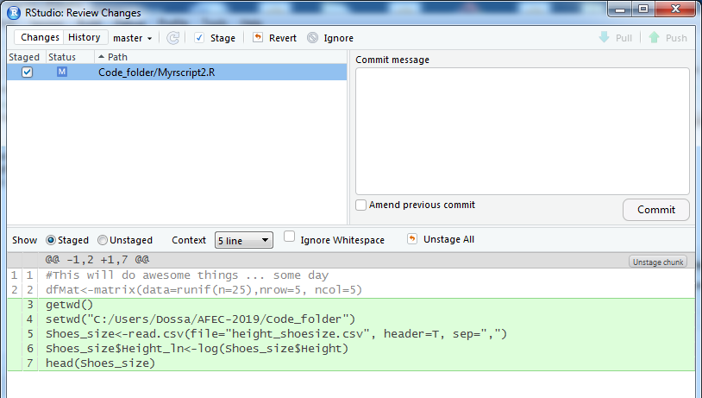
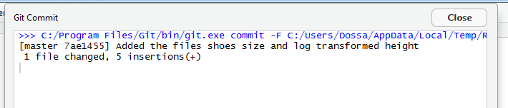
Commit the Changeset

Slide 35
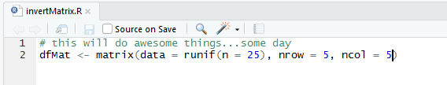
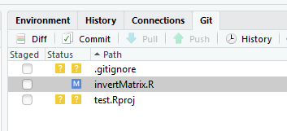
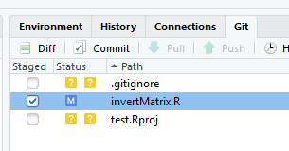
Make Some Modifications
invertMatrix.R
has been
modified
invertMatrix.R
has been
added

Slide 36
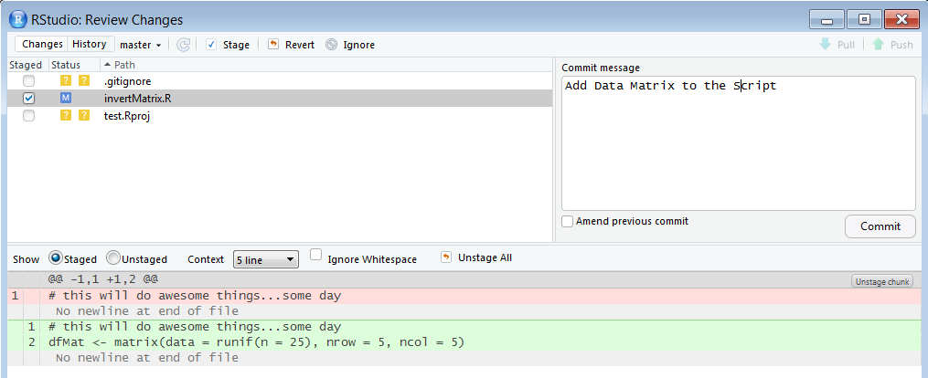
Commit the Modifications

Slide 37
Git in RStudio Covers Most of Your Needs
If RStudio does all of this, why bother with the command line?
Most of the time you won’t need to, but when you need it, you need it
Merge conflicts, for example

Slide 38
Code Time

Slide 39
Connecting a Local Repo to a Remote Repo
Module 7-3

Slide 40
Git is a Distributed Version Control System
Peer-to-peer as opposed to server-client
Common operations (commits, viewing history, etc.) are fast since there is no need to communicate with a central server
Communication is only necessary with sharing changes among peers
Each working copy effectively functions as a remote backup of a codebase and its change history – protecting against data loss

Slide 41
How Does My Local Repo Sync with GitHub*
Several ways to do this:
Clone an existing repository from GitHub to a local folder
Your own, or
Another coder’s
Initialize a repository locally and push to GitHub
Start a new project in RStudio with version control

Slide 42
Local First
We’ve started this with git init in a local repo
How connect to GitHub?
Make an empty repo on GitHub, i.e. no README
Copy the url of this repo from GitHub
Navigate to your current folder
Add the remote
Push the repo

Slide 43
GitHub First
You did a version of this when you worked through the Happy Git with R install tutorial
How connect to GitHub?
Make a repo on GitHub (I typically add both a README and a .gitignore file)
Copy the url of this repo from GitHub
Navigate to your current folder
Clone the repo

Slide 44
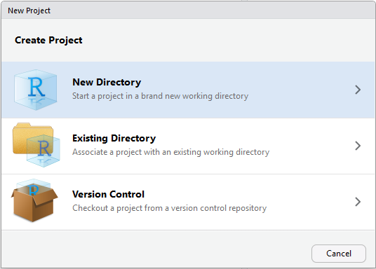
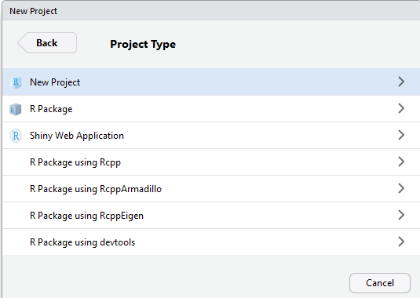
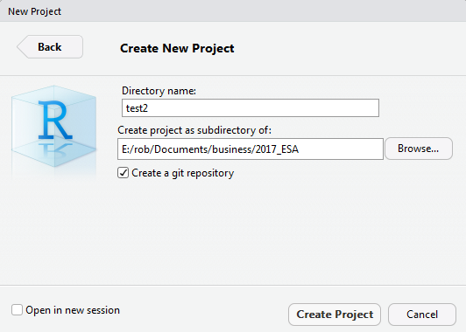
From RStudio*
Make a new project
Project type
Choose name & git

Slide 45
My Preferred Way
Start on GitHub
Create an empty repo
Include a README file
Include a .gitignore file
Clone it locally on the command line
Set up a new project in RStudio in the existing directory

Slide 46
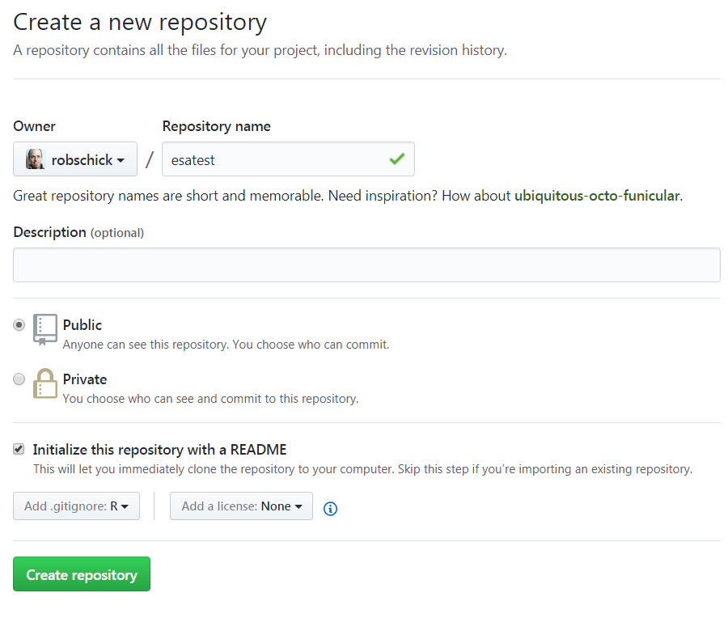
Let’s Practice

Slide 47
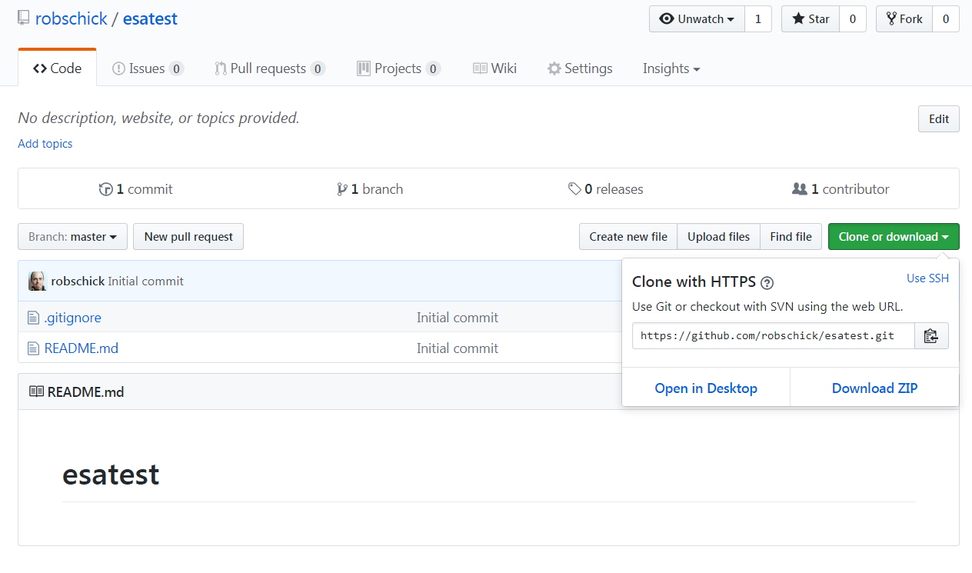
Let’s Practice

Slide 48

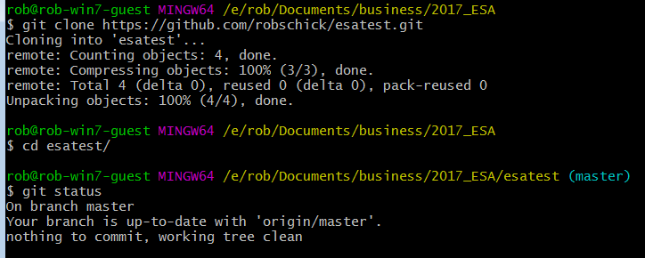
Let’s Practice

Slide 49
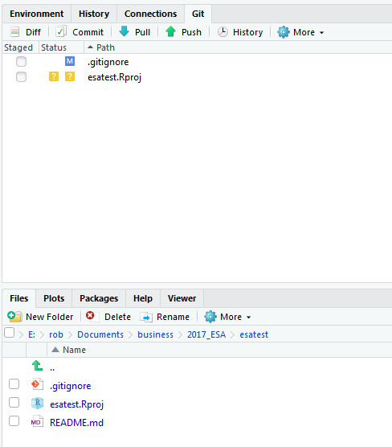
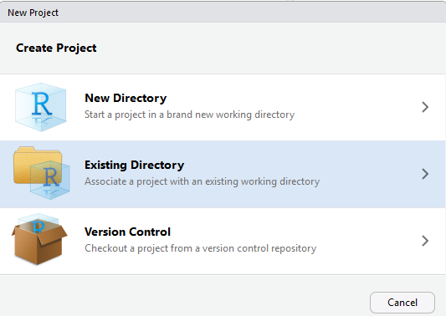
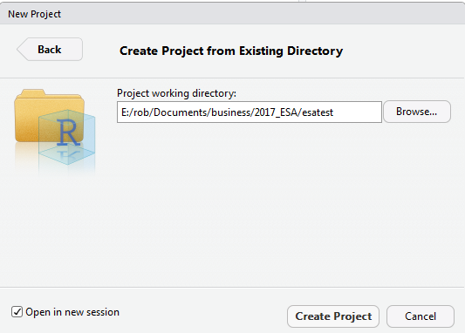
Let’s Practice

Slide 50
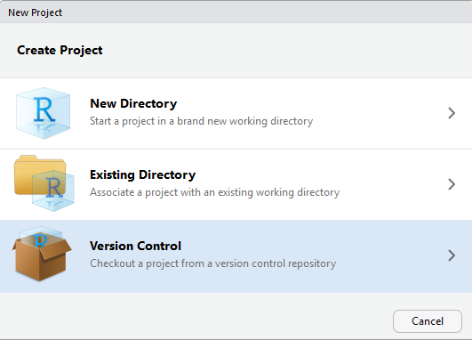
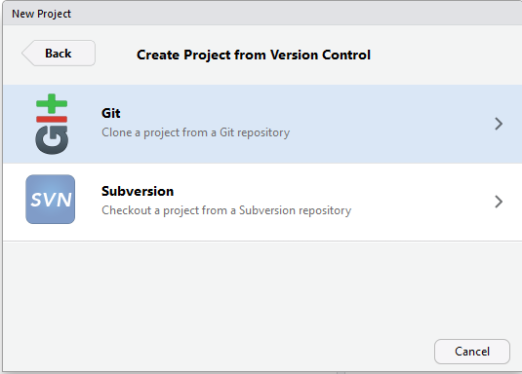
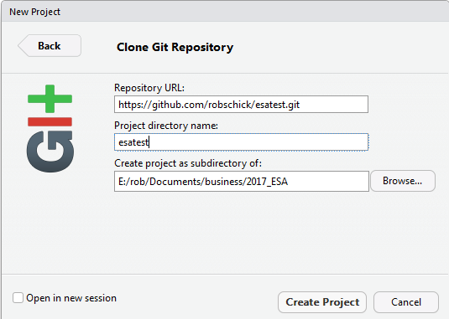
Bypass the Command Line

Slide 51
Pushing to GitHub – How Often?
Several schools of thought on how often to push
A prominent one (Hadley Wickham) is to push considerably less often than you commit*
“Pushing code means publishing code”
“Strive to push code that works”
I tend to push more often than this, because I code on small teams, and I like the back up

Slide 52
Pushing to GitHub – Good Commit Messages*
Be concise, yet evocative. At a glance, you should be able to see what a commit does. But there should be enough detail so you can remember (and understand) what was done
Describe the why, not the what. Since you can always retrieve the diff associated with the commit, the message doesn’t need to say exactly what changed. Instead it should provide a high-level summary that focuses on the reasons for the change

Slide 53
Practice a Cycle in Local Repo

Slide 54
Three Local States with Remote
Working Directory
Staging Area
Repository (.git folder)
Remote (GitHub)
git push

Slide 55
Adding GitHub to the Workflow – git push

Slide 56
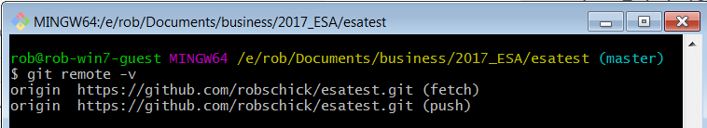
Knowing Your Remotes

Slide 57
What is a Merge Conflict?
A merge operation in git is when you try to blend changes made:
To the same file
On two different branches
Wait, but we haven’t talked (much) about branches?
For now, know that we’ve been working with one branch – MASTER
So we can work with the same branch – MASTER – in two (or more repos):
Local
GitHub
Node
And these can come into conflict – let’s try!

Slide 58
Merge Conflicts
Make sure your working directory shows a clean status
Do a git pull
Do a git push
Modify the file locally
Commit it, but don’t push it yet
Navigate to the repo on GitHub
Modify the same file on GitHub
Commit it
Go back to local repo and attempt a push

Slide 59
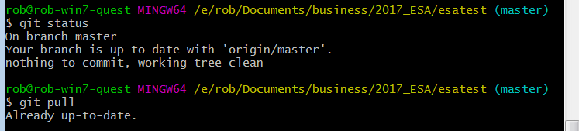
Check Status of Your Local Repo
Best practice to pull before you push (n.b. if it’s just you and GitHub, this isn’t as big a concern)

Slide 60
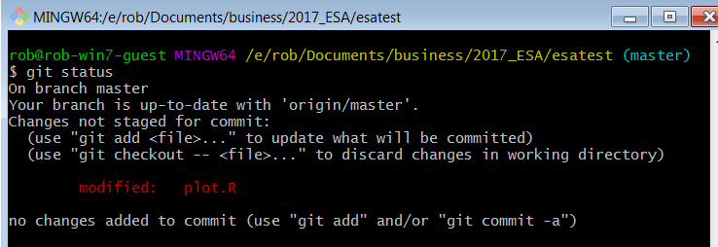
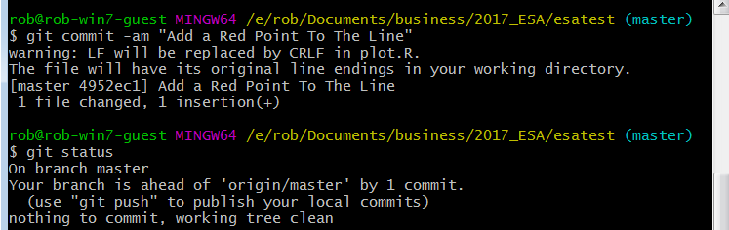
Make Local Changes

Slide 61
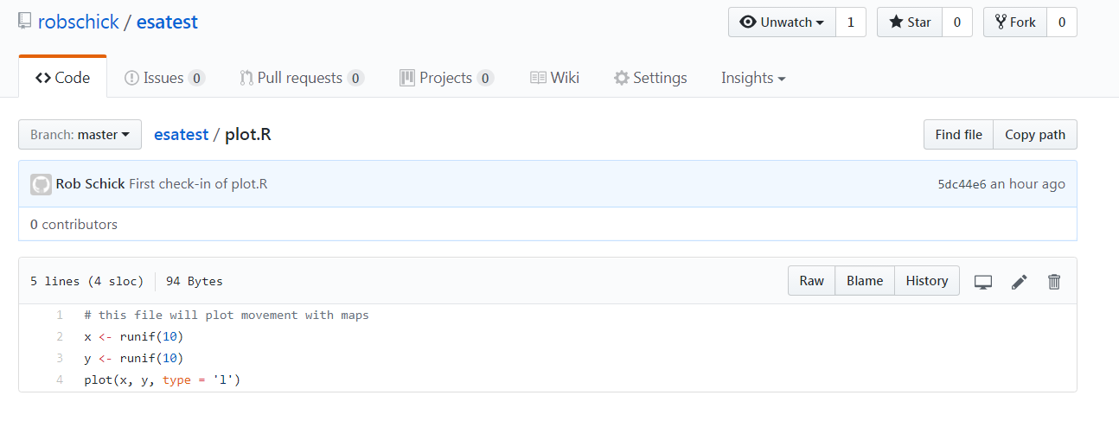
Make Remote Changes
Edit on GitHub

Slide 62
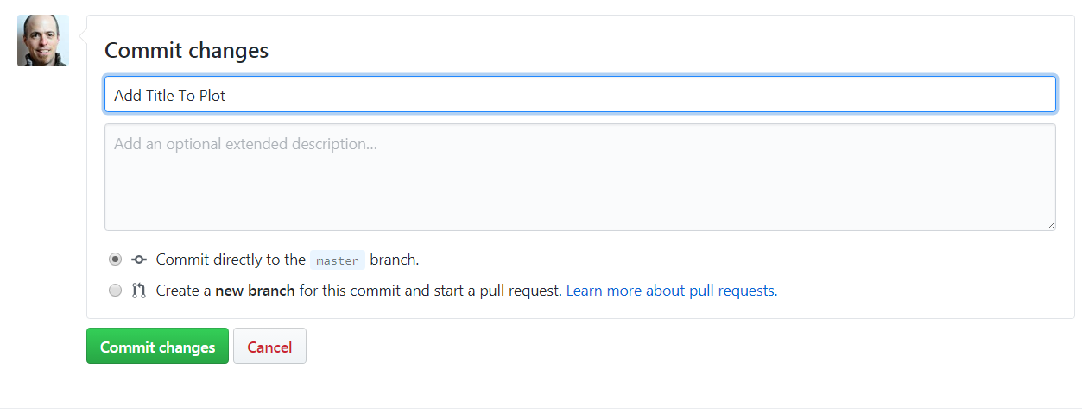
Commit the Changes

Slide 63
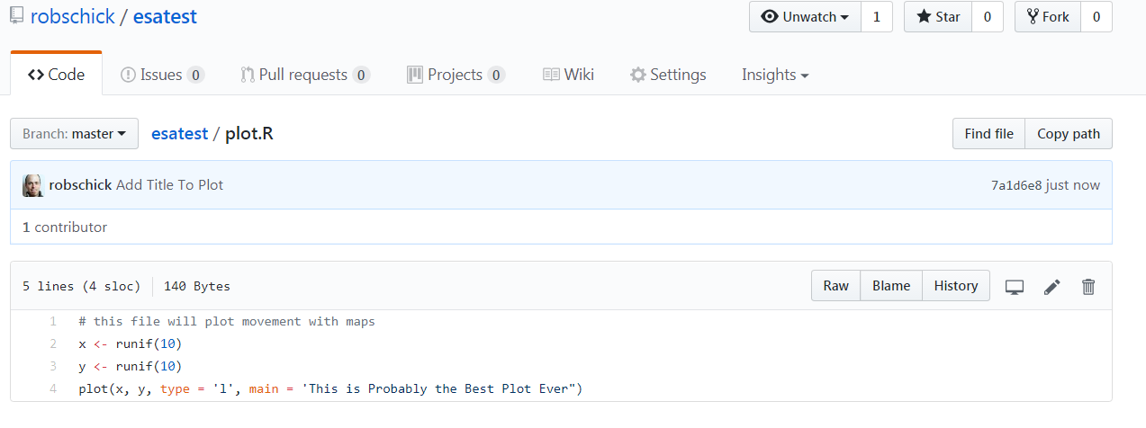
View Status on GitHub

Slide 64
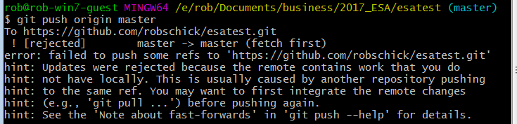

What’s Happened
We have one repo – esatest (or whatever you’ve named it)
We’ve made and committed changes in two different places
Now let’s try to sync the repos by pushing our local to GitHub

Slide 65
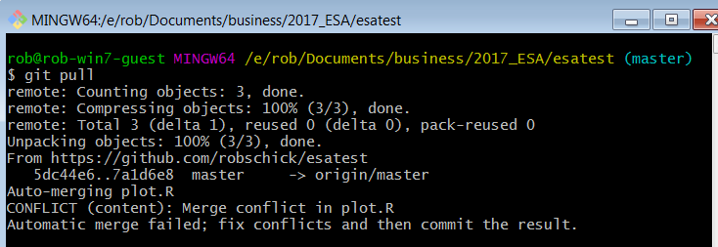
Pull the Changes

Slide 66

Check Status

Slide 67

View the Conflict
Unchanged lines
Incoming marker
Branch Separator
Current marker
sha-1 from GitHub

Slide 68
Manually Resolve the Conflict
Choose this Block
Or this Block

Slide 69

Add it, Commit it, Push it
Note status
Merge Resolved

Slide 70

Merge Commits Look a Bit Different

Slide 71
Just Another Repo!
Well, yes, but…
I’ll try a live demo to show what happens
If it fails, following is an example of the normal bs that you need to put up with
(But it’s worth it!)

Slide 72

SSH to a Linux Box
Cloned my repo from GitHub
Created a new file
Added it
Pushed it:
??? Stackoverflow to the rescue

Slide 73

Need to Use SSH not HTTP

Slide 74


Need to change this

Slide 75

No LUCK!
Need to pair the SSH keys…. http://happygitwithr.com/ssh-keys.html

Slide 76


Slide 77


Slide 78


Slide 79


Slide 80



Slide 81
How Does the Repo Change?
Lesson 7-4

Slide 82
3 Core Concepts
Snapshot
Graph
Changeset

Slide 83
With These Concepts, We Can
Use the sha-1 unique identifier to view a snapshot
Compare the differences from one snapshot to a next
Compare two different snapshots/commits
Revert to the project at specific points (commits) in time

Slide 84



sha-1 Identifier – These Are Crucial
These are the nodes along the graph
We use them to view and/or navigate

Slide 85

Seeing Changes Before a Commit
Visualize Changes
before a commit

Slide 86

Seeing Changes Between Two Diffs
sha-1 commit IDs
Visualize differences
between 2 commits

Slide 87


Order Matters Between Two Diffs

Slide 88
Seeing Changes Between Two Diffs
git diff master~1 master
git diff <sha-1> <sha-1>
git diff (this just shows changes made but not added)
Why all the hassle?
Diffs tell you what changed
Commit messages tell you why
With both, you can easily navigate through the history of a repo

Slide 89
Going to a Particular Commit
git checkout <sha-1>

Slide 90

Going to a Particular Commit
git checkout c572b41

Slide 91

Detached Head???
git log --oneline --decorate
Has to do with where the branch is pointing – now it’s to a previous commit
Explore your script and you’ll see it from that state:

Slide 92

Where are we?

Slide 93
Detached Head???
git log --oneline --decorate
Where did the other commits go?

Slide 94

The Commits Are Still There - Phew!
git checkout master

Slide 95

Why Would You Want to Do This?
Allows you to work with the file as it was at that time:
And then bring those changes into the current commit
I’ll argue for using a branch to do this in the last section

Slide 96
Backing Out Changes
This can get complicated!
Three main commands:
git reset (hard, soft, mixed)
git rebase
git revert
git cherry-pick
This diagram helps:

Slide 97


Slide 98
More Resources
https://git-scm.com/book/en/v2/Git-Basics-Undoing-Things
https://www.atlassian.com/git/tutorials/undoing-changes
https://www.atlassian.com/git/tutorials/rewriting-history

