Slide 1
Core concepts in Git
Module 7-2

Slide 2
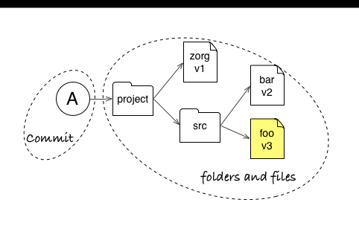
Core Concepts
Git stores snapshots (commits) of your repository

Slide 3
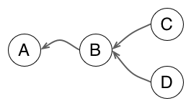
Core Concepts
Git represents relationships between commits as a graph

Slide 4
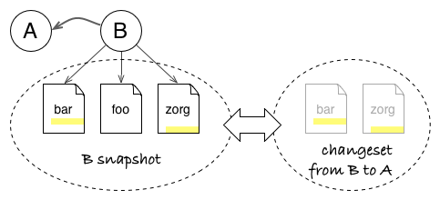
Core Concepts
Git can compute changesets between any two commits of your project

Slide 5
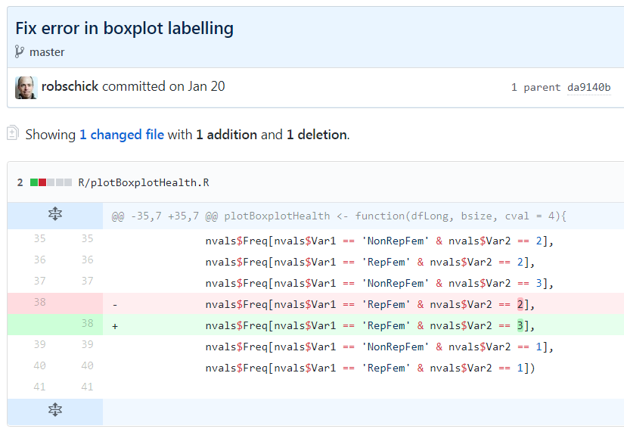
Core Concepts
Git sees changes at the level of lines in a text file

Slide 6
3 Core Concepts
Snapshot
Graph
Changeset

Slide 7
States of a git Repository

Slide 8
The Repository
Collection of files managed by git
History (all of it)
Encompassing file on the Operating System is considered the working directory
Can include files managed by git
Files ignored by git
Files not yet managed by git
Quasi-hidden .git folder
Since the repo contains all the history, keep the repos narrowly focused

Slide 9
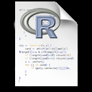
Three Local States
Working Directory
Staging Area
Repository (.git folder)
git add
git commit

Slide 10
Three Local States with Remote
Working Directory
Staging Area
Repository (.git folder)
Remote (GitHub)
git push

Slide 11
Basic Commands
Mastering a Basic Workflow

Slide 12
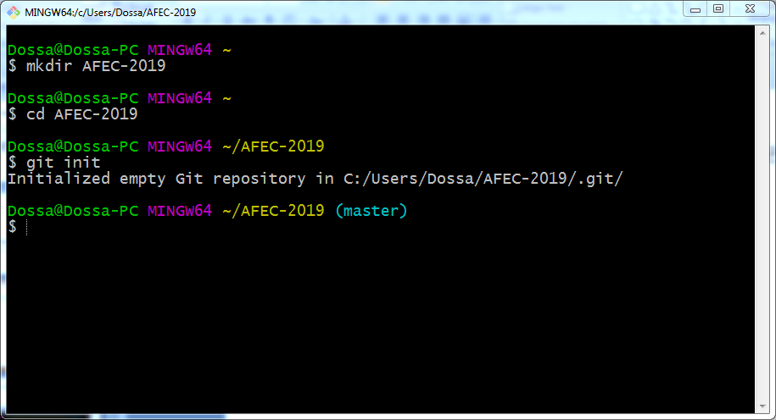
git init – Initialize an Empty Repo

Slide 13
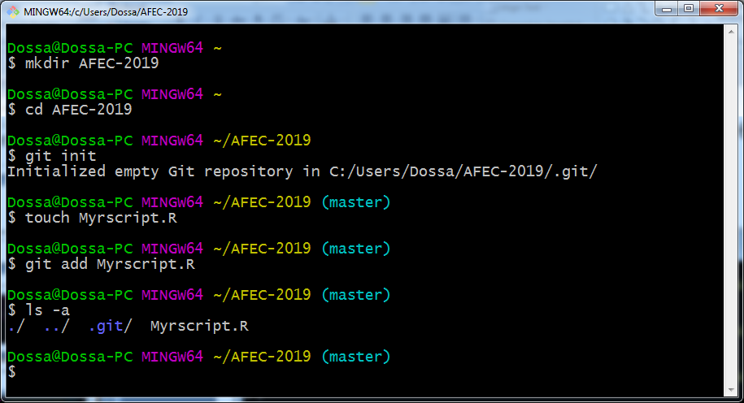
git add – Add a Document to the Staging Area

Slide 14
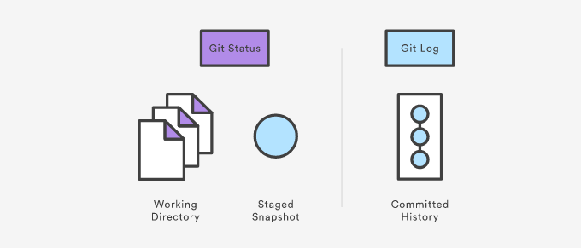
Viewing the Repo

Slide 15
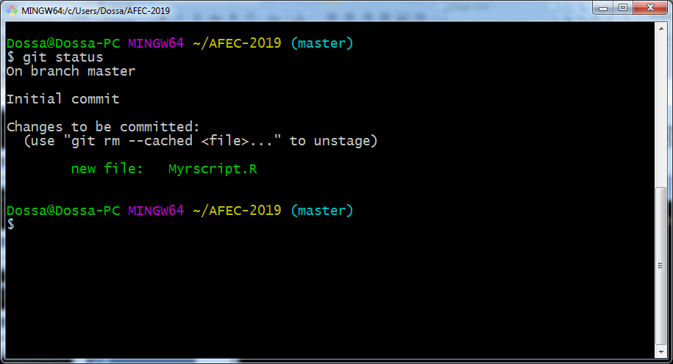
git status – What’s Happening?

Slide 16
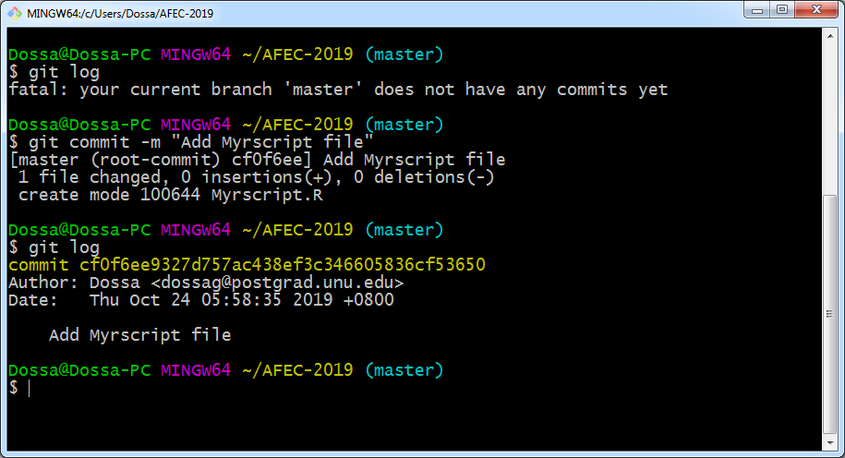
git log – To view the history of Repo

Slide 17
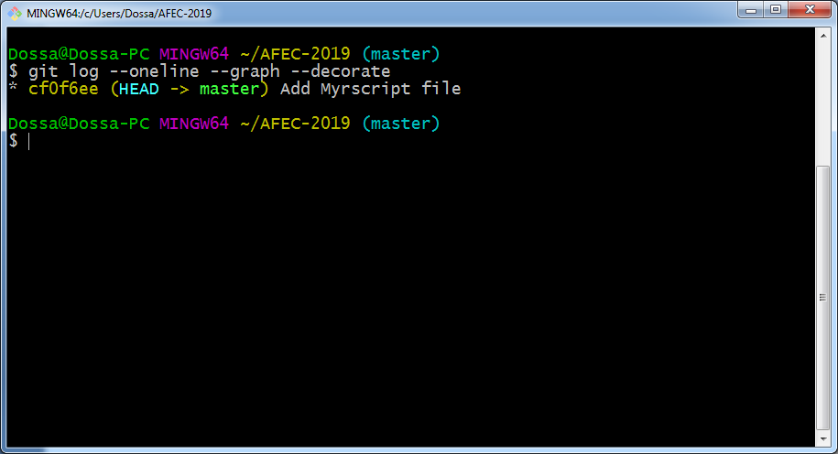
git log – With Options

Slide 18
git commit – Records changes in the Repo
git commit -m “Second check in of my R Script"

Slide 19
Ok, What Just happened?
sha-1 commit
What’s Changed

Slide 20
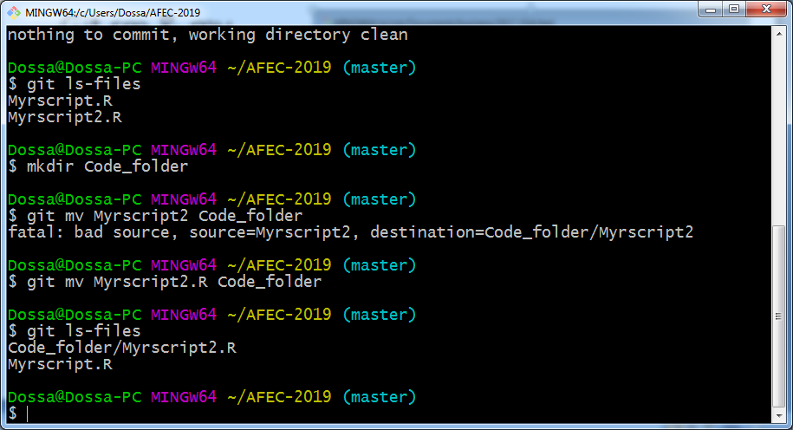
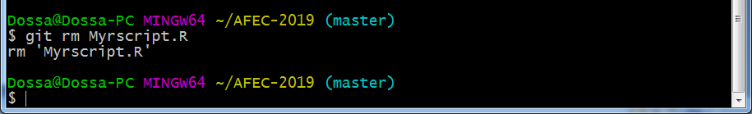
Git rm
Don’t delete or rename tracked files with the OS; use:
git rm
git mv

Slide 21
Git mv
Don’t delete or rename tracked files with the OS; use:
git mv

Slide 22
Lather, Rinse, Repeat

Slide 23
Good Commit Messages*
Be concise, yet evocative. At a glance, you should be able to see what a commit does. But there should be enough detail so you can remember (and understand) what was done
Describe the why, not the what. Since you can always retrieve the diff associated with the commit, the message doesn’t need to say exactly what changed. Instead it should provide a high-level summary that focuses on the reasons for the change

Slide 24
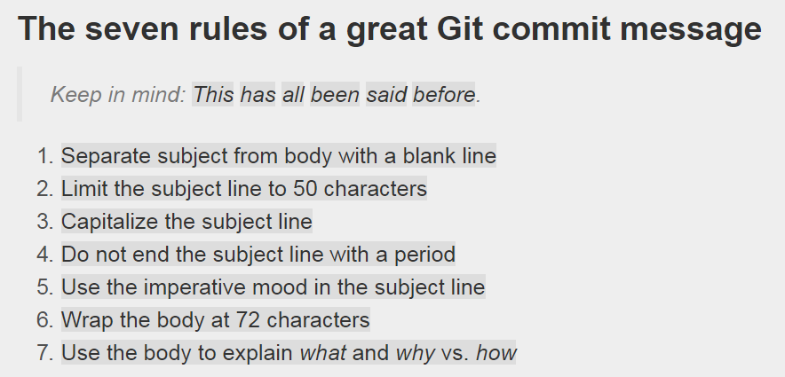
Good Commit Messages

Slide 25
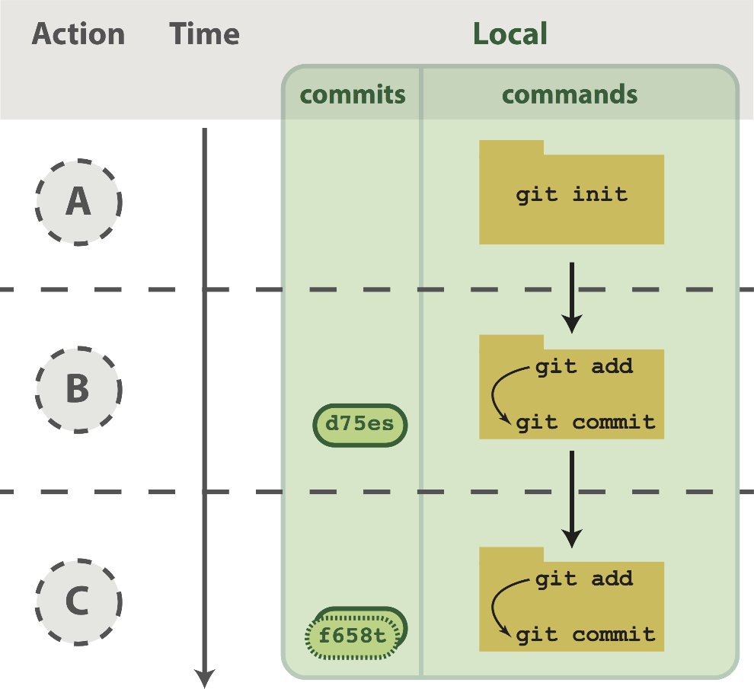
Workflow Visualized

Slide 26
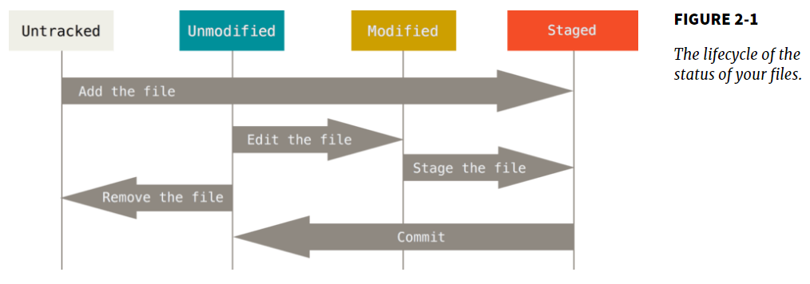
Lifecycle of status

Slide 27
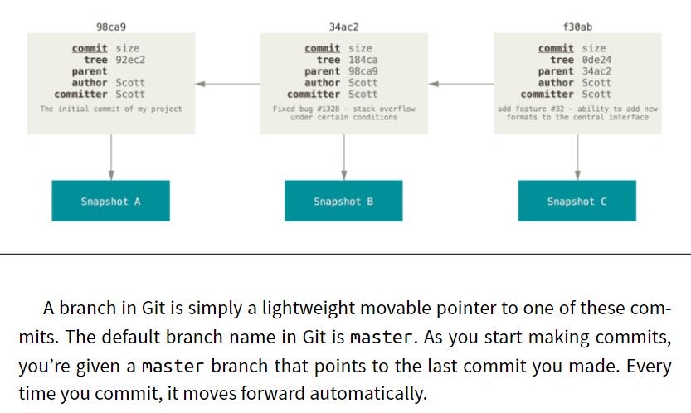
Commit Graph Visualized

Slide 28
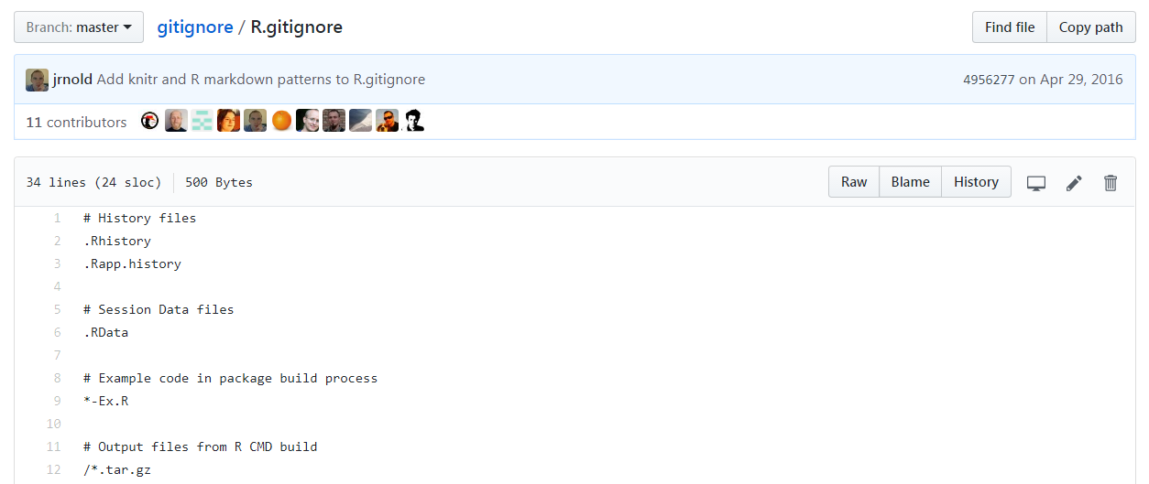
.gitignore

Slide 29
.gitignore
Make the code produce a plot file, say a pdf
Run the code
Make a .gitgnore file
.pdf
.Rout
Add & commit the .gitignore
Run ls (you should see the pdf and the Rout file)
Run git ls-files (you should not see the pdf and the Rout file)

Slide 30
Break Time?

Slide 31
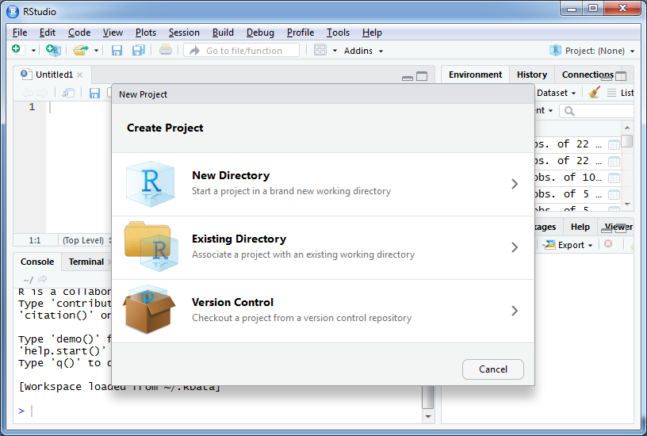
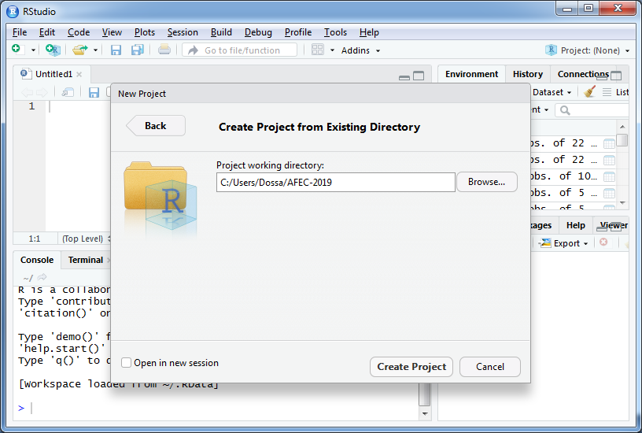
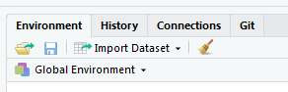
New R Project With Your Existing Repo

Slide 32
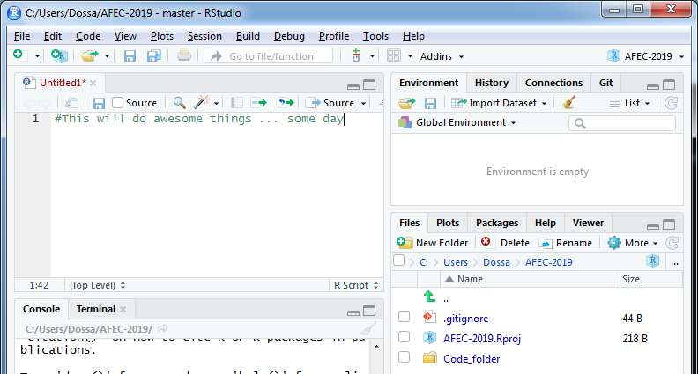
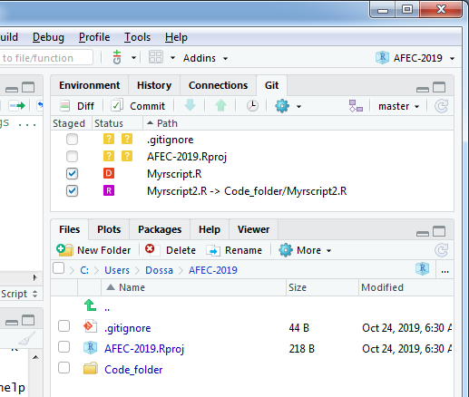
Make the Changes in RStudio
push/pull greyed out
Add / made changes

Slide 33
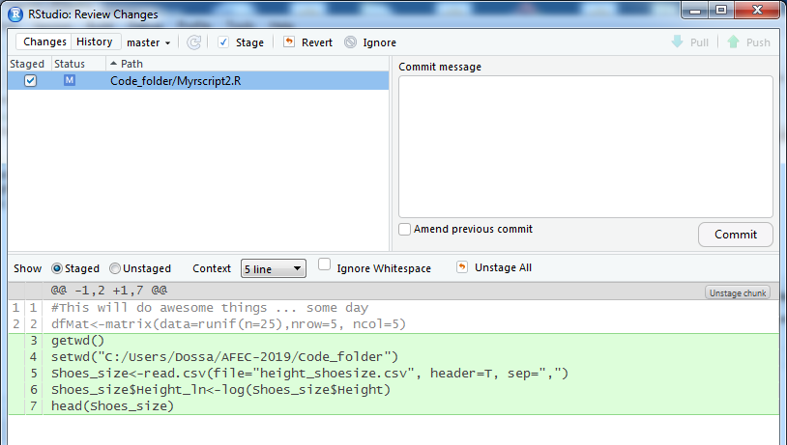
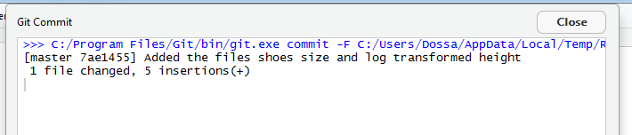
Commit the Changeset

Slide 34
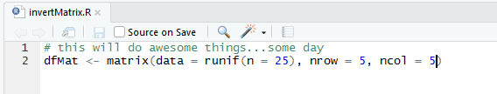
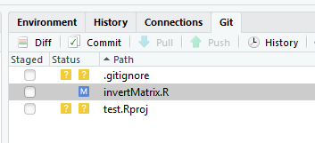
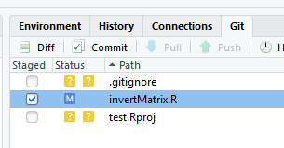
Make Some Modifications
invertMatrix.R
has been
modified
invertMatrix.R
has been
added

Slide 35
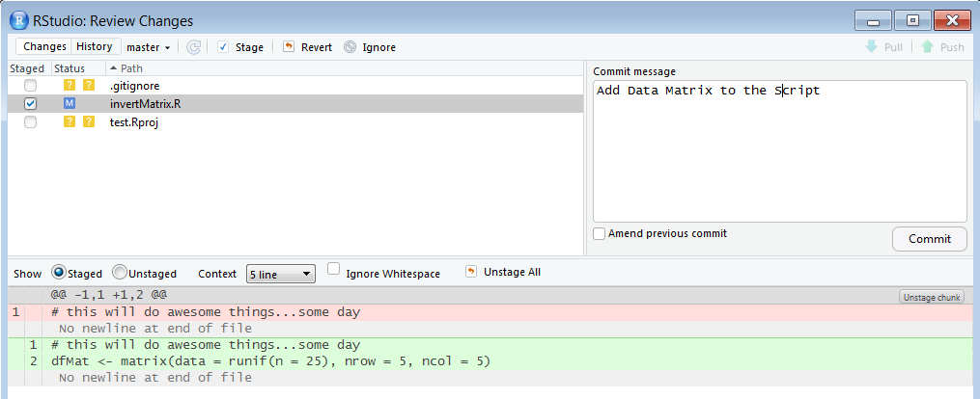
Commit the Modifications

Slide 36
Git in RStudio Covers Most of Your Needs
If RStudio does all of this, why bother with the command line?
Most of the time you won’t need to, but when you need it, you need it
Merge conflicts, for example

Slide 37
Code Time

