Slide 1























$$u$$
$$G$$
$$y$$
$$−$$
$$k_{u,1}$$
$$v_{u,1}$$
$$c_{1}$$
$$v_{y,1}$$
$$k_{y,1}^{T}$$
$$…$$
$$…$$
$$…$$
$$…$$
$$…$$
$$k_{u,n_{j}}$$
$$v_{u,n_{j}}$$
$$c_{n_{j}}$$
$$v_{y,n_{j}}$$
$$k_{y,n_{j}}^{T}$$
$$K_{u}$$
$$C$$
$$K_{y}^{T}$$
$$K$$

Slide 2
LPV Model
Modal Decomposition
Input / Output Blending
SISO Controller Design
Controller
Verification

Slide 3
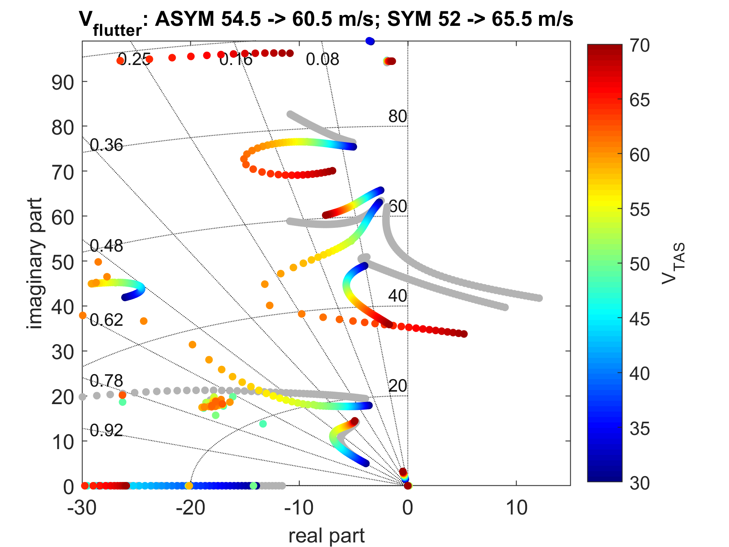
ASYMMETRIC
56 m/s → >70 m/s
Imaginary Part
Indicated Airspeed
SYMMETRIC
52 m/s → 65.5 m/s
Real Part

Slide 4
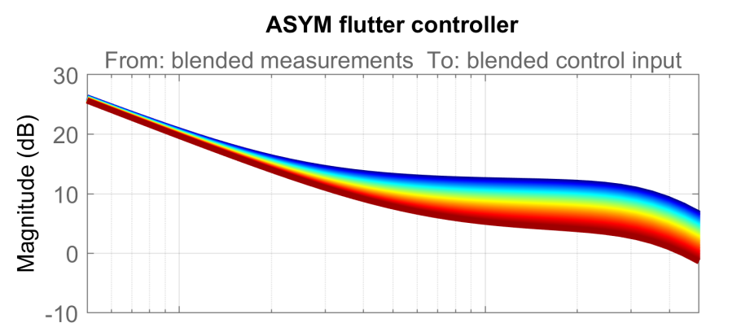
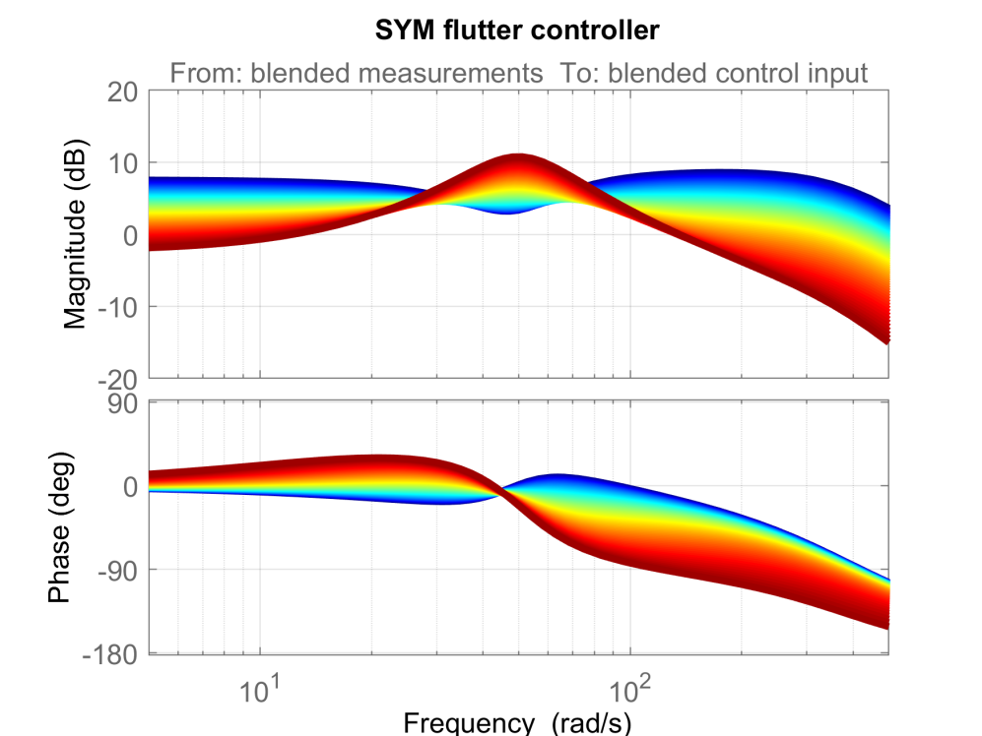
V_{IAS}

Slide 5















$$u$$
$$G\left(ρ\left(t\right)\right)$$
$$y$$
$$−$$
$$k_{u,1}$$
$$v_{u,1}$$
$$c_{1}\left(ρ\left(t\right)\right)$$
$$v_{y,1}$$
$$k_{y,1}^{T}$$
$$…$$
$$…$$
$$…$$
$$…$$
$$…$$
$$k_{u,n_{j}}$$
$$v_{u,n_{j}}$$
$${ c}_{n_{j}}\left(ρ\left(t\right)\right)$$
$$v_{y,n_{j}}$$
$$k_{y,n_{j}}^{T}$$
$$K_{u}∈ℝ^{n_{u}×n_{v}}$$
$$C\left(ρ\left(t\right)\right)$$
$$K_{y}^{T}∈ℝ^{n_{v}×n_{y}}$$
$$K\left(ρ(t)\right)$$

