Slide 1
Presentation

Slide 2

problematic
We have more and more services to provide to clients. And these services are all in paper, this poses a lot of problems:
Sometimes customer files are sent to different email accounts, it’s not easy to find the desired contacts, files (quotes, invoices, bills…etc.) or emails.
Consequently, another problem we face is forgetting to send email reminders for renewals of maintenance, hosting or update contracts.
And here is the assignment of our platform is to solve those issues with full responsive web platform that allows the team to supervise their missions.

Slide 3
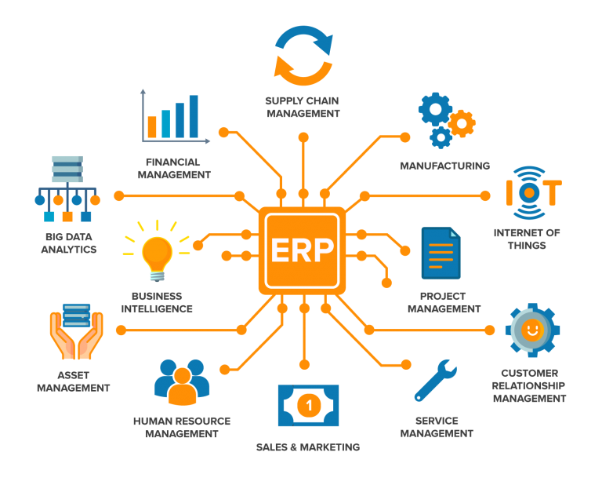
Solution
Erp system

Slide 4

Beneficiary :
NACHD-IT

Slide 5


Tools Used
FRAMEWORKS :
Back Side
Font Side
ANGULAR
LARAVEL

Slide 6

DATABASE :

Slide 7
Principal Modules
Athentification
Manage Users.
Manage Roles.
Manage Clients
Manage Projects
Manage Papers ( contracts , quote … )
Exporting and importing Files
Notification system
Activity Log System
Manage Bills
Gantt Chart

Slide 8
important points to focus in :
Security
Performance
Ergonomy
Optimized code

