Slide 1

I N N O V AT I O N B R I E F
LegalEase.
AI-Powered Legal
Document Generator
An overview of LegalEase, a platform leveraging state-of-the-art
Generative AI to simplify the creation of customizable, accurate, and
editable legal documents.
CORE MISSION
Bridging the Gap Between Accessibility and Legal Professionalism
SYSTEM STATUS: ACTIVE
GENAI FRAMEWORK V.2.4
LEGAL

Slide 2

 | PROJECT SCOPE This presentation outlines the complete architectural, I N F O R M A T I O N A R C H I T E C T U R E development, and deployment blueprint for LegalEase. Table of CORE STRATEGIC PATH Contents from concept to deployment across six core activities and three major milestones. A structured walkthrough of the project 06 03 ACTIVITIES MILESTONES
 | Legal Technologist v1.0 Project Blueprint AGENDA M PROTOCOL

Slide 3

C H A P T E R 0 1
Project Overview
& Scenarios
Demonstrating how LegalEase solves legal document
generation challenges for startups, freelancers, and landlords.
S Y S T E M S T A T U S
PHASE_01 // ARCHITECTURAL_INIT
SECTION 01-A
01

Slide 4

PRACTICAL USE CASES & TARGET SCENARIOS
Real-World Application Scenarios
Three practical use cases showing how different target users interact with LegalEase to generate
formal documents.
Startup Founder
Freelancer
仓✰
Landlord
NEED
Employment Contract for a new hire.
NEED
Non-Disclosure Agreement (NDA) for a
NEED
Residential Lease Agreement.
potential client.
ACTION
ACTION
Enters details about roles, responsibilities,
compensation, and confidentiality.
ACTION
Specifies involved parties, scope of
Inputs property address, tenant details, and
lease terms.
confidentiality, and effective date.
OUTCOME
OUTCOME
Generates a comprehensive agreement,
customizes wording, adds company logo,
OUTCOME
Instantly receives a structured and legally
Creates a formatted document with
editable sections downloadable in .DOCX
LegalEase addresses distinct user needs by providing tailored legal outputs.
APP_SCENARIO_REF_003

Slide 5

C H A P T E R 0 2
Technical Pre-requisites
& Architecture
Establishing a robust foundation using FastAPI,
Streamlit, and Google Gemini 1.5 Pro.
S Y S T E M B L U E P R I N T V 1 . 0

Slide 6
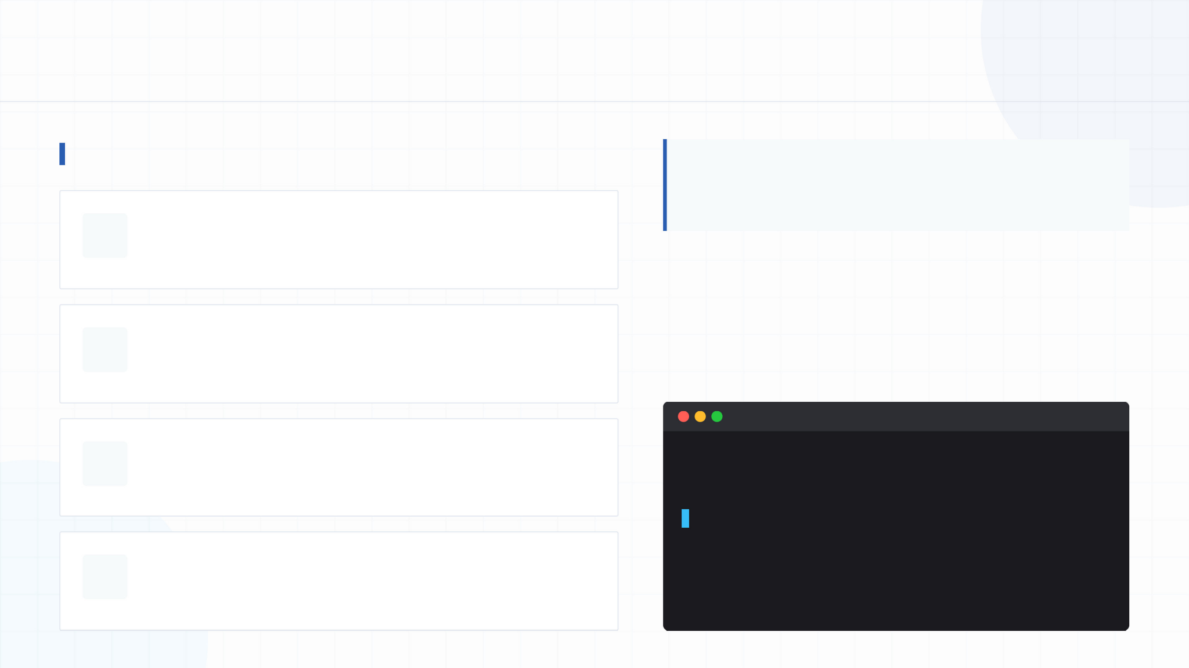
FOUNDATIONAL REQUIREMENTS
Technical Pre-requisites & Environment Setup
Core Framework Knowledge Required
"The foundational knowledge and specific Python libraries
required to build and execute the LegalEase platform."
PROJECT BASIS
A standard Python 3.10+ environment equipped with specialized AI
and document formatting SDKs forms the project basis.
FastAPI Framework
For building high-performance, production-ready backend APIs.
Google Gemini API
Familiarity with Google Generative AI SDK for advanced text generation.
Environment Installation Command
zsh — setup.sh
Streamlit
For rapid frontend UI development and interactive components.
$ pip install fastapi uvicorn streamlit python-docx
fpdf Pillow requests google-generativeai python-dotenv
Python Programming
High proficiency required for core logic and integration.

Slide 7
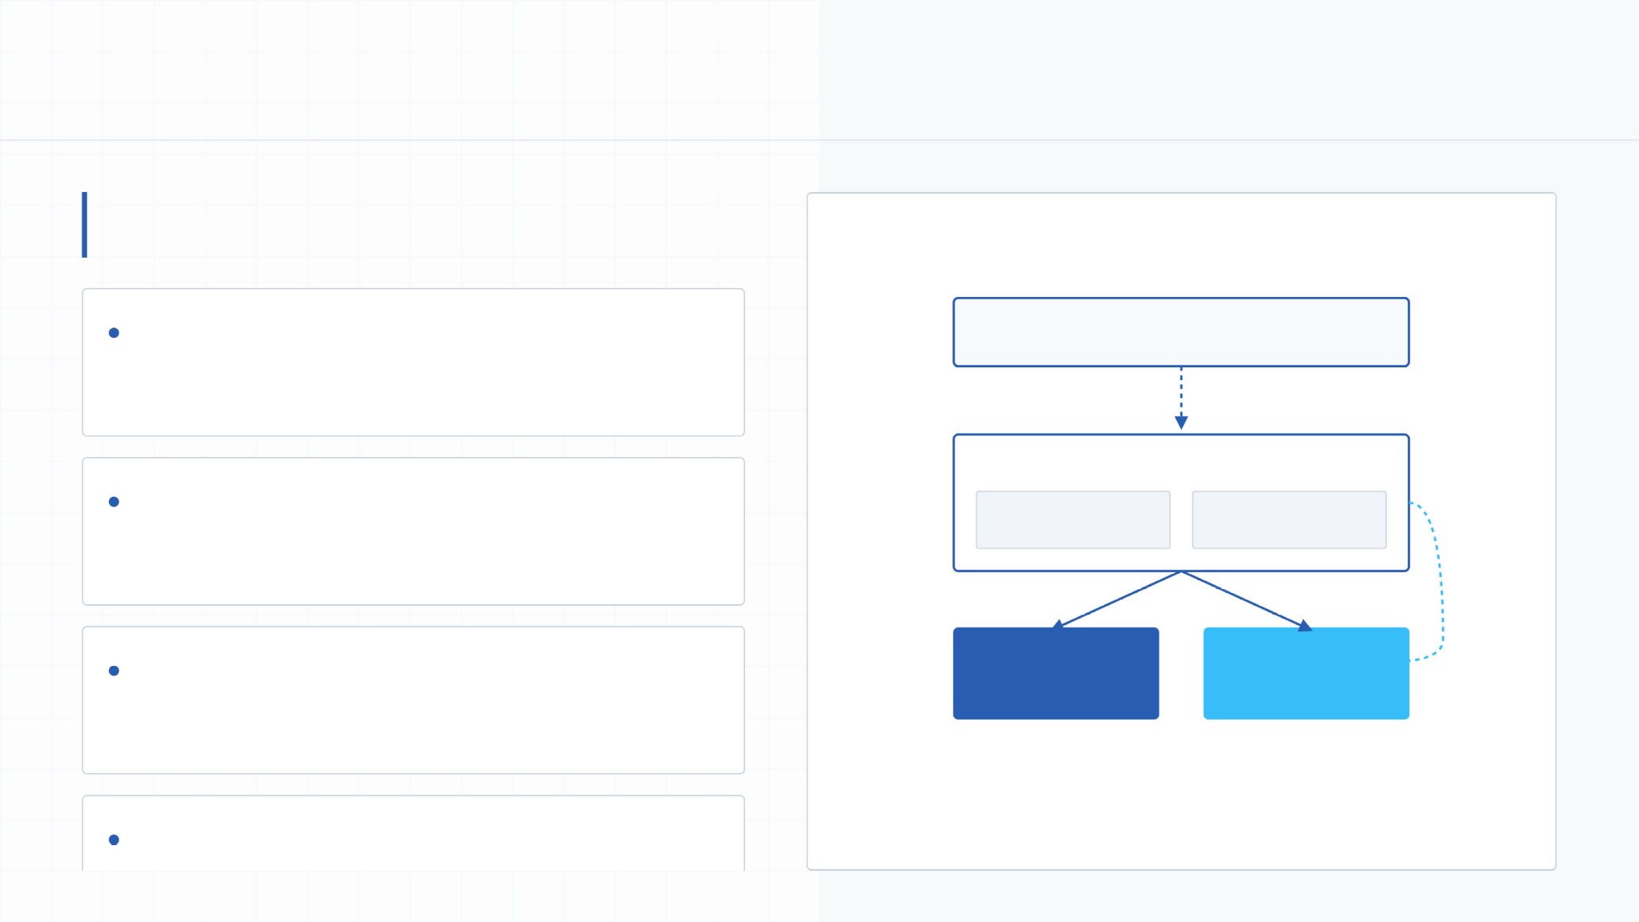
SYSTEM FRAMEWORK OVERVIEW
System Architecture & Component Definition
LegalEase utilizes a decoupled architecture separating the
Streamlit UI from the FastAPI backend for optimal scalability.
Frontend (Streamlit)
ARCHITECTURE DIAGRAM V1.0.4
STREAMLIT FRONTEND
User Interface & Validation
User interaction, document input fields, responsive layouts, dynamic
previews, and file downloads.
FASTAPI BACKEND
Backend (FastAPI)
API routing (main.py, routes.py), processes incoming POST requests, and
communicates with the AI core.
API Routes / Logic
Request Handler
GEMINI AI LINK
AI Core (Gemini)
AI CORE
FORMATTERS
Encapsulated inside gemini_generation.py to handle prompt engineering
and model execution.
Formatting Modules
Gemini Integration
PDF / DOCX / TXT

Slide 8


C H A P T E R 0 3
Selection & Environment
"Selecting the optimal generative model capable of handling complex
legal jargon and multi-part structured prompts."
Milestone 1: Model
SYSTEM.LATENT
0.0031_PRO_VERSION
STATUS
ENVIRONMENT_READY

Slide 9
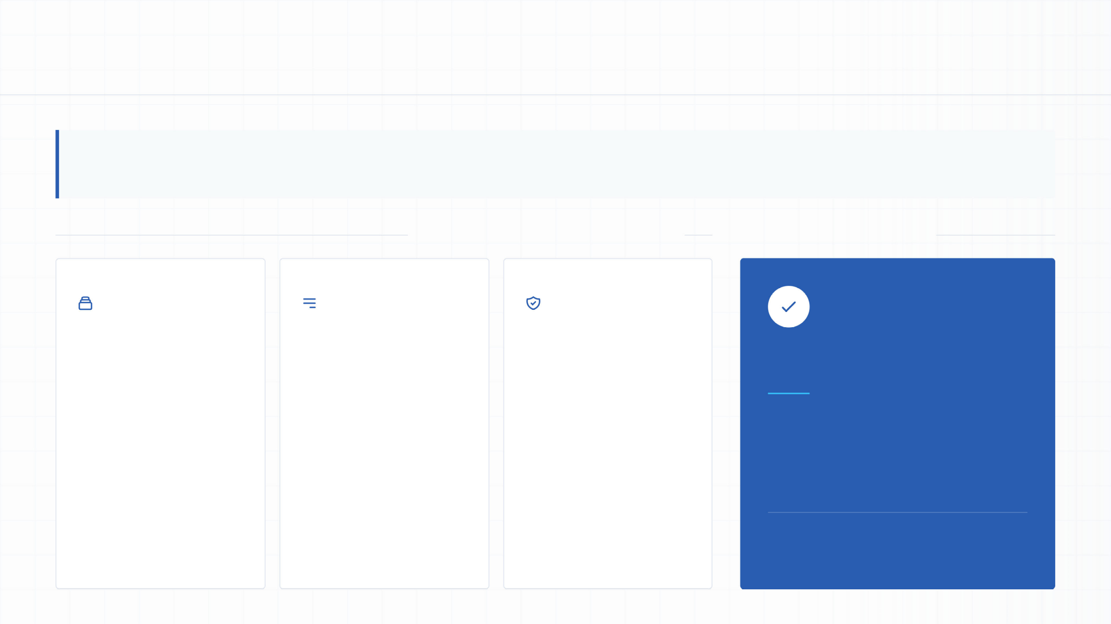
Analysis of the technical capabilities that make Google's Gemini 1.5 Pro the ideal model for legal document generation.
Model Selection: Why Gemini 1.5 Pro?
Gemini 1.5 Pro provides the necessary reasoning depth and context length required for professional legal drafting.
EVALUATION CRITERIA & CAPABILITIES
FINAL SELECTION DECISION
Long Context
Window
Structured
Prompting
Domain
Compatibility
Supports up to 1 million
tokens, allowing extensive
Superior ability to handle
multi-part content and strict
High benchmark marks in
complex reasoning, clause
gemini-1.5-pro
legal templates and historical
formatting instructions
generation, and adherence
context to be processed
simultaneously.
without losing coherence.
to formal legal structure.
Chosen as the optimal engine for drafting
formal documents with clear sections,
dynamic clauses, and specialized legal
jargon based directly on user-provided
variables.
PRO
STATUS: DEPLOYED

Slide 10

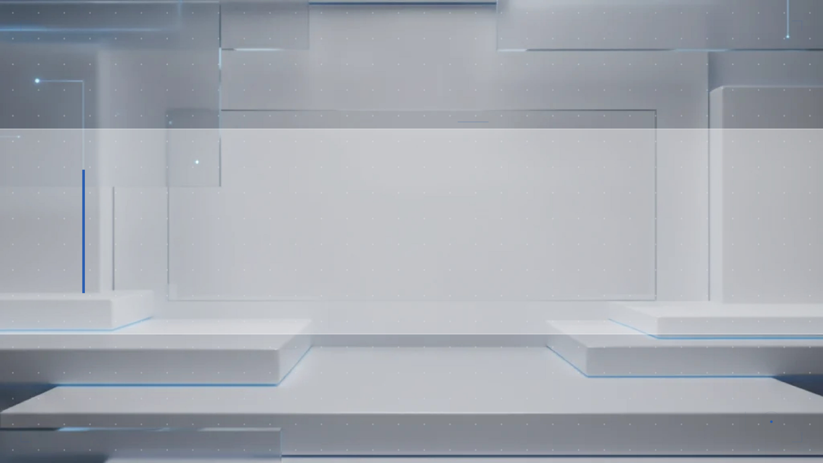
C H A P T E R 0 4
Milestone 2: Core
Translating user inputs into structured legal documents through
programmatic API management.
Functionalities
Development
SYSTEM PR OTOCOL
v2.0.84 // STABLE

Slide 11
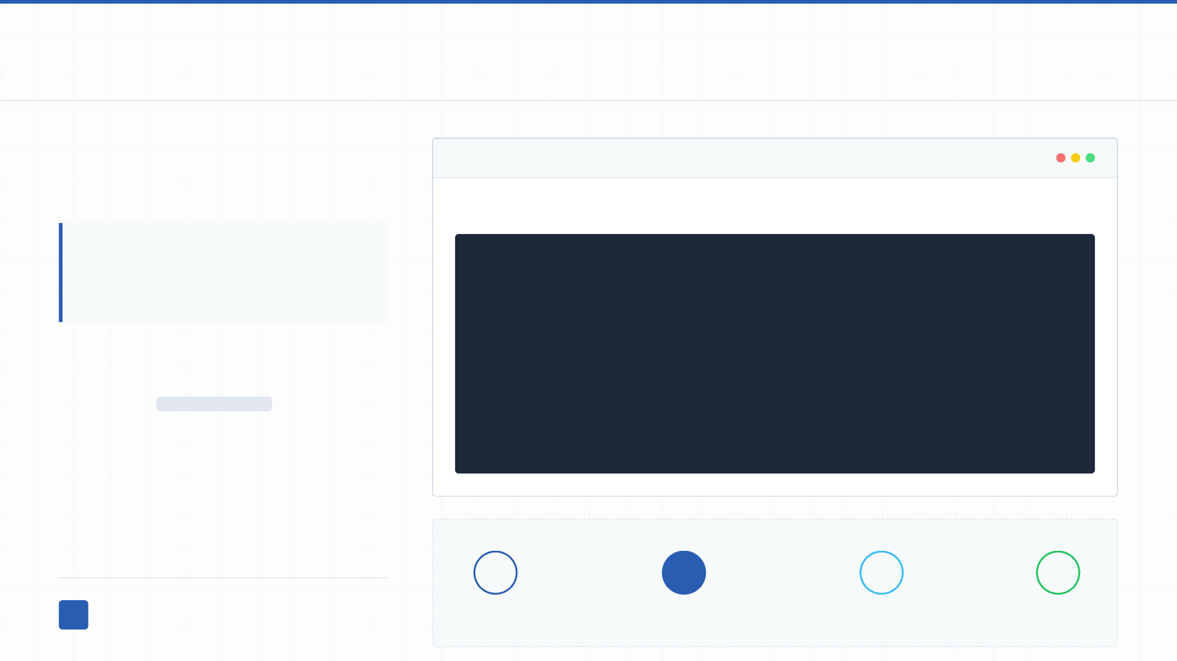
SYSTEM ARCHITECTURE
Backend Generation Logic & Prompt Engineering
Technical code structure and prompt
engineering strategies used to interface the
backend with the Gemini API.
GEMINI_GENERATOR.PY
PROMPT CONSTRUCTION LOGIC
Strict Pydantic schemas ensure
valid data transmission from the
frontend to the AI generation core.
prompt = f"Generate a comprehensive legal document titled '{document_type}'\n" \
f"Involved parties: {parties}\n" \
f"Effective Date: {dates}\n" \
f"Terms and conditions: {terms}\n" \
f"Ensure formal legal structure with multiple sections and legal clauses."
FastAPI Endpoint Mapping
Exposes a POST /generate endpoint for
JSON payloads.
Structured via a Pydantic model:
DocumentRequest.
Fields processed: document_type, parties, terms,
dates.
<>
0
The constructed prompt is sent via
model.generate_content(prompt), returning raw
JSON PAYLOAD
PYDANTIC VALIDATION
PROMPT INJECTION
GEMINI CORE
structured text back to the route handler.

Slide 12
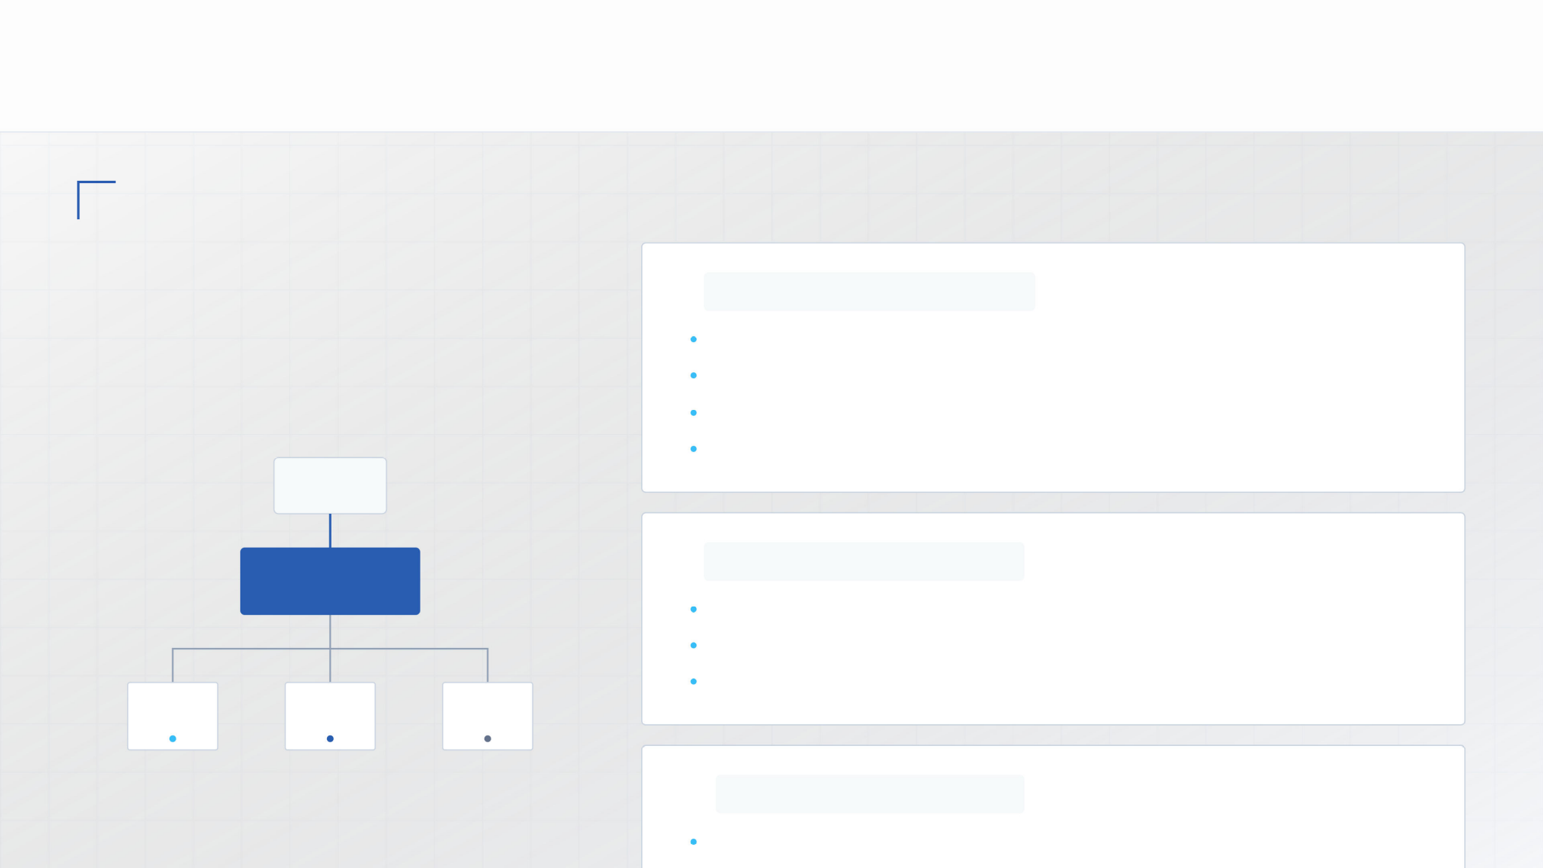
HOW THE APPLICATION TRANSFORMS RAW AI TEXT OUTPUTS
Document Output Formatting & Exporters
MULTI-FORMAT CONVERSION ENGINE
LegalEase bridges the gap between
raw text and professional presentation
through automated layout engines.
W
format_docx(text, doc_type)
Converts raw text into Microsoft Word format.
Automatically embeds custom company logos and branding elements.
Sets typography to professional standards (Times New Roman).
Formats defined terms into structured tables and appends legal footers.
RAW AI TEXT
CONVERSION ENGINE
Automated Layout & Branding
format_pdf(text, doc_type)
Utilizes the fpdf library for high-precision compilation.
Ensures clean, branded PDF documents with unalterable formatting.
Features consistent dynamic headers and automated page numbering.
DOCX
PDF
HTML
</>
format_html_preview(text)
Renders a styled preview directly inside the Streamlit user interface.

Slide 13
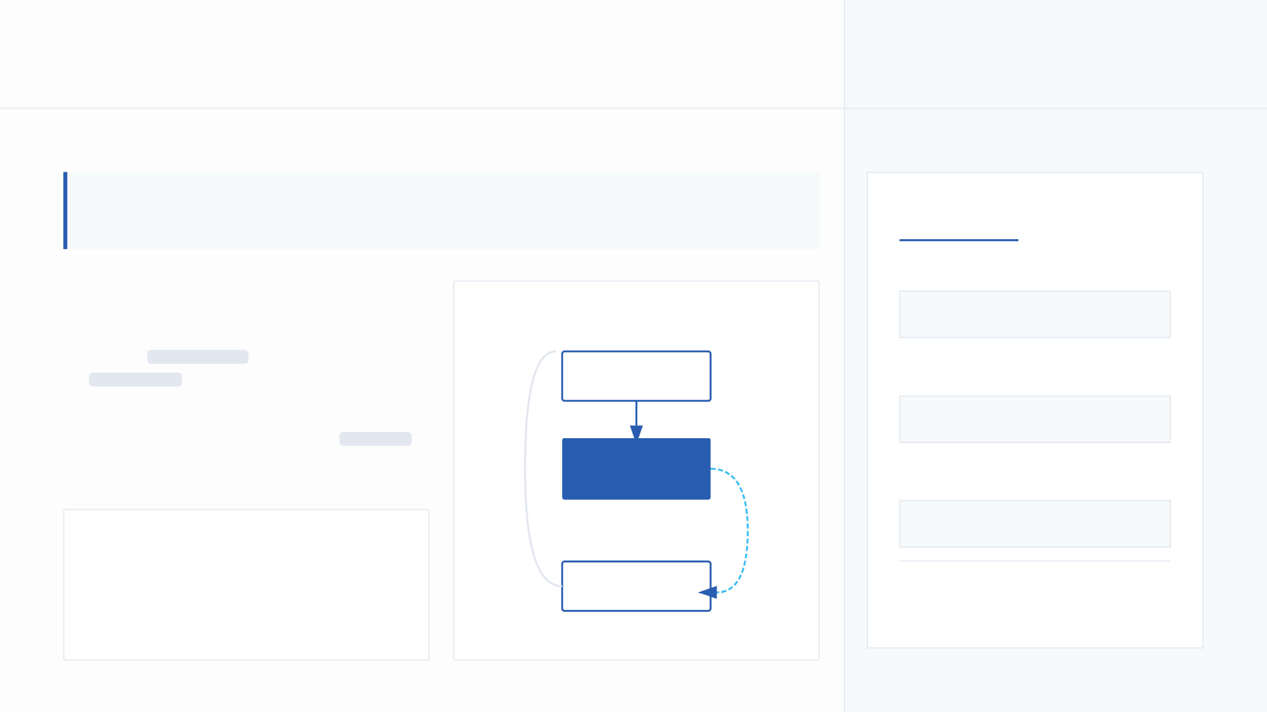
FRONTEND IMPLEMENTATION
Frontend UI & Interactive Session State
Detailed breakdown of the Streamlit frontend implementation, showing input collection and
stateful editing features.
Action Triggers
TXT DOWNLOAD
User Interface Components
SESSION STATE LOGIC LOOP
st.download_button(...)
Input Management
Employs st.text_input for concise variables and
st.text_area for multi-line content.
INPUT MODULE
DOCX DOWNLOAD
W
Stateful Editing
format_docx(data)
Direct text modification enabled when show_edit
condition is met.
SESSION STATE
generated_text
PDF DOWNLOAD
format_pdf(data)
CORE PHILOSOPHY
The frontend provides an intuitive,
interactive workspace allowing immediate
text modification and multi-format export.
EDIT / EXPORT
Real-time synchronization of app.py
* Interactive text area rendered at 300px height
upon state trigger.

Slide 14
T R A N S I T I O N I N G T H E A P P L I C A T I O N F R O M A L O C A L
Project Conclusion
D E V E L O P M E N T E N V I R O N M E N T T O C L O U D
I N F R A S T R U C T U R E .
05 Deployment &

Slide 15
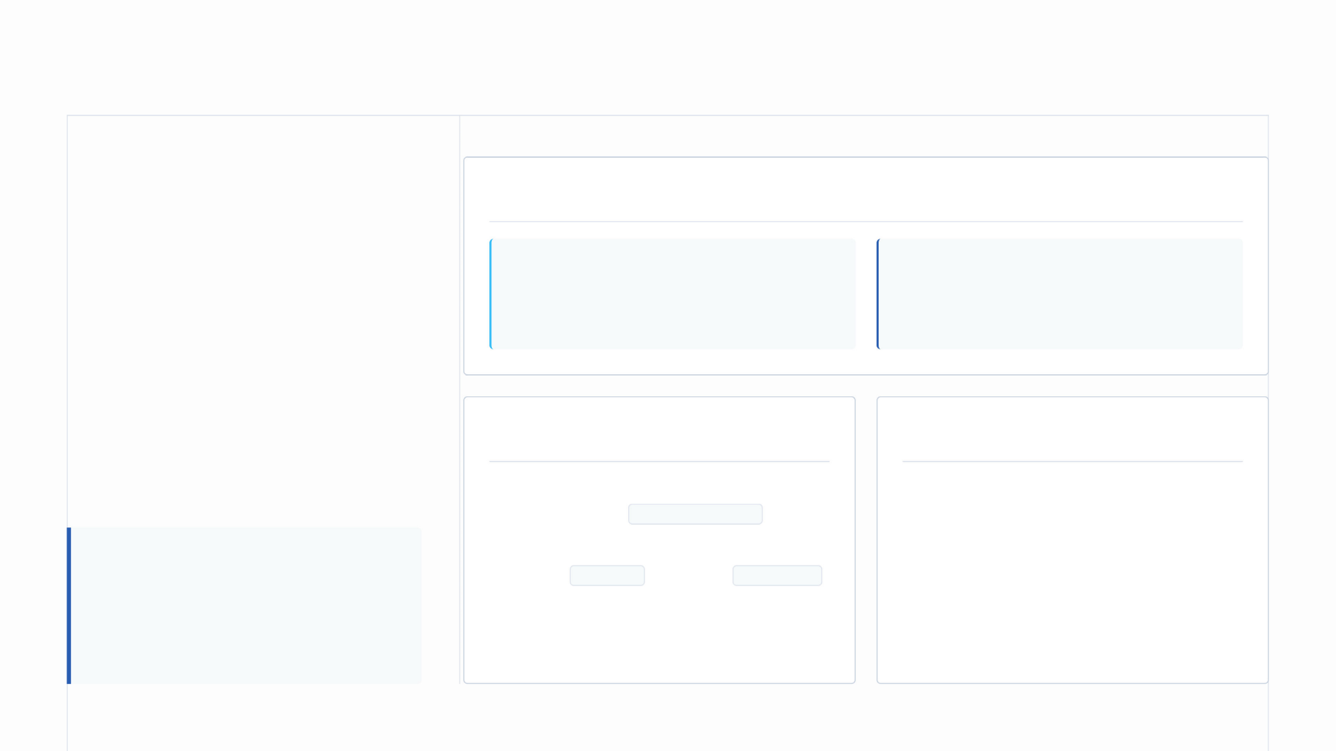
ECOSYSTEM RELEASE ARCHITECTURE
Deployment Strategies & Final Testing
SLIDE OVERVIEW
The final steps required to package, deploy,
Cloud Hosting Infrastructure Options
and verify the LegalEase ecosystem in a
production cloud environment.
Frontend Hosting
Backend Hosting
Streamlit Community Cloud, Render, or Railway for
rapid UI deployment.
Production Preparation
Consolidate production-ready dependencies
within a verified requirements.txt file.
Fly.io, Railway, or dedicated Virtual Private Servers
(VPS) to manage sustained FastAPI request traffic.
Activity 6: Testing & QA
Conduct rigorous end-to-end functionality
testing across diverse input combinations.
CORE PRINCIPLE
Decoupled deployment allows
Configure operational runtime parameters
using a Procfile or standard Dockerfile
configurations.
Validate Gemini API integration stability under
varying network conditions and edge-case
inputs.
independent scaling of the Streamlit
frontend and the FastAPI backend.

Slide 16
Benefits of LegalEase
How the platform improves the legal document creation workflow
• Saves time by generating structured legal documents from user-provided details.
• Supports customizable and editable outputs before the final document is exported.
• Provides professional formatting in DOCX, PDF, and HTML preview formats.
• Connects a Streamlit frontend, FastAPI backend, and Gemini AI generation core.
• Supports practical scenarios such as employment contracts, NDAs, and lease agreements.

Slide 17
Future Enhancements & Safety
Potential improvements for a more reliable production-ready system
• Expand the library of legal document templates and supported scenarios.
• Add stronger validation for user inputs and generated clauses.
• Improve testing using diverse inputs, edge cases, and API/network failure conditions.
• Strengthen privacy and security controls for sensitive legal information and generated files.
• Provide a clear review step so important documents can be checked by a qualified legal professional.

Slide 18

F I N A L S T A T E M E N T
THANK
YOU
SmartBridge — Let's Bridge the Gap.
Empowering users with accessible, professional legal document workflows through
the fusion of technical precision and institutional authority.
L E G A L E A S E A I F R A M E W O R K © 2 0 2 4

